Slide 1

WELCOME --- To help with this meeting
Please Rename yourself to:
Your Name – District # - REP or ALT Jane Doe – 6760 - REP
To do this,
  Tap/Click on “Participants” at the bottom or top of the video window
  Tap/Click on your name
  Choose “Rename”
  Type in your new name like the one above
  Tap
  Reminder this meeting will be Recorded!
  STAY MUTED --- USE RAISE HAND FOR QUESTIONS

Slide 2
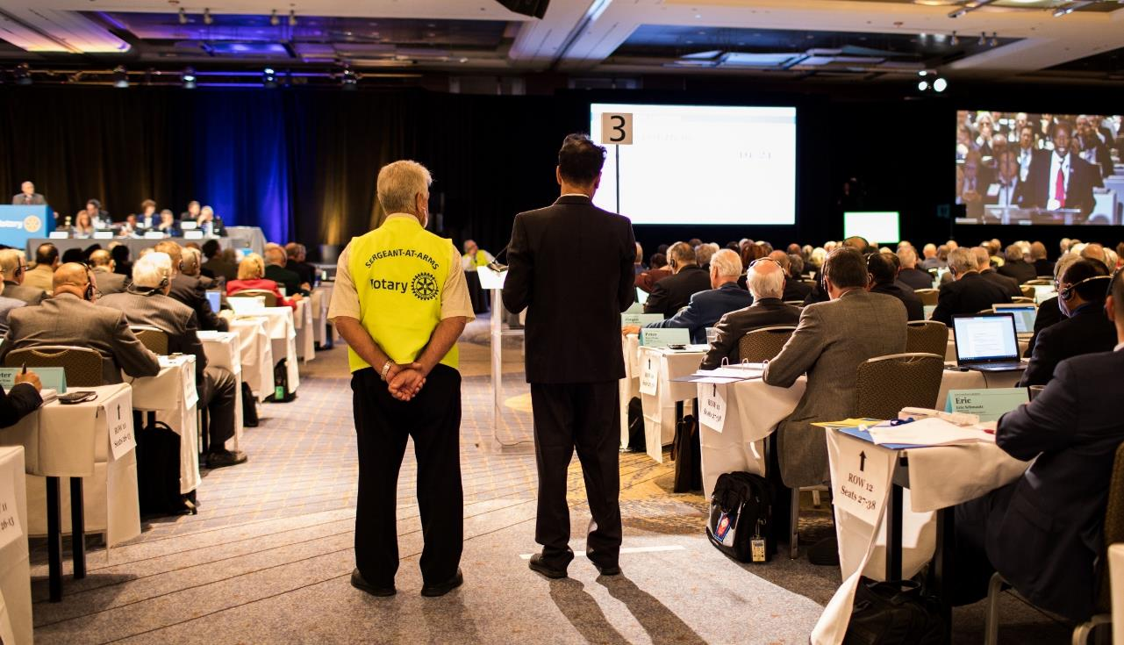
2022 Council on Legislation
Representative Training
Notes:
Brief introductions of Mike, Ken, Karen and Duane
By Duane

Slide 3
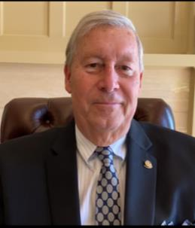
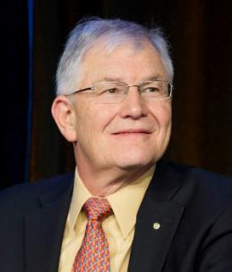
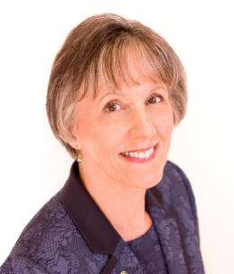
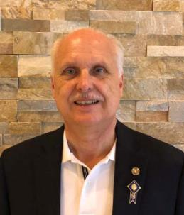
Training panel
Ken Schuppert
2022 COL Chair
Duane Benton
COL Trainer
Karen Wentz
Past RI Director
Michael Brown
Zone Technology Cord.

Slide 4
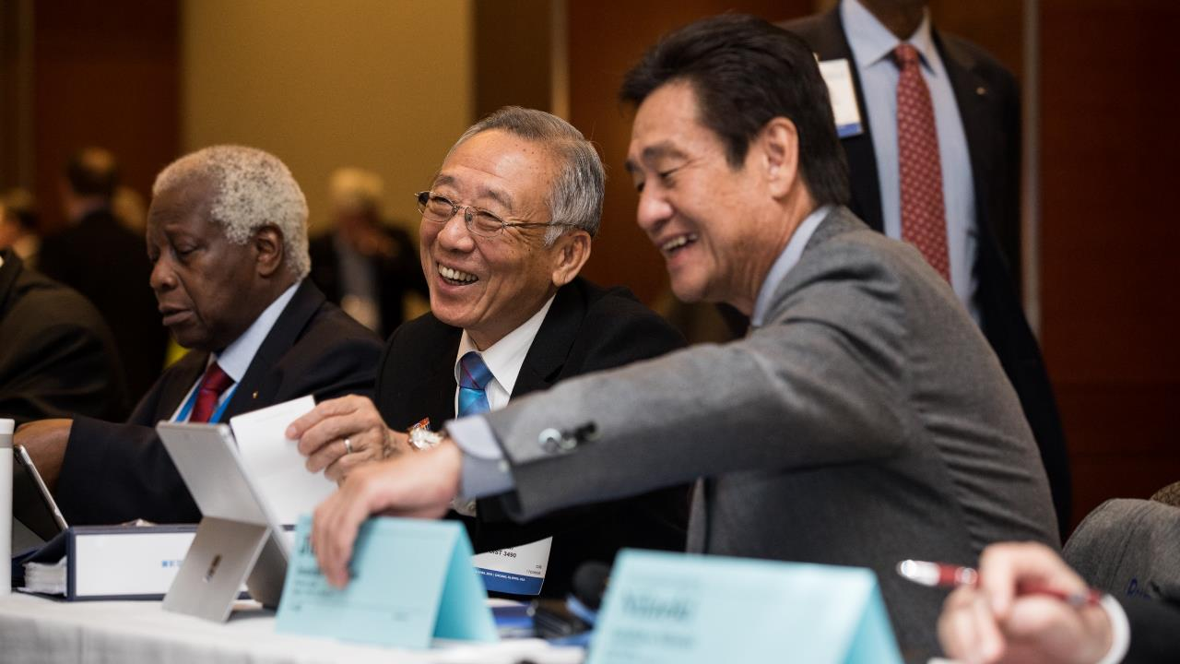
What is the Council?
Rotary’s Parliament
Notes:
**There is animation on this slide. Please follow the mouse click.**
The Council is the body of Rotarians authorized by the RI Constitution and Bylaws to vote on resolutions at the Council on Resolutions and to amend the constitutional documents at the Council on Legislation.
(mouse click) More simply put, Rotary’s parliament.

Slide 5
Council on Legislation
1933: Created and met every year at the Convention
1954: Begin meeting every two years
1972: Become official legislative body
1974: Start meeting every three years
1977: Start meeting independently of Convention
2001: Start meeting in Chicago
2016: Hold a separate Council on Resolutions
2019: Change Council members and permit vetting and urgent enactments
Notes:
For a bit of history, the COL was created by the 1933 Convention to serve as an “advisory body” to assist with the review of annual convention enactments and resolutions and started as a plenary session at the convention.
In 1954 it started meeting every other year.
In 1972, it was decided that the COL would no longer be an advisory body and would serve as Rotary’s official legislative body. In 1974 it decided to start meeting every 3 years, in conjunction with the convention.
In 1977, it decided to start meeting independently of the convention in various locations, but has met in Chicago, Illinois, USA since 2001.
The 2016 Council on Legislation representatives voted to split the Council into two separate meetings, one to consider enactments and position statements, and another to consider resolutions online each year. The idea was that by removing resolutions from the Council on Legislation, that members of the Council will have more time to carefully consider enactments that impact Rotary’s constitutional documents at the Council on Legislation. In addition, it would simplify the process for considering resolutions, by getting adopted resolutions to the Board faster.
The 2019 Council on Legislation voted to be able to consider legislation before the Council on Legislation, as a way of vetting items with significant support or opposition. The Board will also be able to bring enactments that they believe must be voted on before the next Council on Legislation to the Council on Resolutions as well.
The 2019 Council on Legislation also voted to limit nonvoting members of the Council to the RI president, president-elect, the RI directors (as amended by the urgent enactment in 2020), and one Trustee chosen by the Trustees. However, the Board proposed an urgent enactment to the 2020 Council on Resolutions, adding the full RI Board of Directors as non-voting members of the Council. The urgent enactment was adopted and all directors will be able to participate again.

Slide 6
COUNCIL CYCLE
Year one: Representatives (2019-20)
Year two: Proposed Legislation (2020-21)
Year three: The Council on Legislation (2021-2022)
(Council on Resolutions is held each year within this cycle)
Notes:
The Council on Legislation runs on a three-year cycle. In year one, districts begin choosing their representatives and alternate representatives. The selections were due to Rotary by 30 June 2020.
Year two focuses on legislation. For the 2022 COL, proposed legislation was due to Rotary by 31 December 2020. Over 140 enactments were submitted for the 2022 Council. Once submitted, the general secretary formats legislation and prepares it for review by the Constitution and Bylaws Committee and RI Board. The general secretary also prepares a financial impact statement for each item of legislation. In 2019, 116 enactments and 1 position statement were published.
Year three is the year of the Council on Legislation. Legislation is finalized and sent to representatives, Rotary senior leaders, and districts governors. Clubs, districts, and the RI Board also have the opportunity to submit statements of support and opposition on legislation. The RI Board may also submit urgent legislation to the COL through 31 December 2021. Representatives book their travel arrangements, and the COL will take place in April 2022.
In addition to the COL activities, a full Council on Resolutions cycle occurs each year, with most of the work taking place from July to September. Clubs and districts submit resolutions, which are reviewed by the C&B Committee, and then voted on by representatives within the year.

Slide 7
WHAT IS A RESOLUTION?
Resolutions
Requests of the RI Board or Trustees
Do not change RI’s constitutional documents
May be submitted directly to the Board as petitions
Notes:
Of course, the representatives here voted on resolutions last year. But for the benefit of some alternates, let’s talk about what is a resolution.
A resolution is a request to the Board or the Trustees to take an action that is not covered by the constitutional documents. For example, asking the Board to change the age requirements for Interact is a resolution because the age limits for Interact are not in the constitutional documents.
Keep in mind that clubs can also submit resolutions directly to the RI Board as petitions. This is an alternative, quick way to have your club’s or district’s idea considered by the Board, instead of submitting a resolution to the COR.
Resolutions are considered each year at the Council on Resolutions, taking place each October and November. Resolutions that are adopted are then forwarded onto the RI Board or TRF Trustees for consideration.

Slide 8
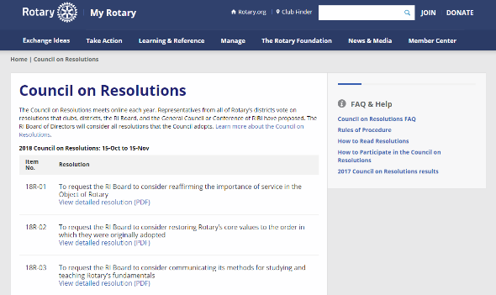
COUNCIL ON RESOLUTIONS
Occurs annually, online
Each district’s Council representative participates
Deadline for submitting resolutions is 30 June each year
Resolutions published 1 October
Limited comments
Voting takes place 15 October – 15 November each year
2020 COR had 31 resolutions
Notes:
The Council on Resolutions meets annually online through the My Rotary website. The COR is not a traditional meeting where everyone is online at the same time viewing and voting on resolutions. Rather, beginning on 1 October, Council members can read and comment on resolutions. Beginning October 15, Council representatives can begin voting. Voting closes on 15 November. Results are published by 20 November.
Before voting begins, Council members may submit comments for other Council members to read. If you have a question about a certain resolution, you are always welcome to email Council Services staff and they will be able to help you.

Slide 9
WHAT IS AN ENACTMENT?
Enactments
Changes constitutional documents
Includes purpose and effect statement
Considered every 3 years
Notes:
We have talked about who is attending the Councils and now let’s talk about what they will be discussing and debating.
Items can be submitted in two forms: enactments or resolutions. Enactments seek to change RI’s constitutional documents (the RI Constitution, RI Bylaws, and the Standard Rotary Club Constitution). They are considered at the Council on Legislation held every three years.
Enactments for the 2022 COL were due by 31 December 2020. When submitting enactments, the proposer, usually a club or a district, must also provided a statement of purpose and effect. The purpose and effect statement, as the name implies, is supposed to provide the reasoning behind the proposal. This statement should identify the issue or problem that the proposed legislation seeks to address and explain how the proposal addresses or resolves the problem or issue. Purpose and effect statements are not required for resolutions, but they may be included.
Enactments for the 2022 COL have been published electronically in English. The enactments will also be published in Spanish, French, Japanese, Korean, Portuguese, and Mandarin and should be available a month or two after English is published.

Slide 10
Council Statistics
 | 2007 | 2010 | 2013 | 2016 | 2019
Items Transmitted to Council | 357 | 220 | 200 | 181 | 117
Enactments | 174 | 128 | 151 | 117 | 116
Resolutions | 183 | 92 | 49 | 64
Position Statements |  |  |  |  | 1
Items Adopted | 97 | 66 | 59 | 61 | 47
Enactments | 59 | 47 | 53 | 47 | 46
Resolutions | 38 | 19 | 6 | 14
Position Statements |  |  |  |  | 1
Notes:
Here’s the breakdown of legislation at past Council. As you will note, about 30 to 40% of the proposed enactments are adopted, while 10 to 20% of the resolutions are sent to the Trustees and Board.
For perspective, during the first year of the COR, about 45% of the Resolutions proposed were adopted. (17 adopted from 38 proposed.)
2019 was the first year where only enactments and position statements were considered at the Council on Legislation.

Slide 11
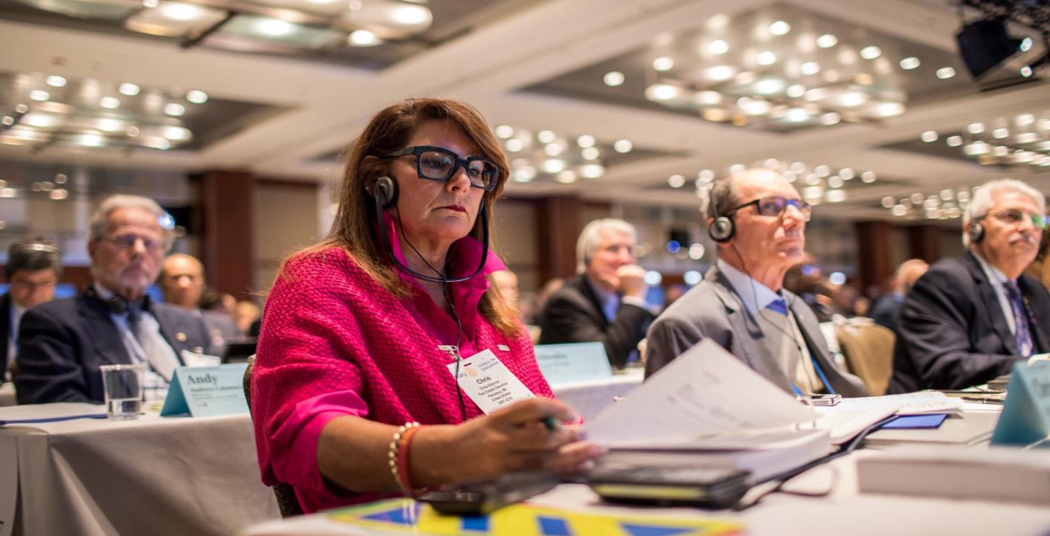
Preparing for the Council

Slide 12
What Should Representatives Do?
Complete Council training
Study the legislation
Prepare introductions for your district’s items
Read the recommended Rules of Procedure
Talk to Rotarians and clubs in your district, but keep an open mind until you hear debate
Remember to ask yourself:
Is the proposal’s purpose clear?
What is best for Rotary as a whole?
Enjoy the COL!
Notes:
There are three trainings for the Council. 1) The zone’s Rotary Institute training, 2) The Rotary Learning Center’s online training, 3) The training at the Council’s opening session. Ideally, you should have the first two done by the end of today.
Study each item of proposed legislation. Have a copy of the 2019 Manual of Procedure nearby or easy access to rotary.org, as you may need to look at the proposal in a broader context than appears in the legislation book. Decide if the proposal is clear in its stated purpose. Documents relating to RI’s policies and procedures are available on rotary.org.
Study the recommended Rules of Procedure when you receive a copy, but remember that they are only recommended rules until adopted by the 2022 Council. Keep in mind that adjustments to time limits and other changes to the Rules may take place during the Council.
Solicit views from clubs in your district and answer their questions. Do not, however, agree to be bound by a club’s or even your district’s views. You must be willing to be educated by Council debate.
Keep an open mind at the Council as you have not heard the debate. You might want to note your initial reaction, but consider other information presented and points of view expressed during the Council. You may gain new understanding when you are presented with more information about why the proposer offered the legislation. It is important that you be objective and act in the best interest of all the worldwide clubs.
If you do not fully understand a proposal, make a note. At the Council, if the debate does not clarify your understanding, ask the Chair for information.
Each item before the Council should be approached with the question, “What is best for Rotary International?” rather than “How will this affect my club?”
Lastly, enjoy the Council! This is a unique, fulfilling experience.

Slide 13
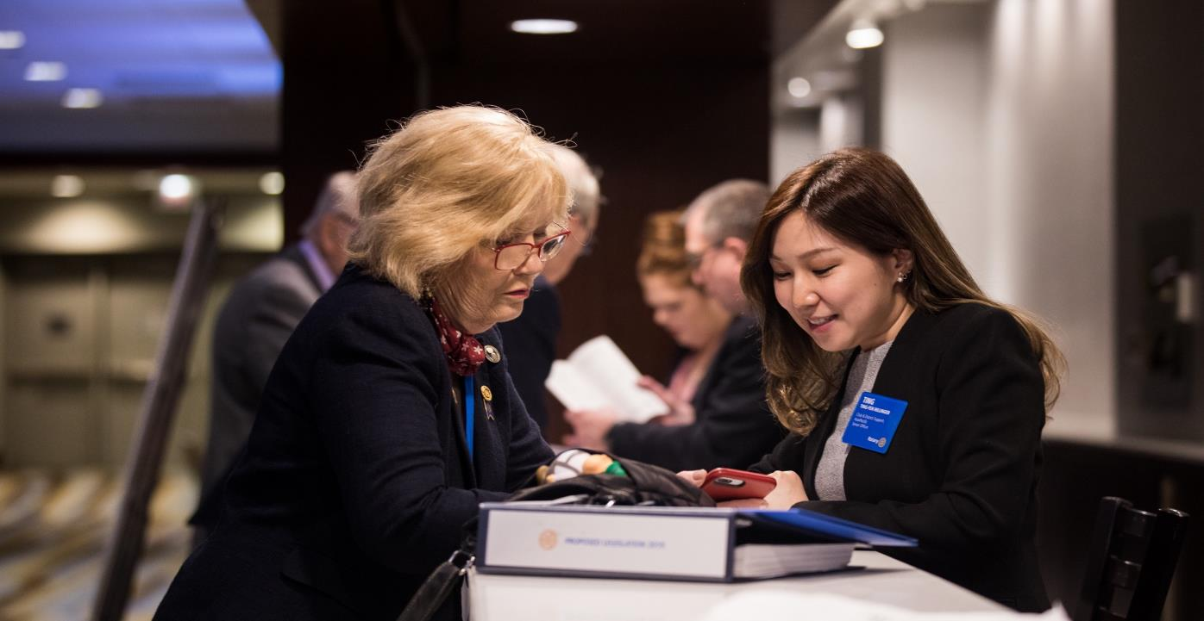
Attending the Council
Notes:
Let’s move on to what you can expect for the 2022 Council on Legislation.

Slide 14
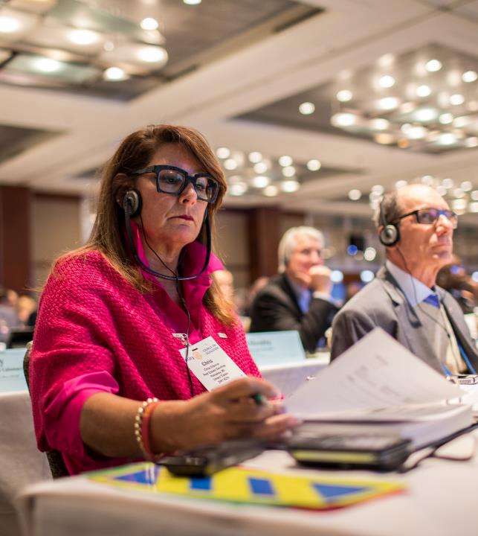
Representatives – Voting Members
One representative and alternate per district
Qualifications:
  Past district governor
  Member of a Rotary club in the district
In 2019, 80% of representatives were serving for the first time
Notes:
Who is a district representative?
Each district selects a Council representative by 30 June 2020 to serve from 1 July 2020 to 30 June 2023.
The bylaws provide that the Council representative be:
a past district officer who served a full term at the time of election.
a member of a club in the district and
Must be informed of the qualifications, duties, and responsibilities of a rep. The duties of a council rep are also outlined in the bylaws and include that they:
Attend the COL for its full duration
Participate in the COR
Be knowledgeable of the existing attitudes in the district and
Report of the deliberations of the Councils.
In 2019, 80% of the Council reps were serving in the position for the first time.

Slide 15
Poll—please answer only one
Question for REPRESENTATIVES: Have you attended a prior Council?
Yes
No
Question for ALTERNATES: Have you attended a prior Council?
Yes
No

Slide 16
MEMBERS OF THE Council
Voting Members
Council Representatives
Non-voting Members
Chair
Vice chair
Parliamentarian
Constitution and Bylaws Committee
RI president
President-elect
RI Board of Directors
One Rotary Foundation Trustee
General Secretary
Secretary
Members-at-Large
Notes:
Now, who will be participating in the Councils?
Representatives selected for the 2020-2023 council cycle will participate in the 2020, 2021, and 2022 Councils on Resolutions, and the 2022 Council on Legislation as the voting members.
While most of the Councils are voting members, there are several non-voting members, who include: the chair, vice chair, and parliamentarian.
The Constitution and Bylaws Committee reviews all legislation to ensure items are “regular” and makes their recommendation to the RI Board, which then transmits all legislation and resolutions to the Councils.
The members at large offer additional details on legislation as needed during debate at the Council on Legislation only.
The RI president, president-elect, the Board, one TRF Trustee, and the General Secretary are members of the Councils and may participate in debate, but do not vote.
[be prepared for questions about observers, virtual observers, etc.]

Slide 17
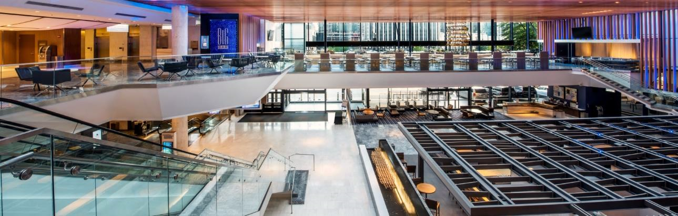
At the Council
Representatives stay at the Hyatt Regency Chicago
Breakfast, lunch, and the Council take place in the hotel
Restaurants are in area for dinner
Notes:
Representatives all stay at the Hyatt Regency Chicago, just steps from the Magnificent Mile. Thhe same location as the 2019 Council.
The Council chambers are a large ballroom in the hotel. Breakfast and lunch are provided in the reserved dining room on the same floor as the Council chamber.
For dinner, representatives can visit one of the many restaurants in the area (information about expenses and reimbursements will be provided in the registration booklet that will be available in November or December).
[be prepared for question about limit on reimbursements.]

Slide 18
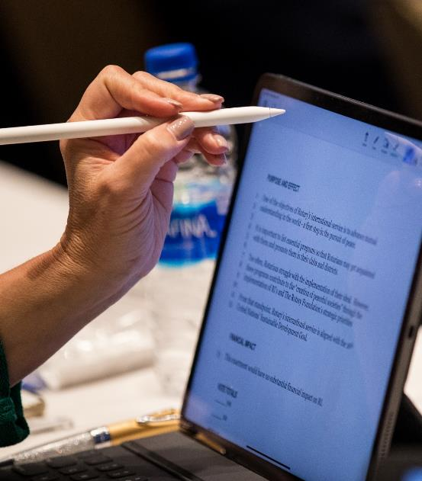
At the Council
Bring a tablet or mobile device
Use the Council app to access the legislation, amendments, and other materials
Business attire for the meeting
Notes:
We will once again have an app for the Council, where you can access all materials electronically. It includes all legislation, the rules of procedure, amendment and withdrawal forms, your program book, and other resources. Council Services will notify you when it is available to download.
The Council on Legislation is a business meeting. Attendees are expected to dress accordingly. During the working part of the day, business attire (customary to the attendee’s country) is appropriate. Be aware that the hotel is air-conditioned and can be quite cool. Attendees should consider bringing a suit jacket, blazer, or sweater to all sessions.
[be prepared for plug-in questions—none at tables due to fire marshal rules.]

Slide 19
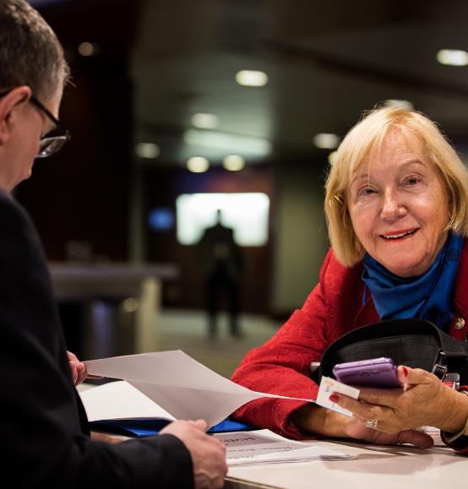
Arrival
When you arrive:
Check-in to the hotel
Stop at the meeting registration desk for registration materials
Visit the app help desk
Pick up a binder, if needed
Notes:
Arriving at the hotel, check in to your room in the hotel lobby. Once checked in, you need to stop at the Council registration desk on the ballroom level. This is where you will pick up your registration packet, name badge, and seat assignments for the week. The registration desk is open on Saturday, Sunday, and Monday morning.
If you need any help downloading or navigating the Council app, please stop at the App Help Desk. Staff will be available to help you.
If you requested to pick up a binder at the Council (rather than have it mailed to you), please get it after you register. The Council will have binders only for those who request them ahead of time.
The opening and orientation session are in the afternoon on Sunday, 10 April in the Council chamber.
[be prepared for travel from airport to hotel—last two councils had a contract with a local transport company. Otherwise, limited reimbursement.]
[be prepared for Can I drive?]

Slide 20
Typical Day
  0630-0830 Breakfast
  0900-1030 Plenary Session
  1030-1100 Refreshment Break
  1100-1230 Plenary Session
  1230-1345 Lunch Break
  1400-1530 Plenary Session
  1530-1600 Refreshment Break
  1600-1730 Plenary Session
Notes:
The Council begins work in earnest on Monday morning and lasts until Thursday noon. The COL begins at 9am each day and ends at 5:30pm, with two 30-minute breaks and a 75-minute lunch. Depending on the amount of legislation considered and the pace of the meeting, the length of the sessions may change. Right now, we expect 2 full days and 2 half days.
More details are in your registration materials.

Slide 21
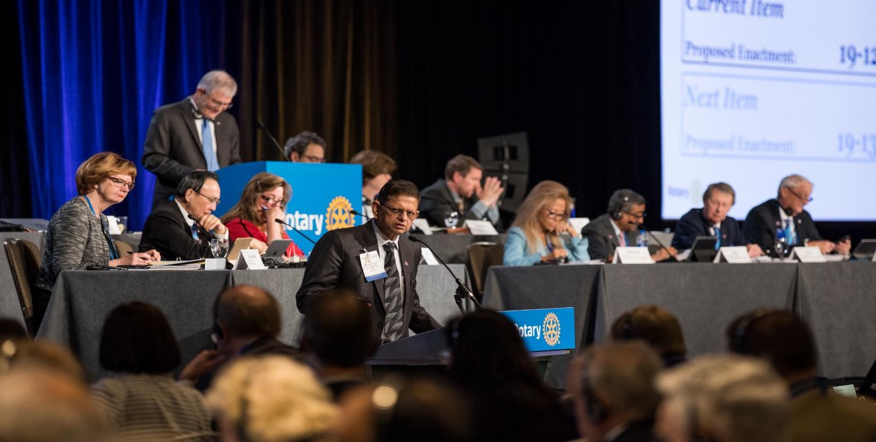
Mock Council
Notes:
To help everyone experience the Council process, we are presenting a mock Council.
Before this session, I asked eight of us to play a role during this session.
[IT – please pin the eight speakers]

Slide 22
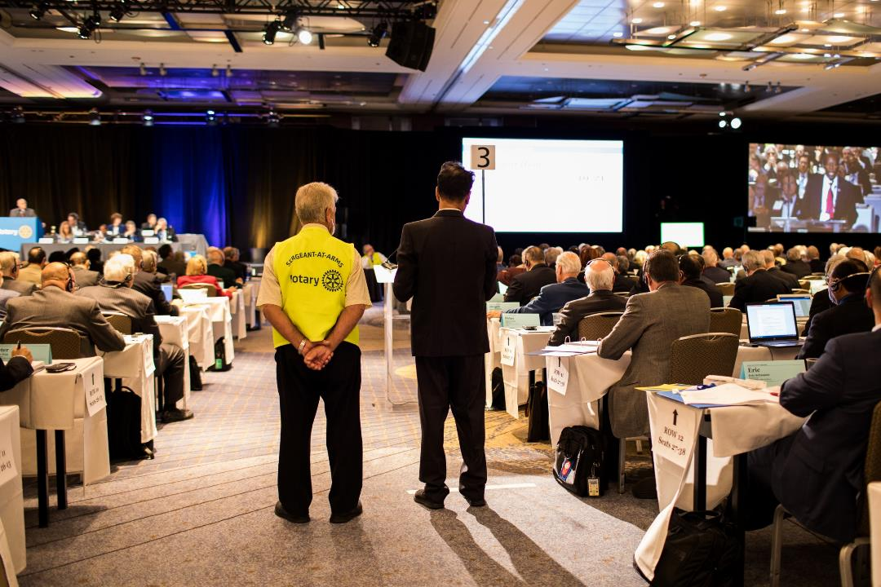

Slide 23
PROPOSED ENACTMENT 22-00
To amend the CONSTITUTION of Rotary International as follows
Article 10 Council on Legislation
Section 2 — Time and Place. The council on legislation shall convene triennially in April, May, or June, but preferably in April. The board will determine the date and place of the meeting, provided that, except for compelling financial or other reasons as determined by a two-thirds vote of the entire board, the meeting shall be held in the vicinity of the RI world headquarters in Tahiti, French Polynesia.
(End of Text)
PURPOSE AND EFFECT
This enactment would amend RI Constitution Article 10, Section 2, to provide that the Council be held in Tahiti, French Polynesia. It is our belief that Rotary would benefit from a tranquil environment to conduct its business.
FINANCIAL IMPACT
This enactment would have no net financial impact on RI because revenues from additional dues to fund the Council on Legislation will be increased by an amount equivalent to the increase in expenses.
The Council on Legislation had fiscal year 2013 actual expense of US$3 million, which included US$1.8 million for 532 representatives to travel to the meeting in Chicago . If the Council on Legislation were conducted in Tahiti, French Polynesia, this could result in an increase in expenses for RI which cannot be determined at this time. An increase in expenses would be contingent upon airfare, hotel, meals, venue rental, transportation, and equipment in Tahiti, French Polynesia.
Notes:
This is the enactment for the Mock Council.
Panel participates in the various roles.
Show this once the proposer begins speaking.

Slide 24
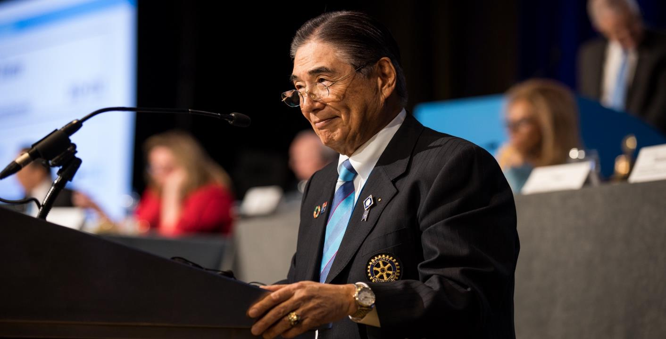
Enactments –
our Zones
Notes:
Our districts are proposers on two enactments. The representatives from those districts will now discuss them.
Hold here until Ken introduces Karen

Slide 25
Proposed enactment 22-85
To remove the attendance report requirement
  Proposers: Rotary Club of Tsuruga, District 2650; Japan; Rotary Club of Kisarazu East, District 2790, Japan; Rotary Club of Maryville, District 6780, USA
To amend the BYLAWS of Rotary International as follows
Article 4 Membership in Clubs
4.080. Attendance Reports.
Each club shall forward monthly attendance reports of its meetings to the governor within 15 days after the last meeting of each month. Non-districted clubs shall forward attendance reports to the general secretary.
Notes:
Karen Wentz to discuss

Slide 26
Proposed enactment 22-40
To provide for a Youth Exchange Committee
    Proposers: [19 other districts] and District 6510, USA
    To amend the BYLAWS of Rotary International as follows
Article 17 Committees
17.010. Standing Committees.
The board shall establish standing committees on:
        (a) communications …
        (b) constitution and bylaws …
        (c) conventions …
        (d) districting…
        (e) election review…
        (f) finance…
        (g) Rotaract …
        (h) youth exchange - with six members, two appointed each year for three-year terms by the president.
Notes:
Catherine Taylor Yank to discuss

Slide 27
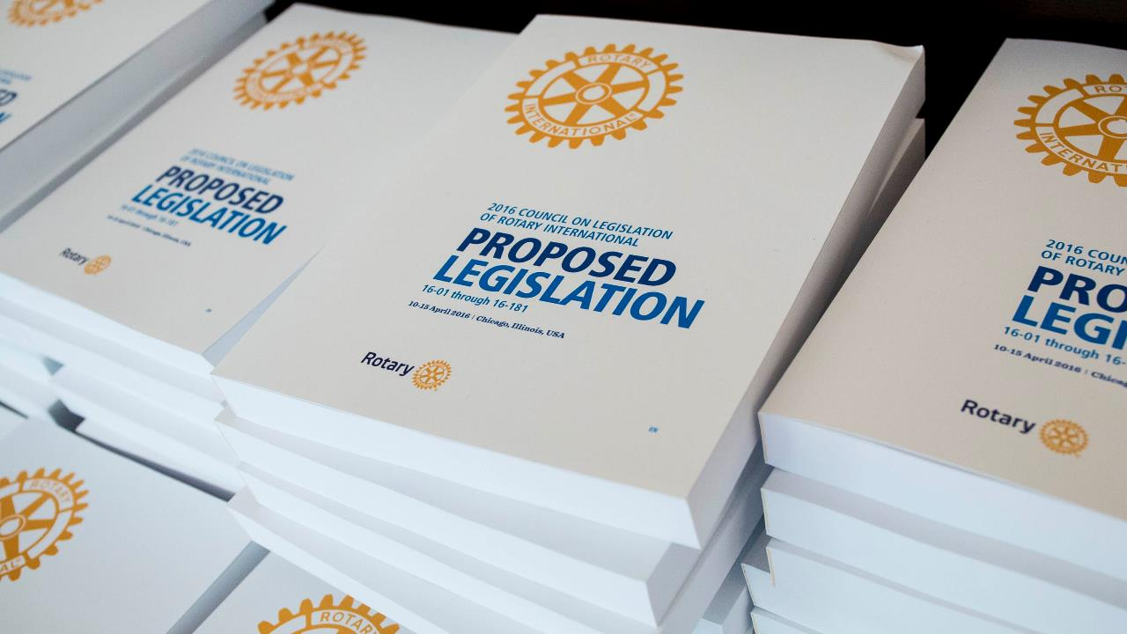
Three Enactments –
RI Board requests each institute discusses
Notes:
The RI Board of Directors has asked each institute to discuss 3 items of Board legislation.
We will meet in small groups to discuss these 3 items in depth. Think about the benefits of the items, any concerns, and if you have questions about the items.
We will work in our groups for 30 minutes and then come together.

Slide 28
Knowledge of Rotary is important, but tenure in Rotary, as a criteria point, eliminates too many potential good leaders.
Many new Rotarians have exceptional leadership skills and experience.
The RI Board wants to encourage capable and interested members to become Rotary leaders.
22-25 To amend the qualifications of a governor-nominee
Notes:
22-25 To amend the qualifications of a governor-nominee
Proposed by the Board of Directors of RI
Summary: This enactment would revise the qualification requirements for governor candidates to consider professional leadership expertise outside of Rotary.
Background:
• This item originally came from the Young Past District Governors Committee as they felt that there are many qualified candidates for district governor who didn’t meet the requirement of having been a member for seven years.
• The RI Board believes that while knowledge of Rotary and the district is important, tenure in Rotary as a criteria point eliminates too many potential good leaders.
• Many new Rotarians have exceptional leadership skills and experience at the moment that they join Rotary. These individuals would be more motivated to stay in Rotary knowing that significant leadership opportunities aren’t seven or more years away.
• The RI Board wants to encourage capable and interested members to become Rotary leaders.
• Removing the tenure requirement could also encourage a more diverse candidate pool.
• A Rotarian who has successfully engaged in leadership either beyond the club or in other platforms, entities, or organizations, and has shown successful delivery of leadership strategies; should be eligible to serve as governor.

Slide 29
2019 Council on Legislation adopted an enactment which admitted Rotaract clubs to RI membership.
The Board recognizes that in order for Rotaract to more fully integrate into Rotary, they should be allowed to participate in the legislative process.
Allows Rotaract clubs to propose legislation to the COL and resolutions to the COR
Provide for 34 Rotaractors to be voting members of the Councils, one Rotaractor member for each zone.
22-63 To allow Rotaract clubs to propose legislation and resolutions, and to permit Rotaractors to serve as voting members of the Council
Notes:
22-63 To allow Rotaract clubs to propose legislation and resolutions, and to permit Rotaractors to serve as voting members of the Council
Proposed by: Board of Directors of RI
Summary: This enactment would allow Rotaract clubs to propose legislation and resolutions with the endorsement of their district and would allow for Rotaractors to be voting delegates of the Council.
Background:
• At the 2019 Council on Legislation, the Council adopted 19-72 which admitted Rotaract clubs to RI membership.
• 19-72 elevated Rotaract clubs and recognized them as an important member of the Rotary family.
• The Board recognizes that in order for Rotaract to more fully integrate into Rotary, a next step is to allow them to more fully participate in the legislative process.
• In order to recognize the status of Rotaract clubs as a member of Rotary International, the proposed enactment would allow Rotaract clubs to propose legislation to the Council on Resolution and Council on Legislation, similar to Rotary clubs.
• In addition, this proposal would provide for 34 Rotaractors to be voting members of the Councils. This would allow for one Rotaractor member for each zone.
• The Rotaractors would be selected in a manner determined by the Board and outlined in the Rotary Code of Policies.
• The RI Board believes that Rotaractors should be allowed to participate on issues important to Rotary and Rotaract as befitting their status.

Slide 30
Would allow the RI Board to conduct a pilot to test new governance models on a limited number of Rotary and Rotaract clubs.
This item does not reorganize clubs, but rather puts in place the rules under which a pilot project may operate.
Rotary needs new, innovative ways of thinking in order to make effective, long-term change.
Using data gathered during a pilot, Rotary will learn how best to implement new governance structures.
22-71 To provide for the administration of clubs in a pilot project
Notes:
22-71 To provide for the administration of clubs in a pilot project
Proposed by: Board of Directors of RI and Rotary Club of Merimbula, District 9705, Australia
Summary: This enactment would allow for alternate models of administering clubs as pilot projects instead of the current district-focused approach.
Background:
• This enactment would allow the Board to conduct a pilot to test new governance models on a limited number of Rotary and Rotaract clubs without affecting all clubs and districts around the world. Small scale testing on a limited basis allows Rotary to determine what changes could work based on real world
implementation and data, rather than making universal changes and hoping they are appropriate.
• This item does not reorganize clubs, but rather puts in place the rules under which a pilot project may operate.
• The current volunteer structure has been in place for decades and has not adapted to meet the needs of members. Instead, it has grown, adding several layers of hierarchy and increasing the time ommitment and responsibilities of those in leadership.
• Pilot club projects are currently authorized in the RI Constitution and have been successful in allowing clubs to test alternate membership and attendance requirements.
• Using data gathered during the pilot, Rotary will learn how to implement a governance structure that:
▪ Provides more manageable leadership opportunities that appeal to more members.
▪ Increases and enhances membership by implementing clear and achievable paths to leadership, allowing all members equitable opportunities to grow personally and professionally.
▪ Uses targeted, local approaches to meet regional community and member needs.
▪ Is more flexible and can quickly adapt to the changing needs of current and future members.
• The same issues have challenged Rotary for a while and Rotary needs new, innovative ways of thinking in order to make effective, long-term change:
▪ Women have been part of Rotary for nearly 40 years, but only make up a quarter of our global membership, while in Rotaract, 50% of members are women.
▪ There are barriers that prevent some capable and interested members from becoming Rotary leaders.
▪ Leadership positions come with a lot of responsibility, costs, expectations, and in some cases, travel requirements, all of which can be too much for a member who is also managing other personal and professional commitments.
▪ Many Rotary positions are appointment-based, which means it can be more about who you know than what you know. This benefits those with the right connections rather than the person most qualified for the job.
▪ Rotary struggles with engaging and retaining current members. In 2019-20, 160,000 members left Rotary and the number of Rotaractors who join Rotary is very low.
▪ Rotary continues to apply singular approaches to global issues, though the challenges, needs, and priorities of our clubs and members are not necessarily universal.

Slide 31
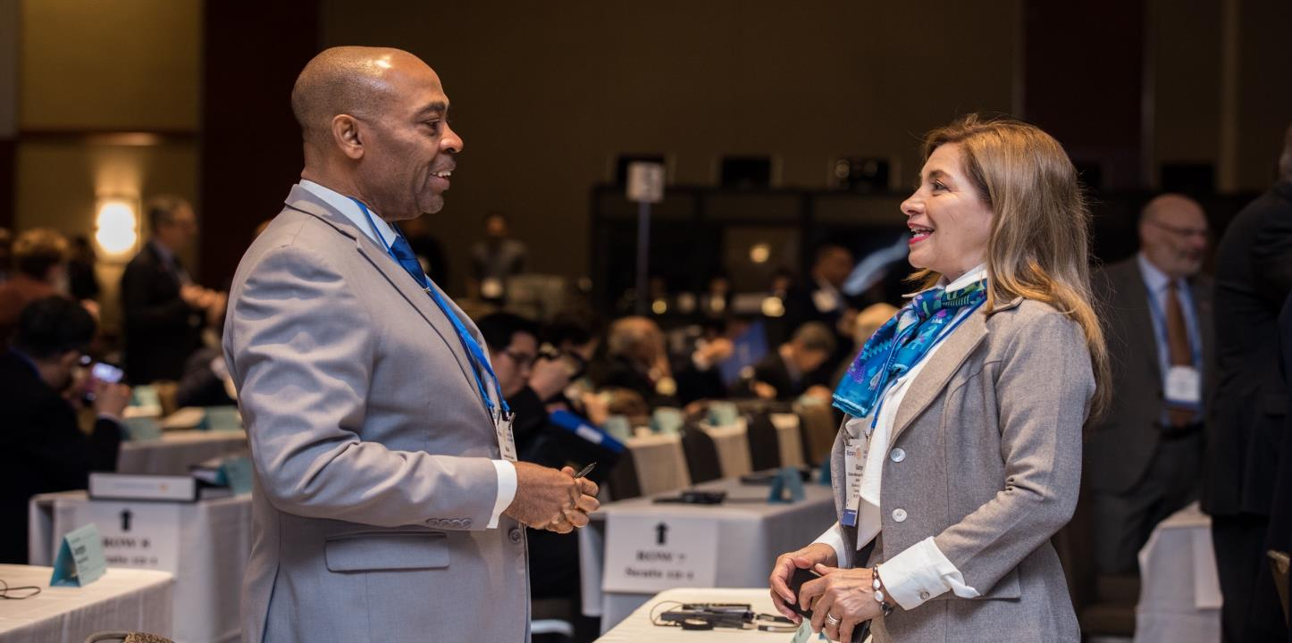
Strategies –
Before AND at
the Council
Notes:
Thank you everyone. Now that we have a stronger idea about what items are coming from our zones and our thoughts on the RI Board items. Let’s talk about how you can strategize before and at the Council.

Slide 32
Strategy before the COL
Statements of Support and Opposition
Sent to each representative before the COL
Give views without speaking during debate – studied ahead of COL
Submitted by clubs, districts, and the RI Board
Deadline – January 10, 2022
Notes:
Statements of Support and Opposition
Submitted by clubs, districts, and the RI Board
Tool to inform representatives about the pros and cons of an item
Submit a statement if your club or district has a strong opinion
Statements should explain why they support or oppose and item
The deadline is 10 January 2022.

Slide 33
“Vetting” screening enactments
Adopted by 2019 COL
Before a COL, representatives vote electronically on some enactments.
If an enactment gets less than 20%, it’s not considered at the COL.
If an enactment gets more than 80%, it’s on the consent agenda at the COL.
Based on the results of past COLs, vetting allows the COL to focus its limited time on those enactments that the representatives feel deserve detailed consideration.
Notes:
RI Bylaw 7.070.6. Council Consideration of Legislation says:
“Before any in-person meeting of the council on legislation, the representatives may vote electronically on duly proposed legislation presented for consideration by the council operations committee, after notice and opportunity for comment. This vote may be part of the council on resolutions. If less than 20 percent of the representatives entitled to vote vote for an enactment, it shall not be considered at the next in-person meeting of the council on legislation. If more than 80 percent of the representatives entitled to vote vote for an enactment, it shall be considered on the consent agenda for the next in-person meeting. At its next in-person meeting, the council shall consider and act upon the consent agenda, all other duly proposed and not defective legislation, and any amendments.”
The Financial Impact Statement for this enactment said:
“Based on averages from the 2013 and 2016 Councils, of the enactments considered, 13 percent (18) were adopted by more than 80 percent of votes cast.”
AND
“Based on averages from the 2013 and 2016 Councils, of the enactments considered, 10 percent (13) were favored by less than 20 percent of votes cast.”
The Purpose and Effect Statement for this enactment gave the details:
“On the final votes at the 2013 Council, 11 proposed enactments received more than 80 percent of the votes cast. On the final votes at the 2016 Council, 24 proposed enactments received more than 80 percent of the votes cast.”
AND
“On the final votes at the 2013 Council, 21 proposed enactments were favored by less than 20 percent of all votes cast. On the final votes at the 2016 Council, 5 proposed enactments were favored by less than 20 percent of the votes cast.”
[The Purpose and Effect Statement added that these numbers are probably greater as they do “not include those enactments voted on by cards or withdrawn by the proposer.”]
The Financial Impact Statement assumed that this enactment would result in “at least 20 percent fewer items of legislation” for the COL meeting itself.

Slide 34
Strategy at the COL
What is important to your district?
What is important for Rotary?
Notes:
Keep in mind that what is important to you may not always be important for Rotary as a whole.
Think about what items may be better implemented at the club or district level, rather than added into the constitutional documents.
This affects when you want to participate in debate, as no one can participate in debate on each item.

Slide 35
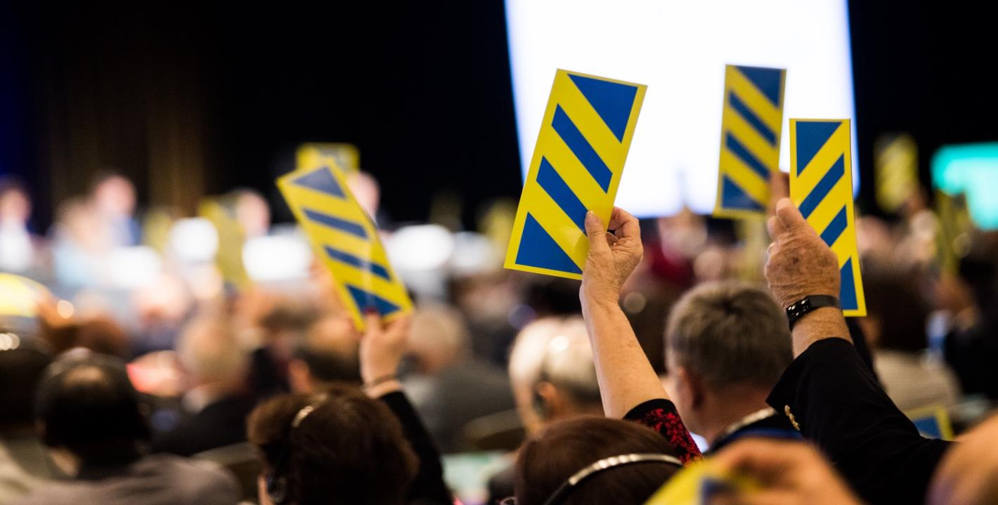
After the Council

Slide 36
Post-Council
Tell clubs in your district the results of the Council, available on My Rotary
Report of Action distributed to clubs, districts, and representatives within two months after the Council
Clubs have the opportunity to oppose any adopted legislation
Notes:
Within two months after the COL, a Report of Action—that all enactments that were adopted, and any amendments—is sent to all clubs, districts, COL representatives, alternates, and Rotary Senior Leaders.
Clubs then may voice their opposition to any adopted legislation by submitting an opposition form to Rotary within two months of the Report of Action being sent out. If any item of legislation receives 5% of votes entitled to be cast by clubs, it is suspended and a ballot-by-mail is distributed to all clubs by the general secretary. Please note that to the knowledge of Council Services staff, no adopted item has been suspended. If it happens, it is rare.

Slide 37

Adopted Enactments
Adopted enactments become effective on 1 July following the Council
The adopted changes are incorporated into the constitutional documents
Revised constitutional documents available
Manual of Procedure is updated
Notes:
The Constitution and Bylaws Committee, along with the general secretary, updates the constitutional documents, which include the Rotary International Constitution, the Rotary International Bylaws, and the Standard Rotary Club Constitution. These documents are then sent to the COL representatives, alternates, district governors, and Rotary Senior Leaders within two months of the COL.
Adopted enactments take effect on 1 July following the Council, unless otherwise noted.

Slide 38
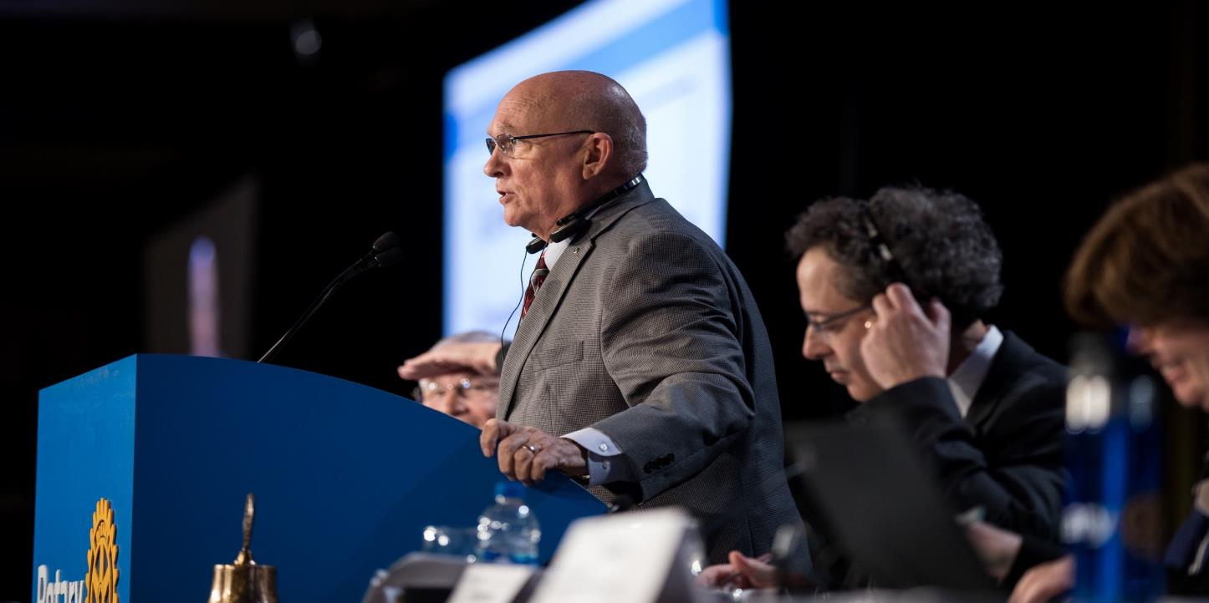
Important Details

Slide 39
key dates for the Councils
August-September 2021 | Legislation for 2022 COL published
1 October – 15 November 2021 | 2021 Council on Resolutions
By 20 November 2021 | COR results posted
November 2021 | COL registration materials emailed to representatives
14 February 2022 | Statements of Support or Opposition due to Rotary
March 2022 | Optional COL webinar (tentative)
10-14 April 2022 | Council on Legislation
By 14 June 2022 | COL Report of Action and updated constitutional documents published
30 June 2022 | Resolutions for 2022 COR due to Rotary
1 October – 15 November 2022 | 2022 Council on Resolutions
Notes:
Summary of key dates

Slide 40
RESOURCES
Articles 7, 8, and 9 of the RI Bylaws
The Councils page on Rotary’s website
How to Propose Legislation and Resolutions course in the Learning Center
Email: council_services@rotary.org
Notes:
Link for learning center needs to be changed.

Slide 41
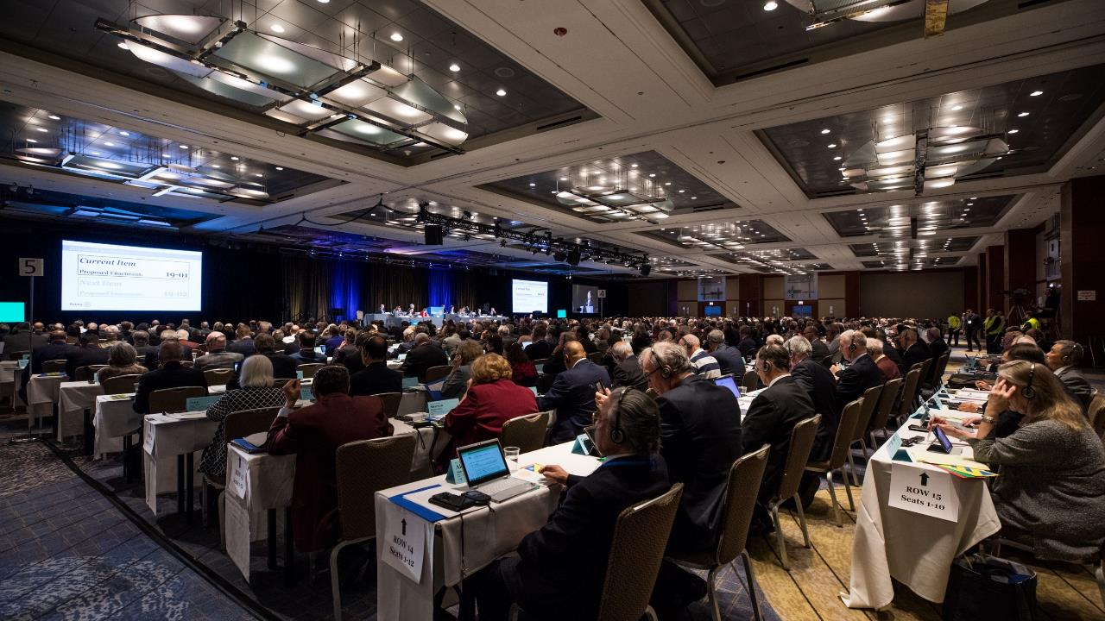
QUESTIONS?
Additional questions can be sent to council_services@rotary.org

