Slide 1
The ABC’s of The Rotary Foundation

Slide 2
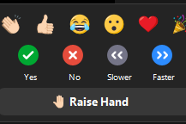
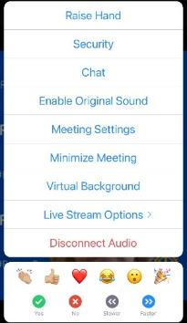
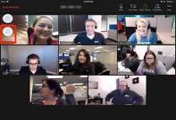
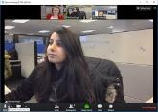
Rules of the zoom
Participants
Please activate your video webcam
Please remain muted until called upon
If using a phone for audio, please self mute and unmute when called upon.
Utilize “chat” function
Utilize “raise hand” function
in reactions
If the meeting is interrupted and ends, please wait 5 min and log in again
Gallery view will show all attendees
Speaker view will show current speaker and is view available on an Ipad or tablet
Desktop Control View
Tablet/Smartphone View
Notes:
Tech Overview: Tech Host (7 minutes) Slide 2
We are going to go over Rules of the Zoom and some Zoom training.
Please stay muted until you want to speak. You will notice you have a microphone icon and when it has a slash through it, that means you are muted. When there is no slash, it means everyone can hear you. The reason we ask this is because there can be all sorts of background noise that can disrupt the meeting such as dogs barking, phones ringing, etc. Please mute yourself now if you have not done that.
It is proper etiquette on a Zoom call to have your video on unless you must step away. If you are on a phone, we ask that you please download the Zoom app so that video will be available to you. The video icon looks like a movie camera. If there is a slash through it, that means it is off. So check right now to be sure your video camera is on.
Please raise your hand in the participant function when you want to answer a question or have a question for the facilitator. See the little blue hand that you will click on in the participant function? Let’s all practice that now. Please raise your hand. Now let’s lower your hand by clicking on the icon to lower it. (Be sure they know how to raise and lower before moving on.)
When you want to answer a question, raise your hand and after being called upon by the facilitator, then unmute and respond.
We will be using the chat box. Please find the chat box icon on your device. Let’s practice that. Type in the chat box the city in which you live.
You have a thumbs up icon on your participant function. Please give us the thumbs up if you agree with this statement: Rotary does so much good in the world.
We will also be doing polls. The facilitator will ask a question or make a statement and then read the choices to you. She or he will indicate if it is either single choice or multiple choice. Make your choices and then click submit. Let’s practice that right now. Here is a poll.
Poll 1: I have a pet: Make single choice.
1. Yes
2. No
Please make your choice and then submit.
If you want to see all the participants, you would go to gallery view with a little icon that has a lot of squares.
If you want to see the current speaker, you need to go to speaker view which is an icon with just one big square.
Zoom will be shut down if our meeting is interrupted by unwanted visitors who would compromise our meeting. If that happens, then in 5 minutes login again.
Please know that these sessions will be recorded.
Now I would like to introduce your Lead Facilitator:­­______

Slide 3
Knowledge of The Rotary Foundation
Poll 1 How would you rate your knowledge of TRF:
Excellent - I am well versed in most areas
Good - I am considered knowledgeable at my Club
Fair - I know a few things about it
Count me as a beginner
Notes:
Dan – On behalf of the Zones 30 & 31 Foundation Teams, welcome to the ABC’s of The Rotary Foundation. I am Dan Ryan, your Zone 30 RRFC. Joining us tonight are my counterpart, Pamela Stewart, your Zone 31 RRFC, Zone 31 EPNC Mike Groom, Zone 31 EMGA Ted Huffhines, and are team members, Sam Adams, Debbie Alexander-Davis, Alan Barth, Lance Singleton, and Jennifer Van Houtte.
For starters, we would love to know how you rate your knowledge of The Rotary Foundation. You will see a poll pop-up and let’s take a couple minutes to see our results. Please rate your knowledge as Excellent, Good, Fair, Beginner.
[Poll 1]
How would you rate your knowledge of TRF:
Excellent,I am well versed in most areas
Good,I am considered knowledgable at my Club
Fair,I know a few things about it
Count me as a beginner
Let’s see our results. [comment…]

Slide 4
The Rotary Foundation’s Mission
The mission of The Rotary Foundation is to enable Rotarians to advance world understanding, goodwill, and peace by improving health, providing quality education, improving the environment, and alleviating poverty.
100 YEARS OF DOING GOOD IN THE WORLD
Notes:
Dan - The Rotary Foundation is a primary source of funding for Rotary’s humanitarian activities, from clubs’ and districts’ local service projects to global initiatives. It also leads Rotary’s ongoing effort to eradicate polio worldwide.
Our Foundation is a not-for-profit organization which is able to achieve its mission through the generous contributions and active participation of Rotarians and friends of Rotary.

Slide 5
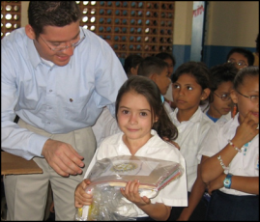
3 FUNDS - SUPPORTING THE ROTARY FOUNDATION
PolioPlus Fund
End Polio Now
Annual Fund
For support today
Endowment Fund
To secure tomorrow
Notes:
Alan:
Contributions to The Rotary Foundation may be made to our PolioPlus Fund to fund the eradication of polio; to our Annual Fund which helps us to support life-changing projects in our local and global communities, to our Endowment Fund which helps us to provide for these same life-changing projects in the future, or to other more specific, focused funding such as the Rotary Disaster Response Fund.

Slide 6
ANNUAL FUND-SHARE
District makes contributions
Contributions are invested over 3 years
Contributions are divided into …
47.5% District Designated Fund
Use up to half for a district grant
Donate to PolioPlus, Rotary Peace Centers, and more
47.5% World Fund
Supports grants and programs available to all districts
Fund global grants and receive World Fund match
5% expenses
Notes:
Lance: When you give money to The Rotary Foundation Annual Fund, SHARE program, in 3 years 47.5% of this comes back to your district for grants. This is what we call District Designated Funds or DDF. Your district can allocate up to 50% of its DDF for district grants and the remaining 50% for global grants.
The 47.5% of our contributions goes to the World Fund which can be used to match your global grants, and 5% is used for operating expenses.

Slide 7
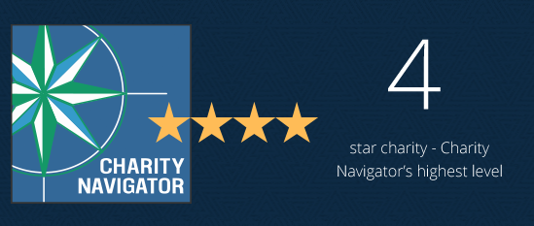
CHARITY NAVIGATOR
Notes:
Debbie: In recognition of its efficiency, transparency, good governance and impact, Charity Navigator, the largest independent evaluator of US based charities, awarded TRF another 4-star rating this year. A 4-star rating is best rating a charity can receive.
This is the 14th consecutive year TRF has received this designation, placing it among the top 1% of charities evaluated by Charity Navigator. This designation sets our Foundation apart from its peers – demonstrating to our members and the public its trustworthiness.

Slide 8
Individual recognition
Rotary Foundation Sustaining Member - When you give $100 or more per year to the Annual Fund.
Benefactor - When you include the Endowment Fund as a beneficiary of $1,000 or more in your estate plans or when you donate $1,000 or more to the fund outright.
Paul Harris Fellow - When you give $1,000 or more to the Annual Fund, PolioPlus, or an approved Foundation grant. To recognize someone else as a Paul Harris Fellow, you can give that amount in their name.
Multiple Paul Harris Fellow - When you give additional gifts of $1,000 or more to the Annual Fund, PolioPlus, or an approved Foundation grant.
Paul Harris Society member - When you elect to contribute $1,000 or more annually to the Annual Fund, PolioPlus, or an approved Foundation grant.
Naming opportunities:
Endowed global grant fund
Named endowment
Directed gift global grants
Rotary Peace Centers endowment opportunities
Rotary Peace Centers directed gifts
Rotary Peace Symposium directed gifts
Entrepreneurial named gift for peace
Notes:
Ted:
There are many opportunities for individual recognition such as a Rotary Foundation Sustaining Member, Benefactor, Paul Harris Fellow, and Paul Harris Society Member. [Let’s take a minute or two for you to enter your name in the chat if you have one or more of these recognitions.]
Naming opportunities
Special opportunities are available to create an endowment or make a directed gift in your name or the name of a loved one. Endowed gifts are invested in perpetuity, with part of their earnings spent on a designated program. Directed gifts are spent in their entirety, usually in the following Rotary year.
Endowed global grant fund
$500,000 or more: You can specify up to three of the following: the district sponsor, the area of focus, the general geographic region of the project, or the type of grant activity, such as a project or scholarship.
$250,000 or more: You may choose up to two of the options listed above
$150,000 or more: You may choose one grant activity type, such as a humanitarian project, scholarship, or vocational training team.
Named endowment
If you donate $25,000 or more, you can direct the money to one of the following:
Area of Focus: funds global grants in one area of focus
World Fund: funds global grants in all areas of focus
SHARE: supports the World Fund and provides district designated funds to your district
Rotary Peace Centers: supports Rotary’s partnership with leading universities around the world to train professionals in conflict resolution, peace studies, international relations, and related disciplines
Learn more
Directed gift global grants
$150,000: A one-time gift that provides funding for global grants in up to two areas of focus of your choice or to a special initiative of the Foundation, such as WASH in Schools
$30,000: A one-time gift that provides your district with funds for one or more global grants in an area of focus of your choice
$15,000: A one-time gift that provides funding for a global grant in an area of focus of your choice without specifying the district that will sponsor the grant
Rotary Peace Centers endowment opportunities
$1.5 million: Endows a Rotary Peace fellow every year
$1 million: Endows a Rotary Peace fellow every two years
$1 million: Endows a visiting lecturer every year
$750,000: Endows a Rotary Peace fellow every three years
$500,000: Endows a Rotary Peace fellow every four years
$250,000: Endows one Rotary Peace certificate fellow every year
$100,000: Endows an annual seminar at a Rotary Peace Center
$25,000 and up: Provides general support
Rotary Peace Centers directed gifts
$75,000: Provides funding for a Rotary Peace Fellow to complete a two-year master’s degree program
$75,000: Provides funding for up to 10 internships or research projects for peace fellows
$60,000: Provides funding for five fellows enrolled in the three-month professional development certificate program
$10,000: Provides general support
Rotary Peace Symposium directed gifts
$400,000-$500,000: Underwrites the cost of the Peace Symposium
$50,000-$100,000: Provides full funding for a donor-specified element of the peace symposium (speakers, Rotary Peace Fellow travel, etc.)
$10,000-$25,000: Provides funding for a hosted reception connected to the Peace Symposium
$10,000 and up: Provides general support for the Peace Symposium
Entrepreneurial named gift for peace
$75,000-$1 million: Funds new opportunities within Rotary’s peace programs for global grants and the Rotary Peace Centers, such as workshops and retreats, and other initiatives.

Slide 9
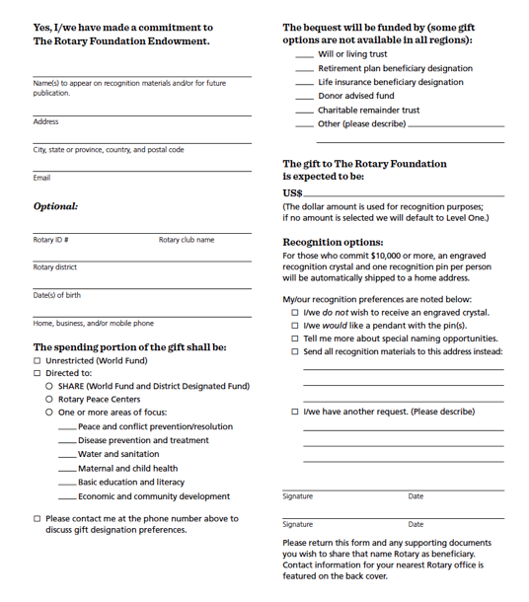
Cumulative gifts to date or legally binding agreement
Major
Donor
$10,000⁺
Arch Klumph
Society
$250,000⁺
Documented promise of a future gift
Bequest
Society
$10,000⁺
Legacy
Society
$1,000,000⁺
Notes:
Alan: You can receive special recognition for your legacy by notifying the Foundation of your commitment. You can do this by completing a Your Rotary Legacy notification form or submitting notification online at rotary.org/legacy.
When you make a promise of a future commitment to the Endowment or an outright gift of $1,000 to the Endowment, you will be recognized as a Benefactor. Starting this year, clubs that have 100% member support of the Endowment may be recognized as Rotary’s Promise Clubs.
As you can see on the slide, gifts made during your lifetime count toward Major Donor and Arch Klumph Society recognition.
Additionally, the Trustees are pleased to confer membership to the Bequest Society for anyone who tells The Rotary Foundation they have left a legacy of $10,000 or more. Members of this group of dedicated humanitarians receive special Foundation updates, invitations to events, and an exclusive pin or pendant. Rotarians who invest in the Foundation’s future retain their membership regardless of fluctuations in their financial portfolio or other assets.
We also have a special recognition for individuals and couples who substantiate a future gift to The Foundation of $1 million or more.

Slide 10
Club recognition
100% Paul Harris Fellow Club - For clubs in which all dues-paying members are Paul Harris Fellows. This is a one-time recognition.
100% Paul Harris Society Club - For clubs in which every dues-paying member contributes a minimum of $1,000 to the Annual Fund, PolioPlus, or global grants within a Rotary year
100% Foundation Giving Club - For clubs that achieve an average of $100 in per capita giving and 100 percent participation, with every dues-paying member contributing at least $25 to any or all of the following during the Rotary year: Annual Fund, PolioPlus Fund, approved global grants, or Endowment Fund.
100% Rotary’s Promise Club - A designation provided to clubs in which every dues-paying member supports The Rotary Foundation’s Endowment with a minimum commitment of $1,000 or more in an estate plan or via an outright gift of $1,000 or more. A certificate honoring the achievement will be provided upon request.
Every Rotarian, Every Year Club - For clubs that achieve a minimum Annual Fund contribution of $100 per capita during the Rotary year, and every dues-paying member must personally contribute at least $25 to the Annual Fund during the year.
Top Three Per Capita in Annual Fund Giving - For the three clubs in each district that give the most, per capita, to the Annual Fund. Clubs that give at least $50 per capita are eligible.
Rotaract Giving Certificate - Rotaract clubs that collectively contribute $100 or more annually to The Rotary Foundation will be eligible for a Rotaract Giving Certificate.
Notes:
Sam: Just as there are individual recognitions, there are club recognitions for those clubs which create a culture of giving and support for The Rotary Foundation, including 100% Paul Harris Fellow Clubs, 100% Paul Harris Society Clubs, 100% Foundation Giving Clubs, 100% Rotary’s Promise Clubs, Every Rotary, Every Year Clubs, and top per capita giving clubs, and Rotaract Giving clubs. I want to take a minute or two to provide more information on the Paul Harris Society and why this is so vital at the individual and club level. The Paul Harris Society is different from being a Paul Harris Fellow. You must make an ongoing commitment to The Rotary Foundation to give at least $1,000 per year to become a member of the Paul Harris Society. Many donors are eligible for this but never complete the commitment form because they are not aware that this is an honor distinct from Paul Harris Fellow.
And making an auto withdrawal of $84 a month out of your checking account using Rotary Direct, you may not even notice the deduction, but you will be able to see the positive impact Rotary makes and promote a culture of giving in your club and district.

Slide 11
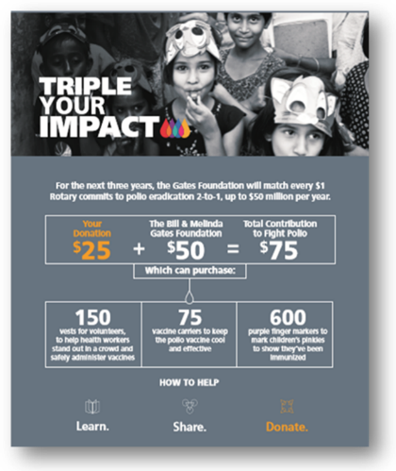
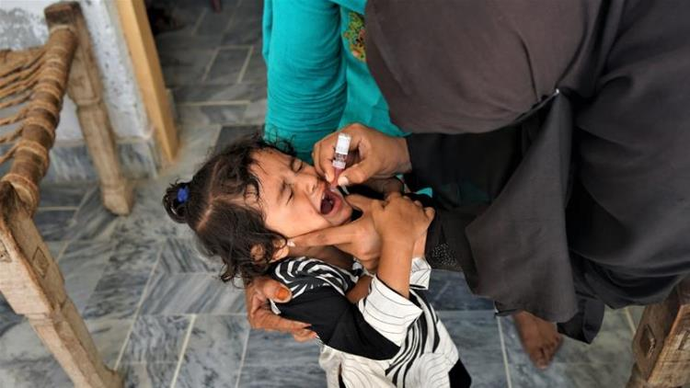
END POLIO NOW Just Two Drops
Notes:
Mike G:
Rotary International’s effort to eradicate polio began in 1979, with a multiyear 3-H grant to immunize 6 million children in the Philippines.
Rotary’s own financial support for PolioPlus has been magnified by an agreement with the Bill & Melinda Gates Foundation for a match 2 to 1 match. This means contributions to Rotary’s PolioPlus program will have three times the impact.
Take pride in what Rotary has done
3 billion children vaccinated in 40 countries
More than 19 million children were saved from contracting polio.
Save 1.5 million children from dying from polio
Polio only endemic in Pakistan & Afghanistan, but we have said polio is only a plane ride away and this year we have seen new cases in Malawi, London, New York, and other formerly polio-free safe havens.

Slide 12
2.025 BY 2025
Notes:
Ted: The Rotary Foundation Endowment ensures that future Rotary members will have the resources they need to design and implement sustainable projects year after year. The principal of gifts to the Endowment is never spent. Spendable earnings generated on the principal are directed annually to Foundation grants and programs. Gifts to the Endowment support the same programs that the Annual Fund supports, but in perpetuity. The following types of contributions can be made to the Endowment: Outright gifts of cash, investments, or other property; Life income gifts (for example, charitable remainder trusts, charitable gift annuities, pooled-income funds); Testamentary gifts through wills or estate plans; Beneficiary of life insurance, retirement plan accounts, or other financial accounts.

Slide 13
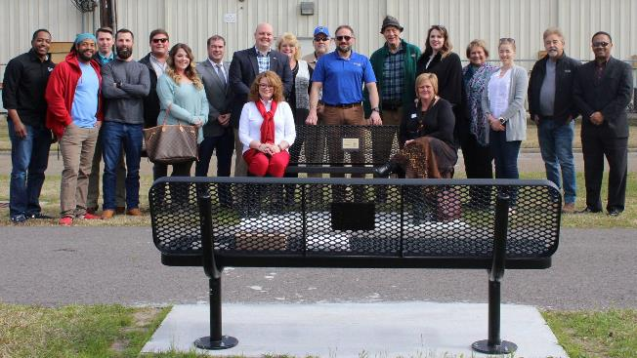
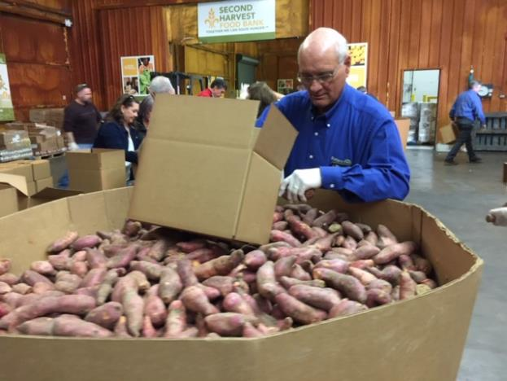
District Grants
Smaller activities and projects
Funds both local & international activities
Activities must be consistent with the mission of Rotary
Notes:
Jennifer: As Lance explained, our Annual Fund-SHARE gifts come back to our districts in the form of the District Designated Fund. One use of these funds is for district grants which are smaller, short-term projects usually in our local communities, but some districts even use these funds to do smaller, shorter term international projects.

Slide 14
Global Grants
Longer-term projects
Sustainable impact
Support One of Rotary’s 7 Areas of Focus
Larger amount ($30,000-$400,000)
Address an important need identified in the community
Strengthen the community’s capacity to address its own needs
Notes:
Debbie: As [Jennifer] explained, our Annual Fund-SHARE gifts come back to our districts in the form of the District Designated Fund. In addition to district grants, these funds are available for global grants. Global grants are by nature longer-term, larger grants and as such have additional requirements set by The Rotary Foundation to ensure that the projects are sustainable with measurable and lasting outcomes and that the grant funds are managed responsibly. A global grant must also meet an important need of the community within one of Rotary’s 7 areas of focus and help improve the community’s capacity to address its own needs.

Slide 15
Seven Areas of Focus
Notes:
Mike: Remember we now have 7 areas of focus, as we added the Environment.

Slide 16
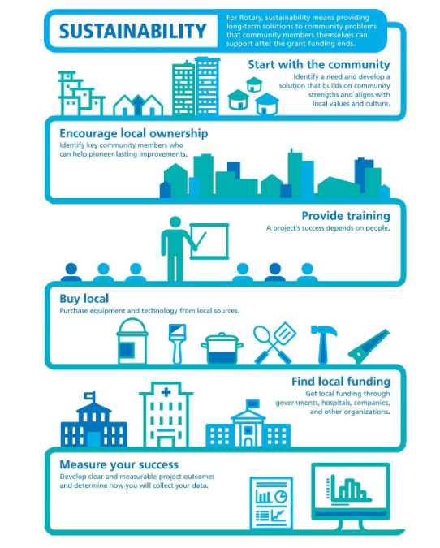
Notes:
Lance: Global grants must have sustainable impact. Here we have 6 steps to sustainability. Start with the community to identify a need and develop a solution that builds on community strengths and aligns with local values and culture. This means we need to start with a community assessment – ask the community what they need rather than deciding what you think you would like to do. You may want to provide school uniforms, but the community may have a greater need for clean water or for trained teachers and books. Identify key community members to assess their needs and become partners committed to the project and maybe even create new jobs or sell goods and services. Provide training and education so that the community knows how to take over the project when the grant funding is gone. Buy local, getting at least 3 bids, and make sure spare parts will be available locally. Get local funding through governments, hospitals, companies or other organizations. Develop clear, measurable project outcomes and engage the community in collecting data and evaluating the outcomes.

Slide 17
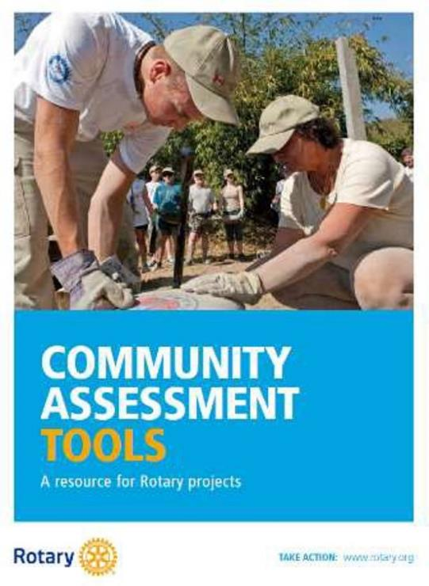
Community Needs Assessment
Remain open minded
Choose participants carefully
Include overlooked or marginalized groups
Consider yourself an outsider
Avoid promising a project before your club makes a formal decision
Empower stakeholders
Notes:
Jennifer: Don’t presume you know what the community needs, choose a group of diverse participants (gender, age, ethnicity, religion, income levels, and vocations), include women, young, elderly, religious and ethnic minorities, speak with your participants not at them, AND don’t overpromise – your club may not vote for the project you think they will. While community needs assessments are required for global grants, it is wise to use them for district grants and club projects to make sure you are having the greatest impact for good.

Slide 18
The Rotary Foundation – District Qualification Memorandum of Understanding
District Qualification
District Officer Responsibilities
Club Qualification
Financial Management Plan
Annual Financial Assessment
Bank Account Requirements
Report on Use of Grant Funds
Document Retention
Method for Reporting and Resolving Misuse of Grant Funds
Notes:
Sam: For those of you who have worked on grants or are considering requesting grant funding, you will need to make certain that your club and district meet qualifications for grant funding annually and provide proper documentation and oversight to ensure funds are safe-guarded.

Slide 19
Program of Scale Programs
Key Characteristics
• Request $2 million in funding from Rotary — no less and no more
• Include an implementation timeline that spans three to five years
• Include other cash or in-kind contributions to be used along with the $2 million from the Foundation (note that funding cannot come in the form of District Designated Funds)
Programs should also be ready to scale, sustainable, promote learning, and represent Rotary.
Notes:
PAS: We now have a new tool in our arsenal to do good in the world. Rotary’s Programs of Scale builds on the scope, impact, and sustainability of successful Rotary service projects in our areas of focus by supporting larger and longer-term undertakings. Programs of Scale empowers Rotary members to work with experienced partners to implement large-scale, high-impact programs that benefit many people. The Rotary Foundation awards one $2 million Programs of Scale grant each year to a program sponsored by a qualified club or district that is working in strong collaboration with partner organizations. Each grant helps a program scale up, or expand, over three to five years to create lasting change.

Slide 20
Ways to Give and How to Support Fundraising
Educate members
Thank donors in innovative ways
Get donors and potential donors involved in projects
Rotary.org/donate
Rotary Direct
Memorial/tribute gifts
Employee matching
Raise for Rotary
Facebook
Encourage members and donors to support the Foundation in different ways
Notes:
PAS: Contributions to The Rotary Foundation may be made by credit card at rotary.org/donate. You can also give by check or wire transfer, or through your club, using The Rotary Foundation Contribution Form available at My Rotary. Club officers who sign into My Rotary can make online gifts for their club or its members. With all gifts, be sure to include your member ID to ensure that you get proper credit and recognition.
Recurring giving (Rotary Direct) Support Rotary’s Foundation year-round by making a recurring gift with Rotary Direct. You choose how much and how often to give. It is a simple and secure way to make a big impact. Online credit card contributions can be made monthly, quarterly, or annually. Donors can also enroll by using The Rotary Foundation Contribution Form, calling the Rotary Support Center at +1-866-9ROTARY (+1-866-976-8279), or writing to rotarysupportcenter@rotary.org. Donors can change or cancel their recurring giving online at any time through My Rotary.
Memorial and tribute gifts: If you wish to honor or memorialize someone with a contribution to The Rotary Foundation, please go to rotary.org/donate. Select Donate, choose what you would like to support, and then select “I would like to make this donation in honor or in memory of someone.” Donors will receive gift credit and a tax receipt (where applicable). The person they honor, or the family in the case of a memorial, will be notified of the gift by email if their email address is entered accurately when the contribution is made. The process is simple, and honorees and family members can be notified by email or by a print-at-home notification.
Employee matching gifts: Double the impact of your gift by asking your employer to match your contribution to The Rotary Foundation. More than 15,000 companies match gifts to the Foundation, including many international corporations. Find out if your employer does at rotary.org/matching gifts.
Fundraising for The Rotary Foundation on Raise for Rotary Raise for Rotary is a platform that allows individuals and teams to create online fundraisers that benefit The Rotary Foundation. They are a great way to celebrate personal events and special occasions. Organizers can share their fundraisers through social media, email, and text, so family, friends, colleagues, and supporters can donate online.
Fundraising for The Rotary Foundation on Facebook You can raise funds for The Rotary Foundation using Facebook. Simply select either Rotary International or End Polio Now as your nonprofit and share it with your friends. Funds received through the Rotary International page will support the World Fund, which pays for the Foundation’s most urgent needs. Those received through End Polio Now will support polio eradication. Donations made through Facebook, as with other non-Rotary platforms, are combined and can’t be credited individually by The Rotary Foundation. If you prefer to have your contributions recorded, donate directly to The Rotary Foundation.

Slide 21
Ways to Give and How to Support Fundraising
Notes:
PAS: Contributions to The Rotary Foundation may be made by credit card at rotary.org/donate. You can also give by check or wire transfer, or through your club, using The Rotary Foundation Contribution Form available at My Rotary. Club officers who sign into My Rotary can make online gifts for their club or its members. With all gifts, be sure to include your member ID to ensure that you get proper credit and recognition.
Recurring giving (Rotary Direct) Support Rotary’s Foundation year-round by making a recurring gift with Rotary Direct. You choose how much and how often to give. It is a simple and secure way to make a big impact. Online credit card contributions can be made monthly, quarterly, or annually. Donors can also enroll by using The Rotary Foundation Contribution Form, calling the Rotary Support Center at +1-866-9ROTARY (+1-866-976-8279), or writing to rotarysupportcenter@rotary.org. Donors can change or cancel their recurring giving online at any time through My Rotary.
Memorial and tribute gifts: If you wish to honor or memorialize someone with a contribution to The Rotary Foundation, please go to rotary.org/donate. Select Donate, choose what you would like to support, and then select “I would like to make this donation in honor or in memory of someone.” Donors will receive gift credit and a tax receipt (where applicable). The person they honor, or the family in the case of a memorial, will be notified of the gift by email if their email address is entered accurately when the contribution is made. The process is simple, and honorees and family members can be notified by email or by a print-at-home notification.
Employee matching gifts: Double the impact of your gift by asking your employer to match your contribution to The Rotary Foundation. More than 15,000 companies match gifts to the Foundation, including many international corporations. Find out if your employer does at rotary.org/matching gifts.
Fundraising for The Rotary Foundation on Raise for Rotary Raise for Rotary is a platform that allows individuals and teams to create online fundraisers that benefit The Rotary Foundation. They are a great way to celebrate personal events and special occasions. Organizers can share their fundraisers through social media, email, and text, so family, friends, colleagues, and supporters can donate online.
Fundraising for The Rotary Foundation on Facebook You can raise funds for The Rotary Foundation using Facebook. Simply select either Rotary International or End Polio Now as your nonprofit and share it with your friends. Funds received through the Rotary International page will support the World Fund, which pays for the Foundation’s most urgent needs. Those received through End Polio Now will support polio eradication. Donations made through Facebook, as with other non-Rotary platforms, are combined and can’t be credited individually by The Rotary Foundation. If you prefer to have your contributions recorded, donate directly to The Rotary Foundation.

Slide 22
Ways to Give and How to Support Fundraising
Educate members
Thank donors in innovative ways
Get donors and potential donors involved in projects
Rotary.org/donate
Rotary Direct
Memorial/tribute gifts
Employee matching
Raise for Rotary
Facebook
Encourage members and donors to support the Foundation in different ways
Notes:
PAS: Contributions to The Rotary Foundation may be made by credit card at rotary.org/donate. You can also give by check or wire transfer, or through your club, using The Rotary Foundation Contribution Form available at My Rotary. Club officers who sign into My Rotary can make online gifts for their club or its members. With all gifts, be sure to include your member ID to ensure that you get proper credit and recognition.
Recurring giving (Rotary Direct) Support Rotary’s Foundation year-round by making a recurring gift with Rotary Direct. You choose how much and how often to give. It is a simple and secure way to make a big impact. Online credit card contributions can be made monthly, quarterly, or annually. Donors can also enroll by using The Rotary Foundation Contribution Form, calling the Rotary Support Center at +1-866-9ROTARY (+1-866-976-8279), or writing to rotarysupportcenter@rotary.org. Donors can change or cancel their recurring giving online at any time through My Rotary.
Memorial and tribute gifts: If you wish to honor or memorialize someone with a contribution to The Rotary Foundation, please go to rotary.org/donate. Select Donate, choose what you would like to support, and then select “I would like to make this donation in honor or in memory of someone.” Donors will receive gift credit and a tax receipt (where applicable). The person they honor, or the family in the case of a memorial, will be notified of the gift by email if their email address is entered accurately when the contribution is made. The process is simple, and honorees and family members can be notified by email or by a print-at-home notification.
Employee matching gifts: Double the impact of your gift by asking your employer to match your contribution to The Rotary Foundation. More than 15,000 companies match gifts to the Foundation, including many international corporations. Find out if your employer does at rotary.org/matching gifts.
Fundraising for The Rotary Foundation on Raise for Rotary Raise for Rotary is a platform that allows individuals and teams to create online fundraisers that benefit The Rotary Foundation. They are a great way to celebrate personal events and special occasions. Organizers can share their fundraisers through social media, email, and text, so family, friends, colleagues, and supporters can donate online.
Fundraising for The Rotary Foundation on Facebook You can raise funds for The Rotary Foundation using Facebook. Simply select either Rotary International or End Polio Now as your nonprofit and share it with your friends. Funds received through the Rotary International page will support the World Fund, which pays for the Foundation’s most urgent needs. Those received through End Polio Now will support polio eradication. Donations made through Facebook, as with other non-Rotary platforms, are combined and can’t be credited individually by The Rotary Foundation. If you prefer to have your contributions recorded, donate directly to The Rotary Foundation.

Slide 23
Follow-up on The Rotary Foundation
Poll 2 As a result of this webinar, I would like to see a more advanced follow up
Yes
No
Notes:
Dan: We would love to know if you would be interested in more opportunities to explore The Rotary Foundation. We have a couple of very quick polls we would appreciate your answering and would like to know what questions you might like to have answers for. You will see a poll pop-up and let’s take a couple minutes to see our results.
[Poll 2]
As a result of this webinar, I would like to see a more advanced follow up
Yes
No
[Poll 3]
As a result of this webinar,I would like to know more about:
Fundraising ideas for the Annual Fund and Polio
How the funds are spent [and invested]
Endowment Fund
The ABCs of doing a Global Grant
Let’s see our results. [comment…]
Tonight’s session has been recorded, but we would like to also provide you answers to other questions you may have. If you have any questions you would like addressed, please enter them in the chat box. We will prepare responses and share those answers, along with the video link for tonight.

Slide 24
Follow-up on The Rotary Foundation
Poll 3
As a result of this webinar, I would like to know more about:
Fundraising ideas for the Annual Fund and Polio
How the funds are spent and invested
Endowment Fund
The ABCs of doing a Global Grant
Other
Notes:
Dan: We would love to know if you would be interested in more opportunities to explore The Rotary Foundation. We have a couple of very quick polls we would appreciate your answering and would like to know what questions you might like to have answers for. You will see a poll pop-up and let’s take a couple minutes to see our results.
[Poll 2]
As a result of this webinar, I would like to see a more advanced follow up
Yes
No
[Poll 3]
As a result of this webinar,I would like to know more about:
Fundraising ideas for the Annual Fund and Polio
How the funds are spent [and invested]
Endowment Fund
The ABCs of doing a Global Grant
Other
Let’s see our results. [comment…]
Tonight’s session has been recorded, but we would like to also provide you answers to other questions you may have. If you have any questions you would like addressed, please enter them in the chat box. We will prepare responses and share those answers, along with the video link for tonight.

Slide 25
Zone 30 Rotary Foundation Coordinator Team Members
Assignments:
Maryjane Shackelford Debbie Alexander-Davis Santhana Naidu Deb Cheney 6670 6710 6760 6860 6540 6600
6690 6740 6780 6880 6560 6630
6580 6650
Notes:
Dan: Thank you for joining us tonight. We would love to hear from you, to respond to questions, and to provide support to help you to be successful in your support of The Rotary Foundation. Zone 30 [name each].

Slide 26
Zone 31 Rotary Foundation Coordinator Team Members
Assignments:
Alan Barth Suzanne Ellerbrock Jennifer Van Houtte Lance Singleton
6820 6460 6110 5750
6200 6840 6490 6150 5770
6510 6170 5830
Notes:
PAS: Zone 31’s team includes…., and we stand with Zone 30’s team to help support our Zones 30 & 31 Rotarians and Rotoractors and The Rotary Foundation.

Slide 27
Upcoming Events
https://rizones30-31.org/events/zone-webinars/
Notes:
We also want to share with you all an upcoming opportunity with our Zone teammates, the Innovative Club Advocates for Zones 30 & 31 will be presenting “Expand Our Reach-New Club Development 2 Part Workshop” on November 9 & 10 at 5 PM CT/6 PM ET.

