Slide 2
Please rename yourself using this format:
Your Name and Club: Jane Smith, Springboro Metro
To do this,
Tap/Click on "Participant" at the bottom or top of the video window.
Tap/Click on your name.
Choose "Rename"
Type in your new name like the one above
Tap/Click "OK" or press the Enter Key

Slide 3
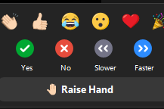
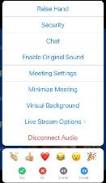
Rules of the zoom
Participants
Please activate your video webcam
Please remain muted until called upon
If using a phone for audio, please self mute and unmute when called upon.
Utilize “chat” function
Utilize “raise hand” function
in reactions
If the meeting is interrupted and ends, please wait 5 min and log in again
Gallery view will show all attendees
Speaker view will show current speaker and is view available on an Ipad or tablet
Desktop Control View
Tablet/Smartphone View
Notes:
Tech Overview: Tech Host (7 minutes) Slide 2
We are going to go over Rules of the Zoom and some Zoom training.
Please stay muted until you want to speak. You will notice you have a microphone icon and when it has a slash through it, that means you are muted. When there is no slash, it means everyone can hear you. The reason we ask this is because there can be all sorts of background noise that can disrupt the meeting such as dogs barking, phones ringing, etc. Please mute yourself now if you have not done that.
It is proper etiquette on a Zoom call to have your video on unless you must step away. If you are on a phone, we ask that you please download the Zoom app so that video will be available to you. The video icon looks like a movie camera. If there is a slash through it, that means it is off. So check right now to be sure your video camera is on.
Please raise your hand in the participant function when you want to answer a question or have a question for the facilitator. See the little blue hand that you will click on in the participant function? Let’s all practice that now. Please raise your hand. Now let’s lower your hand by clicking on the icon to lower it. (Be sure they know how to raise and lower before moving on.)
When you want to answer a question, raise your hand and after being called upon by the facilitator, then unmute and respond.
We will be using the chat box. Please find the chat box icon on your device. Let’s practice that. Type in the chat box the city in which you live.
You have a thumbs up icon on your participant function. Please give us the thumbs up if you agree with this statement: Rotary does so much good in the world.
We will also be doing polls. The facilitator will ask a question or make a statement and then read the choices to you. She or he will indicate if it is either single choice or multiple choice. Make your choices and then click submit. Let’s practice that right now. Here is a poll.
Poll 1: I have a pet: Make single choice.
1. Yes
2. No
Please make your choice and then submit.
If you want to see all the participants, you would go to gallery view with a little icon that has a lot of squares.
If you want to see the current speaker, you need to go to speaker view which is an icon with just one big square.
Zoom will be shut down if our meeting is interrupted by unwanted visitors who would compromise our meeting. If that happens, then in 5 minutes login again.
Please know that these sessions will be recorded.
Now I would like to introduce your Lead Facilitator:­­______

Slide 4
Poll
How would you rate your knowledge of Global Grants
Excellent, I am well versed in most areas
Good, I am considered knowledgeable at my Club
Fair, I know a few things about it
Count me as a beginner

Slide 5
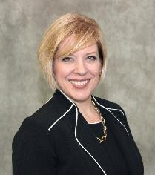
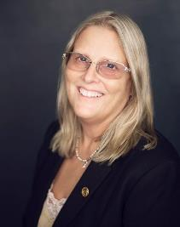
Resources for Global Grant Assistance
Holli Seabury, DGN 6540
Zone 30 Global Grant Resource
RotarianHolli@gmail.com
260-760-4831
Karen Johnson, PDG 6190
Zone 31 Global Grant Resource
KarenJohnson.Rotary@gmail.com
318-780-7481

Slide 6
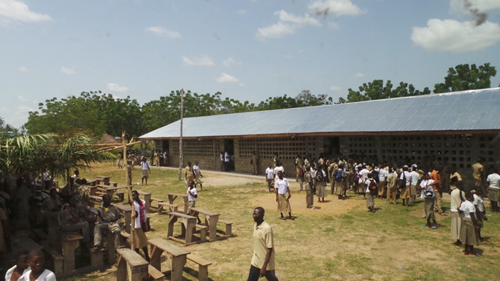
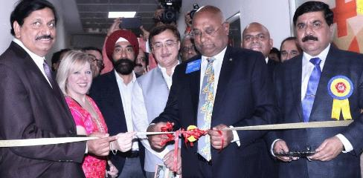
A little bit about my first foray into the world of Global Grants.

Slide 7
What We Will Discuss
What are Global Grants?
How are Global Grants funded?
How do I learn how to put together a Global Grant application?
How do I find a project and partners?
What’s Step One?
What is the benefit to my club to participate in a Global Grant?
Who in the Rotary world can help my club with a global grant?

Slide 8
What are Global Grants?
A partnership between a host club/district (where the project takes place) and an international club/district
Large projects with sustainable, measurable outcomes
Minimum $30,000 budget
Must address an Area of Focus

Slide 9
Global Grants Must Focus on at Least One of Rotary’s Areas of Focus

Slide 10
How are Global Grants Funded?
A combination of District Designated Funds (DDF), cash gifts from clubs or individuals, RI directed gifts, and from the World Fund.
Rotary Foundation’s World Funds are match funds and only District Designated Funds (DDF) are matched (at 80%)
Annual Fund SHARE provides the DDF to power global grants

Slide 11
How do I Learn How to Put Together a Global Grant?
District annual training
District Rotary Foundation Chair (DRFC), District Governor (DG) and clubs in your District who have been successful in obtaining Global Grants
Zone Global Grant Resource Coordinators and Foundation Team
Grants Management Seminar on the Learning Center at My.Rotary.org

Slide 12
How to get to the Learning Center Log into My.Rotary.org
1. Hover here
2. Click here

Slide 13
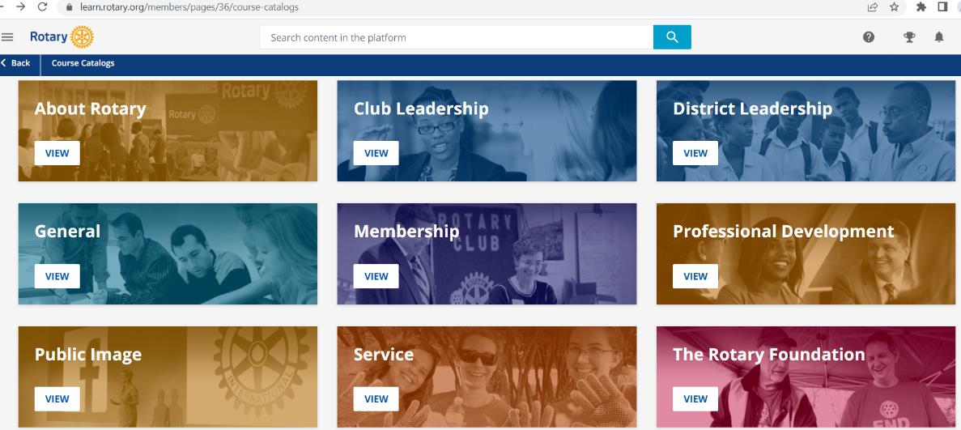
Click here

Slide 14
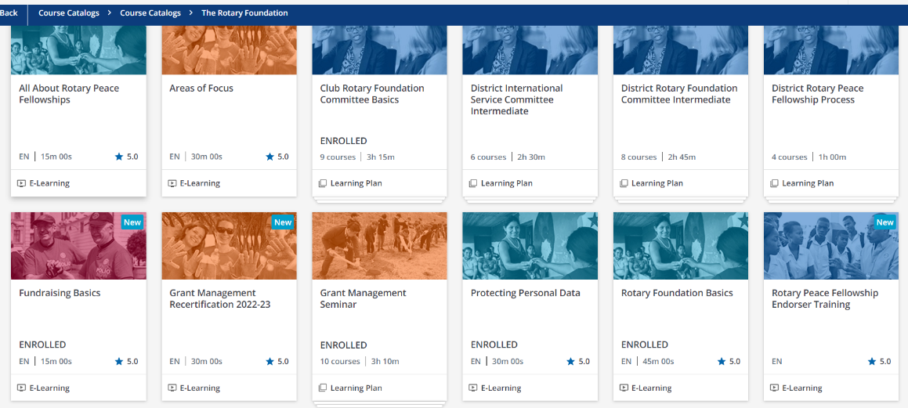
Click here

Slide 15
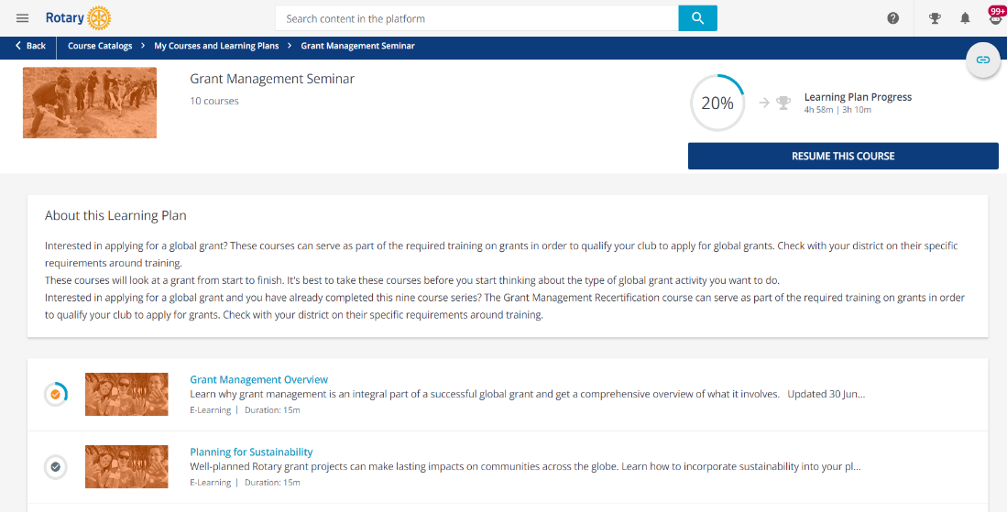

Slide 16
Resources & reference
A Guide to Global Grants (PDF)
Community Assessment Tools (PDF)
Cooperating Organization Memorandum of Understanding (DOC)
Global Grant Application Supplement for Microcredit Projects (DOC)
Global Grant Application Template (DOC)
Global Grant Calculator (XLS)
Global Grants Community Assessment Results (DOC)
Global Grant Monitoring and Evaluation Plan Supplement (PDF)
Global Grant Report Supplement for Microcredit Projects (DOC)
Global Grant Scholarships Supplement (PDF)
How Rotaractors Can Participate in Rotary Grants: Frequently Asked Questions (PDF)
https://my.rotary.org/en/take-action/apply-grants/global-grants

Slide 17
https://my-cms.rotary.org/ en/document/ community-assessment-tools

Slide 18
Applications are completed online in the Grants Center at My.Rotary.org.
Sponsoring clubs/committee members
The project’s objectives
Project activities
The project plan and schedule
Community needs
Areas of focus
Cooperating organizations and partners (if any)
Volunteer travel (if any)
Rotary member participation
The project budget
Financing
Sustainability
Monitoring and evaluation plan

Slide 19
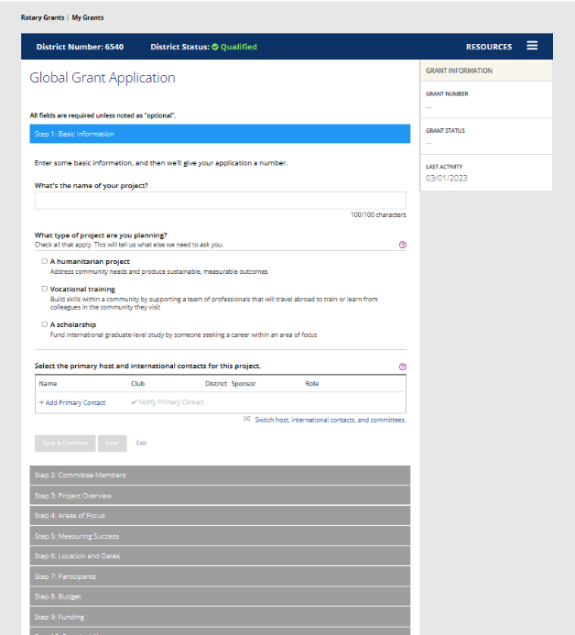

Slide 20
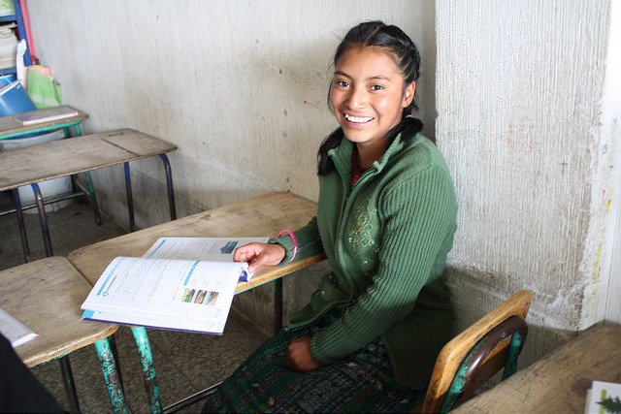
Read a successfully funded proposal:
https://www.guatemalaliteracy.org/wp-content/uploads/2022/07/GLP_request_for_funding_2022-2023.pdf

Slide 21
How to Find a Project and Partners
Join an existing project
Look within your club and community
International Convention
Search Rotary Showcase or put your project on Rotary Showcase

Slide 22
Rotary Showcase
https://map.rotary.org/en/project/pages/LearnMore.aspx

Slide 23
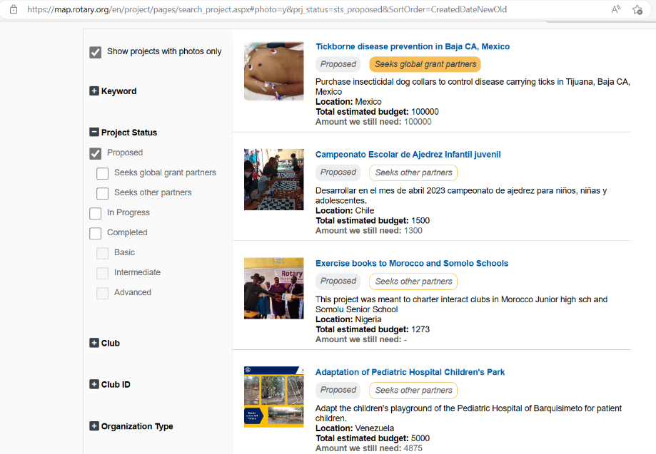

Slide 24
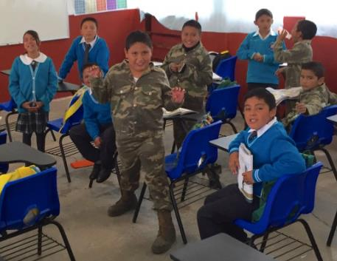
Heart2Heart
Virtual Project Fair February 11, 2023 at 10 am EST/ 9 am CT
Website: https://rizones30-31.org/news/heart-2-heart
Contact: Ron Appuhn
Phone: 865-567-9576
Email: Rappuhn53@yahoo.com

Slide 25
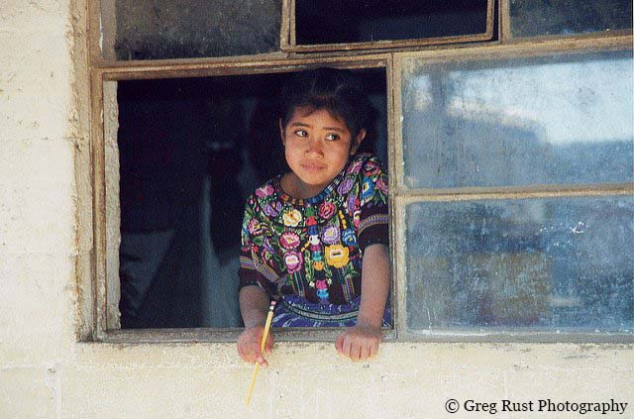
Guatemala Literacy Project
Guatemalaliteracy.org
One of the largest grassroots, multi-club,
multi-district projects in Rotary.

Slide 26
This is nice, but I joined Rotary to do local service.

Slide 27
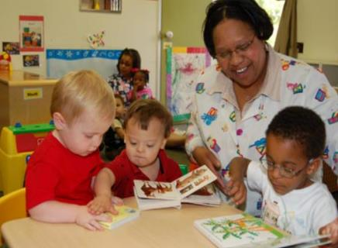
There are no “reverse” Global Grants, but you CAN do global grants for US projects
Title: Goldman School Area of Focus: Basic Literacy and Education Location: District 6190
$80,000 to serve the educational needs of children with disabilities by providing materials and curriculum to replicate an already successful location.
Title: The Looking Glass Area of Focus: Environmental Location: District 6190
$35,000 to create an educational kiosk to educate the public on the importance of recycling and the consequences of not recycling.
CONTACT: PDG Karen Johnson KarenJohnson.Rotary@gmail.com or 318-780-7481

Slide 28
Step One
Talk to your District Rotary Foundation Chair and District Governor.
Find out how much DDF is available to allocate for your grant and get on their radar.
Your DRFC, DG, and Club President will need to electronically approve the grant application before it is submitted to RI.
Talk to your grant partner about how much DDF they can allocate and the amount of club/directed gifts they can give so you know up front how much your club will need to raise.

Slide 29
Impact of Global Grants on our Club
Membership growth
Giving: members are giving directly to our global grants (counts toward next Paul Harris or Major Gift)
Annual Fund SHARE since we emphasize that’s where the DDF comes from that helps to fund our grants

Slide 30
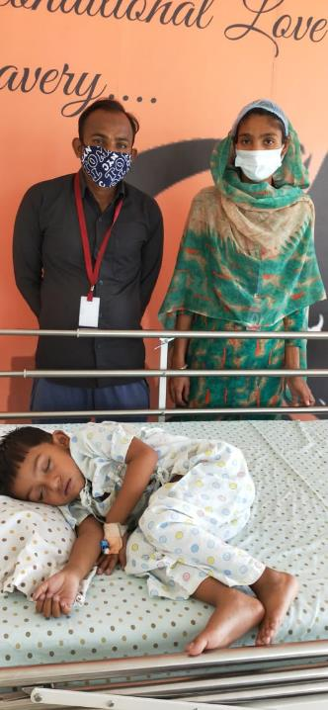
Who in the Rotary world can help my club with a global grant?
The Rotary Cadre (volunteer technical advisors)
A contact list by Area of Focus can be found at: https://my.rotary.org/en/take-action/apply-grants/cadre-technical-advisers
District leadership (DRFC, DG, PDGs)
Zone Foundation Team
Other clubs who have been successful writing Global Grants in your District
Zone Global Grant Resource

Slide 31
Resources for Global Grant Assistance
Holli Seabury, DGN 6540
Zone 30 Global Grant Resource
RotarianHolli@gmail.com
260-760-4831
Karen Johnson, PDG 6190
Zone 31 Global Grant Resource
KarenJohnson.Rotary@gmail.com
318-780-7481

Slide 32
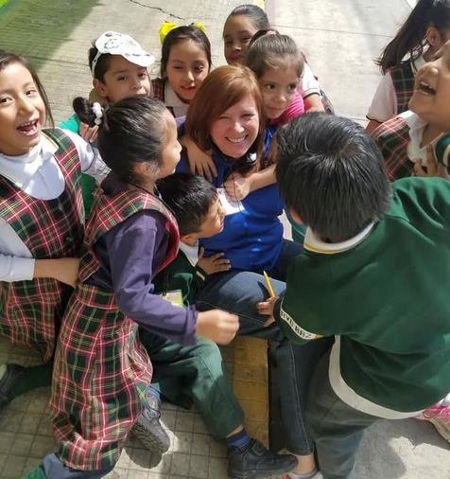
Questions?
Heart2Heart Rotary trip to Mexico City

Slide 33
Zone 30 Rotary Foundation Coordinator Team Members

Slide 34
Zone 31 Rotary Foundation Coordinator Team Members

Slide 35
Register at:
https://rizones30-31.org

