Slide 2
Please rename yourself using this format:
Your Name and Club: Jane Smith, Springboro Metro
To do this,
Tap/Click on "Participant" at the bottom or top of the video window.
Tap/Click on your name.
Choose "Rename"
Type in your new name like the one above
Tap/Click "OK" or press the Enter Key

Slide 3
Poll
Have you been involved in any natural or man-made disaster?
Yes
No

Slide 4
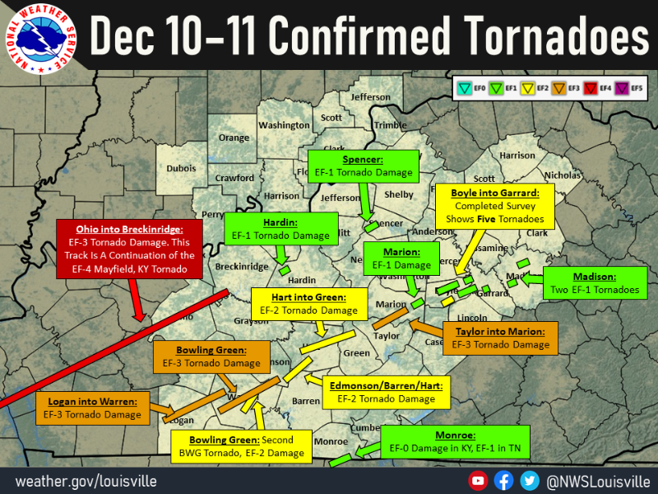
KENTUCKY TORNADOES DECEMBER 2022

Slide 5
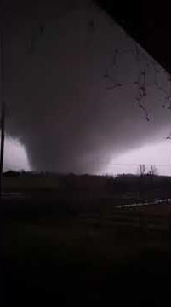
The Bremen Tornado

Slide 6
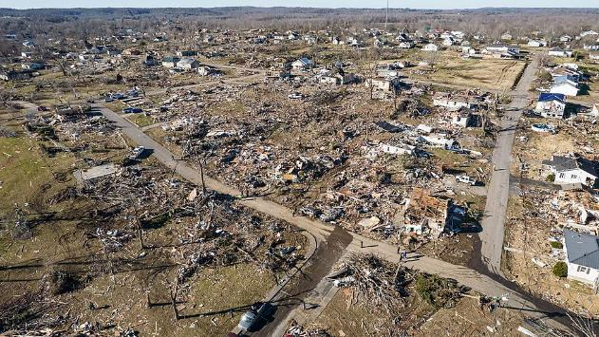
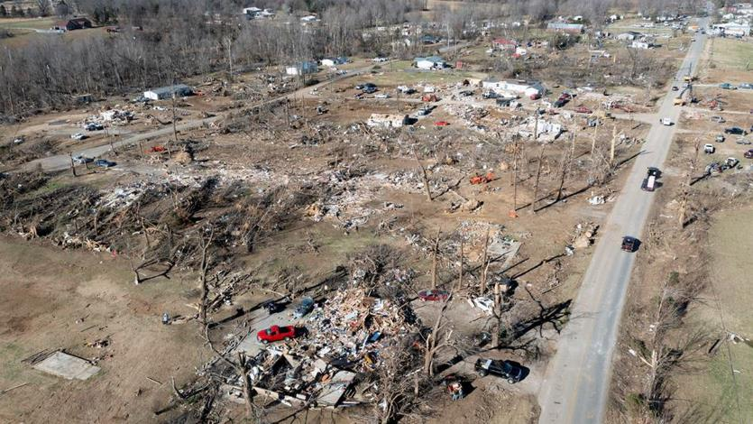
Tornado Damage in Bremen

Slide 7
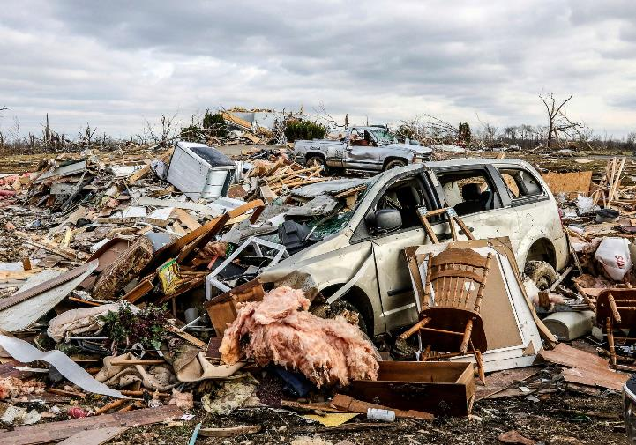
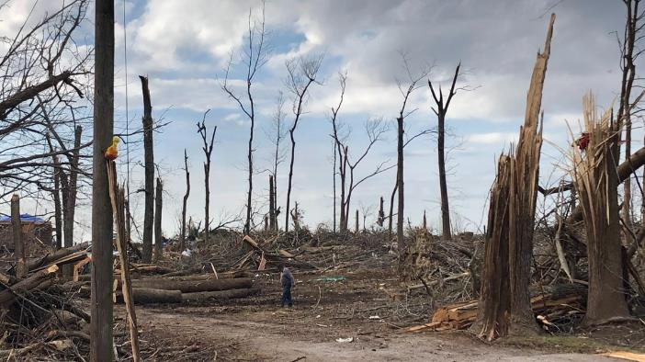
Bremen, Kentucky Damage

Slide 8
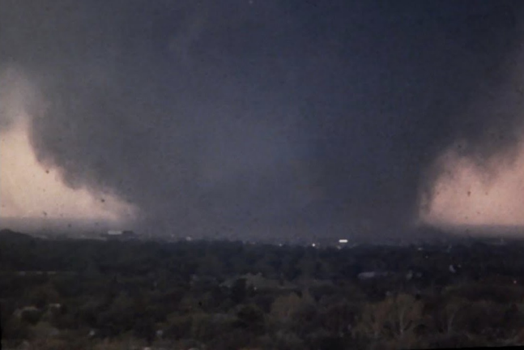
Benton, Kentucky tornado damage

Slide 9
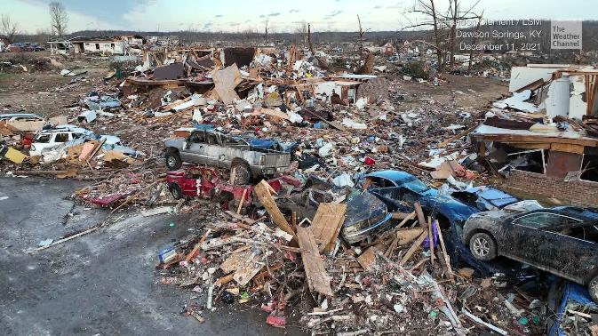
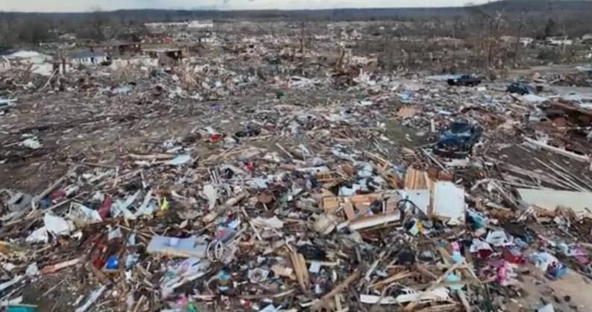
Dawson Springs, Tornado Damage

Slide 10
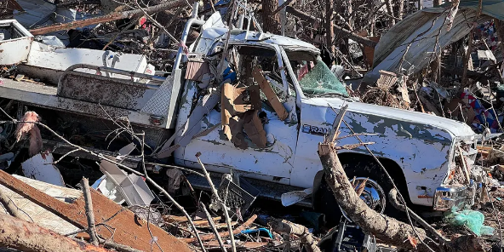
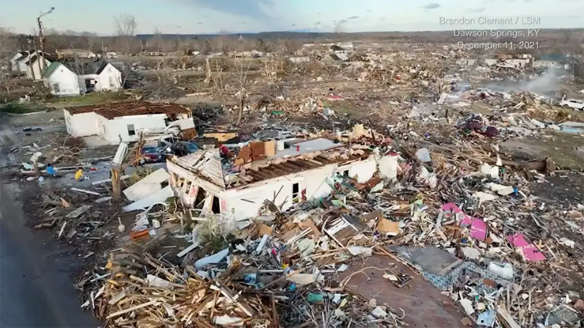

Slide 11
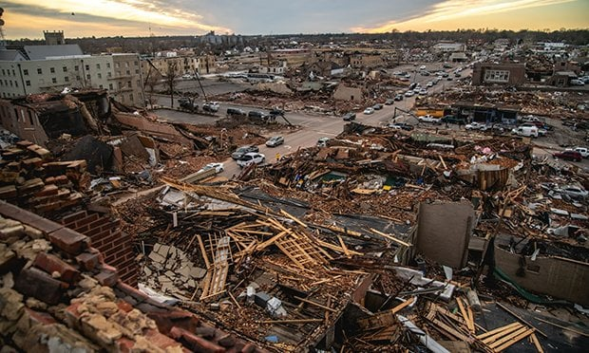
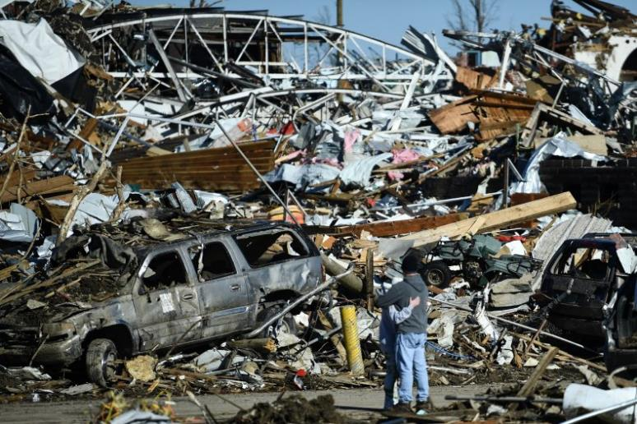
Mayfield, Kentucky Tornado Damage

Slide 12
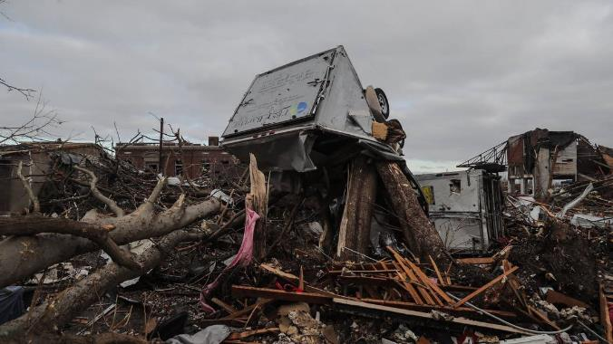
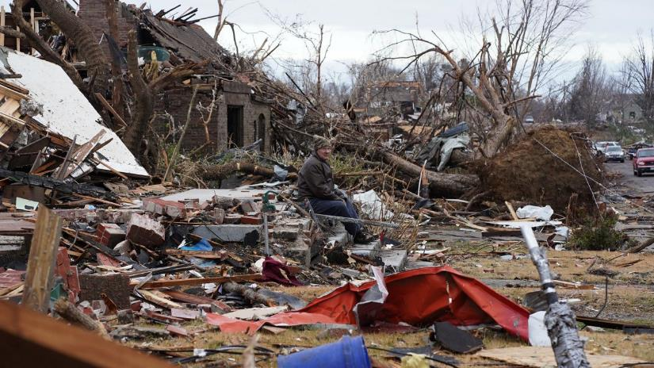
Mayfield, Kentucky Tornado Damage

Slide 13
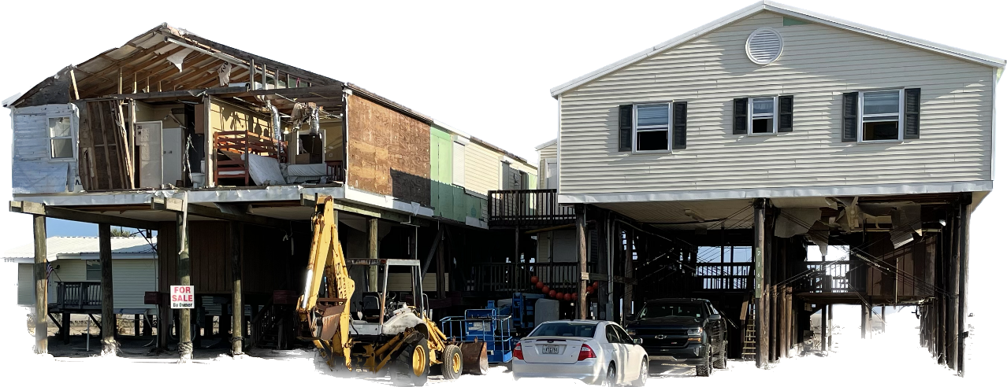
HURRICANE IDA

Slide 14
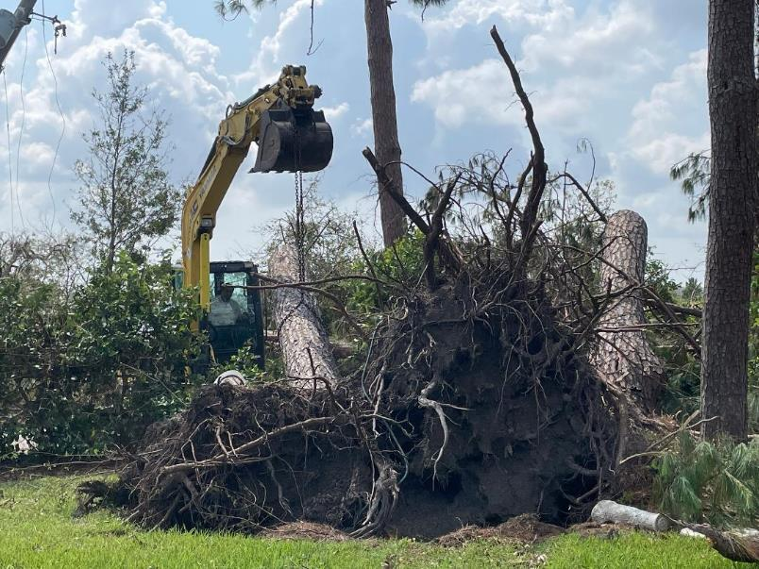

Slide 15
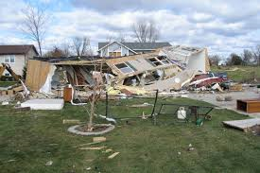
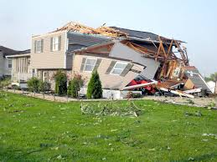
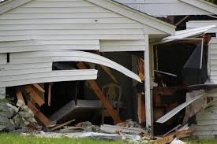

Slide 16
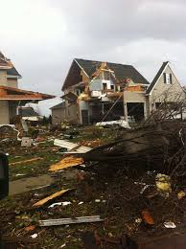
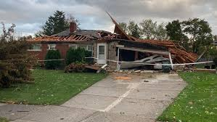

Slide 17
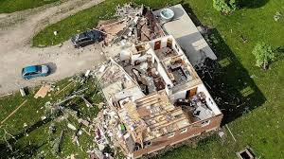

Slide 18
Poll
Do you believe that your district needs a disaster plan in place?
Yes, we need to develop one
Already have one in place
Ours needs to be updated
No

Slide 19
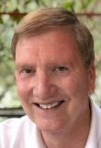
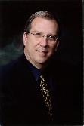
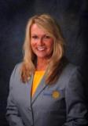
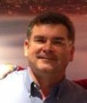
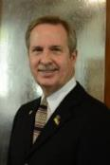
Contact Resources
Robert A. Stuart, Jr.
DNA-RAG Chair 2018-22
Past RI Director 2005-07
rstuart@bhslaw.com
Frank Bradshaw
PDG 6200 2002-03
Rotary6200@lusfiber.net
Gail Story
PDG 6710 2021-22
gail.rotary6710@gmail.com
Bob Vaughn
PDG 6840 2021-22
bobvaughn6840@gmail.com
Mark Lee
PDG 6200 2021-22
mark@coastalvolute.com
https://dna-rag.com/

Slide 20
Register at:
https://rizones30-31.org

Slide 21
