Slide 1
Intermediate Global Grant Workshop April 25, 2023 5:30pm CT/6:30pm EST

Slide 3
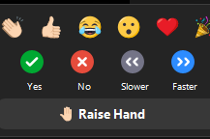
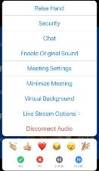
Rules of the zoom
Participants
Please activate your video webcam
Please remain muted until called upon
If using a phone for audio, please self mute and unmute when called upon.
Utilize “chat” function
Utilize “raise hand” function
in reactions
If the meeting is interrupted and ends, please wait 5 min and log in again
Gallery view will show all attendees
Speaker view will show current speaker and is view available on an Ipad or tablet
Desktop Control View
Tablet/Smartphone View
Notes:
Tech Overview: Tech Host (7 minutes) Slide 2
We are going to go over Rules of the Zoom and some Zoom training.
Please stay muted until you want to speak. You will notice you have a microphone icon and when it has a slash through it, that means you are muted. When there is no slash, it means everyone can hear you. The reason we ask this is because there can be all sorts of background noise that can disrupt the meeting such as dogs barking, phones ringing, etc. Please mute yourself now if you have not done that.
It is proper etiquette on a Zoom call to have your video on unless you must step away. If you are on a phone, we ask that you please download the Zoom app so that video will be available to you. The video icon looks like a movie camera. If there is a slash through it, that means it is off. So check right now to be sure your video camera is on.
Please raise your hand in the participant function when you want to answer a question or have a question for the facilitator. See the little blue hand that you will click on in the participant function? Let’s all practice that now. Please raise your hand. Now let’s lower your hand by clicking on the icon to lower it. (Be sure they know how to raise and lower before moving on.)
When you want to answer a question, raise your hand and after being called upon by the facilitator, then unmute and respond.
We will be using the chat box. Please find the chat box icon on your device. Let’s practice that. Type in the chat box the city in which you live.
You have a thumbs up icon on your participant function. Please give us the thumbs up if you agree with this statement: Rotary does so much good in the world.
We will also be doing polls. The facilitator will ask a question or make a statement and then read the choices to you. She or he will indicate if it is either single choice or multiple choice. Make your choices and then click submit. Let’s practice that right now. Here is a poll.
Poll 1: I have a pet: Make single choice.
1. Yes
2. No
Please make your choice and then submit.
If you want to see all the participants, you would go to gallery view with a little icon that has a lot of squares.
If you want to see the current speaker, you need to go to speaker view which is an icon with just one big square.
Zoom will be shut down if our meeting is interrupted by unwanted visitors who would compromise our meeting. If that happens, then in 5 minutes login again.
Please know that these sessions will be recorded.
Now I would like to introduce your Lead Facilitator:­­______

Slide 4
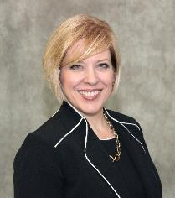
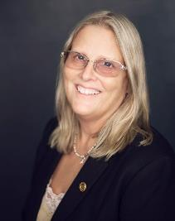
Resources for Global Grant Assistance
Holli Seabury, DGN 6540
Zone 30 Global Grant Resource
RotarianHolli@gmail.com
260-760-4831
Karen Johnson, PDG 6190
Zone 31 Global Grant Resource
KarenJohnson.Rotary@gmail.com
318-780-7481

Slide 5
The Rotary Foundation
Cadre of Technical Advisors
Wade Nomura
North American Regional Organizer

Slide 6
550+
members
Cadre Global Membership
More than 550 Rotarians from over 75 different countries

Slide 7
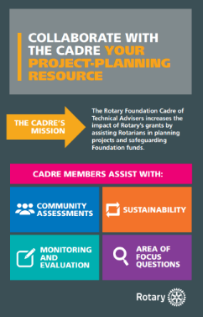
Cadre as Consultants & Trainers
Cadre members have professional & practical experience and can assist with:
Community assessments
Area of focus questions
Monitoring and evaluation
Measurement & data collection
Project planning advice
Integrating elements of sustainability
Financial & project management best practices
Notes:
Cadre members can play an important role outside of official assignments. By assisting clubs with the initial planning of Global Grants, cadre members can guide grant sponsors towards creating sustainable projects from the start.
Community Assessments: Community Assessments help host Rotarians better understand the needs of a community. Community assessments are the foundation of project sustainability. They guarantee that the people to benefit from the project have a voice in the project from the beginning.
Cadre members can encourage Rotarian hosts to establish relationships and have discussions with project beneficiaries, and then guide Rotarians towards the most appropriate community assessments for the area.
Monitoring and Evaluation: Cadre members can guide Rotarians towards establishing strong project objectives and clear project measures, and encourage them to maintain trusting relationships with beneficiaries so that if there is a problem – and all projects encounter problems - they will hear about it directly from the beneficiaries. Such relationships are important to help Rotarians in their oversight of the cooperating organization.
Rotary Global Grant Model: Help Rotarians who are new to Future Visions understand the Global Grant model and application process.
Other Elements of Planning Sustainable Projects: Cadre members can assist host Rotarians in considering other elements of project planning, such as using local materials; identifying local funding sources; providing training, education and community outreach; and motivating beneficiaries to take ownership.

Slide 8
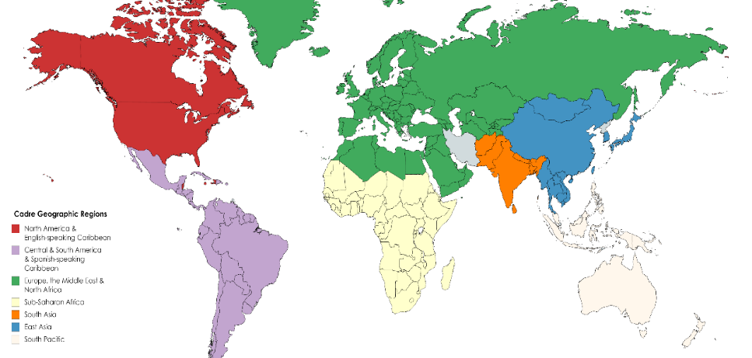
7 Regional Organizers

Slide 9
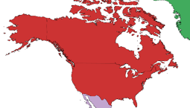
Regional Organization for North America
Also Organized by Areas of Focus
Peace and Conflict Prevention
Disease Prevention and Treatment
Water, Sanitation and Hygiene
Maternal and Child Health
Basic Education and Literacy
Economic and Community Development
Supporting the Environment

Slide 10
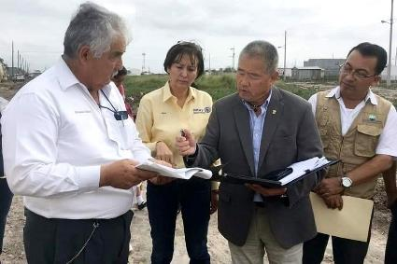
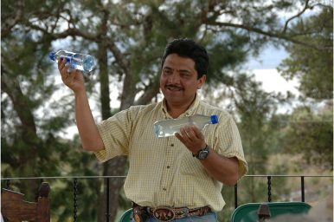
Community Assessments
Not Needs Assessment,
Must include Assets
Local Resources
Government
Local Businesses
Education
Supplies
Labor
Beneficiaries
Include Measurable Outcomes/Results

Slide 11
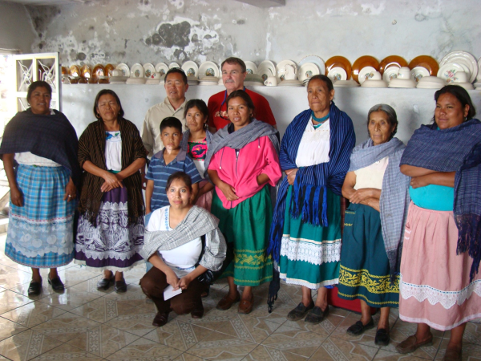
Guatemala

Slide 12
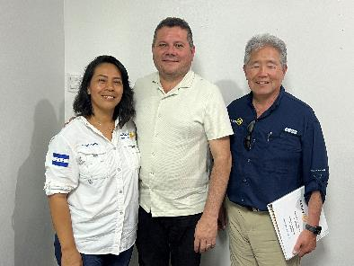
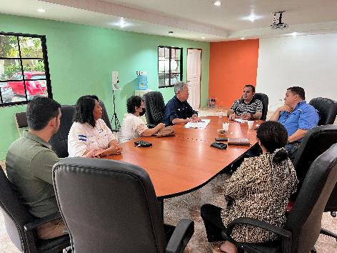
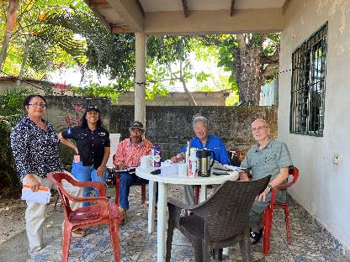
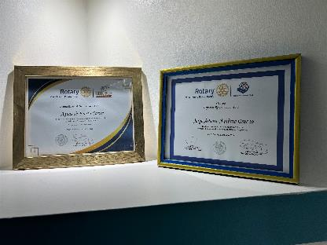
Strategic Partners

Slide 13
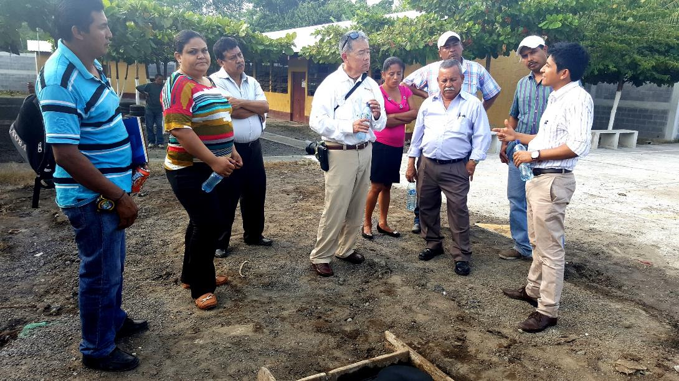
Partnering with Local Governments

Slide 14
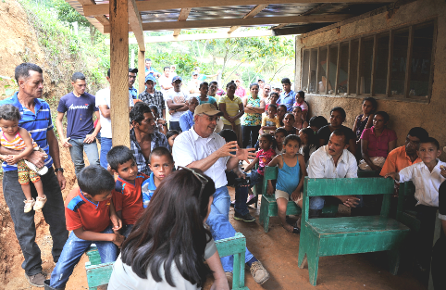
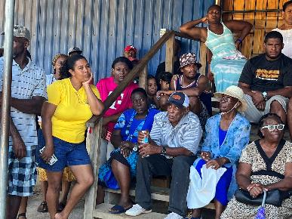
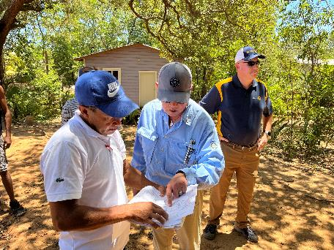
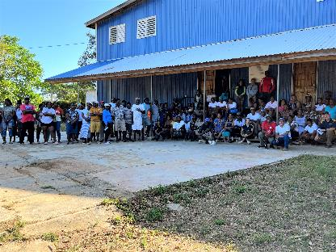
Partners-Beneficiaries

Slide 15
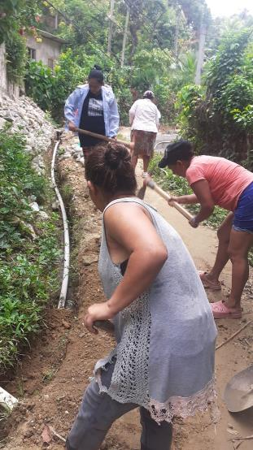
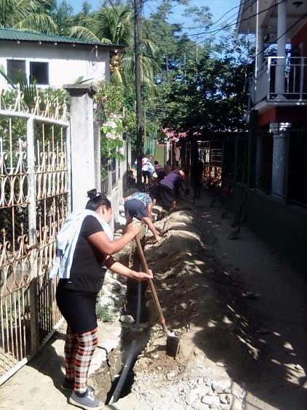
Ownership

Slide 16
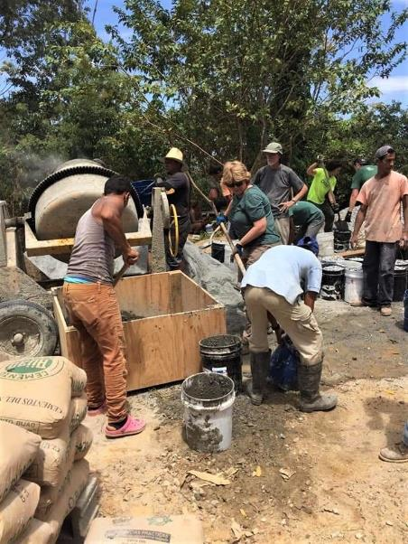
Beneficiaries working side by side with Rotarians

Slide 17
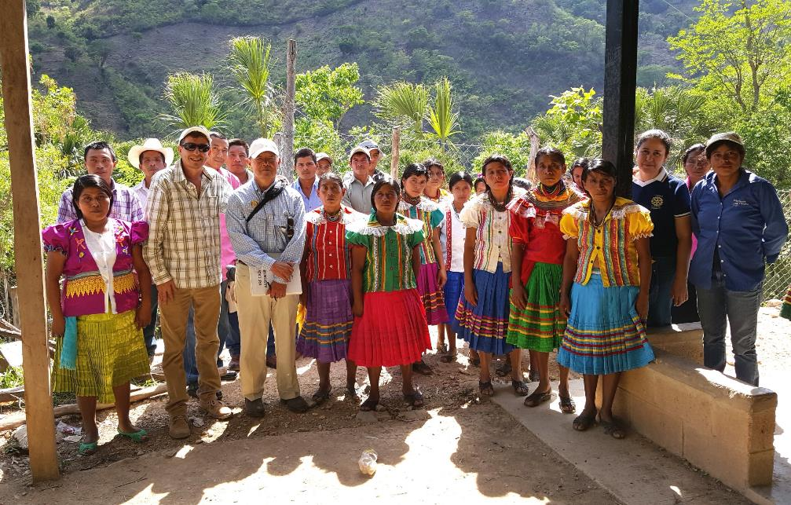
Site Visit and Data Gathering on Sustainability
Notes:
Gathering Data
Key component to success

Slide 18
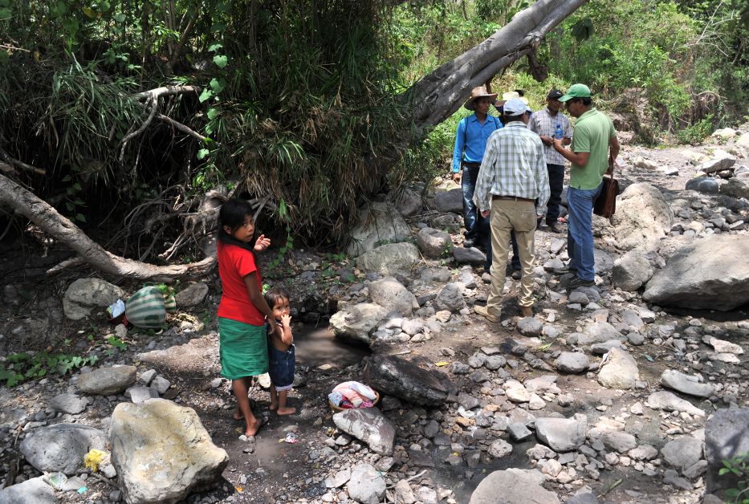
Site Visit and Data Gathering on Sustainability
Notes:
Gathering Data
Key component to success

Slide 19
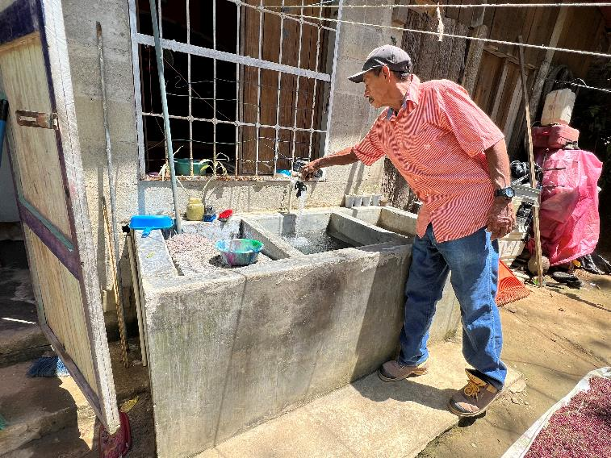
Site Visit and Evaluation
Notes:
Site Evaluation Household

Slide 20
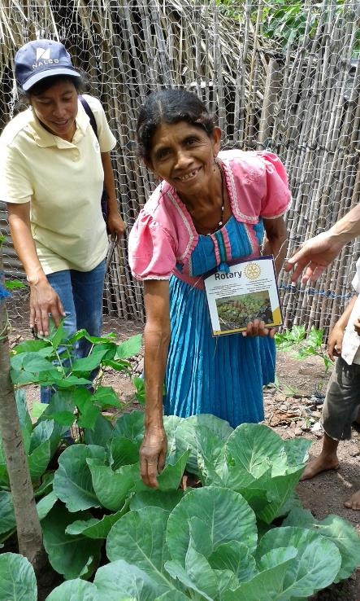
Measures and Evaluation

Slide 21
Questions?
Wade Nomura wadenomura.com
wade@wadenomura.com

Slide 22
This is nice, but I joined Rotary to do local service.

Slide 23
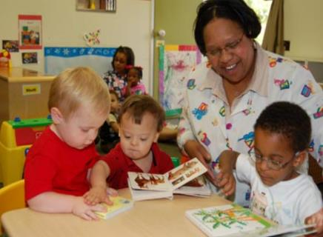
There are no “reverse” Global Grants, but you CAN do global grants for US projects
Title: Goldman School Area of Focus: Basic Literacy and Education
Location: District 6190, Shreveport Louisiana Rotary Club
Estimated Project Budget: $80,000
Summary: Help a local non-profit expand their ability to serve the
educational needs of children with disabilities by providing the
materials and curriculum to replicate an already successful location.
Title: The Looking Glass Area of Focus: Environmental
Location: District 6190, Alexandria Louisiana Rotary Club, Central Louisiana
Estimated Project Budget: $35,000
Summary: A project to create an educational kiosk called “The Looking Glass” to educate the public on the importance of recycling and the consequences of not recycling.
CONTACT: PDG Karen Johnson at KarenJohnson.Rotary@gmail.com or 318-780-7481

Slide 24
Step One of a Global Grant – Talk to Your District
Before you start working on your grant, talk to your District Rotary Foundation Committee Chair and District Governor.
Find out how much DDF is available to allocate for your grant and get on their radar so they know your request is coming.
Your DRFC Chair, DG, and Club President will need to electronically approve the grant application before it is sent to RI. Make sure they are all in the loop. Your Club executive committee or board may also need to approve the application.
Also talk to your grant partner about how much DDF they can allocate and the amount of club/directed gifts they can give so you know up front how much your club will need to raise.

Slide 25
Impact of Global Grants on our Club
Membership growth: many of our new members are attracted to our international work
Global grants have had an impact on giving: members are giving directly to our global grants (counts toward next Paul Harris or Major Gift)
It has an impact on Annual Fund SHARE since we emphasize that’s where the DDF comes from that helps to fund our grants
We have one member who has given over $850,000 to RI, completely to global grants.

Slide 26
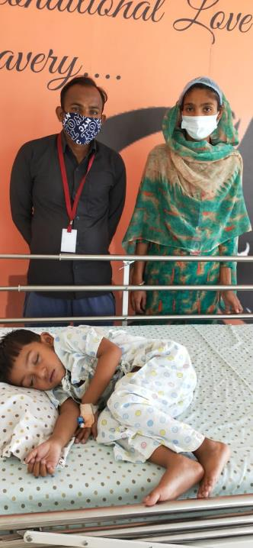
Who in the Rotary world can help my club with a global grant?
The Rotary Cadre (volunteer technical advisors.) A contact list by Area of Focus can be found at: https://my.rotary.org/en/take-action/apply-grants/cadre-technical-advisers
Your District leadership (DRFC, DG, PDGs)
Other clubs who have been successful writing Global Grants in your District
Your Zone Global Grant Resource

Slide 27
QUESTIONS
Notes:
Any Questions?
Thank you …..

Slide 28
Resources for Global Grant Assistance
Holli Seabury, DGN 6540
Zone 30 Global Grant Resource
RotarianHolli@gmail.com
260-760-4831
Karen Johnson, PDG 6190
Zone 31 Global Grant Resource
KarenJohnson.Rotary@gmail.com
318-780-7481

Slide 29
Zone 30 Rotary Foundation Coordinator Team Members

Slide 30
Zone 31 Rotary Foundation Coordinator Team Members

Slide 31
THANK YOU!
AND
FINISH THE YEAR STRONG!

