Slide 1
ROTARY BRAND CENTER
ZONE 30-31
Notes:
Thank you, Debbie for that very kind introduction. Thank you, Mike, for being our wonderful and talented Tech Host tonight.
Welcome everyone to an overview of the Rotary Brand Center and why it is a critical part of sharing your stories.
I am Laura Carie the Rotary Public Image Chair for Zone 30 (RPIC) and with me is Jamie Higgins the Rotary Public Image Chair for Zone 31 (RPIC)
We are going to go over how to navigate in the brand center and highlight some of the areas that will help you throughout your year.
If you have a question as we are going through this presentation, please write it down and we will take all questions at the end of the presentation.
Next slide

Slide 2
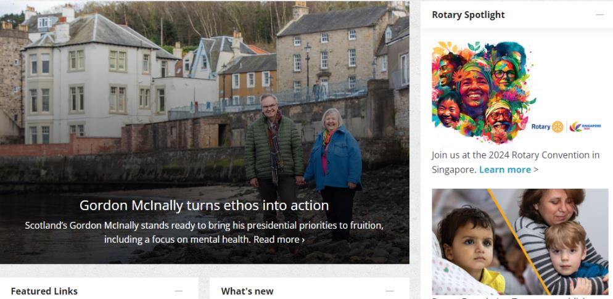
HOW TO ACCESS BRAND CENTER GO TO WWW.ROTARY.ORG CLICK ON MY ROTARY
Notes:
Here is the easy part….Go into your “My Rotary” account.
How many of you have already set up your My Rotary account? Is there anyone that has not had the opportunity to set up your account?
Next slide

Slide 3
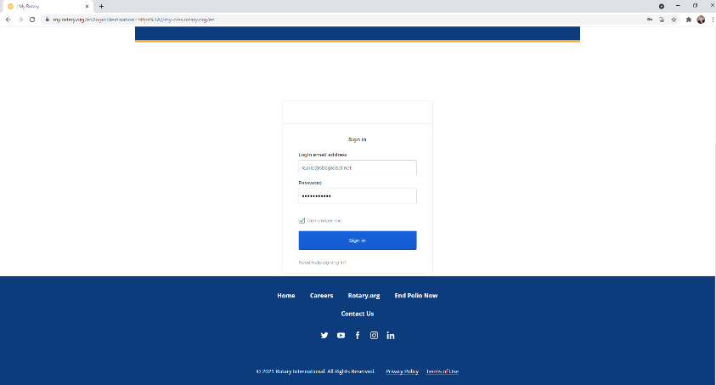
HOW TO ACCESS BRAND CENTER LOG IN
Notes:
Enter your log in information
Next slide

Slide 4
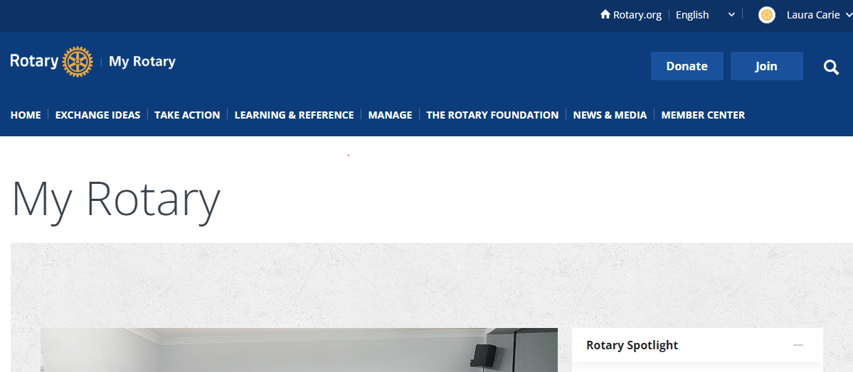
HOW TO ACCESS BRAND CENTER CLICK ON NEWS & MEDIA
Notes:
Go to the “News & Media” tab at the top of your screen
Next slide

Slide 5
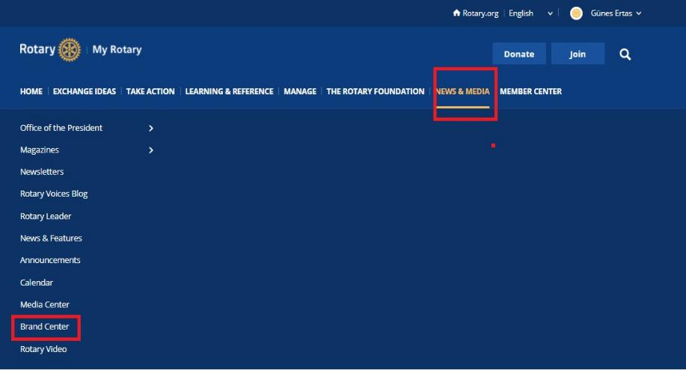
HOW TO ACCESS BRAND CENTER CLICK ON BRAND CENTER
Notes:
Then click on the Brand Center at the bottom of the page
Next slide

Slide 6
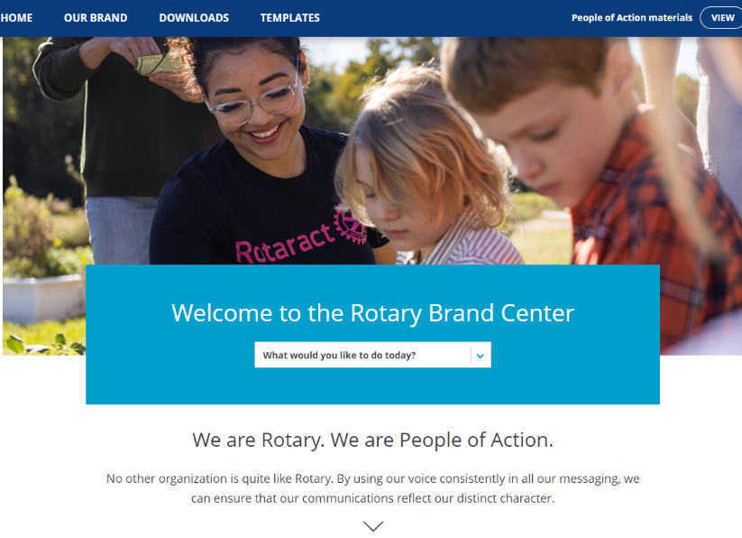
OVERVIEW OF BRAND CENTER
Notes:
This is the Brand Center Welcome page it has all the tabs you need to get started along the top of the page
If you would like a short cut to see all the different topics within the Brand Center. What would you like to do today? Click on the down arrow.
Create a Club Logo
Find an Image or Video
Find Club or Member Resources
Find People of Action Materials
Learn how to promote Rotary
Learn how to strengthen our Brand
There is also a button at the top to view People of Action Materials
JAMIE, I AM GOING TO TURN IT OVER TO YOU
Next Slide

Slide 7
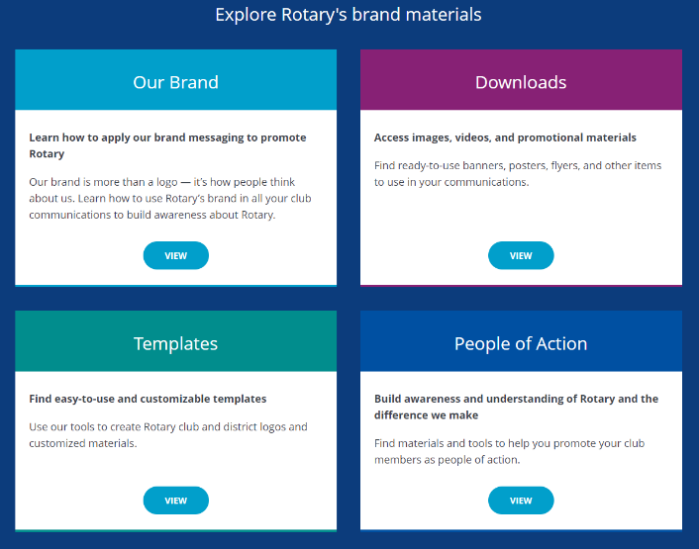
EXPLORE BRAND MATERIALS
Our Brand
Downloads
Templates
People of Action
Notes:
The next step is to find the Brand Materials you are looking for.
Our Brand – Learn how to apply our brand messaging to promote Rotary
Downloads – Access images, videos, and promotional materials
Templates – Find easy-to-use and customizable templates
People of Action – Build awareness and understanding of Rotary and the Difference we make

Slide 8
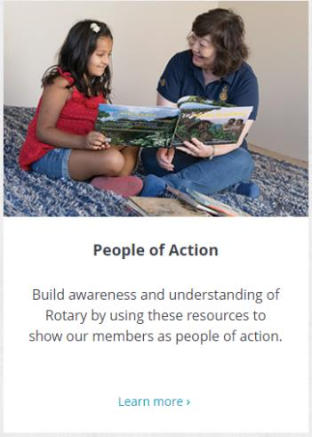
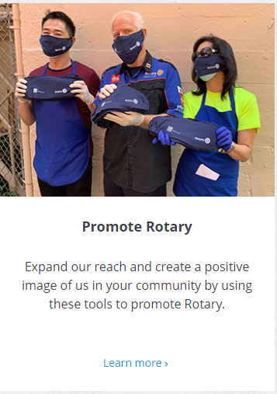
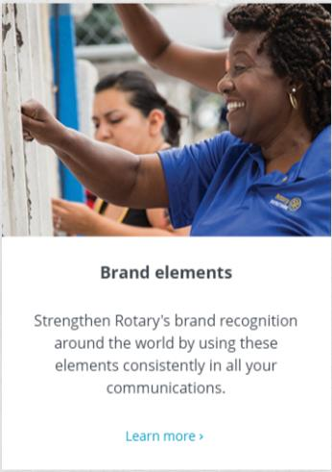
OUR BRAND INTRODUCTION PAGE
Notes:
Click on Our Brand –
Thank you, Laura! We’re going to start with the Our Brand section. Awareness of Rotary is high when it comes to our members however the public understanding of who we are, what we do, and the value we bring to communities is concerningly low. This is why our Image Matters! Think about it for a minute. No matter where you are in the world or what language you speak, the Rotary logo is universal. It’s what unites us and the impact we have around the world. Rotary clubs can tap into the strength of this connection by using a consistent club logo. The more unified our voice it, the greater our impact will be.
On this page you will be able to click on the following sections:
-People of Action
-Brand Elements
-Promote Rotary
Next Slide

Slide 9
BRAND ELEMENTS
Logos and Graphics
Voice and messaging
Images and videos
Colors
Topography
Notes:
Brand elements are an essential part of our story around the world. Everything that has been developed and added to the Brand Center will help you bring our brand to life.
It is critical to have a consistent voice and a unified visual identity. They are essential components of a strong brand.
Here are the components of the design elements to build awareness and recognition of Rotary.
Logos and graphics – Rotary breaks down all the different types of logos – Signature systems, Logo lockups, Masterbrand Signature, Mark of Excellence, End Polio Now logo and the areas of focus icons
Voice and messaging – It is important as we talk about Rotary locally or internationally our voices is clear, persuasive and reliable. We want to our voice to be personal and sincere. Our messaging is vital to rotary’s mission. This is how we distinguish ourselves from other organizations and appeal to all of our audiences by using compelling and consistent messages. We want to provide a simple, consistent answer to the question, “What is Rotary”. We want that personal connection. There is also a section on How to use our voice. There is a section on Our essence, Our values and Our Action Plan.
Images and videos – Here it talks about Our photography style, it is important to focus on relationships, community impact and action and engagement. There is a section that talks about using videos, Creating your own videos, customizing Rotary videos, the importance of getting permission and also gives you resources.
Colors – There is literally a color pallet. Why is this important – to give us constancy in our brand.
Topography – There are approved fonts. Open Sans and Ariel are free that you can find on Canva, Microsoft etc. however the other is Frutiger which is licensed and of course not free. Use the primary fonts for headlines and navigation labels Open Sans or Ariel. There are secondary fonts to be used for body text, secondary headlines and captions. Sentinel ( licensed) and Georgia which is free.
All of this makes a difference when you are telling your club or districts story.

Slide 10
WHAT IS UNDER BRAND ELEMENTS Logos and graphics
Notes:
Logos and graphics
You can help to promote Rotary by using Rotary Logo effectively and adding them to your club and district communications.
Start with Signature systems
This section will give you examples of Masterbrand Signatures and Masterbrand Signature Simplified for Rotary Clubs, Rotaract Clubs and Interact Clubs
There is also a link to create or update your club, district, or zone logo by using the templates.
Logo Lockups
This logo style allows you to combine your Club logos with a partner, event, program, or sponsor’s logo or name. This allows you to show your affiliation with other entities.
There is also a link to create logo lockup templates
Masterbrand Signature
This is the official logo of Rotary International for Rotary Clubs, Rotaract Clubs, and Interact Clubs.
Each of the three has downloadable files for print and digital.
It will give you the option of the original Masterbrand with the rotary international within the cog and the simplified version with the cog solid. (we recommend using smaller logos or embroidered ones.

Slide 11
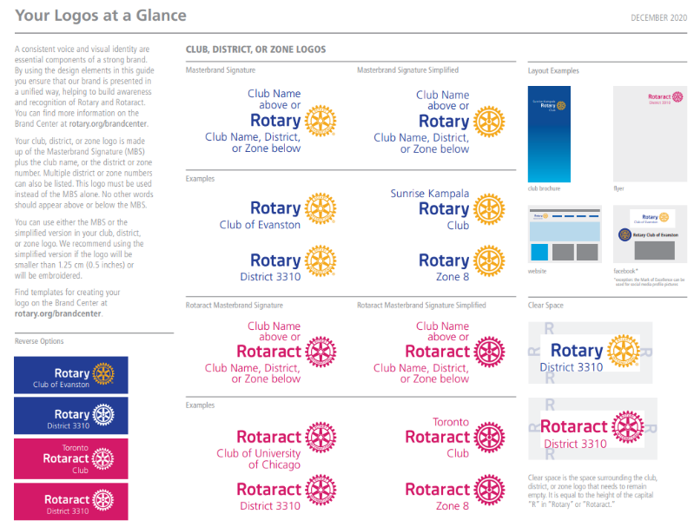
BRANDING GUIDELINES
Signature Systems
Your Logos at a Glance
-Logos
-Using Rotary Logos
-Downloadable Document
Notes:
The page looks like this with all the downloadable materials on it.
NOW I WILL TURN IT OVER TO LAURA TO GO OVER LOGO SYSTEMS
Next slide

Slide 12
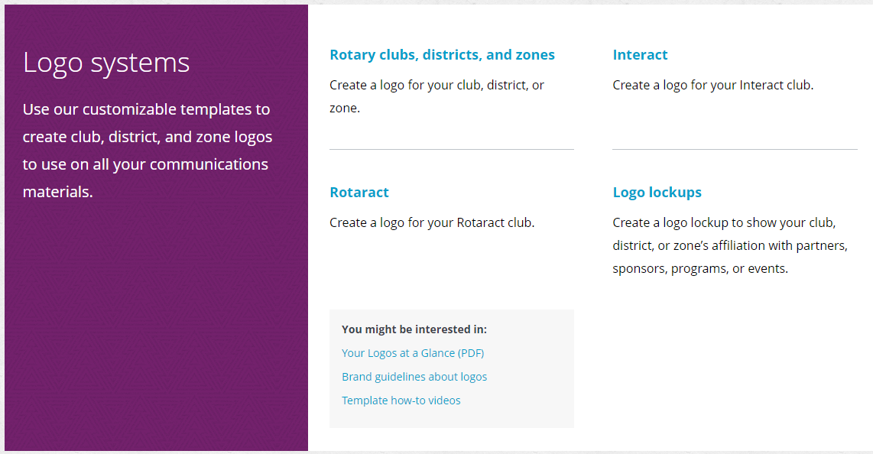
LOGO SYSTEMS - TEMPLATES
Rotary Club, Districts,
and zones
Interact
Rotaract
Logo lockups
Your Logos at a Glance
Brand guidelines about
logos
Template how-to videos
Notes:
Within each of the three sections there is an option to click on create a club, district or zone logo. Each time it brings you to this page where you have the option to create all the logos you would need to effectively promote Rotary.
-Rotary
-Rotaract
-Interact
-Lockups
On this page it also gives you the opportunity to download
Your Logos at a glance
Brand Guidelines about logos
Templates how to video's.
Next slide

Slide 13
OUTDATED LOGOS
NO
Notes:
This is what you will not see on the brand center. These are old logo’s and Rotary International has deleted all these logos from its brand center and all of its public image platforms and correspondence.
If you are still using any of these logos please replace them on your social media. And faze them out on your printed materials and banners as you run out or have it in your budget. Actually please consider putting a line item in your budget to replace the old logos.
I will tell you I still see many of these old logos even on social media today
Next slide

Slide 14
ROTARY LOGOS
Mark of Excellence
Masterbrand
Lockup logo
Notes:
Different Rotary logos and people of action logos
The Masterbrand can be in displayed in the two tones or in the one color. Just as long as it is in the designated color pallet. Yes I did say it – The designated color pallet. Once again the Masterbrand is the word rotary with the wheel. Now you can have for example the People of action under the word Rotary or on the other side of the wheel. For example the line under neath Rotary could be the Zone 30-31 or District 6580 (the name of the district)
The mark of excellence is to be displayed along with the Masterbrand and should not be alone. The entire wheel should be displayed and not just a part of it. For example: If you have the Masterbrand at the top of document you could have the mark of excellence in a bottom corner. Do not display the mark of excellence hiding inside an object/a word. I should be displayed in a noticeable way. There is also what is called the Lock Up Logo – that is the one with Rotary master brand and then the presidential theme.
The perfect document to help you with all of this is the Identity at a glance. This document is a critical component of Rotary’s Branding.
(lets put this document in the chat as a downloadable file)
Next slide

Slide 15
PROGRAM LOGOS
Notes:
Different Rotary youth Exchange/Rotaract/Interact logos
Everything you would need for all your youth programs are already designed for you.
Once again you will see the different color palettes that are approved by Rotary. You will also see the Masterbrand.
Next slide

Slide 16
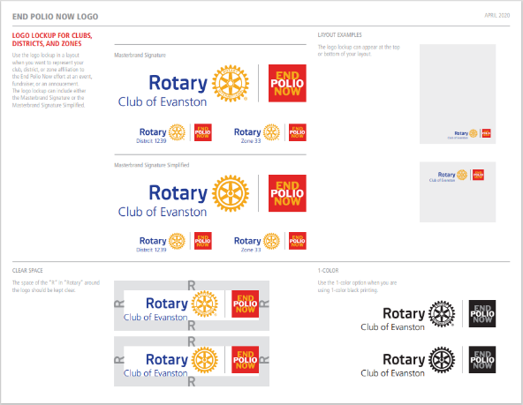
FOUNDATION LOGOS
Secondary Logo
Primary Logo
Notes:
Rotary Foundation Logo’s and End polio now.
The End Polio Now can either have the Mark of Excellence or just by itself. Even for the foundation logos there is a color palette.
There is a very specific End Polio Now logo visual guidelines. This is also a downloadable document that you can find on the brand center under LOGOS.

Slide 17
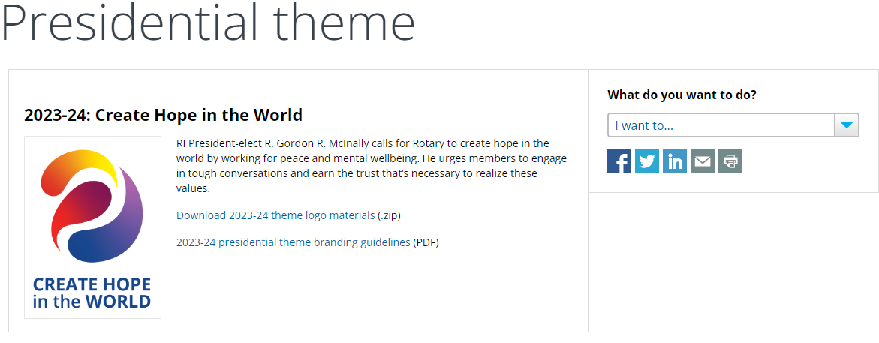
THEME LOGOS
Notes:
Specific theme logos are used internally for Rotary Club & District events, fundraisers, and service projects. You click on the presidential theme 21-22 and you will download a zip drive with all the approved theme logos. You will also have the approved color palette. So why did I specify that the theme logos are used for internal communication? Remember ROTARY BRANDING –Rotary Public Image is concerned with External use! We want to tell the Rotary story, to educate and excite our communities to become a part of our Rotary Family. Because of that, it would be confusing to our communities if we used the presidential theme logo, and it changed each year. Remember we need consistency and with consistency we build confidence in our Rotary Brand. ONE BRAND ONE MESSAGE! Always keep in mind that each year when we change RI presidents they are allowed to have their own defining theme.
PAUSE TO SEE IF THERE IS ANYTHING IN THE CHAT BOX.
I AM GOING TO TURN IT OVER TO JAMIE SO HE CAN GO OVER THE DOWNLOADS

Slide 18
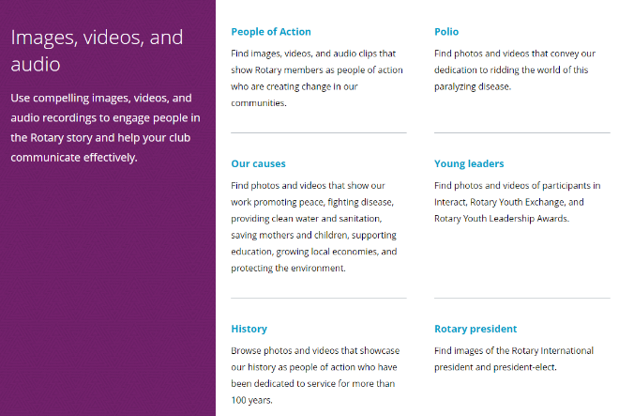
DOWNLOADS
People of Action
Polio
Our Causes
Young Leaders
History
Rotary President
Events
Meeting Content
Photos from 2021 & 2022 Convention
Notes:
The People of Action downloads are filled with compelling images, videos, and audio clips that tell Rotary’s story of how our members create change in our communities. The images are high-resolution action photos.
Polio downloads are with specific polio photos and audio clips. These are perfect to use for your World Polio Day campaign. Once again the images are high-resolution photos
Our Causes focus on images and videos that depict Fighting Disease, Supporting Education, Growing Local Economies, Promoting Peace, Providing Clean Water, Saving Mothers and Children, Protecting the Environment and Ending Polio
Young Leaders downloads are images with Interact Clubs, Youth Exchange and RYLA.
History downloads are images of Arch Klump, Our founders and Paul Harris
Rotary President downloads are images of our current President Gordon, President Elect Stephanie and historical photos
Events downloads are images from RI convention, International Assembly, Rotary Institutes, Rotary Day at the Untied Nations, World Polio Day
Meeting content downloads are filled with videos about so many Rotary topics that are available to enhance your meetings.
There are also images of the 2021-2022 Conventions
Everything that is available here Rotary makes it easy to use to enhance your social media, print media, every type of media possible.

Slide 19
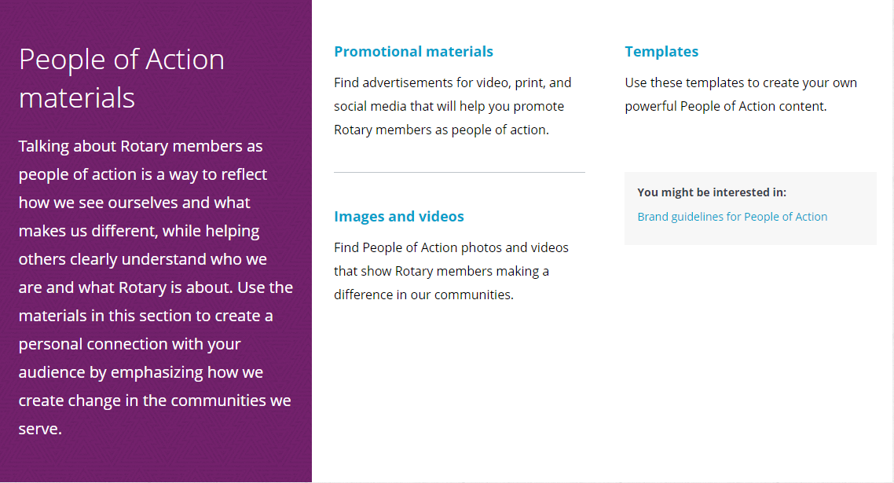
PEOPLE OF ACTION
Promotional materials
Templates
Images and Videos
Brand guidelines for
People of Action
Notes:
PROMOTIONAL MATERIAL
Along with the specific images and videos there is also branded materials for pop-up banners, computer backgrounds, people of action lock-up logos, and stacked logos.
TEMPLATES
This is where you are able to create People of Action Print ads, Digital Banners, and Facebook Posts. All of these have the ability to use either stock photos with all the TOGETHER WE (verbs) or you can use your own. It walks you through step by step. Quick and easy.
IMAGES AND VIDEOS
Online – First, we’re going to talk about online ads. These are materials already designed that have our action verbs (Together WE …..Transform, Learn, Save Lives, Promote Peace, Mentor, Fight Hunger, Empower, Transform, Inspire, Connect, End Polio) All this is ready for Facebook, Instagram, digital banners, Twitter. All you will need to do is upload to the platform you desire.
Print – The print ad section includes print-ready ads in various sizes. Like the online ads, these already have our People of Action verbs overlaid on the ad.
Outdoors – The outdoor ad section includes print-ready ads for billboards and other outdoor signage. Like online and print, these already have our People of Action verbs on the ad.
Radio – The radio ad section includes multiple generic radio ads that work well for any community. You can download audio files and radio scripts to send to your local radio station. The radio ads direct the listener to rotary.org for membership leads, so don’t forget to check your district’s membership leads for potential new members.
BRAND GUIDELINES FOR PEOPLE OF ACTION
On so many locations there is a link to explain the guidelines.

Slide 20
TEMPLATES
Club and Member
Resources
People of Action
Notes:
CLUB AND MEMBER RESOURCES:
This is where you will find templates to create an ad campaign, Brochure, Business cards, and Young leaders promotional cards (RYLA, ROTARACT, INTERACT, YOUTH EXCHANGE)
Everything has a step-by-step process. Easy as 1-2-3.
PEOPLE OF ACTION
Another tab allows you to design the People of Action items. Facebook posts, Digital Banners, and Print Ads
NOW I AM GOING TO TURN IT OVER TO LAURA TO GO OVER PHOTOS

Slide 21
PHOTOS PEOPLE OF ACTION
SHOW MEMBERS TAKING ACTION
Notes:
We are looking to share Rotary with new audiences
How do we start.
Tell your People of Action Story.
We need an action photo. Rotary gives you the opportunity to download photo’s like this. People work together to make a difference in the lives of others. Smiling, collaborating, people in motion
Create a text for your ad or social media post. Be short but informative and always inspiring.
What did you do – What action did you take
Offer statistics or other proof of the difference you made: What did you accomplish? How did you change lives?
Always issue a call to action. Donate, Participate, Learn more. Be clear.

Slide 22
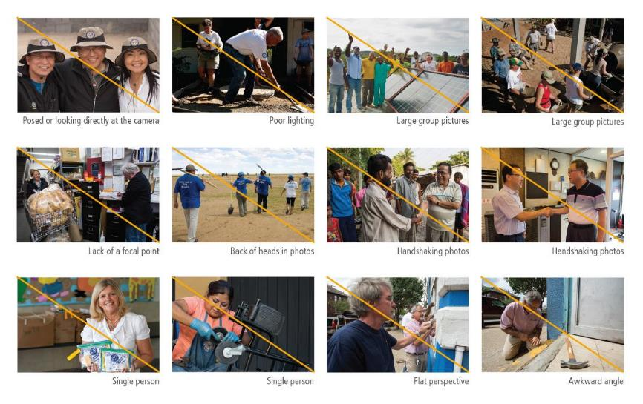
PHOTOS TO AVOID
Notes:
Why should you avoid these types of images?
Lets take a few minutes to have people raise their hand and we will call on you to unmute and pick and image and tell us why to avoid an image.

Slide 23
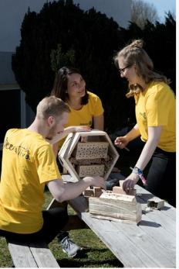
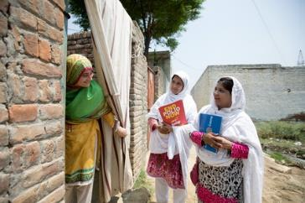
IMAGES
Action Verbs for People of Action
Inspire
Connect
Transform
End Polio
Mentor
Empower
Learn
Save lives
Fight hunger
Promote peace
Notes:
Here are a few images from the Brand Center. Look at all of these pictures. (PAUSE)
What do you see? In a few moments, we’re going to stop screen share. We would like for you to tell us what you see in chat or by using use raised hand in the reaction function. We will call on you to unmute or we will read your answers from the chat.
So, in one or two words, what did you see in those pictures? How do those pictures make you feel?
What do you see? Do you see action? Connection? Engagement?
Next slide

Slide 24
TRANSFORM A PROJECT
Add hashtags
#peopleofaction
#rotaryinternational
(what else)
Notes:
Just take a couple of minutes to have them look at what has been created and ask what other hash tag can be used
Put it in the chat and read the chat

Slide 25
BRAND AMBASSADOR AWARD
rizones30-31.org/resources/rpic/
Notes:
JAMIE

Slide 26
BRAND CENTER
QUESTIONS

