Slide 1
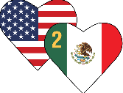
GLOBAL GRANT PROJECT 2346253
Holtz-Beahon Kidney Transplant Program
Rotary Club Cuajimalpa
Distrito 4170
District Governor Ulises Vidaña 2022 - 2023

Slide 2
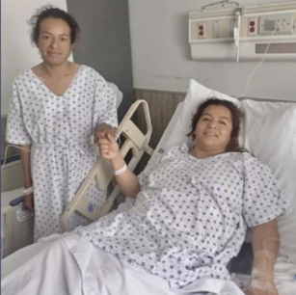
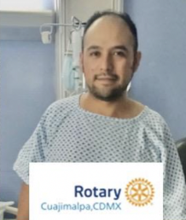
Necessity
The waiting list in Mexico for a kidney transplant is approximately 12,000 people
The cost of having a transplant surgery performed is prohibitive for the patients we work with.
Our program promotes the practice of live donor transplants
Training of doctors on live donor transplant surgery
Many of the patients are the breadwinners of their families, therefore sustaining the family unit

Slide 3
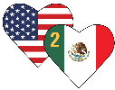
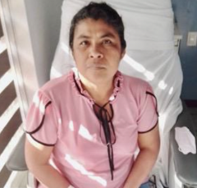
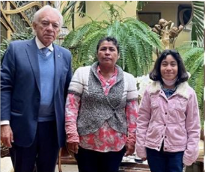
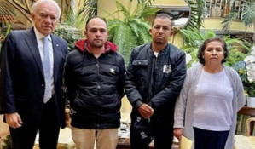
Area of Focus: Disease
Performing approximately 100 live donor kidney transplants
Training multiple physicians on how to perform live donor kidney transplant surgery
Saving individual lives and entire families
Promote the the practice of live donor transplants

Slide 4
Sustainability
Collaborators: Fundacion Solo Por Ayudar IAP, American British Cowdray Medical Center IAP, Corporativo Hospital Satelite, Instituto Mexicano de Trasplantes, District 4179,4170, Heart 2 Heart.
Where: Mexico City and Cuernavaca, Morelos
Beneficiaries: Around 100 beneficiaries
Time Impact: Increase awareness of the possibility of live donor kidney patient programs. Increase availability of transplants by training more physicians, thus saving lives and families.
Impact on Rotary’s Image: The program demonstrates Rotary’s dedication to saving individuals, supporting families and promoting positive societal change through social awareness.

Slide 5
Budget
CONCEPT | UNITS | COST USD
Kidney Transplant | 45 | $180,000
Administration | 1 | $18,000
Total Amount |  | $ 198,000

Slide 6
Funding
Sponsor | Amount USD
DDF Contributions (US and Mexico) | $103,570
Cash Contributions (Mexico) | $11,575
TRF World Fund match | $82,855
Total Amount | $198,000

Slide 7
