Slide 1
GLOBAL GRANT PROJECT 2348995
Project:
Roger Sims equipment for treatment of scoliosis in children and adolescents
(Heart 2 Heart) Stage II
Rotary Club FLORIDA SATÉLITE
Distrito 4170
District Governor Ulises Vidaña 2022 - 2023

Slide 2
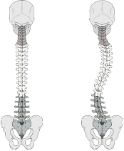
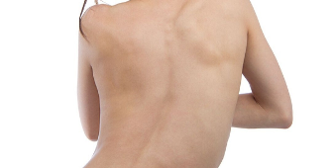
TREATMENT OF SCOLIOSIS IN CHILDREN AND ADOLESCENTS
WHAT IS SCOLIOSIS?
Scoliosis is a medical condition in which a person's spine has a sideways curve. This can bring complications such as lung, heart, breathing and back damages.
CAUSES OF THE DISEASE
There are three main causes of scoliosis: idiopathic, congenital and a consequence of a neuromuscular disease.
SHORT TERM OBJECTIVE
Support 65 low income children or adolescents suffering from scoliosis at the Traumatology and Orthopedics Lomas Verdes Hospital, with an orthopedic corset to avoid or lengthen the surgery; support 21 patients with neuromuscular scoliosis who require a special wheelchair to support their body at the chair;
Benefit 25 patients who require spinal surgery through the use of 3D models so that doctors can develop a corrective strategy before entering the operating room and achieve better surgeries in less time.

Slide 3
Focus Area: DISEASE PREVENTION
The age range is from 2 to 15 years old.
40% of children undergo surgery and the corset is donated so that the Scoliosis does not progress or so that the surgery has better results.
The remaining 60% is to prevent scoliosis from advancing and thus avoid surgery.
30% of the children have neuromuscular scoliosis who, in addition to the curvature of the spine, have some brain or muscle problem such as cerebral palsy, bifid spine, muscular dystrophy or spinal cord injures so a special wheelchair is needed to move them.
Before surgery After surgery with the corse

Slide 4
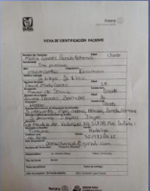
Sustainability
It is supported by a group of specialized doctors working at the
Lomas Verdes Hospital of IMSS.
The social workers will provide the information of the socioeconomic
situation of the patients, to determine if their are candidates to be
supported with the orthopedic corset.
As the size of the corset, depends on the height of the patient, it must be
changed every period of time with natural growth and disease treatment.
Numbers of patients at Lomas Verdes Hospital of IMSS,
Scoliosis cases: weekly monthly yearly
9 patients
36 patients
432 patients
First time
36 patients
144 patients
1,728 patients
Follow-up appointments
1 patient
4 patient
48 patient
Pediatric surgery

Slide 5
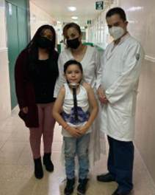
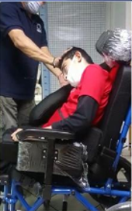
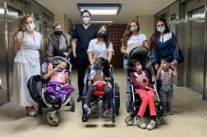
Budget
Orthopedic Corset Boston | 55 | $647.05 | $35,588.00
Orthopedic Corset Milwakee | 10 | $1,058.80 | $10,588.00
Wheelchair PCI | 15 | $541.93 | $8,129.00
Wheelchair PCA | 6 | $720.33 | $4,322.00
3D Printer | 1 | $11,057.00 | $11,057.00
Data Precessors for high resolution | 2 | $3,468.50 | $6,937.00
PLA white matte filament 1 kg (consumable) | 42 | $33.42 | $1,404.00
Total Amount |  |  | $78,025.00
EXCHANGE RATE
1 USD = 17 MEXICAN PESOS

Slide 6
Funding from Mexico club sources
Sponsor | Amount USD
Florida Satélite Rotary Club | $6,250.00
Woodland Rotary Club | $1,000.00
Total Amount | $ 7,250.00

