Slide 1
How to Prevent Club Conflicts through “Active Listening”
Darwin Sampedro, CDS Senior Officer
Club and District Support, The Americas
Notes:
Your Club and District Support team (CDS) understanding the importance of how conflicts can affect the normal functioning of a club, has considered important to create tools to help clubs in how to prevent or handle conflicts, when they arise. The following presentation will provide you with skills in how to prevent club conflicts through ACTIVE LISTENING.
Active Listening is one of the most important skills we all need to learn. How well you listen has a major impact on your job effectiveness and on the quality of your relationships with other people.

Slide 2
OBJECTIVES
What is conflict?
Poor Listening vs. Active Listening
Exercise: Are you a good listener?
Solving club conflicts through Active Listening

Slide 3
Conflicts happen and are part of life, how we handle them, makes a difference.

Slide 4
Conflict
Notes:
What comes to your mind when you hear the word conflict? War, Fights, Rivalry, Competition, Struggle

Slide 5
Conflict
According to collinsdictionary.com:
Conflict is serious disagreement and argument about something important between two or more individuals.
Notes:
https://www.collinsdictionary.com/us/dictionary/english/conflict

Slide 6
Conflict
FOR MORE THAN 30 YEARS, OUR MEMBERSHIP HAS NOT GROWN FROM:
1,200,000 Rotarians
What is happening?
Notes:
Lack of interest?

Slide 7
Conflict

Slide 8
Conflict
Participation
72% of current rotary club members
20% of proposed rotary club members
8% of former rotary club members
65% Male
34% Female

Slide 9
Conflict
52% of current members
WOULD RECOMMEND their family members, friends and relatives join their Rotary club.

Slide 10
Conflict
46% of former members
WOULD NOT RECOMMEND anyone join Rotary

Slide 11
Conflict
Of all the reasons why a member ended their membership with Rotary, the main one was:
52% of former members
Personality conflicts

Slide 12
Conflict
Notes:
https://blink.ucsd.edu/HR/supervising/conflict/handle.html
The University CA San Diego did a research about conflicts in workplace and provide practical strategies you can use to handle conflicts

Slide 13
Poor Listening vs. Active Listening

Slide 14
Poor Listening vs. Active Listening
The Price of Poor Listening
Notes:
Poor listening leads to assumptions and misunderstandings. These lead to errors, ineffective decisions, and/or costly mistakes. On a personal level, poor listening leads to hurt feelings and a loss of team cohesion. This deteriorates trust and weakens communication even further.

Slide 15
“Our worst enemy in communication is that we do not listen to understand, we listen to respond. ” -Pilar Morey Bulbena
Notes:
It takes us one year to learn to speak… and an entire life to learn to listen.

Slide 16
Poor Listening vs. Active Listening
In the business industry:
Assumptions
Misunderstandings
Errors
Ineffective decisions and/or costly mistakes

Slide 17
Poor Listening vs. Active Listening
On a personal level:
Hurt feelings
Deteriorates trust
Weakens communication even further

Slide 18
Poor Listening vs. Active Listening
Aggrieved member:
Becomes disinterested
Becomes negative
Takes a leave of absence
Joins another Rotary Club
Resigns from Rotary

Slide 19
Poor Listening vs. Active Listening
Active Listening
Notes:
This is where you make a conscious effort to hear not only the words that another person is saying but, more importantly, the complete message being communicated.

Slide 20
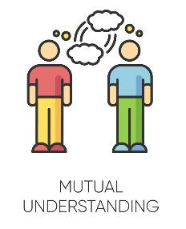
What is Active Listening?
It is a way of listening and responding to another person that improves mutual understanding.
Notes:
https://blink.ucsd.edu/HR/supervising/conflict/handle.html
The University CA San Diego did a research about conflicts in workplace and provide practical strategies you can use to handle conflicts

Slide 21
What is Active Listening?
2. It’s an important first step in defusing situations or finding solutions to problems.

Slide 22
What is Active Listening?
3. This requires the listener to fully concentrate, understand, respond and remember what has been said.

Slide 23
What is Active Listening?
4. You make a conscious effort to hear and understand the complete message being spoken rather than just passively listening.
Notes:
Image taken from: http://kell.indstate.edu/pub-comm-intro-2ed/chapter/5-5-stages-of-listening/

Slide 24
Active Listening Exercise
Notes:
https://www.youtube.com/watch?v=KNYBTZjE2Yk
Exercises taken from The Benchmark Portal video: Active Listening Exercises: https://www.youtube.com/watch?v=KNYBTZjE2Yk

Slide 25
Active Listening
Rules:
Listen and take notes
Answer questions

Slide 26
Active Listening Exercise
Notes:
You are driving a bus that leaves Springfield at 8:30am with 23 passengers onboard. Stops in Wellington dropping 10 people and picking up four passengers. It travels south to Monroe dropping another 5 passengers and picking up 6. It arrives at Cincinnati 2 hours later. WHAT IS THE BUS DRIVER’S NAME

Slide 27
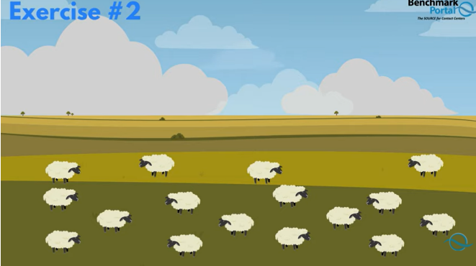
Active Listening Exercise
Notes:
If a farmer had 17 sheep and all but 9 of them escaped. HOW MANY WOULD HE HAS LEFT?

Slide 28
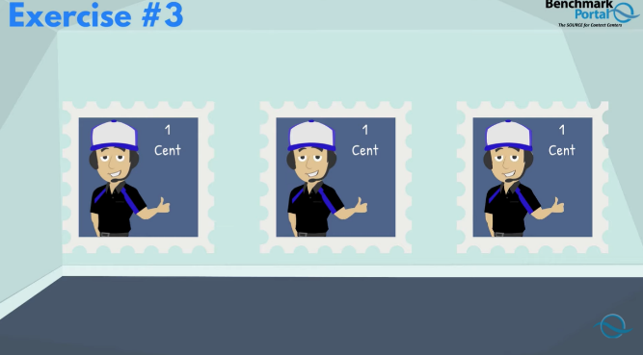
Active Listening Exercise
Notes:
If there are twelve one cent stamps in a dozen, how many two cents' stamps would be in a dozen?

Slide 29
Active Listening Exercise
Notes:
If some months has 31 days, and other months has 30 days how many months has 28 days.

Slide 30
Active Listening Exercise
Notes:
An airplane was traveling from Houston to Mexico City the interior was blue with red seats and there were 154 passengers onboard, unfortunately, the plane crash right in the border between USA and Mexico. According to Internationally law where were the survivors buried?

Slide 31
Active Listening Exercise
Answers
YOUR NAME
9
12 TWO CENT STAMPS
ALL 12 MONTHS
NOWHERE
Notes:
YOUR NAME. Because you were driving the bus
9 Because all 9 because all butt nine sheep died
12 TWO CENTS STAMPS Because there is always 12 stamps in a dozen regardless of the denomination
ALL 12 MONTHS Because all 12 months contains 28 days
NOWHERE Because you did not buried survivors
Now, I am going to ask you to write down in a paper a conflict that your club has experienced, is experiencing or might experience in the future. You do not have to write down your club’s name. At the end of the presentation, we will pick one scenario and work on it together.

Slide 32
Active Listening
What can we learn from this exercise?
Focus on details
Listening vs. problem-solving
Receiver bias
Avoid distractions
Asking relevant questions
Notes:
If you missed the question about the airplane, it was only one word, SURVIVORS, which change the meaning and outcome of their entire situation. Your focus on one detail change everything, so stay focus in detail. Because DETAILS DO MATTER.
In some cases, you might have switch from listening to problem-solving. In the bus example you might have focused on the number of passengers. Trying to solve a math problem that you though was going to be the issue. Stay in listening mode without jumping ahead to problem solving.
Bias Listening. Is Jumping to conclusions because the listener believes they already know the answer that could have happened in one question where you mind jump ahead assuming we meant months with only 28 days.
Keep in mind that good listening means having an open mind and without holding judgment until the speaker has finished. It is easy to be distracted by surroundings and emotions or even details. In the airplane or the bus example the addition of irrelevant details could cause you to become distracted and miss the point. Don’t allow outside circumstances or irrelevant details to distract you.
The most important thing is asking relevant questions. When mistakes are made is due to not taking the time to ask questions. That clarify your understanding and avoid mistakes.
https://www.youtube.com/watch?v=KNYBTZjE2Yk

Slide 33
5 Key Active Listening Skills

Slide 34
5 Key Active Listening Skills
Pay Attention
Notes:
1. Pay attention.
Give the speaker your undivided attention and acknowledge the message. Recognize that non-verbal communication also "speaks" loudly.
Look at the speaker directly.
Put aside distracting thoughts. Don't mentally prepare a rebuttal!
Avoid being distracted by environmental factors.
"Listen" to the speaker's body language.
Refrain from side conversations when listening in a group setting.
Taken from Mindtools.com

Slide 35
5 Key Active Listening Skills
2. Show that you are listening
Notes:
2. Show that you are listening.
Use your own body language and gestures to convey your attention.
Nod occasionally.
Smile and use other facial expressions.
Note your posture and make sure it is open and inviting.
Encourage the speaker to continue with small verbal comments like “Yes” and “Aha”

Slide 36
5 Key Active Listening Skills
3. Provide Feedback
Notes:
3. Provide feedback.
Our personal filters, assumptions, judgments, and beliefs can distort what we hear. As a listener,
your role is to understand what is being said. This may require you to reflect what is being said and
ask questions.
Reflect what has been said by paraphrasing. "What I'm hearing is" and "Sounds like you are saying"
are great ways to reflect back.
Ask questions to clarify certain points. "What do you mean when you say", "Is this what you mean?"
Summarize the speaker's comments periodically.

Slide 37
5 Key Active Listening Skills
4. Defer Judgement
Notes:
4. Defer judgment.
Interrupting is a waste of time. It frustrates the speaker and limits full understanding of the message.
Allow the speaker to finish.
Don't interrupt with counter arguments

Slide 38
5 Key Active Listening Skills
5. Respond Appropriately
Notes:
5. Respond Appropriately.
Active listening is a model for respect and understanding. You are gaining information and
perspective. You add nothing by attacking the speaker or otherwise putting him or her down.
Be candid, open, and honest in your response.
Assert your opinions respectfully.
Treat the other person as s/he would want to be treated.

Slide 39
Benefits of Handling Club Conflicts Effectively
Retention of members
Better club atmosphere
Mutual respect between members
Increase focus on club projects, membership and goals!

Slide 40
Conclusion

Slide 41
Conclusion
Rotary’s active listening is what we do best
Through active listening we change people’s lives
Respond to world challenges
Rotary Creates HOPE in the world

Slide 42
Conclusion
Use “Active Listening Skills”
to effectively prevent any
club conflict.

Slide 43
cds@rotary.org

