Slide 1
YOUR SUPPORT FROM ROTARY Funding Guidelines
Gregory Franks Zones 30-31
Senior Supervisor
Club and District Support, The Americas

Slide 2
ROTARY INTERNATIONAL
Rotary at a glance
More than 1,300,000 Rotarians and Rotaractors
More than 48,000 clubs
In more than 195 countries and other geographical areas

Slide 3
A GLOBAL RI STAFF NETWORK

Slide 4
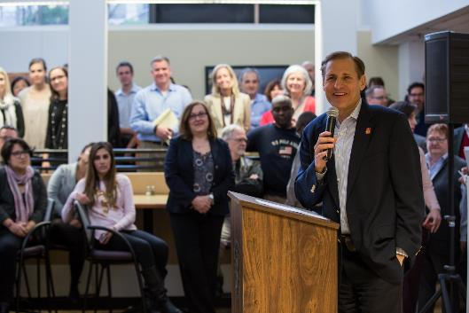
ROTARY STAFF – ROTARY INTERNATIONAL WORLD HEADQUARTERS
500+ professionals in Evanston and 250 in IO’s
General Secretary
John Hewko

Slide 5
YOUR CLUB AND DISTRICT SUPPORT TEAM
Notes:
[click]

Slide 6
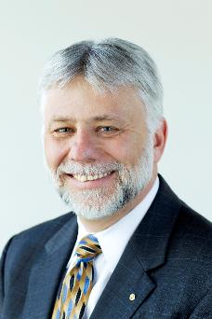
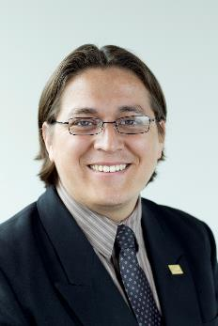
YOUR CLUB & DISTRICT SUPPORT (CDS) TEAM
Gregory Franks,
Senior Supervisor Gregory.Franks@Rotary.org
1-847-866-3272
Darwin Sampedro,
Senior Officer
Darwin.Sampedro@Rotary.org
1-847-866-3259
Districts: 6040-6200, 6510, 6710-6880
Notes:
Although we’re a large organization, we serve Rotarians through an office with specialists familiar with your region.
Your Club and District Support Team, also known as CDS, will serve as your primary contact at Rotary over the next two years.
We provide direct support and assistance to Rotarians and work closely with club and district leaders.
Your team, pictured here, includes [add names]
We are your regional experts and just one email or phone call away.
[click]

Slide 7
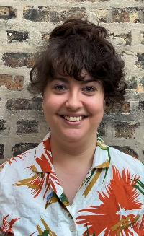
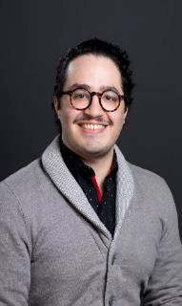
YOUR CLUB & DISTRICT SUPPORT (CDS) TEAM
Cassandra DellaCorte, Associate Officer
Cassandra.DellaCorte@rotary.org
1-847-424-5212
Andrez Perez,
Associate Officer
Andrez.Perez@Rotary.org
1-847-424-5368
Districts: 5750, 6540-6690
Notes:
Although we’re a large organization, we serve Rotarians through an office with specialists familiar with your region.
Your Club and District Support Team, also known as CDS, will serve as your primary contact at Rotary over the next two years.
We provide direct support and assistance to Rotarians and work closely with club and district leaders.
Your team, pictured here, includes [add names]
We are your regional experts and just one email or phone call away.
[click]

Slide 8
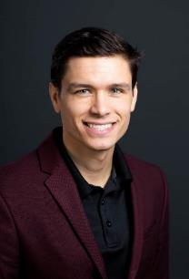
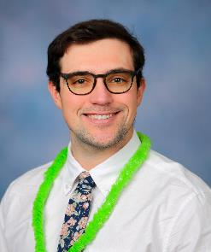
YOUR CLUB & DISTRICT SUPPORT (CDS) TEAM
Nick Taylor,
Supervisor
Nick.Taylor@Rotary.org
1-847-866-3429
Michael DeGrandis,
Associate Officer
Michael.DeGrandis@Rotary.org
1-847-866-3107
Districts: 5770-5830
Notes:
Although we’re a large organization, we serve Rotarians through an office with specialists familiar with your region.
Your Club and District Support Team, also known as CDS, will serve as your primary contact at Rotary over the next two years.
We provide direct support and assistance to Rotarians and work closely with club and district leaders.
Your team, pictured here, includes [add names]
We are your regional experts and just one email or phone call away.
[click]

Slide 9
CLUB AND DISTRICT SUPPORT REPRESENTATIVES (CDS)
We are your first contact with Rotary.
We offer assistance and support to Rotarians in Zones 30 and 31.
We collaborate closely with club and district leaders: operations, RI policy, resources, training (GETS, IA, PETS), RI website, etc.

Slide 10
ROTARY FUNDING

Slide 11
ROTARY FUNDING
What is it?
How is determined?
How is distributed?
How is reported to Rotary?

Slide 12
ROTARY FUNDING- WHAT IS IT?
It is the financial support you will receive from Rotary to support your basic expenses, incurred while fulfilling your duty as DGN, DGE and DG.
Important note:
Explore other sources of funding
Notes:
The Rotary Funding is meant to support you to cover basic expenses incurred while fulfilling your duty as a governor. You can incur these expenses as DGN, DGE and DG.
While expectations for governors vary widely among districts, the RI Board distributes funds in a globally fair manner because Rotary’s income primarily comes from membership dues.
The main purpose of the Rotary Funding is meant to support you have when visiting clubs, training district leaders and running the administration of the district – so it is meant to cover basic expenses, not meant to cover all of your expenses.
[click] Explore other ways to fund what you want to accomplish. Talk to your district finance committee or treasurer about your financial needs and participation goals. Solicit donations from your club and community businesses.
Please note that Expenses of your partner/spouse are not included.
[click]

Slide 13
HOW IS YOUR FUNDING DETERMINED?
Number of Rotarians
Number of Clubs
Office Expenses
Training Costs
Notes:
There is a set amount allocated to each district, based on the number of Rotarians and the number of Clubs. These figures influence the amount that is allocated to your district towards training costs and office expenses.
The information that we asked you for in August – the Rotary Funding Questionnaire - will be used to work out an approximation of the basic costs you will incur to visit your clubs.
[click]

Slide 14
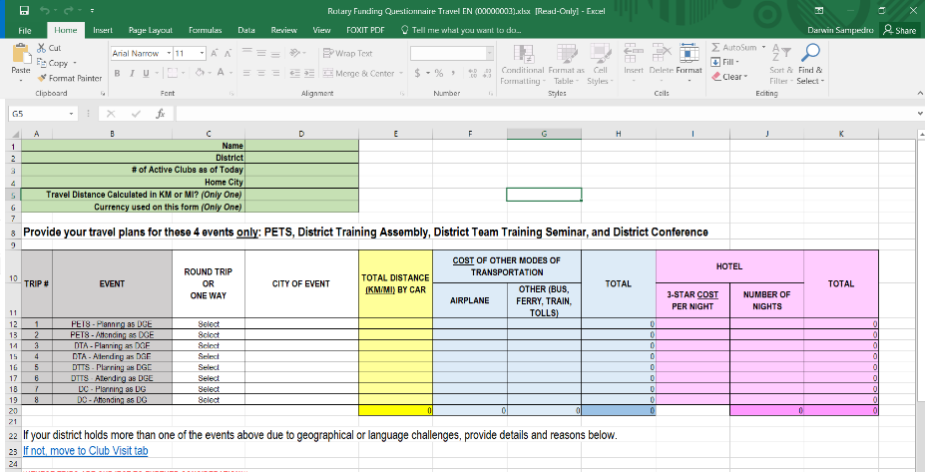
ROTARY FUNDING-QUESTIONNAIRE
Notes:
The Rotary Funding is meant to support you to cover basic expenses incurred while fulfilling your duty as a governor. You can incur these expenses as DGN, DGE and DG. How many of you already submitted the report. If you have not done it please do it soon.
While expectations for governors vary widely among districts, the RI Board distributes funds in a globally fair manner because Rotary’s income primarily comes from membership dues.
The main purpose of the Rotary Funding is meant to support you have when visiting clubs, training district leaders and running the administration of the district – so it is meant to cover basic expenses, not meant to cover all of your expenses.
[click] Explore other ways to fund what you want to accomplish. Talk to your district finance committee or treasurer about your financial needs and participation goals. Solicit donations from your club and community businesses.
Please note that Expenses of your partner/spouse are not included.
[click]

Slide 15
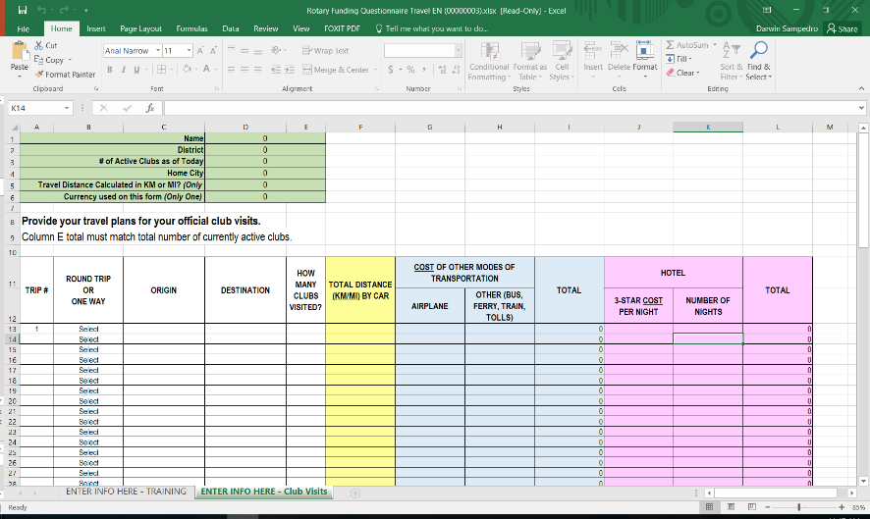
ROTARY FUNDING-QUESTIONNAIRE
Notes:
The Rotary Funding is meant to support you to cover basic expenses incurred while fulfilling your duty as a governor. You can incur these expenses as DGN, DGE and DG.
While expectations for governors vary widely among districts, the RI Board distributes funds in a globally fair manner because Rotary’s income primarily comes from membership dues.
The main purpose of the Rotary Funding is meant to support you have when visiting clubs, training district leaders and running the administration of the district – so it is meant to cover basic expenses, not meant to cover all of your expenses.
[click] Explore other ways to fund what you want to accomplish. Talk to your district finance committee or treasurer about your financial needs and participation goals. Solicit donations from your club and community businesses.
Please note that Expenses of your partner/spouse are not included.
[click]

Slide 16
ROTARY FUNDING: HOW IT’S DISTRIBUTED?
All expenses paid directly to district July-Aug. 2024
100%
Notes:
Districts will receive 100% of the funding directly to a district-managed bank account in July-August of 2024.

Slide 17
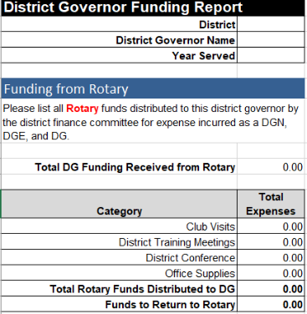
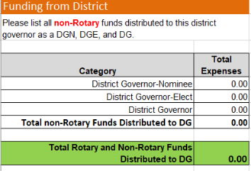
ROTARY FUNDING: HOW IT IS REPORTED TO ROTARY?
Make sure your District Finance Chair submits the District Governor Funding Summary Report to your CDS team by 31 July 2025
Notes:
From there, it is up to the district governor and the district finance chair to determine the timelines, reimbursement structure, and reporting requirements for the district governor to the district.
We recommend making sure that each new governor and finance chair take the time to:
- review the Rotary provided resources regarding this test
communicate early and often about managing processes
develop a reporting system that works for all parties.
As governor, you will report your expenses to your district. Your district finance chair will be required to track those expenses, categorize them, and report them using the District Governor Funding Summary Report, which they will be required to submit to their CDS representative by 31 July 2025.

Slide 18
DISTRICT FINANCES (Art. 15.060.4 RI Bylaws)

Slide 19
DISTRICT FINANCES
15.060.4 Annual Statement and Report of District Finances
Within one year of serving as governor, the immediate past governor must provide each club an independently reviewed annual statement and report of district finances.
30 days for clubs to review and accept.
Notes:
Within one year of serving as governor, the immediate past governor must provide each club an independently reviewed annual statement and report of district finances. The immediate past governor must provide the statement and report and have it discussed and adopted at a district meeting to which all clubs are entitled to send a representative and for which 30 days’ notice has been given. Alternatively, within one year of serving as governor, the immediate past governor may ask the governor to conduct a club ballot for adoption of the statement and report. The statement and report shall be sent at least 30 days before the club ballot. The governor shall start this process within 30 days of receiving the request from the immediate past governor. The review may be conducted by either a qualified accountant or a district audit committee. An audit committee must:

Slide 20
DISTRICT FINANCES
The review may be conducted by either a qualified accountant or a district audit committee. An audit committee must:
have at least three active members be selected in accordance with established district procedures;
(b) include at least one member who is a past governor or an independent, financially literate person; and
(c) not include any current governor, treasurer, signatory of district bank accounts, or member of the finance committee.

Slide 21
DISTRICT FINANCES
The annual statement shall include, but not be limited to, all:
sources of the district’s funds (RI, TRF, district, and club);
funds received by or on behalf of the district from fundraising activities;
grants received from TRF or TRF funds designated by the district for use;
financial transactions of district committees;
(e) financial transactions of the governor by or on behalf of the district;
(f) expenditures of district funds; and
(g) funds received by the governor from RI.

Slide 22
INTERNATIONAL ASSEMBLY: 7-11 JANUARY 2024
We look forward to seeing you at the International Assembly for an in-depth view of your responsibilities as a
Rotary District Governor.
Thank you!
See you in Orlando!

