Slide 1
leadership seminar 2023
Rotary Zones 30 & 31

Slide 2
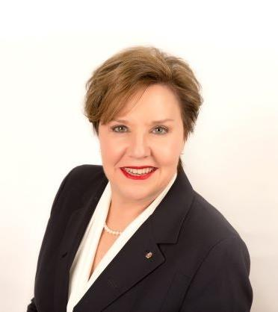
Beth Stubbs
Rotary International Director
Zones 30 & 31
Serving 2023-25

Slide 3

Rotary’s 2023-24 Theme
Create Hope In The World
Notes:
Intentional Leadership = Success on purpose
Let’s look at what successful clubs are doing

Slide 4
Leadership for growth
Notes:
Intentional Leadership = Success on purpose
Let’s look at what successful clubs are doing

Slide 5
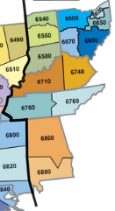
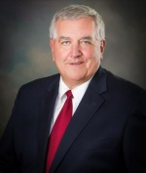
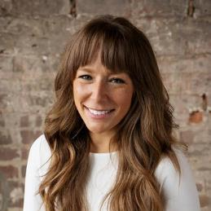
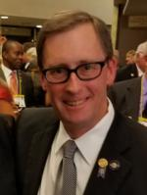
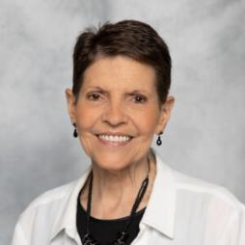
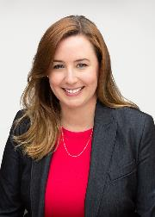
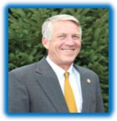

Kirk Bouchie
Jenny Stotts
John Hutchings
Maris Brenner
6670, 6690
6540,6560,6580
6710,6740,6780
Jeris Gaston
6600,6630,6650
Steve Sandbo
Zone 30 Team
6760,6860,6880
Zone 30 Rotary Coordinator

Slide 6
CONSISTENT & FLEXIBLE MEETINGS
76%
Meet weekly in person
65%
Use hybrid or virtual technology
29%
Created a satellite club as an alternative Rotary experience
Notes:
Explain the North American survey from club presidents whose clubs had year over year growth for the past 5 year.
What are they doing?
These clubs meet regularly and are flexible in their approach. Nearly 30% of these growth clubs have created a satellite club as an alternate experience for prospective Rotarians

Slide 7
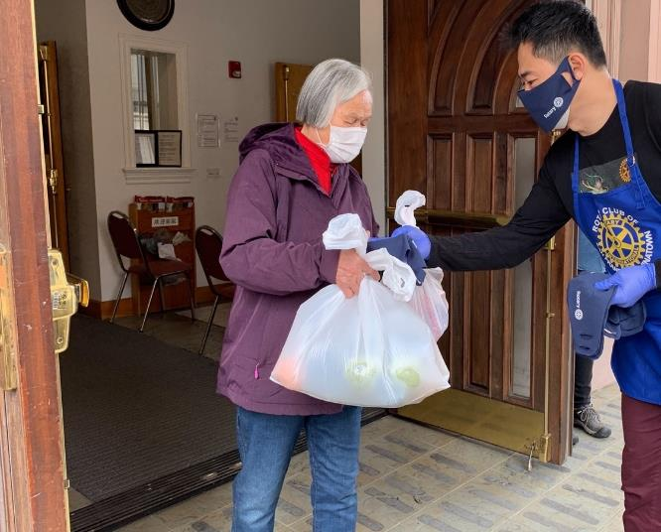
“SIGNATURE” SERVICE PROJECTS & FUNDRAISERS (>50% Member Involvement)
86%
Have a repeating ‘signature’ project every year
83%
Have a repeating ‘signature’ fundraiser every year
Notes:
Read Slide

Slide 8
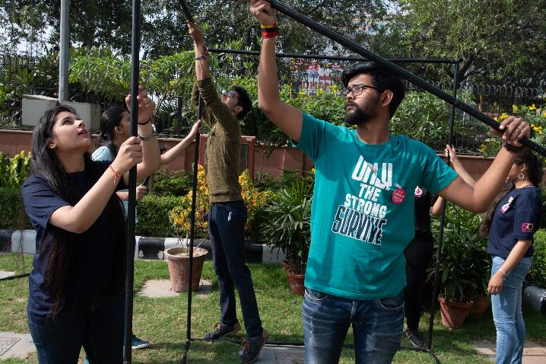
INCLUDE COMMUNITY MEMBERS
“The Secret Sauce”
87%
Invite community members to projects and fundraisers
67%
Hold one or more events to attract new members
Notes:
We can’t emphasize strongly enough how important the act of reaching out to the broader community is to creating the perception of a dynamic, attractive and welcoming group of people. As we quote from the survey. It really is the secret sauce, creating opportunities to engage and inspire ‘not yet Rotarians’.

Slide 9
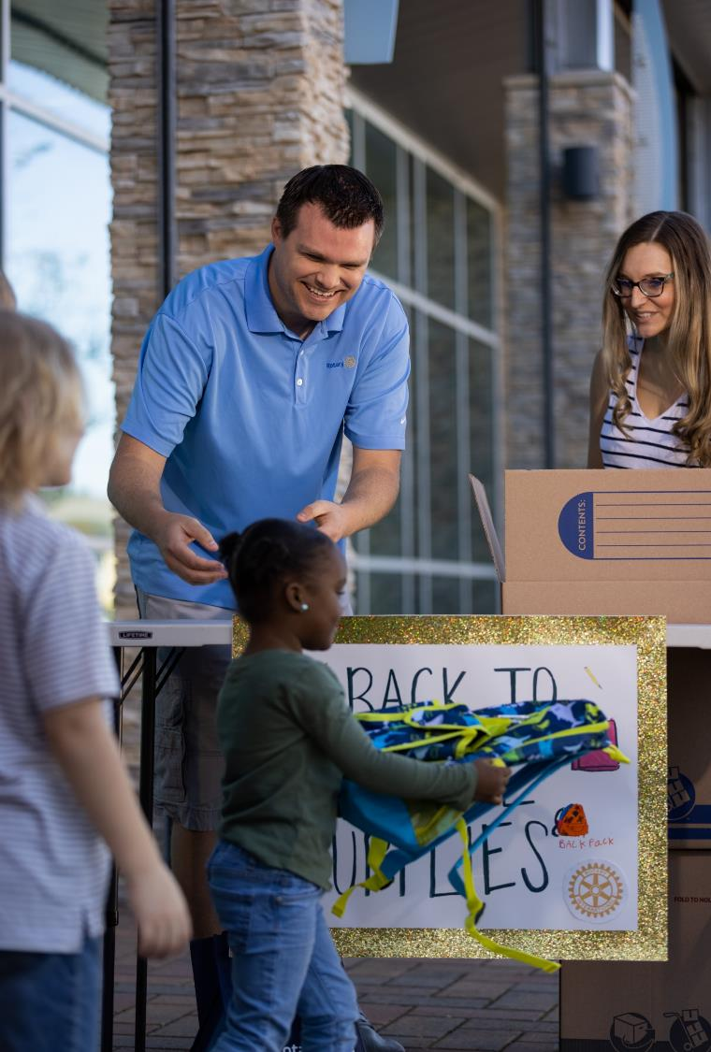
ONGOING, ACTIVE SERVICE
78% Had 4 or more Service Projects during the year
(40% had 10 or more)
Notes:
These clubs have frequent service projects. Only about 20% of the clubs indicated tat they only have a few service projects. Nearly 40% of the clubs have more than 10 service projects per year. Lets hear club leaders talk about service.

Slide 10
ACTIVE USE OF MEDIA TOOLS
95%
Use Facebook
21%
Use Instagram
77%
Use Their Club Website
55%
Use Local Print News Outlets
Notes:
Read Slide

Slide 11
USING PUBLIC AWARENESS TO FOCUS ON MEMBER ATTRACTION
67%
Hold events to attract new members
77%
Many members sponsor new members
87%
Invite community members to projects
Notes:
Read Slide
Now, club leaders will talk about their approaches to public image in their community.

Slide 12
ATTRIBUTES OF GROWING CLUBS
ACTIVE, INTENTIONAL MEMBER ENGAGEMENT
DYNAMIC, MEANINGFUL SERVICE
EFFECTIVE GOVERNANCE (Intentional Leadership)
STRONG PUBLIC IMAGE
(WELL KNOWN IN COMMUNITY)
DIVERSITY, EQUITY & INCLUSION
Notes:
With the data from the first survey as a key basis for inquiry, we were able to seek more detail, with the result that our understanding of the qualities that make clubs successful was enhanced, clarified and expanded:
First, and most importantly, strong leaders create strong clubs. More than this, leaders of surveyed clubs focused on 5 key attributes, which we will explore in more detail:
Outstanding governance – clubs are well organized, plan, set goals and have continuity in leadership.
Active, intentional member engagement – A healthy, engaged and inspired membership is key to club success.
Dynamic, meaningful service – engaged members keep busy ‘doing’ throughout the year. Rotary is about service.
Strong public image – Clubs aren’t just doing – they’re seen to be doing.
Diversity, Equity and Inclusion – ensuring club membership reflects their community
While not all leaders focussed equally on all 5 areas, most clubs take all these areas seriously.

Slide 13
THEY PLAN FOR GROWTH &
SET GOALS
81%
Have a Planning Process for Growth
71%
Regularly Updated Growth Plans
Annually (48%)
Quarterly (16%)
More Frequent (7%)
83%
Established Annual Membership Goals
Notes:
The significant majority of clubs don’t just plan and set goals, they keep those plans alive and up to date, reviewing and adjusting regularly.
.

Slide 14
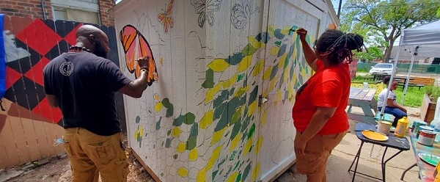
Using the membership success tool
Notes:
The reality is, in this last Rotary year, almost half of our clubs added 0 or 1 new member. To overcome the natural attrition, we MUST attract members to our clubs. What if you could go into a Rotary year with a pretty good idea of exactly how many members would leave over the year so you knew how many to add to have positive, net growth? The good news is, we now have a tool to help us with that.

Slide 15


Slide 16
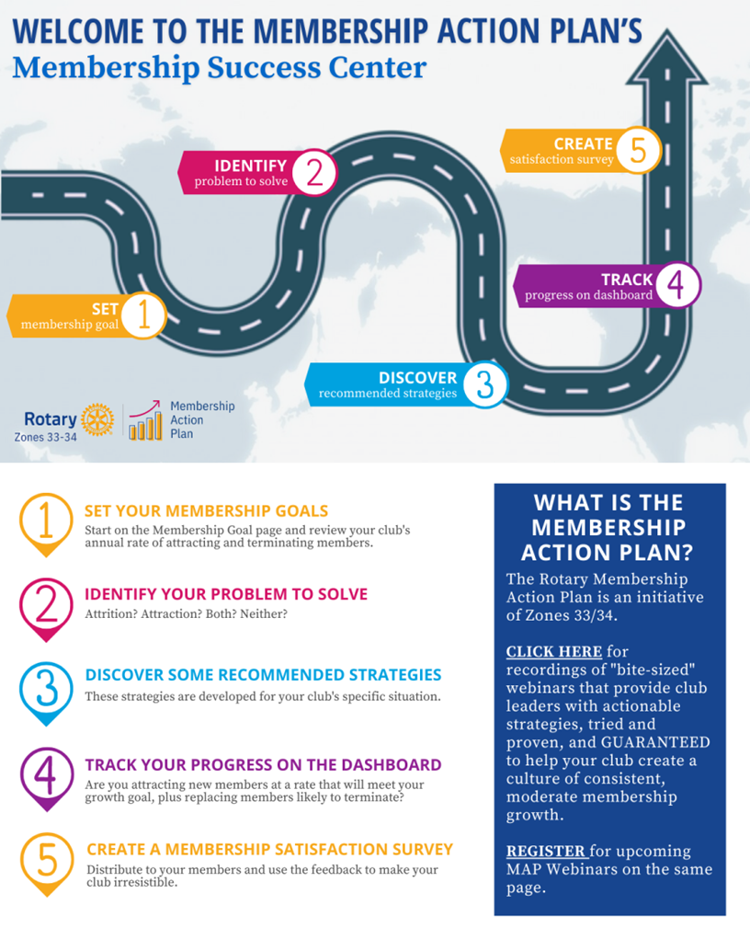

Membership Success Center
Notes:
This is a component of DACdb with feeds directly from RI. Don’t worry if you are a Club Runner District, there is a way we can get you access to this system as well
It starts with entering in the membership goal the club has entered into MyRotary > Rotary Club Central
Considering your club’s recent membership history, what’s a reasonable growth goal? Something in the range of 5%-10% is reachable for most clubs –
Just enter that growth rate in the goal setting worksheet. Alternatively, you can enter a numerical membership goal and the growth percentage will be calculated for you.

Slide 17
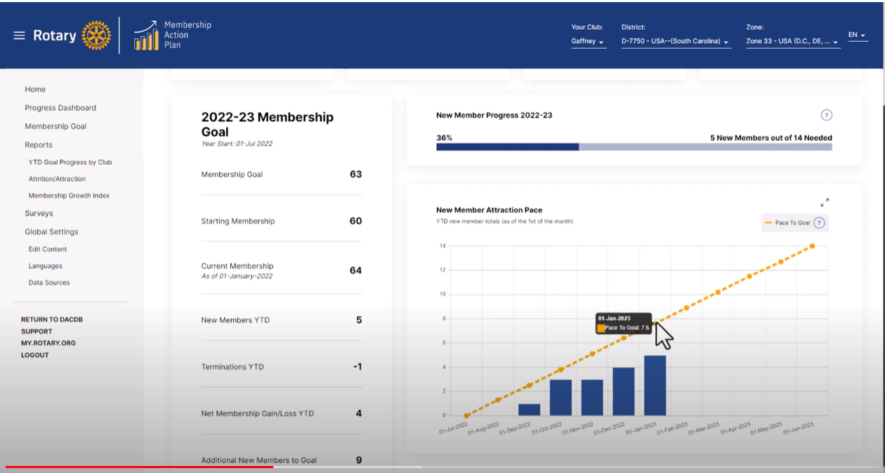
Notes:
Once you’ve set a membership goal, the Progress Dashboard provides you a monthly updated snapshot of your pace of attracting new members, compared to the pace needed to meet your membership growth goals, plus replace those likely to leave over the year. The Pace graph always shows you where you are towards your yearly goal. It shows whether you are ahead of, or behind where you need to be to reach your membership goal. It is highly active as a predictor

Slide 18
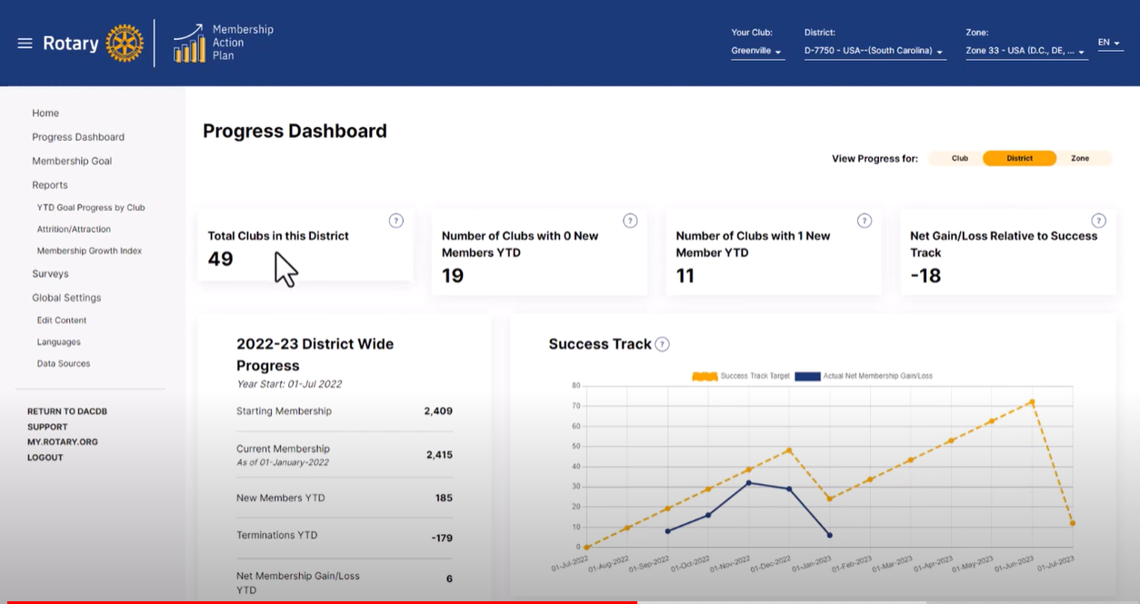
Notes:
There’s also a District View to track District wide progress and see if you are on track for successful growth

Slide 19
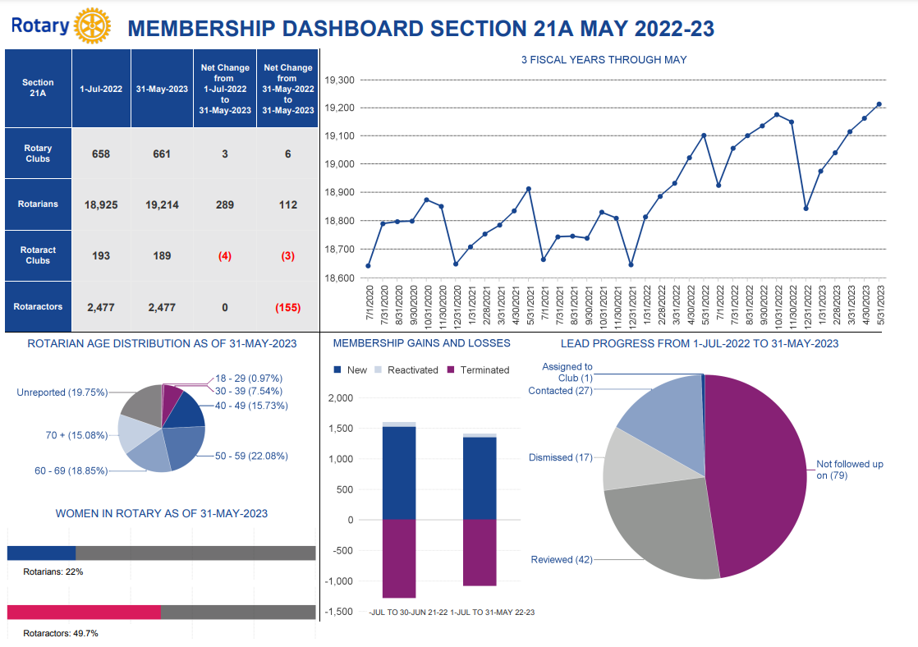
Zone 30
Notes:
Comparison from May 2022-May 2023 for Zone 30 (use in Decatur and Columbus)
Make a few comments about year over year growth vs losses

Slide 20
What about new clubs?
Notes:
Like attrition and attraction with members, we are losing more clubs than we are starting.
In 2018 Zone 30 had 728 clubs and Zone 31 had 783. Unfortunately, in 2023 Zone 30 is down to 701 and Zone 31 761.
That’s a 3.7% attrition in Z30 and 2.8% attrition in Z31. So how are we doing with attraction?

Slide 21
What about new clubs?
Notes:
The good news is we have re-admitted some lost clubs which is usually an administrative issue for nonpayment.
As you can see our attrition is almost 2 x our attraction rate.
So, what can we do about this challenge?

Slide 22
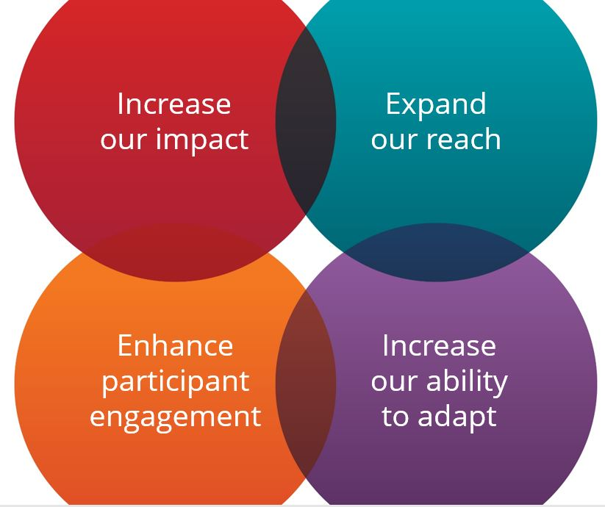
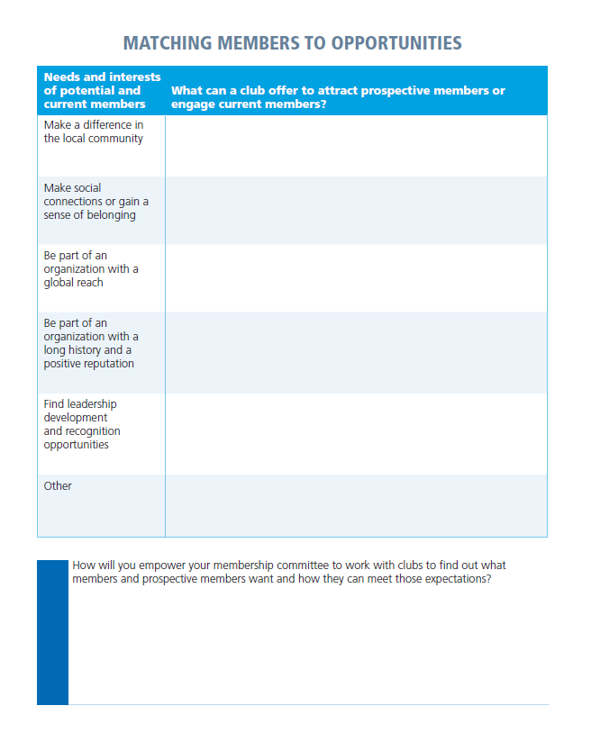

Exercise
What can a current, or new club, offer to attract and engage based on their interest?
Notes:
Let’s discuss how we can make our existing clubs more engaging and identify what a club experience my look like that would appeal to a variety of members’ (existing or potential) interests. We would like you to work in groups at your table on the exercise being handed out. This chart lists some needs and interests of potential and current Rotary members. For each need or interest, please consider:
What might attract prospective members?
What kinds of programs & activities could a club offer to engage current members?
You will have 10 min to work on this and then we will share what you have discussed
Facilitator – based on time have as many share as possible and then ask them to reflect on how their district can empower the membership committee to work with clubs to find out what members and prospective members want and how they can meet those expectations. Encourage them to share this exercise with their club presidents to help them identify opportunities for engaging members.

Slide 23
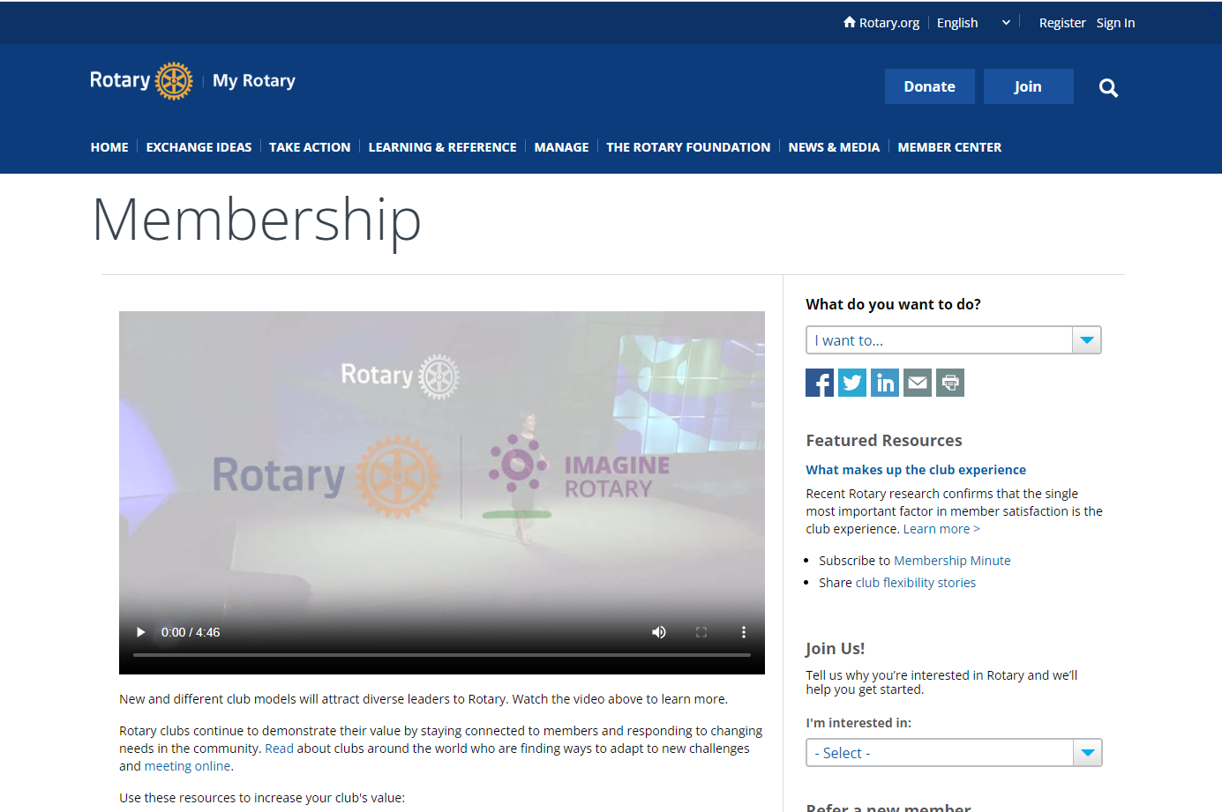
Resources
Rotary.org/membership
Notes:
Share resource rotary.org/membership Use these resources to increase your club's value:
Assess and adapt
Engage current members
Connect with prospective members
Make new members feel welcome The New and Prospective Member Interest Survey can help
Create an inclusive club culture
Strengthen your club
Start a new club
Stay current
Not sure where to start? Our Club Planning Assistant can help customize a club resource specific to their needs

Slide 24
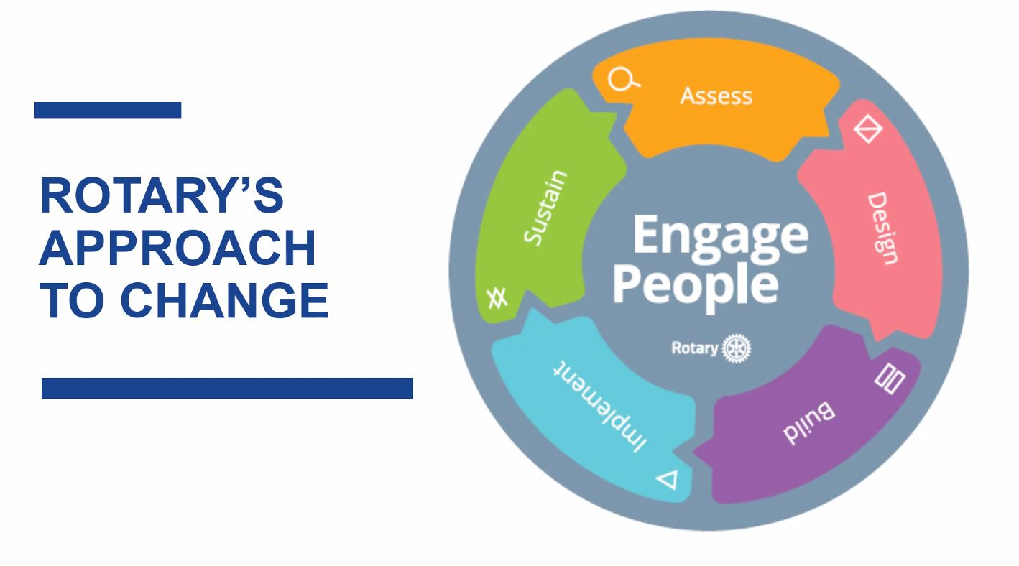
Cultural change
MyRotary > Learning Center >
Leading Change
Notes:
“We realize your Clubs and Districts have gone through a lot in the last 3 years, and a leadership mindset that includes “change” is a delicate topic. How do you feel about change? Rotary has a terrific model to assist, and we don’t have time today to go into it in detail, but we encourage you to go to the Learning Center in MyRotary called “Leading Change” to see how you can incorporate some of the ideas you may hear today into your club and district in a way they embrace those ideas and are less likely to resist. Why do you think “Engage People” is at the center of the model?”
We’d like to hear your ideas on how we can encourage others to do exactly what you’ve done today, invest your time in participating in Zone and District events to expand their reach beyond their club for idea sharing and growth in their Rotary journey. How can you adapt your District learning opportunities to become “simply Irrestible”?
Facilitator: have as many share as time allows.
Facilitator: ask them to right down at least one idea they will be taking back to their club/district, share a few if time allows,
Transition to Foundation facilitator by sharing how “finding a passion within a member or community leader can enhance engagement and attract new members to rotary by leveraging the power of The Rotary Foundation”.

Slide 25
Creating a culture of giving
Notes:
Intentional Leadership = Success on purpose
Let’s look at what successful clubs are doing

Slide 26
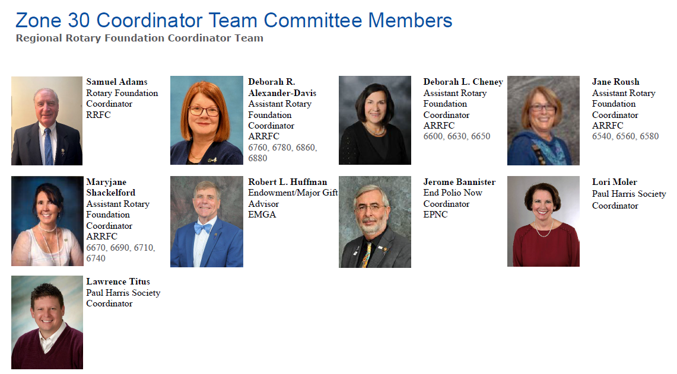
Notes:
First, let’s introduce our team. [mention that Zone 31 team is on our website rizones30-31.org]

Slide 27

BUILDING A CULTURE OF GIVING TO OUR ANNUAL FUND
Working together to develop practices and tools for measuring and sharing Rotary’s positive, long-term change
Using our resources for programs that have the potential for the greatest impact
Applying lessons learned through our polio eradication efforts to how we approach other partnerships
Implementing Programs of Scale to provides us with a new framework for thinking about how we bring about change in the world
Notes:
The Annual Fund is the primary source of funding for a broad range of local and international Rotary activities. We’re an organization you can support with confidence. We’ve dedicated about 90 percent of our total spending to programs over the past 10 years, far exceeding the efficiency standards set by independent charity-rating services. You can direct your gift to an area of focus within the Annual Fund. However, Annual Fund gifts that are designated to an area of focus do not generate District Designated Funds (DDF). When you donate to the Annual Fund-SHARE, a portion of those funds becomes available to your district each year through the District Designated Fund. At the end of three years, your district can use this money to pay for Foundation, club, and district projects. Annual Fund-SHARE The Annual Fund is the main funding source for Foundation programs. Your gift empowers Rotarians to carry out sustainable service projects in your community and around the world. At the end of each year, contributions directed to Annual Fund-SHARE from all Rotary clubs in the district are divided between the World Fund and the District Designated Fund. The Rotary Foundation uses the World Fund to support Rotary’s highest-priority grants and programs, which are available to all Rotary districts. Your district uses the District Designated Fund to pay for Foundation, club, and district projects the clubs in your district choose. [Note that the Annual Fund has included until this year, the Disaster Response donations.] Without support from our members and friends of the Rotary Foundation, there would be no money to fund the life-saving, life-changing projects. – Note handouts, including goals (BYB) and last year’s performance.
Let’s start with a short-answer on your colored index cards:
I am a proud supporter of the Annual Fund because….
[pre-print: I was asked, I was told about it by my club mentor, I learned about it in orientation, I heard about it at a district event, other; I am not currently a supporter of the Annual Fund.]
Then go to panelist: why are you a supporter? What is the #1 thing you have done in your district to build a culture of giving to our Annual Fund? What has been your #1 challenge to this? What have you done to overcome that challenge?
Small group discussion: Handout: Annual Fund emphasis [20 min.]: Following panelists, there would be small group discussions of a strategy each attendee would plan to use to create or maintain their club/district culture, including: Actions steps, who, how long, measuring progress, resources.

Slide 28
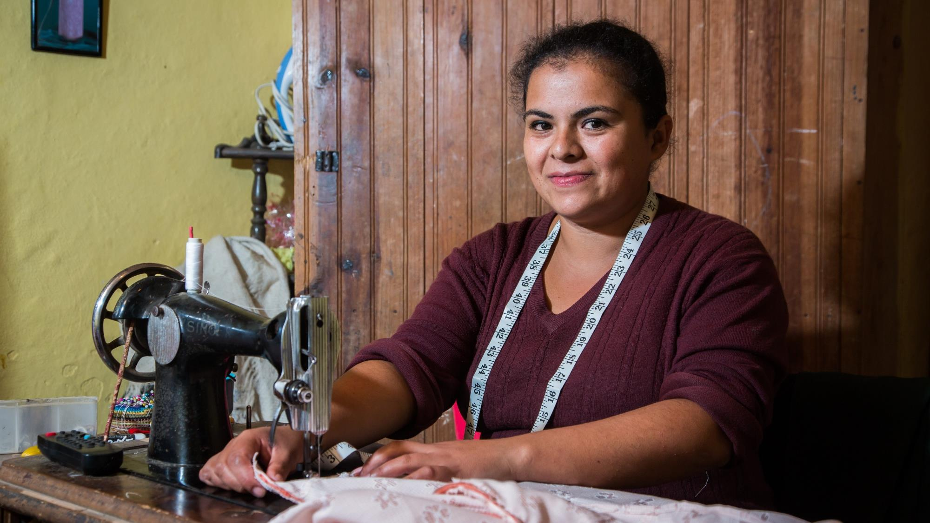
The annual fund
Notes:
Our Foundation’s Annual Fund helps pay for local and international grant projects. Contributions to our Annual Fund make our humanitarian impact possible.
When you give to the Annual Fund, you help people like Gabriela Martinez Flores. Gabriela is expanding her small sewing business and providing a better life for her family, thanks to a grant project created by Rotarians in Honduras and the United States that offers business training and microloans.
Giving to the Annual Fund supports Rotarian-led projects like these — projects that are created at the local level, that are developed to meet the community’s needs, and that foster international friendship. Through a single gift, you can help women like Gabriela provide a better life for their families.

Slide 29


ANNUAL FUND - areas of focus
170
$59.4
189
$15.3
57
101
$8.9
Notes:
Our Foundation is dedicated to causes — or areas of focus — that build international relationships, improve lives, and promote a more peaceful world. Which of these causes resonates with you? What are you passionate about?
The Foundation can help you turn your passion for a cause into action and lasting change. Rotarians are encouraged to lead efforts in these areas, and The Rotary Foundation is here to support those efforts with grants.
In fact, the very mission of our Foundation is to enable Rotarians to advance world understanding, goodwill, and peace by improving people’s health, supporting education, improving the environment, and alleviating poverty.

Slide 30
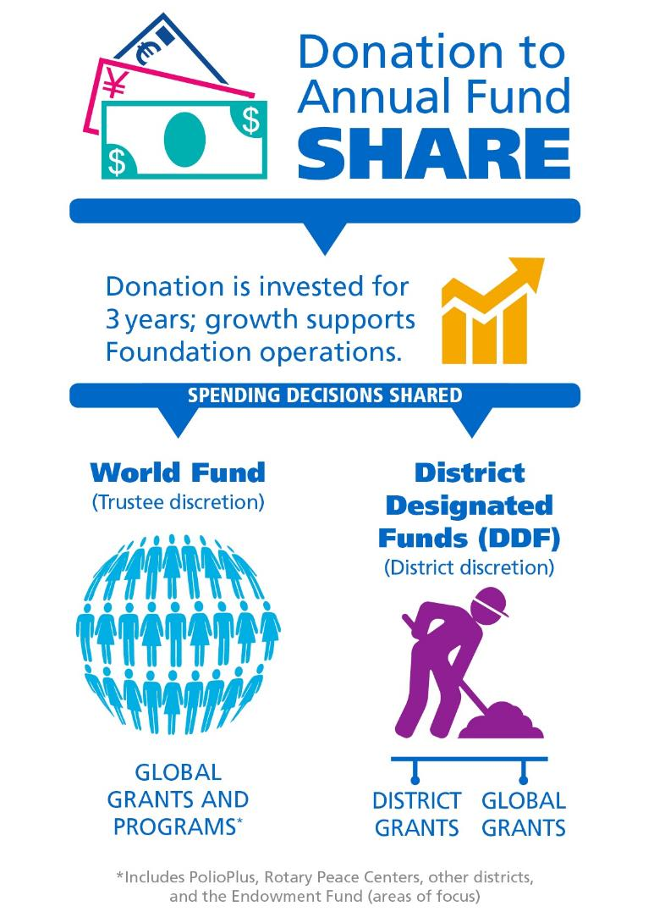
ANNUAL FUND -
SHARE
When you give to Annual Fund – SHARE, The Rotary Foundation transforms your gifts into service projects that change lives close to home and around the world.
Learn more at: my.rotary.org/annual-fund-and-share
Notes:
When donors are asked why they support the Annual Fund, many say it’s because you get something back when you give. When you contribute to the Annual Fund-SHARE, part of your gift becomes available for your district and its clubs to use however they want on Foundation programs.
[Consider giving the following explanation, depending on the audience.]
When you donate to the Annual Fund-SHARE:
For three years, your contribution is invested.
After three years, that money is made available to fund projects.
A portion goes into your district’s District Designated Funds (also known as DDF). Your district can use it to help fund local and international projects. It decides how to use the money.
A portion goes to the World Fund. This money is used for grants, grant matches, Foundation programs that are available to all Rotary districts, or aid where the Trustees determine it to be needed most.
Districts that use both district grants and global grants get the full impact of gifts made by their members.
How many of you have participated in a global grant?
The World Fund is the source of the Rotary funding for your global grants.
And how many of you have participated in a district grant?
Those grants, too, are possible because Rotarians in your district gave to the Annual Fund.
The funds we have access to this year come from contributions made three years ago. (For example, funds available in 2021-22 are from contributions made in 2018-19.) That’s why it’s so important for members to support the Foundation consistently.
For more information about the Annual Fund, go to my.rotary.org forward slash erey or annual-fund-and-share.

Slide 31


Every rotarian, every year
Did you know that donors who gave $25-$50 contributed more than $5.1 million to the Foundation in 2020-21? When every Rotarian gives every year, it makes life-changing, sustainable projects possible.
Also in 2020-21:
$139 million was given to the Annual Fund.
34% of Rotarians donated to the Annual Fund.
82% of Rotary clubs supported the Annual Fund.
2,066 global grants were awarded.
Notes:
These projects we’ve just discussed were possible because Rotarians supported the Foundation and participated in Foundation grants.
Rotary has a fundraising initiative called Every Rotarian, Every Year. The goal is to increase both Annual Fund support and Rotarian engagement with the Foundation. How many of you have heard of Every Rotarian, Every Year?
The idea is that, if every Rotarian gave at least $25 to the Annual Fund yearly, what the Foundation could accomplish would multiply.
In 2020-21, we accomplished a lot:
Donors who gave $25-$50 contributed over $5.1 million to the Foundation.
Rotarians gave a little over $139 million to the Annual Fund.
34% of Rotarians supported the Annual Fund as individual donors.
82% of Rotary clubs worldwide supported the Annual Fund.
The Foundation awarded 2,066 global grants.
With a third of Rotarians worldwide donating to the Annual Fund and becoming eligible for EREY, we’ve achieved a lot and improved the lives of many. Can you imagine how many more lives could be changed through grant projects if we encouraged even more members to contribute at least $25 to the Annual Fund every year?

Slide 32
PROVEN WAYS
TO GAIN SUPPORT
FOR THE ANNUAL FUND

Slide 33
2023 – 2024
ZONE 30 GOALS
ANNUAL FUND

Slide 34
Increase # of clubs & members giving to the AF by 10%
Encourage new members to donate $25+ to the AF (EREY Campaign)
“Beat Your Best” AF per capita giving over the last 10 years
Increase PHS members by 10%

Slide 35


Rotary Zone 30 - Paul Harris Society
Paul Harris Fellow vs. Paul Harris Society
Convert Numbers to Impact
Study Donor List & Reengage – PHS Contest #1
Building Culture of Giving – PHS Contest #2
Say THANK YOU!

Slide 36
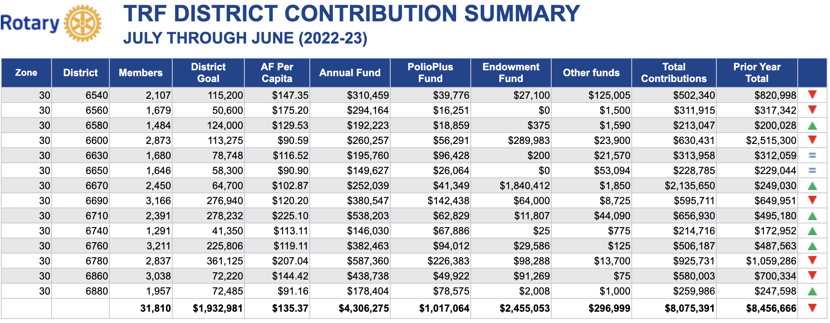

Slide 37
Recommended Foundation Goals for
Districts and Clubs in
Zone 30 for 2023-2024

Slide 38
Annual Fund
Beat Your Best (per capita) (minimum of $100 per capita*)
Increase total number of members and clubs contributing to the Annual Fund (10%)
Encourage each new member to donate $25 to the Annual Fund
Increase total number of Paul Harris Society members by 10% (approx. 120 new members)
  Competition to win up to $10,000 in CASH
*see handout for details

Slide 39
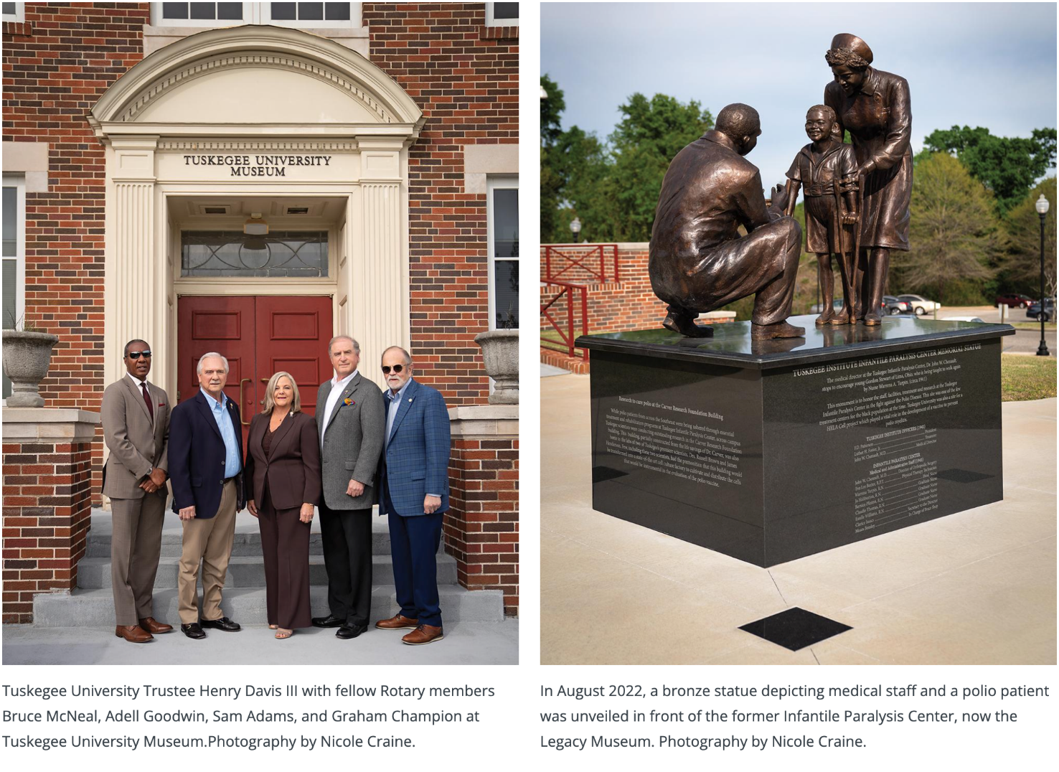

Slide 40

BUILDING A CULTURE OF GIVING TO OUR POLIOPLUS FUND
Working together to develop practices and tools for measuring and sharing Rotary’s positive, long-term change
Applying lessons learned through our polio eradication efforts to how we approach other partnerships
What can you do to help your club and district to finish this, our greatest humanitarian project?
Notes:
Did you know where the first major outbreak of polio occurred? In happened in 1894 in Vermont. And did you know since 1988, our efforts and funds have helped immunize 3 billion children, 20 million people are walking today because of us and there are 20 million health workers and volunteers working worldwide to help tackle polio. And these health workers and volunteers do this despite substantial risk to themselves, in some places. This year Pakistan had more than 370,000 volunteer workers dedicate three days to immunize 44 million children along with more than 80,000 security personnel. During this campaign, 64 of these workers were killed. If a shooting incident occurs, the campaign may stop for an hour and then start again. And if a family initially refuses vaccination, workers come back later and try again, sometimes with success.
The world health and science communities understand how important our worldwide polio eradication efforts are but did you know only 1 in 12 Rotarians give and only 1 in 5 clubs contribute to PolioPlus. This is true even though this is our number one priority as Rotarians, it is our largest humanitarian grant by far. All it costs to vaccinate one child is $3.00. We, with our partners in the Global Polio Eradication Initiative, are vaccinating more than 400 million children each year. So, as you can see our participation in this is extremely important. When we make our annual commitment of $50 million and receive the Gates Foundation match of $100 million, we raise enough funds to vaccinate 50 million of these 400 million plus children. And we, Rotarians, are the ones who started all of this, we convinced WHO, the CDC, UNICEF, the Gates Foundation and Gavi, the vaccine alliance, that this could be done. And we, Rotarians, are the ones who are going to FINISH THIS. We are going to make sure there are no more children that are condemned to a life of misery from polio.
So, how do we continue to reach our goal? We have to create a culture of giving to PolioPlus. We do this by informing, we do this by participation, we do this by example. There are resources galore for you to use: EndPolio.org (Rotary’s site), the Learning Center at Rotary, WHO, CDC, the GPEI. A very easy way to create this culture is to create a PolioPlus Society in your district. PolioPlus Societies are district administered where members pledge to give at least $100/year until we finish our fight against polio. Another way is to participate in a World Polio Day Event (October 24). Clubs and districts can and are encouraged to register their World Polio Day events at endpolio.org. Another great way to build the culture is to have either or both inward/outward looking polio fundraising events. And it is extremely important to our effort that Districts pledge annually 20% of their DDF, because when they do so, the World Fund matches that pledge 50 cents to each dollar and that combined commitment is then matched by the Gates Foundation, so each dollar pledged has $4.5 dollars in impact.
This is our dream. Let’s make sure all children grow up healthy. I want to be a part of this history making event, don’t you?
How many of you know someone who has had polio?
How many of you have given to PolioPlus in the last year?
How many of you have participated in a World Polio Day Event?
How many of you are members of the PolioPlus Society?
Break to small group discussion: [What can you do?] Let’s take 10 minutes to brainstorm 1 or 2 ideas for publicizing and fundraising for our continued efforts to eradicate polio and share at your tables. Also discuss the action steps to planning this (who, what, when (start and end date and duration), where, why).

Slide 41

BUILDING A CULTURE OF GIVING TO OUR ENDOWMENT FUND
Working together to develop practices and tools for measuring and sharing Rotary’s positive, long-term change
Notes:
Tell what the Endowment Fund does: supports our grants and programs; SHARE, Areas of Focus, programs well into the future; never touch corpus -- without support from our members and friends of the Rotary Foundation, there would be no money to fund the life-saving, life-changing projects; many ways to give (see handout)

Slide 42


MAKING A BEQUEST
This method of transferring assets is usually documented in a will or estate plan.
https://youtu.be/_-8-VwmNQZU
Notes:
What we normally think of with Endowment is a bequest. A bequest is a commitment of $10,000 or more to the Endowment Fund via a codicil in your will or estate plan. The Rotary Foundation recognizes these at the same levels as Major Donor- 1. $10,000, 2. $25,000, 3. $50,000, 4. $100,000 and so on. These commitments can be via cash, equities, life insurance or property. What happens to your gift ? Rotary strives to increase the value of your gift to the Endowment by preserving and investing your initial contribution and spending only a portion of the earnings.
This strategy supports Rotary's causes today while generating funds that will further the work of future Rotarians committed to Doing Good in the World.

Slide 43
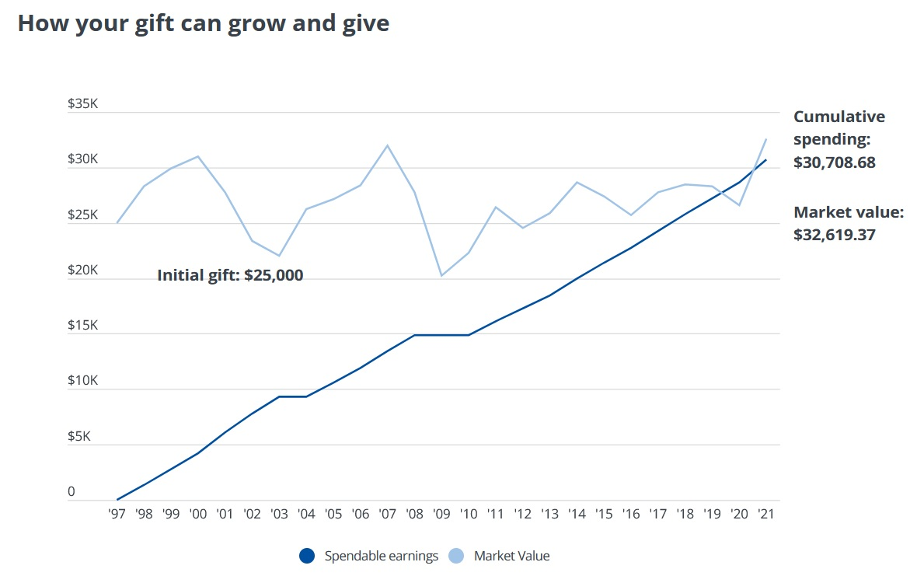
Endowment Fund

Slide 44
NEW BEQUESTS ZONE 30 JULY 1, 2022 – JUNE 30, 2023
DISTRICT |  |  | DISTRICT
6540 | 2 |  | 6690 | 4
6560 | 0 |  | 6710 | 0
6580 | 1 |  | 6740 | 1
6600 | 0 |  | 6760 | 1
6630 | 1 |  | 6780 | 3
6650 | 0 |  | 6860 | 0
6670 | 1 |  | 6880 | 0
6760 RY 2019-2020 48 Bequests 6780 RY 2021-2022 16 Bequests
NEW BEQUESTS
Notes:
Bequests have been stagnant in our Zone. You can see the chart which shows the recent 14 months for each District. We have been challenged by the Rotary Foundation Board of trustees with increasing gifts and commitments to the Endowment Fund. It will be important that every district is intentional about making the ask and promoting giving to the Endowment Fund during the 23-24 Rotary year.
There are Bequest Forms for you to use and/or take back to your district or club and share with prospective donors. You may have noticed the asterisk by D6840. They recently held a MDD in the spring of 2022. Districts who have held MDD have a large increase in Bequests. What is a MDD, or Legacy Dinner? The next couple of slides help explain:

Slide 45
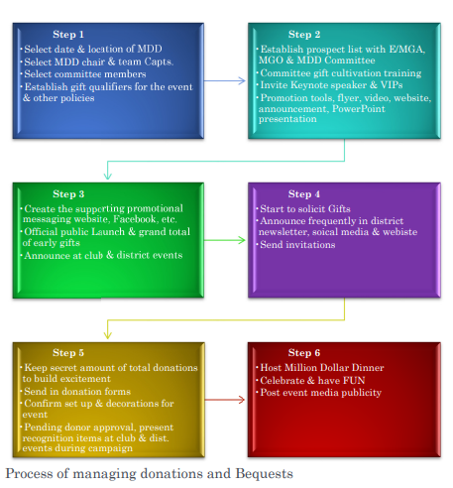
Million Dollar/legacy dinners
Notes:
One way to build your club and district culture of giving to the Endowment Fund is through the Million Dollar or Legacy Dinner plan. Discuss rename Million Dollar Dinner to Legacy Dinner or some other name to overcome trepidation Rotarians often have that this is too much/too hard to do. We have a template with a checklist and step by step process.

Slide 46
10-15 Months
planning the event
Notes:
For success, you need to spend 10-15 months planning, building a training, fundraising, inviting, planning the event, etc. Plus the money doesn’t all have to come in that night, there’s a window of time over which funds can be contributed or pledged.

Slide 47
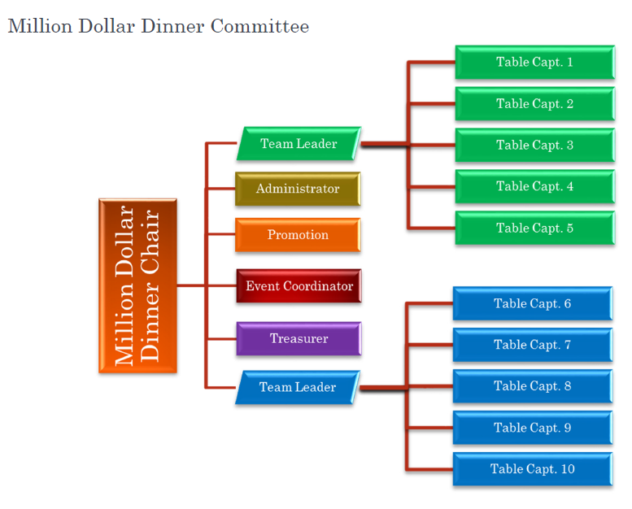
Building the team
Notes:
You are building a strong team with a Chair to lead and team captains and are training them all in the how and why of identifying, cultivating, soliciting, and stewarding. Even when the event is over, keep this team in place to do ongoing fundraising and to provide a skilled team with historical knowledge to assist in future legacy dinners, as we are encouraged to plan a legacy event every 5-8 years.

Slide 48
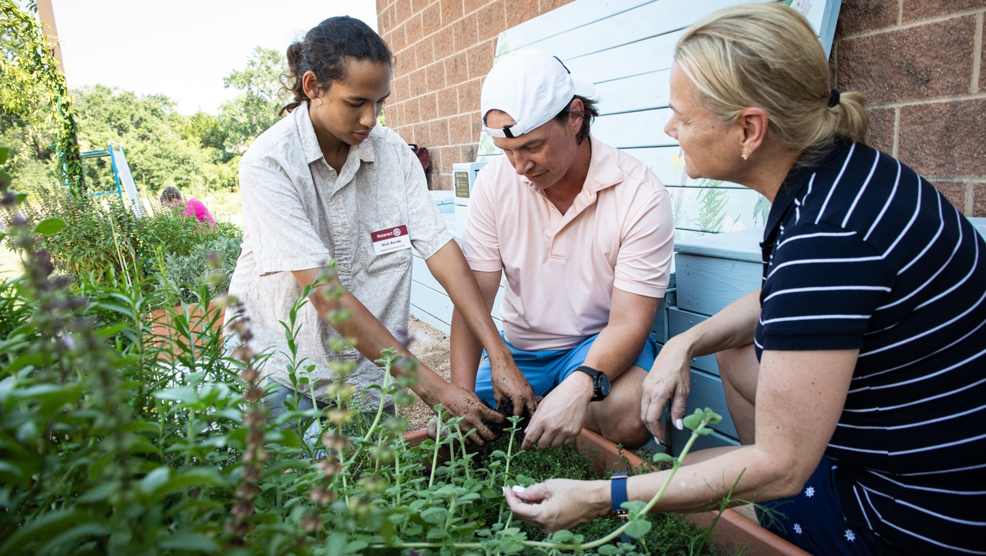
BUILD A CULTURE OF PHILANTHROPY
At home and in your community
Notes:
With our long record of making an impact, The Rotary Foundation is an organization you can trust to nurture your legacy and provide support every year for the causes you care about while fostering continued growth.
This ensures that generations of Rotary members will have the resources they need to design achievable, sustainable projects that fulfill your goals. Rotary is your partner, now and later, and is working to grow the Endowment Fund to $2.025 Billion by 2025.
Building a culture of giving is vital, and the key to building an influential Rotary legacy is to plan gifts now that will provide for the future.

Slide 49
Everyone has a story
Notes:
Intentional Leadership = Success on purpose
Let’s look at what successful clubs are doing

Slide 50
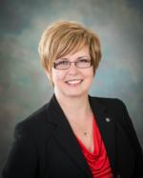
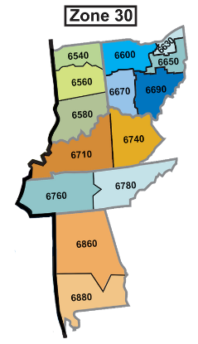
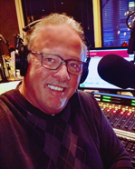
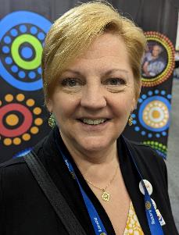
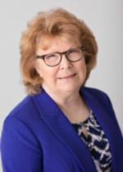

Districts
6540,6600,
6630,6650
Your Zone 30 Public Image Team
RPIC
Districts 6860,6710,
6740,6760
Districts
6580,6670,
6690
We are here to help you!
Ask us to come to your District Conference, PETS, District Assembly and/or Vibrant Club Workshops!
Districts
6780,6860,
6880

Slide 51

How to Tell Your Story
What is Most Important?
Start and Stop Your Story with What you Want People to Remember.
Make it Personable – Be Authentic
Make it Relatable – Don’t Use Jargon

Slide 52
Exercise
Complete the worksheet on How to Tell Your Story – 5 Minutes
When prompted by the facilitator share your story with a partner at your table then listen to your partners story.

Slide 53

How to Tell Someone Else’s Story
Ask the Five Ws
  Who, What, When, Where and Why
Get Before & After
  What was it like before
  How did it feel when
  What’s next for you?

Slide 54
Exercise
Working with a different partner at your table listen to your partner talk about their most impactful Rotary experience.
As they talk about their story listen for the Who, What, When, Where and Why. You may need to ask follow up questions. Then ask the questions in Step 2.
Each partner has 5 mins total for Step 1 and Step 2. After each partner has completed Step 1 and Step 2 complete Step 3 and develop the story using the same principles you learned in How to Tell Your Story.

Slide 55


Slide 56



Slide 57



Slide 58

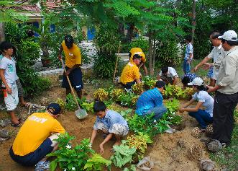

Slide 59



Slide 60



Slide 61



Slide 62
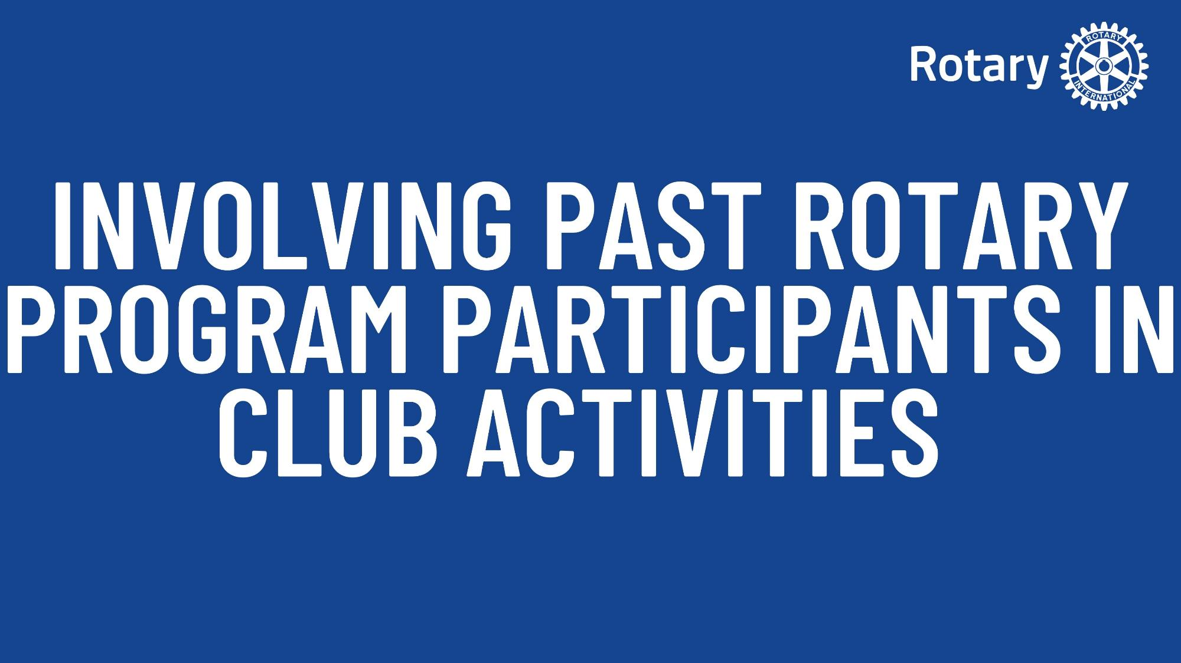


Slide 63



Slide 64



Slide 65



Slide 66



Slide 67



Slide 68
Disaster communications
Things to remember when communicating during a disaster

Slide 69

Top Tips for Communicating In A Disaster
Highlight the 'need to know' information.
Use easy to understand terminology and avoid technical jargon.
Utilize visuals strategically
Identify a spokesperson the community trusts.
Communicate with empathy and concern.
Provide timely updates.
Have a team

Slide 70

Channels for Communication
Mobile Phone Service Maybe down – have phone charged bring car charger
If communicating to disaster victims – Posters, Social Media Post, Radio and door to door efforts will be most effective
If communicating to donors and community at large – TV, Newspapers, social media and email blast will be most effective

Slide 71
Ethics in disaster communications
Make sure what you say is 100 percent factual – check all your information
Never use photos of people or their property without their permission
Remember to work as a team with other organizations

Slide 72
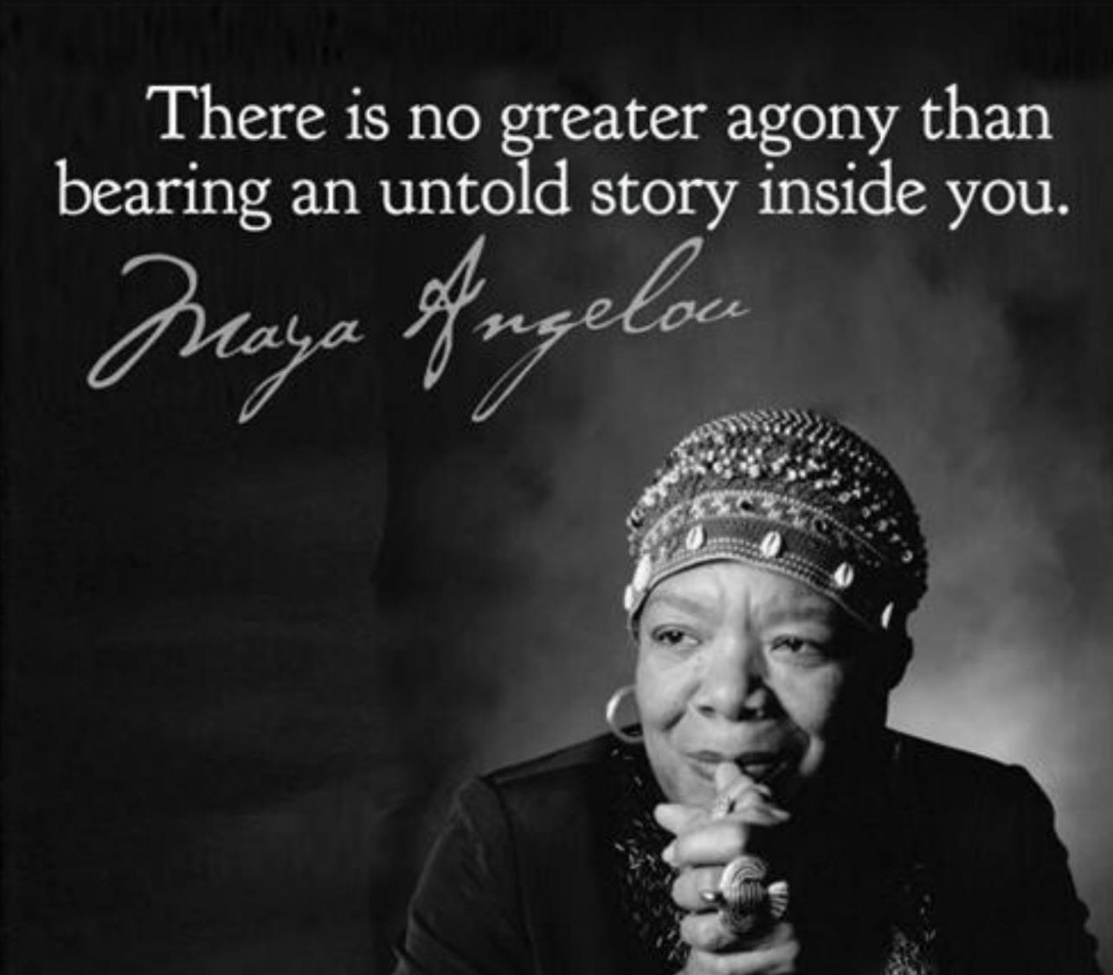

Slide 73
Districts
6540,6600,
6630,6650
Your Zone 30 Public Image Team
RPIC
Districts 6860,6710,
6740,6760
Districts
6580,6670,
6690
We are here to help you!
Ask us to come to your District Conference, PETS, District Assembly and/or Vibrant Club Workshops!
Districts
6780,6860,
6880

Slide 74

QUESTIONS

Slide 75
Putting rotary’s action plan into action
Notes:
Facilitator
We now want to give you some space to Put Rotary’s Action Plan into Action and apply what you’ve learned today. We will have you work in small groups in the following Case study.

Slide 76
CASE STUDY #1
CASE STUDY
Your District has a newly formed club focused on the environment. You have been asked to assist this new club in identifying a grant opportunity to support their project to introduce a recycling program in their local middle school, they requested with the intent to engage their new members and attract others to this club.
How can they attract donations and support from potential partners with a shared interest?
How can the Rotary Foundation resources be of assistance?
How can they tell the story to their community?
How can they use this opportunity to further engage their members and attract new members?

Slide 77
CASE STUDY #2
CASE STUDY
Your District has a community that is under-represented by Rotary. There are four Rotary clubs in nearby communities. This community had a flood two years ago and it flooded the community grade school. The school will be reopening in six-months and they are trying to raise money for new library books. Four local Rotary Presidents decided to combine their clubs’ resources via a service project to help replace the books. How can they make this a successful project?
How can they attract donations and support from partners with a shared interest?
How can The Rotary Foundation resources be of assistance?
How can they tell the story to the community?
How can they use this opportunity to further engage their members and attract new members?

