Slide 1
BUILDING A STRONG ROTARY BRAND
STRATEGIES AND BEST PRACTICES
Angela Rickman Laura Carie
ARPIC Zone 31 RPIC Zone 30
Notes:
Introduction of presenters – Angela

Slide 2

TO HELP WITH THIS MEETING
Please Rename yourself to:
Your Name, Title and District #: Jane Doe DGN 6760
To do this,
  Tap/Click on “Participants” at the bottom or top of the video window
  Tap/Click on your name
  Choose “Rename”
  Type in your new name like the one above
  Tap
  Reminder this meeting will be Recorded!
Notes:
Laura cover requests for meeting

Slide 3

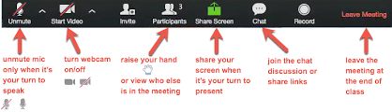
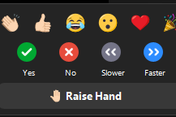
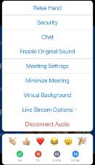




RULES OF THE ZOOM
Participants
  Please activate your video webcam
  Please remain muted until called upon
  If using a phone for audio, please self mute and unmute when called upon.
  Utilize “chat” function
  Utilize “raise hand” function
  in reactions
  If the meeting is interrupted and ends, please wait 5 min and log in again
  Gallery view will show all attendees
  Speaker view will show current speaker and is view available on an Ipad or tablet
Desktop Control View
Tablet/Smartphone View
Notes:
Laura Please stay muted until you want to speak
So if you have not muted already, please do so now. And also please mute your phone.
It is proper etiquette to have your video on unless you must step away Explain use of chat box for answering questions.
If you would like to answer a question, raise your hand in the reactions function and when called on, unmute and respond. Let’s do that now. Please raise your hand.
Please lower your hand after you have been called upon. Let’s do that now.
Zoom will be shut down if disturbed; then in 5 minutes login again
Know that we are recording this training
Laura Introduce: It is my pleasure to introduce our Zones 30-31 Director, Beth Stubbs

Slide 4
What is our brand?
Notes:
Angela – You can’t build a strong brand if you don’t have a clear understanding of what your brand is. Ask audience “What is our brand?” Get several responses live/chat.

Slide 5
subhead
OUR BRAND IS MORE THAN A LOGO – IT’S HOW PEOPLE THINK ABOUT US.
Notes:
Angela - Emphasize it’s more than just a logo, it’s how people think about us. Keeping that in mind we are going to dive in more on how we strengthen our brand by understanding the components that go into it – what determines how people think of us.

Slide 6

Understanding our brand
Consistency
People of Action
Notes:
Angela - A consistent voice and unified visual identity are essential components of a strong brand and People of Action is an important component of that and that will be the focus of this part of our session.

Slide 7
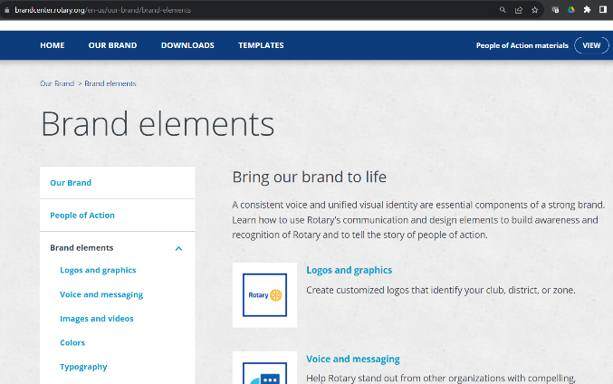
Consistency
  Logos and graphics
  Voice and messaging
  Images and Videos
  Colors/Typography
  The Rotary name
Notes:
Angela - Starting first with consistency. There are many elements to consider when talking about consistency. The elements we are going to be talking about today can be found in the brand center, if you go to our brand and then click on brand elements you will get in-depth information on each element like in the screen shot here. While we could probably spend the entire session on each of these individually, our goal today is to bring to your attention some key considerations that maybe you haven’t thought of before, and to do that we’re going to play a game. Have any of you ever played the game higher or lower? My son has this on his phone and it’s more pop culture facts that you have to guess whether figures are higher or lower so today we’ve turned that into a Rotary version. On each slide I am going to put up a statement and you are going to guess whether the figures made in the statement are actually higher or lower. Please type in the chat your responses. Ok here we go:

Slide 8
LOGOS AND GRAPHICS
Higher or lower?
4
There are 4 available colors combinations for your club/district logo.
Notes:
Angela – Logos and Graphics. Is the actual answer higher or lower than 4?

Slide 9





HIGHER
LOGOS AND GRAPHICS
1
2
5
3
4
5
Notes:
Angela – It’s higher. There are 5 colorways available…Why? Some colors work better on different backgrounds. If this background was gold or yellow the first two logos would not work well. Instead of clubs trying to modify logos or use different combinations if they have all 5 already downloaded, they will easily be able to be consistent by utilizing official logos. Do your clubs have all 5 downloaded? Don’t forget the Brand Center – Brand Elements is your guide not only on club logos but other graphics such as logo lock up’s, the Masterbrand signature, mark of excellence, end polio now icons, and Areas of Focus icons which also have color options. And a little birdie told me that logos are going to be part of the topics being covered next month with Megan so I encourage you to join that and also make sure you have all 5 of yours downloaded.

Slide 10
VOICE AND MESSAGING
Higher or lower?
5
The Rotary voice focuses on 5 attributes that describe Rotary and members.
Notes:
Angela – Voice and Messaging

Slide 11
LOWER
VOICE AND MESSAGING
Persevering
Inspiring
Compassionate
Smart.
4
Notes:
Angela – The correct answer is 4. Persevering, Inspiring, Compassionate and Smart. How many of you knew that there was s specific voice outlined regarding our brand? We want to distinguish Rotary from other organizations and appeal to all of our audiences by using compelling and consistent messages. Rotary’s voice is clear, persuasive, and reliable. It’s personal and sincere. As public images representatives we need to think how we do this in our external communications. Are we inspiring, do we show compassion?

Slide 12
IMAGES AND VIDEOS
Higher or lower?
928
There are 928 items available for download in the Brand Center.
Notes:
Angela – Images and Video. Do you think the number of downloads in the brand center is higher or lower than 928?

Slide 13
HIGHER
v
IMAGES AND VIDEOS
Roll up Banners
Virtual Backgrounds
Power Point Templates
RYLA Graphics
Pictures
Videos
Radio Ads
Outdoor digital billboard
And so much more!
1,238
Notes:
Angela - HIGHER! Again what easier way to be consistent than to use the resources provided for us, of which there is no shortage. Yes you can use your own pictures, and there’s a download available for that too, giving you tips and guidelines to understand our photography style – a “documentary style” meaning subjects are not posed.

Slide 14
COLORS/TYPOGRAPHY
Higher or lower?
3
There are 3 free Primary fonts that can be used for headlines and navigation labels.
Notes:
Angela – Colors and Typography another brand element. Are the number of free primary fonts higher or lower than 3?

Slide 15
LOWER
COLORS/TYPOGRAPHY
Frutiger (Licensed)
Open Sans (Free)
Arial (Free)
2
Notes:
Angela - LOWER. This one is a trick question. There are 3 Fonts, but only 2 are Free Fonts, 1 is Licensed. When you use Rotary’s typography, or fonts, you help keep our communications cohesive and distinctive. Build recognition for your club and Rotary by using these fonts. You can use the free options when the licensed options aren’t available or are cost-prohibitive. There are also 2 secondary fonts Sentinel which is licensed and Georgia which is Free. While I won’t make you guess on the Rotary Brand colors, it’s important to know that the brand center also provides that information.

Slide 16
THE ROTARY NAME
Higher or lower?
101
There are 101 Rotary Marks that are trademarked and owned by Rotary International.
Notes:
Angela – The Rotary Name. Do you think that are more or less than 101 Rotary marks trademarked?

Slide 17
HIGHER
THE ROTARY NAME
Rotary
Rotary Club
Rotarian
Rotaract
Rotaract Club
Interact
Interact Club
End Polio Now
People of Action
You can find a full listing of the Rotary Marks in the Rotary Code of Policies, section 34.005.
105+
Notes:
Angela - HIGHER. I stopped counting at 105 thus the plus, but the full list is available on the Rotary Code of Policies document. The "Rotary" name, along with our logo, reflects our long history and trusted reputation. It serves as a beacon to members as well as to the public. And our brand doesn't just include Rotary — it also includes Rotaract, Interact, and more. How do we protect it, make sure it is used correctly and consistently? One of the most common issues I see with the name has to do with projects or events that we use the word Rotary on... How many times have you seen something like “Rotary Park”? Here’s some examples.

Slide 18
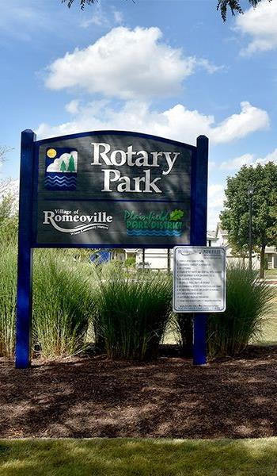
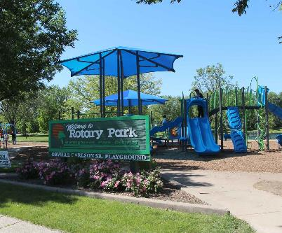
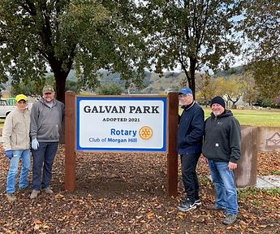
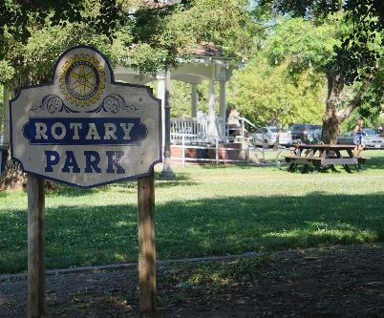
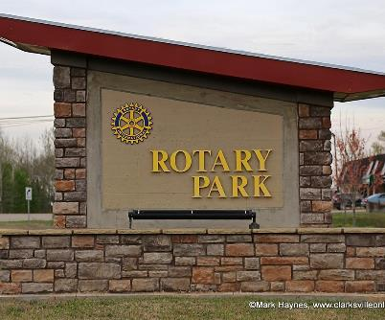
Notes:
Angela – What’s the issue with just saying Rotary Park? Well it implies that Rotary International is part of the project and instead clubs should use the club name. While these are all nice signs, Can you spot the only correct use of the logo/rotary name in these pictures? If we’ve got anyone on the district grants committee in here, this would be a good opportunity when paperwork is submitted for projects to work with the public image team to ensure any signage is brand compliant. Let’s move on to people of action.

Slide 19

People of action
Builds awareness
Build recognition
Provides a simple consistent answer to the question, “What is Rotary?”
Notes:
Angela - People of Action isn’t an advertising campaign. It’s the way we talk about and present ourselves and it supports the message that, together, we envision a world where people take action to create lasting change. Using this messaging we can build awareness, recognition and help with that question what is Rotary. Many of you are probably aware that there is a template on the brand center, you can use stock photos or you can use your own photos as well. There are 3 different templates, one for a print ad, one for a digital banner, and one for a facebook post. It’s time for our final question on our game.

Slide 20
PEOPLE OF ACTION
Higher or lower?
6
There are 6 VERBS available on the People of Action brand center template.
Notes:
Angela – People of Action

Slide 21
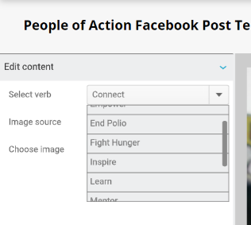

HIGHER
PEOPLE OF ACTION
Connect
Empower
End Polio
Fight Hunger
Inspire
Learn
Mentor
Promote Peace
Save Lives
Transform
10
Notes:
Angela - Higher. There are 10 in the official template. You have to scroll down to see them all! Together We… Are your clubs using this with their photos? Remember that incorporating people of action is part of our brand ambassador goals this year, again because it creates a consistent message and tells the story of who we are.

Slide 22

ANY QUESTIONS?
Notes:
Angela - Before we move on to our next section, what questions do you have on being consistent with brand elements? Now I am going to hand it off to Laura to cover Branding Strategies.

Slide 23
Branding strategies
Storytelling
Audience Centric Branding
Partnerships
Notes:
Laura - BUILD AWARENESS OF OUR BRAND THROUGH COMMUNICATIONS THAT WORK BEST
FOR YOUR CLUB. You are able to do this through Storytelling, Audience Centric Branding and
through Partnerships.
Let’s first start with story telling – (change slides)

Slide 24
STORYTELLING
Tell your People of Action story
In the text of your ad or social media post, tell your People of Action story. Keep it short but informative and inspiring. In as few words as possible:
  Say what you did: What action did you take?
  Offer statistics or other proof of the difference you made: What did you accomplish? How did your club's action change lives?
  Issue a call to action: Do you want people to donate, participate, or learn more? Make it clear what you want them to do.
Notes:
Laura –
Here are some helpful hints to keep in mind when you are telling your “People of Action” story.
This will apply to just about all forms of media.
- Keep your message short, informative and inspiring. – think about when you are on social
media, you scroll through so quickly…something has to catch your eye…..grab your attention.
-Talk about what you did and what action was taken. Paint that picture and inspire the public.
-Show proof of what you accomplished how you were able to change lives. Do this through
statistics or a testimonial of someone who’s life was changed through your clubs actions.
-always issue a call to action. Be specific on what you want the public to do…..donate to a
project or to TRF, participate in a project, join the Rotary club. If we educate the public on what
we are doing within our communities and around the world, they will want to become apart of
it.
Continuing with the people of action theme, why is story telling important, how do we tell our
story, what will inspire people? Keeping our communications consistent and compelling
strengthens our brand and reinforces that we’re people of action. A strong brand helps us
engage and attract more members, participants, donors, and partners.
Now lets look at our audience. (next slide)

Slide 25
AUDIENCE CENTRIC BRANDING
Questions to ask?
Who are you trying to reach with your messaging?
What are the interests of the audience?
What does the audience need to be able to connect with your messaging?
Notes:
Laura – Always remember Public Image = External Facing. Our goal is to educate the public, the
community, non Rotarians.
These are the questions you need to ask yourself.
1. Who are you trying to reach with your messaging?
2. What are the interests of the audience?
3. What does the audience need to be able to connect with your messaging?
Keep these four questions in mind….
1. Why would someone want to join Rotary?
2. Why would someone want to come to your meeting?
3. How does the topic you are sharing relate to your audience?
4. What can you share as a call to action?
Let’s look at a couple of social media examples. (next slide)

Slide 26
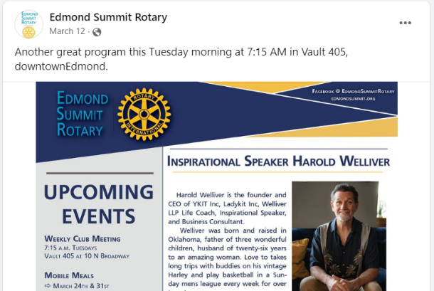
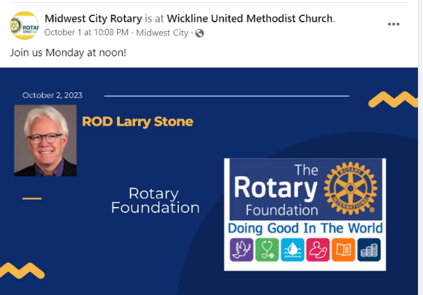
AUDIENCE CENTRIC BRANDING
Notes:
Laura - Let’s look at these two examples of social media posts.
Logos not right, but also when you look at the messaging- is it audience centric?
- Edmond Summit Rotary …. Could we instead talk about one benefit of Rotary is how it
develops leaders? That’s why they should join us for the program.
- Midwest City Rotary Club…Instead of just saying join us could we share some facts about
the Rotary Foundation that the public doesn’t know and how rotary can get grants
to impact things in our own backyard?
Do these posts meet the desires, demands and expectations of your consumer? The public is
our consumer.
Partnerships are vital to Rotary, why? (next slide)

Slide 27
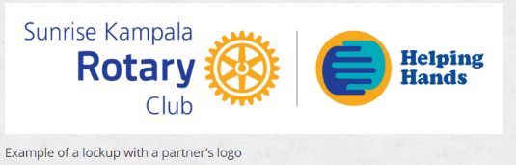
partnerships
Clubs can amplify their service by working or collaborating with other local organizations.
Show your club’s affiliation with a partner by using Rotary’s customizable logo templates.
Notes:
Laura - Partnerships is one of many ways to promote Rotary. We are able to “Expand our
Reach” by Expanding our impact in the community by partnering with organizations and
corporations that support our work. Don’t keep your partnership a secret. Make sure to
promote your partnership in all your communications and promotional materials to increase
your visibility and strengthen Rotary’s brand.
Ask why they think this could be powerful in communities?
Please put your thought in the chat----Why do you think promoting your community
partnerships could be powerful in communities?
Read 3 or 4 and thank them.
Now I would like to turn it over to Angela to talk about leveraging Technology and Tools.
Angela

Slide 28
ANY QUESTIONS?
Notes:
Laura - Now I am going to hand it off to Angela as we move into leveraging technology and tools.

Slide 29
Leveraging technology & tools
BUILD AWARENESS OF OUR BRAND THROUGH COMMUNICATIONS THAT WORK BEST FOR YOUR CLUB.
Chat GPT
Canva Magic Write
Notes:
Angela - We’ve covered the brand center, but what other tools can help you? Today I’m going to cover a few that have helped with my club’s public image and will share some tips for creating some scripting templates.

Slide 30
Utilizing ai (Chat GPT & AI)
Chat GPT Prompts to create social media content
  Be specific
  Give context
  Refine if needed
Refining messaging with Canva Magic Write
  Summarizing
  Changing tone
Notes:
Angela - AI can help us with consistent messaging in a style true to the rotary voice. Remember we talked about the 4 attributes. It can also help us answer why, tell a story. We’ll walk through these things but I want to start by giving a few tips for each. In chat GPT being specific is important, it helps to give context and it’s ok if the first output isn’t what you wanted, you can refine and chat gpt will learn. In Canva Magic write which we will just cover briefly, it’s a great way to polish your messages.

Slide 31
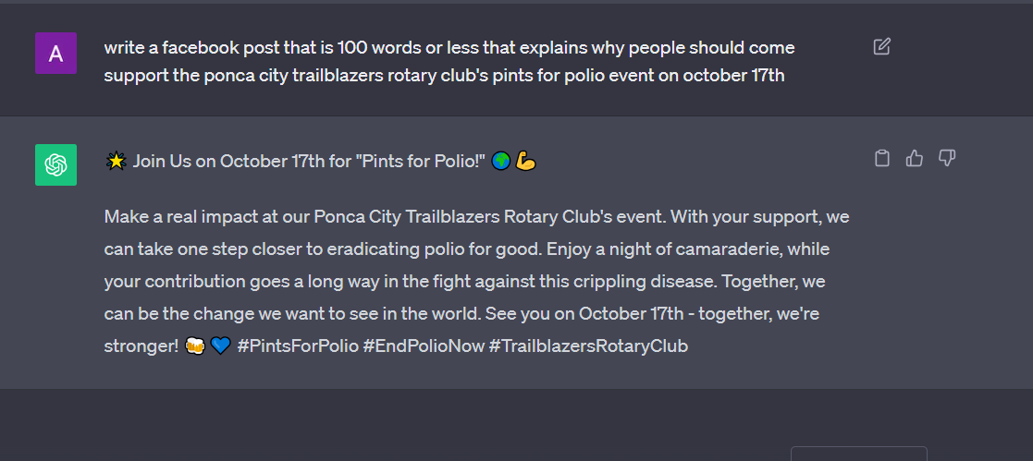
CHAT GPT
Notes:
Angela - AI can help us with consistent messaging.It can also help us answer why, and can help tell a story. You can also use it to create scripts that can easily be edited. In this example I wanted to create a facebook post to encourage people to come to our clubs pints for polio. Notice the specific items I mentioned “Facebook post” “100 words or less” “why”. Seconds later I got a post complete with hashtags that I was able to copy and paste. It is audience centric because it answers why and speaks to more than just existing rotarians, anyone could be interested in this.

Slide 32
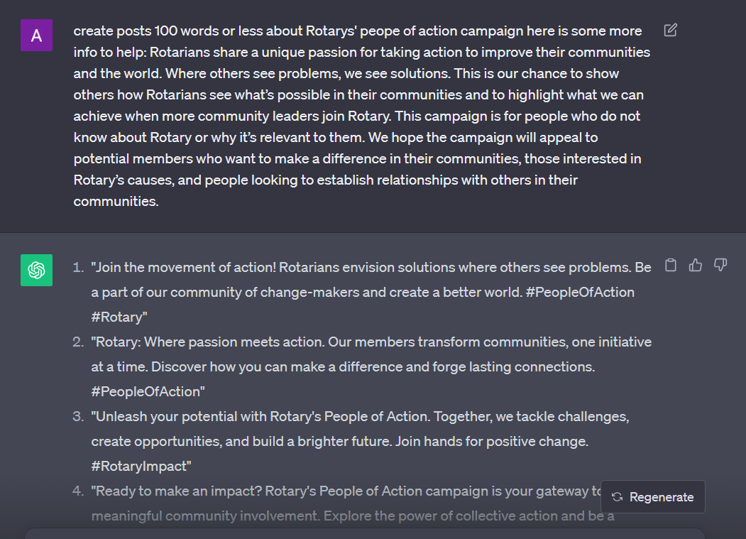
CHAT GPT
Notes:
Angela - AI can help us with consistent messaging in a style true to the rotary voice. Remember we talked about the 4 attributes. You can also use to create scripts that can easily be edited. In this example I wanted chat GPT to help create a library of scripts that my clubs public image chair could easily pull from for posts each week. In this case I asked it to focus on people of action and provided some context on what people of action is. I’m going to stop sharing the presentation now and I’d like to show you a few things live.

Slide 33

CHAT GPT
You can sign up for ChatGPT for free & it is available for download on the App Store or Google Play
https://openai.com/chatgpt
Notes:
Angela – Here’s the website information, also can use on your phones there are some copy cats out there that don’t work very well, so I would look for the official version on the app store. If you don’t want to sign up just yet clik on try chatgpt to start playing around and getting ideas.

Slide 34
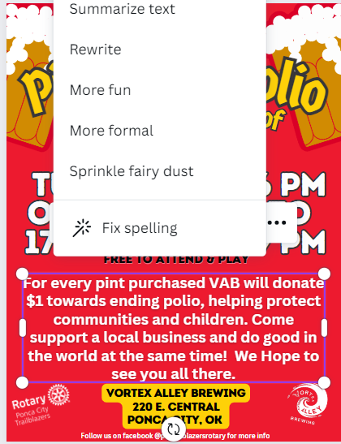
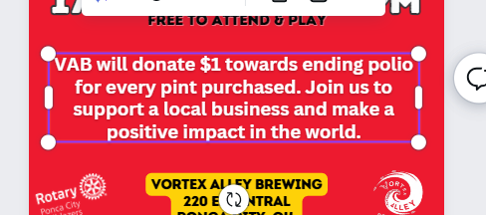
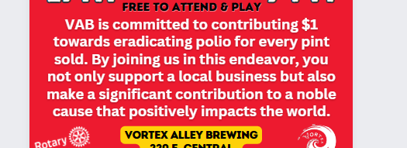
canVa Magic write
Summarize
More formal
Notes:
Angela – I’ll cover this very briefly as I want you to know this is an option but Canva Magic Write can help you with clarity, shortening messages, making more fun or formal. In this example I asked it to summarize my post and make it more formal. Keep this in mind for next month when you are working on elevating your visuals!

Slide 35
ANY QUESTIONS?
Notes:
Angela – Any quick questions that I can answer on using AI? I am now going to hand this over to Laura as we wrap up with our next section on putting it all together.

Slide 36
Putting it all together
Taking our messaging from good to great!
Real Life Examples in our Districts
Notes:
Laura - It’s your turn…let’s take 10 minutes in groups utilize examples provided. Discuss how it could go from good to great by being consistent with rotary branding, people of action, messaging, audience centric? Will then come back and do a read outs. Rules for this exercise are (next slide)

Slide 37
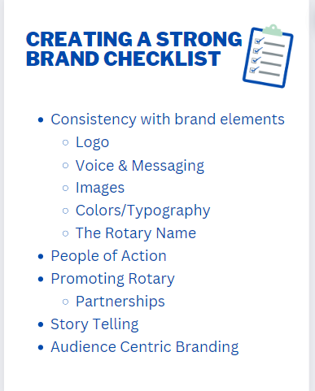
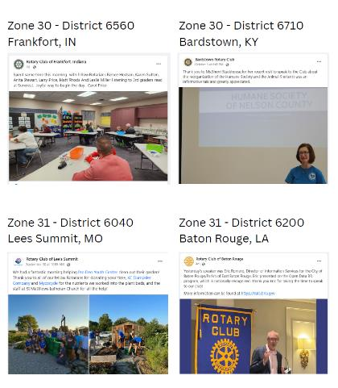
Group exercise
Utilize the provided examples along with the strong branding checklist to discuss how we could take these posts from good to great.
Notes:
Give groups 10 minutes. Examples will be posted in the chat

Slide 38
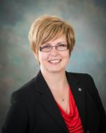
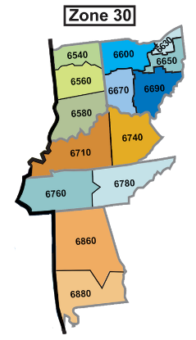
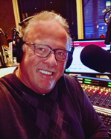
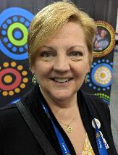
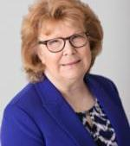

Districts
6540,6600,
6630,6650
Your Zone 30 Public Image Team
RPIC
Districts 6860,6710,
6740,6760
Districts
6580,6670,
6690
We are here to help you!
Ask us to come to your District Conference, PETS, District Assembly and/or Vibrant Club Workshops!
Districts
6780,6860,
6880

Slide 39
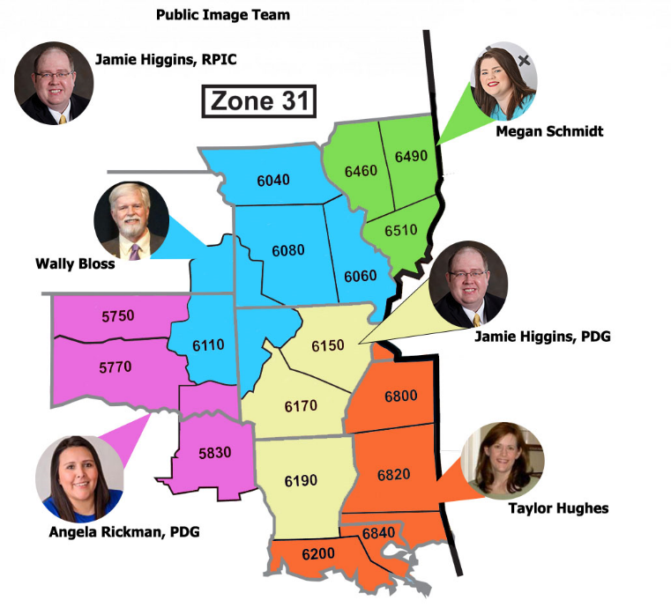
YOUR
ZONE 31 PUBLIC IMAGE
TEAM
Place holder for Zone
_________________________
We are here to help you!
Ask us to come to your
District Conference,
PETS, District Assembly
and/or Vibrant Club
Workshops!
Notes:
Laura

Slide 40
Thank You!
JOIN US NEXT MONTH FOR OUR NEXT SESSION:
ELEVATE YOUR VISUALS: CANVA TIPS & TRICKS
NOVEMBER 14TH AT 7PM ET | 6PM CT
Notes:
Laura

