Slide 1

The ABC’s
of The Rotary Foundation

Slide 2
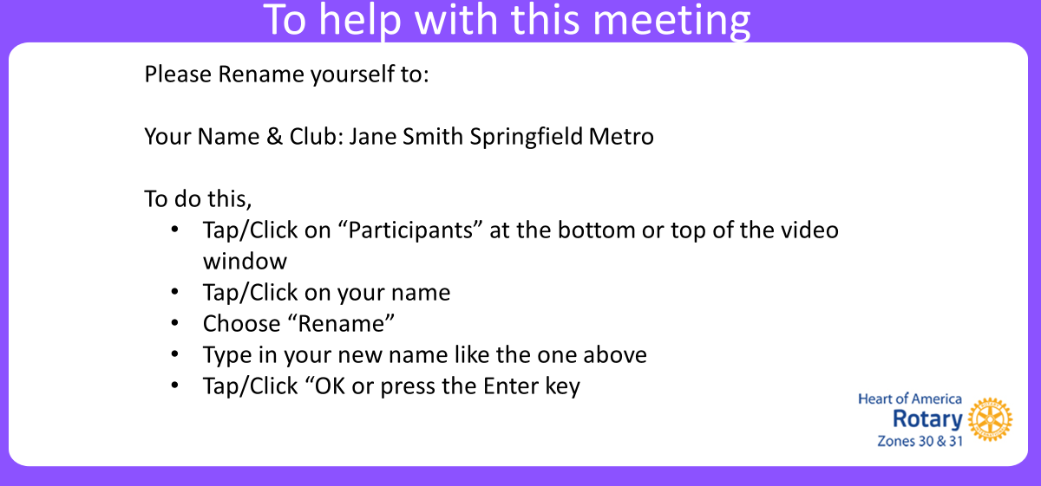

Slide 3

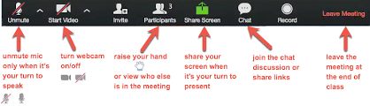
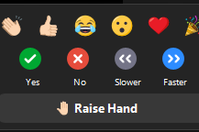
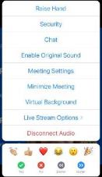




Rules of the zoom
Participants
  Please activate your video webcam
  Please remain muted until called upon
  If using a phone for audio, please self mute and unmute when called upon.
  Utilize “chat” function
  Utilize “raise hand” function
  in reactions
  If the meeting is interrupted and ends, please wait 5 min and log in again
  Gallery view will show all attendees
  Speaker view will show current speaker and is view available on an Ipad or tablet
Desktop Control View
Tablet/Smartphone View
Notes:
Tech Overview: We are going to go over Rules of the Zoom and some Zoom training.
Please stay muted until you want to speak. The reason we ask this is because there can be all sorts of background noise that can disrupt the meeting such as dogs barking, phones ringing, etc. Please mute yourself now if you have not done that.
We will be using the chat box. Please find the chat box icon on your device. Let’s practice that. Type in the chat box the city in which you live.
You have a thumbs up icon on your participant function. Please give us the thumbs up if you agree with this statement: Rotary does so much good in the world.
We will also be doing polls. The facilitator will ask a question or make a statement and then read the choices to you. She or he will indicate if it is either single choice or multiple choice. Make your choices and then click submit. Zoom will be shut down if our meeting is interrupted by unwanted visitors who would compromise our meeting. If that happens, then in 5 minutes login again.
Please know that these sessions will be recorded.
Now I would like to introduce our Director Beth Stubbs.

Slide 4

INCREASE OUR IMPACT
Notes:
Sam – On behalf of the Zones 30 & 31 Foundation Teams, welcome to the ABC’s of The Rotary Foundation. I am Sam Adams, your Zone 30 RRFC. Joining us tonight are my counterpart, Pamela Stewart, your Zone 31 RRFC, Zone 30 EPNC Jerome Bannister, Zone 31 EPNC Mike Groom, Zone 30 EMGA Robert Huffman, Zone 31 EMGA Ted Huffhines, and our team members, Debbie Alexander-Davis, Deb Cheney, Jane Roush, M.J. Shackleford, Larry Titus, Suzanne Ellerbrock, Paul Reinert, Lance Singleton, Jennifer Van Houtte, and Bill Walker.

Slide 5
Knowledge of The Rotary Foundation
Poll 1 How would you rate your knowledge of TRF:
Excellent - I am well versed in most areas
Good - I am considered knowledgeable at my Club
Fair - I know a few things about it
Count me as a beginner
Notes:
Sam –
For starters, we would love to know how you rate your knowledge of The Rotary Foundation. You will see a poll pop-up and let’s take a couple minutes to see our results. Please rate your knowledge as Excellent, Good, Fair, Beginner.
[Poll 1]
How would you rate your knowledge of TRF:
Excellent,I am well versed in most areas
Good,I am considered knowledgable at my Club
Fair,I know a few things about it
Count me as a beginner
Let’s see our results. [comment…]

Slide 6

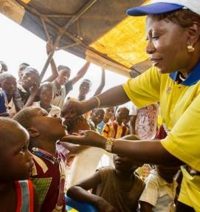

The Rotary Foundation’s Mission
The mission of The Rotary Foundation is to enable Rotarians to advance world understanding, goodwill, and peace by improving health, providing quality education, improving the environment, and alleviating poverty.
100 YEARS OF DOING GOOD IN THE WORLD
Notes:
PAS - The Rotary Foundation is a primary source of funding for Rotary’s humanitarian activities, from clubs’ and districts’ local service projects to global initiatives. It also leads Rotary’s ongoing effort to eradicate polio worldwide.
Our Foundation is a not-for-profit organization which is able to achieve its mission through the generous contributions and active participation of Rotarians and friends of Rotary.

Slide 7
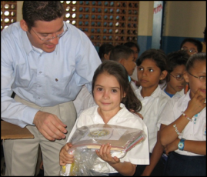
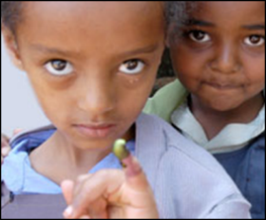
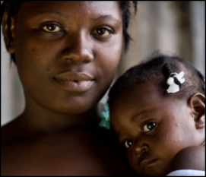
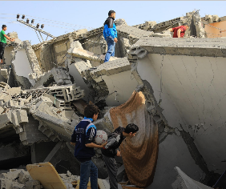
4 FUNDS - SUPPORTING THE ROTARY FOUNDATION
Annual Fund
For support today
PolioPlus Fund
End Polio Now
Gates 2 to 1 Match
Endowment Fund
To secure tomorrow
2.025 BY 2025
Disaster Response Fund
Disaster-Related Reserve
Notes:
Bill:
Contributions to The Rotary Foundation may be made to our PolioPlus Fund to fund the eradication of polio; to our Annual Fund which helps us to support life-changing projects in our local and global communities, to our Endowment Fund which helps us to provide for these same life-changing projects in the future, or to other more specific, focused funding such as the Rotary Disaster Response Fund.

Slide 8
ANNUAL FUND-SHARE
District makes contributions
Contributions are invested over 3 years
Contributions are divided into …
47.5% District Designated Fund
Use up to half for a district grant
Donate to PolioPlus, Rotary Peace Centers, and more
47.5% World Fund
Supports grants and programs available to all districts
Fund global grants and receive World Fund match
5% expenses
Notes:
Lance: When you give money to The Rotary Foundation Annual Fund, SHARE program, in 3 years 47.5% of this comes back to your district for grants. This is what we call District Designated Funds or DDF. Your district can allocate up to 50% of its DDF for district grants and the remaining 50% for global grants.
The 47.5% of our contributions goes to the World Fund which can be used to match your global grants, and 5% is used for operating expenses.

Slide 9
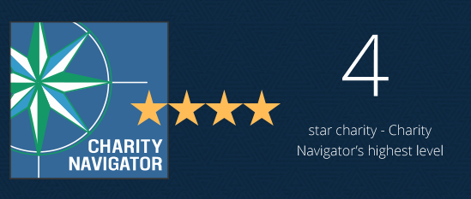
CHARITY NAVIGATOR
15 years in a row!
Notes:
Debbie: In recognition of its efficiency, transparency, good governance and impact, Charity Navigator, the largest independent evaluator of US based charities, awarded TRF another 4-star rating this year. A 4-star rating is best rating a charity can receive.
This is the 15th consecutive year TRF has received this designation, placing it among the top 1% of charities evaluated by Charity Navigator. This designation sets our Foundation apart from its peers – demonstrating to our members and the public its trustworthiness.

Slide 10
Individual recognition
Rotary Foundation Sustaining Member - When you give $100 or more per year to the Annual Fund.
Benefactor - When you include the Endowment Fund as a beneficiary of $1,000 or more in your estate plans or when you donate $1,000 or more to the fund outright.
Paul Harris Fellow - When you give $1,000 or more to the Annual Fund, PolioPlus, or an approved Foundation grant. To recognize someone else as a Paul Harris Fellow, you can give that amount in their name.
Multiple Paul Harris Fellow - When you give additional gifts of $1,000 or more to the Annual Fund, PolioPlus, or an approved Foundation grant.
Paul Harris Society member - When you elect to contribute $1,000 or more annually to the Annual Fund, PolioPlus, or an approved Foundation grant.
Naming opportunities:
Endowed global grant fund
Named endowment
Directed gift global grants
Rotary Peace Centers endowment opportunities
Rotary Peace Centers directed gifts
Rotary Peace Symposium directed gifts
Entrepreneurial named gift for peace
Notes:
Ted:
There are many opportunities for individual recognition such as a Rotary Foundation Sustaining Member, Benefactor, Paul Harris Fellow, and Paul Harris Society Member. [Let’s take a minute or two for you to enter your name in the chat if you have one or more of these recognitions.]
- [briefly skim over the below]
Naming opportunities
Special opportunities are available to create an endowment or make a directed gift in your name or the name of a loved one. Endowed gifts are invested in perpetuity, with part of their earnings spent on a designated program. Directed gifts are spent in their entirety, usually in the following Rotary year.
Endowed global grant fund
$500,000 or more: You can specify up to three of the following: the district sponsor, the area of focus, the general geographic region of the project, or the type of grant activity, such as a project or scholarship.
$250,000 or more: You may choose up to two of the options listed above
$150,000 or more: You may choose one grant activity type, such as a humanitarian project, scholarship, or vocational training team.
Named endowment
If you donate $25,000 or more, you can direct the money to one of the following:
Area of Focus: funds global grants in one area of focus
World Fund: funds global grants in all areas of focus
SHARE: supports the World Fund and provides district designated funds to your district
Rotary Peace Centers: supports Rotary’s partnership with leading universities around the world to train professionals in conflict resolution, peace studies, international relations, and related disciplines
Learn more
Directed gift global grants
$150,000: A one-time gift that provides funding for global grants in up to two areas of focus of your choice or to a special initiative of the Foundation, such as WASH in Schools
$30,000: A one-time gift that provides your district with funds for one or more global grants in an area of focus of your choice
$15,000: A one-time gift that provides funding for a global grant in an area of focus of your choice without specifying the district that will sponsor the grant
Rotary Peace Centers endowment opportunities
$1.5 million: Endows a Rotary Peace fellow every year
$1 million: Endows a Rotary Peace fellow every two years
$1 million: Endows a visiting lecturer every year
$750,000: Endows a Rotary Peace fellow every three years
$500,000: Endows a Rotary Peace fellow every four years
$250,000: Endows one Rotary Peace certificate fellow every year
$100,000: Endows an annual seminar at a Rotary Peace Center
$25,000 and up: Provides general support
Rotary Peace Centers directed gifts
$75,000: Provides funding for a Rotary Peace Fellow to complete a two-year master’s degree program
$75,000: Provides funding for up to 10 internships or research projects for peace fellows
$60,000: Provides funding for five fellows enrolled in the three-month professional development certificate program
$10,000: Provides general support
Rotary Peace Symposium directed gifts
$400,000-$500,000: Underwrites the cost of the Peace Symposium
$50,000-$100,000: Provides full funding for a donor-specified element of the peace symposium (speakers, Rotary Peace Fellow travel, etc.)
$10,000-$25,000: Provides funding for a hosted reception connected to the Peace Symposium
$10,000 and up: Provides general support for the Peace Symposium
Entrepreneurial named gift for peace
$75,000-$1 million: Funds new opportunities within Rotary’s peace programs for global grants and the Rotary Peace Centers, such as workshops and retreats, and other initiatives.

Slide 11


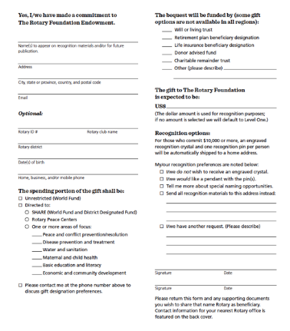

Cumulative gifts to date or legally binding agreement
Major
Donor
$10,000⁺
Arch Klumph
Society
$250,000⁺
Documented promise of a future gift
Bequest
Society
$10,000⁺
Legacy
Society
$1,000,000⁺
Notes:
Robert: You can receive special recognition for your legacy by notifying the Foundation of your commitment. You can do this by completing a Your Rotary Legacy notification form or submitting notification online at rotary.org/legacy.
When you make a promise of a future commitment to the Endowment or an outright gift of $1,000 to the Endowment, you will be recognized as a Benefactor. Starting this year, clubs that have 100% member support of the Endowment may be recognized as Rotary’s Promise Clubs.
As you can see on the slide, gifts made during your lifetime count toward Major Donor and Arch Klumph Society recognition.
Additionally, the Trustees are pleased to confer membership to the Bequest Society for anyone who tells The Rotary Foundation they have left a legacy of $10,000 or more. Members of this group of dedicated humanitarians receive special Foundation updates, invitations to events, and an exclusive pin or pendant. Rotarians who invest in the Foundation’s future retain their membership regardless of fluctuations in their financial portfolio or other assets.
We also have a special recognition for individuals and couples who substantiate a future gift to The Foundation of $1 million or more.

Slide 12
Club recognition
100% Paul Harris Fellow Club - For clubs in which all dues-paying members are Paul Harris Fellows. This is a one-time recognition.
100% Paul Harris Society Club - For clubs in which every dues-paying member contributes a minimum of $1,000 to the Annual Fund, PolioPlus, or global grants within a Rotary year
100% Foundation Giving Club - For clubs that achieve an average of $100 in per capita giving and 100 percent participation, with every dues-paying member contributing at least $25 to any or all of the following during the Rotary year: Annual Fund, PolioPlus Fund, approved global grants, or Endowment Fund.
100% Rotary’s Promise Club - A designation provided to clubs in which every dues-paying member supports The Rotary Foundation’s Endowment with a minimum commitment of $1,000 or more in an estate plan or via an outright gift of $1,000 or more. A certificate honoring the achievement will be provided upon request.
Every Rotarian, Every Year Club - For clubs that achieve a minimum Annual Fund contribution of $100 per capita during the Rotary year, and every dues-paying member must personally contribute at least $25 to the Annual Fund during the year.
Top Three Per Capita in Annual Fund Giving - For the three clubs in each district that give the most, per capita, to the Annual Fund. Clubs that give at least $50 per capita are eligible.
Rotaract Giving Certificate - Rotaract clubs that collectively contribute $100 or more annually to The Rotary Foundation will be eligible for a Rotaract Giving Certificate.
Notes:
PAS : Just as there are individual recognitions, there are club recognitions for those clubs which create a culture of giving and support for The Rotary Foundation, including 100% Paul Harris Fellow Clubs, 100% Paul Harris Society Clubs, 100% Foundation Giving Clubs, 100% Rotary’s Promise Clubs, Every Rotary, Every Year Clubs, and top per capita giving clubs, and Rotaract Giving clubs.

Slide 13


Rotary Zone 30 - Paul Harris Society
Paul Harris Fellow vs. Paul Harris Society
Convert Numbers to Impact
Study Donor List & Reengage
Building Culture of Giving
Say THANK YOU!
Notes:
Larry: I want to take a minute or two to provide more information on the Paul Harris Society and why this is so vital at the individual and club level. The Paul Harris Society is different from being a Paul Harris Fellow. You must make an ongoing commitment to The Rotary Foundation to give at least $1,000 per year to become a member of the Paul Harris Society. Many donors are eligible for this but never complete the commitment form because they are not aware that this is an honor distinct from Paul Harris Fellow.
And making an auto withdrawal of $84 a month out of your checking account using Rotary Direct, you may not even notice the deduction, but you will be able to see the positive impact Rotary makes and promote a culture of giving in your club and district.

Slide 14

Notes:
Jerome/Mike: We are also expanding our reach through Polio Eradication, Rotary’s #1 humanitarian project.
Mike and Jerome – WHO WE ARE (as EPNCs)
Our role is to foster awareness of polio and advocate for its eradication, as well as to raise funds for our number one humanitarian project at the club and district levels. We help Rotary raise at least $50 million each year in contributions, District Designated Funds (DDF), and World Fund matches to achieve our annual End Polio Now: Countdown to History fundraising goal.
We understand and communicate:
Inclusion in Rotary’s Action Plan
The progress of the global polio eradication effort
PolioPlus fundraising goals and priorities
Opportunities to raise money for the PolioPlus Fund
We promote locally and regionally:
Continuous support for achieving a polio-free world
Use of Rotary Foundation giving tools
Increasing the number of clubs that support the PolioPlus program
Allocation of 20% or more of districts’ DDF to the PolioPlus Fund
We are resources for all of you to use in our efforts to eradicate polio.

Slide 15
Notes:
Mike/Jerome: Mike/Jerome: Because of our efforts to eradicate polio, 4 billion children have been vaccinated, 20 million people are walking today that otherwise would have been paralyzed. And, we have helped prevent other vaccine preventable diseases, e.g., Measles, Ebola, Covid 19. Just as importantly, we have created decent standards of health care where there was none or very little.

Slide 16
The Polio Windshield Shows We Still Have New Cases
Wild Polio, (Paralyzing)
2023 9 cases (3 in Pakistan, 6 in Afghanistan)
2022 30 cases (2 in Afghanistan, 20 in Pakistan, 8 in Mozambique)
2021 6 cases (Pakistan, Afghanistan, Malawi)
2020 140 cases (Pakistan, Afghanistan)
Vaccine Derived (Mutated, somewhat less severe and mostly in Africa)
2023 315 cases (compared with 440 for the same period in 2022)
2022 876 cases
2021 698 cases
Notes:
Mike/Jerome: So, where are we today in our eradication efforts?
Wild Polio, (Paralyzing)
2023 9 cases (3 in Pakistan, 6 in Afghanistan)
2022 30 cases (2 in Afghanistan, 20 in
Pakistan, 8 in Mozambique)
Vaccine Derived (Mutated, somewhat less severe
and mostly in Africa)
2023 315 cases (compared with 440 for the same period in 2022)
2022 there were 876 cases
How do we reach our goals?
Every district pledge at least 20% of their available DDF to PolioPlus.
Every club contributes $30 per capita for PolioPlus.
Every club and district participate in a World Polio Day event on October 24.and register those events
Participate in world immunization week.

Slide 17
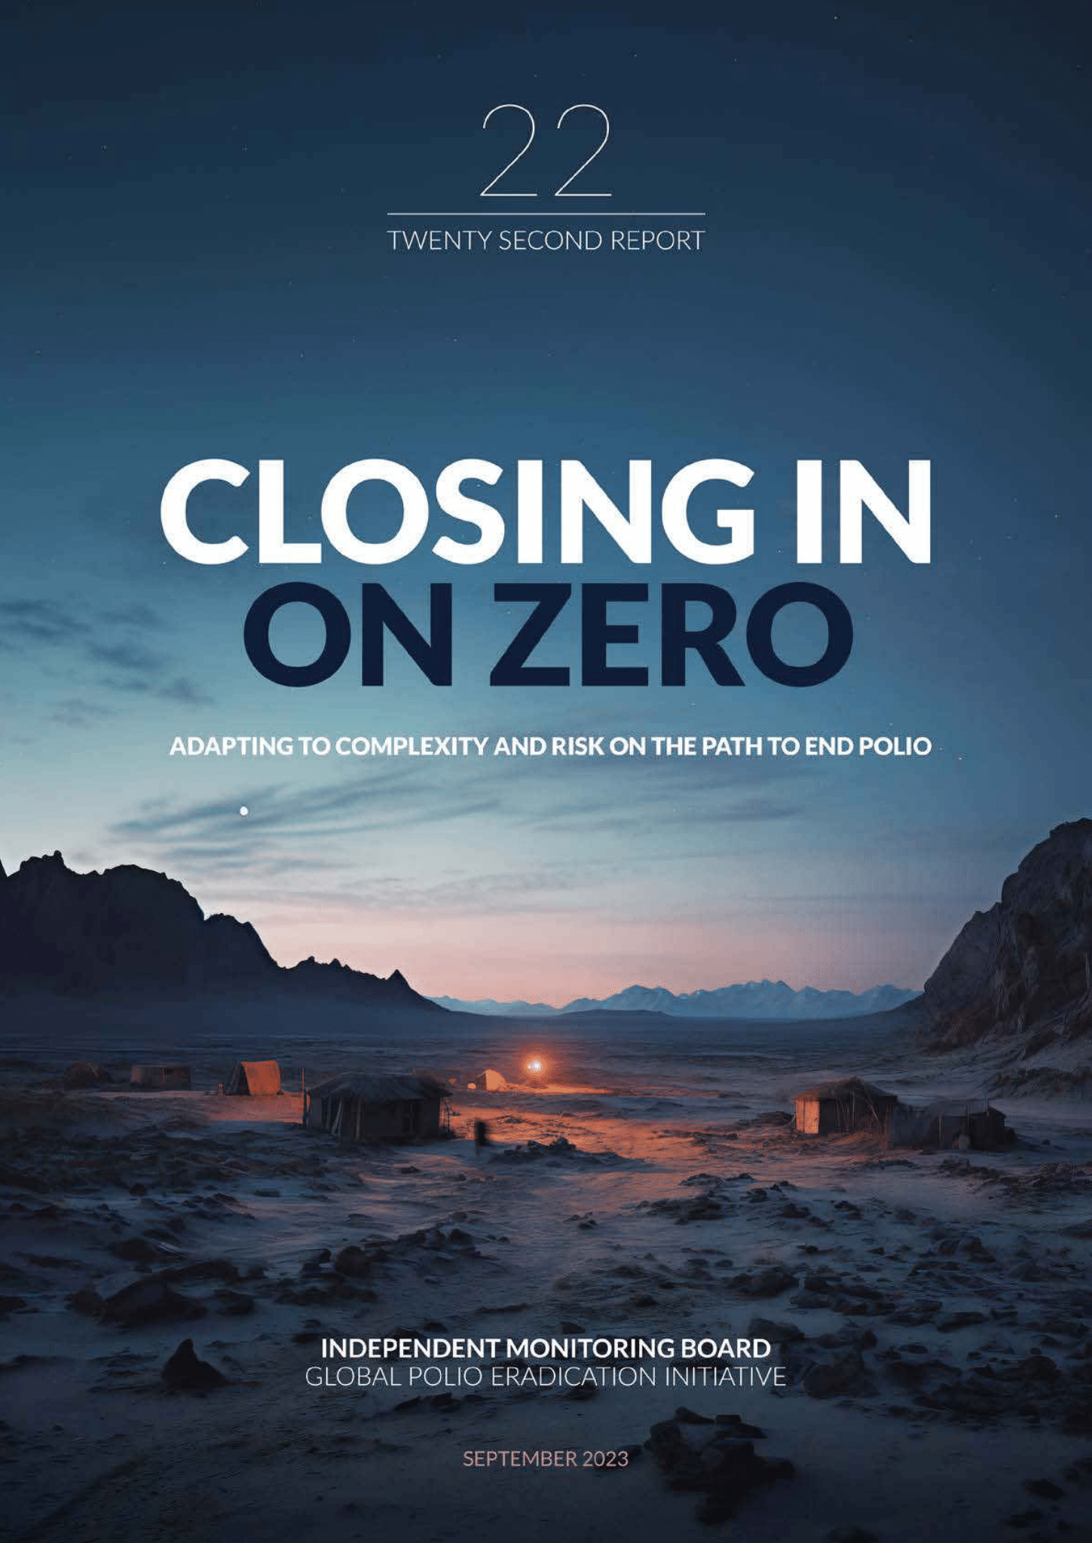
As we close in on our goal of zero polio cases, we need to remember that there used to be 365,000 kids paralyzed each year. This is a huge success story that we, Rotarians, started here in Zones 30/31. Eradication is the ultimate in both equity and sustainability, because it is for everyone and forever.

Slide 18
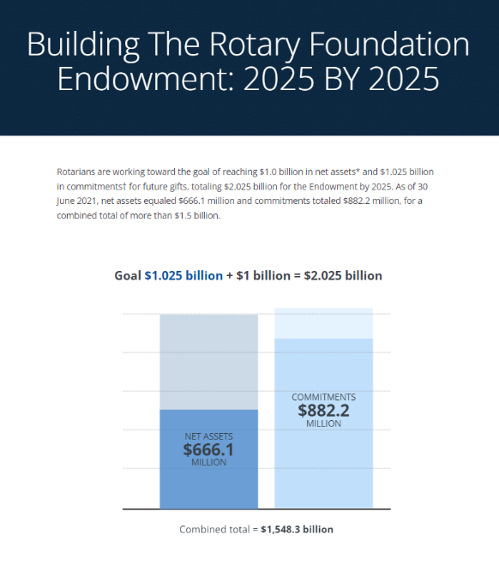
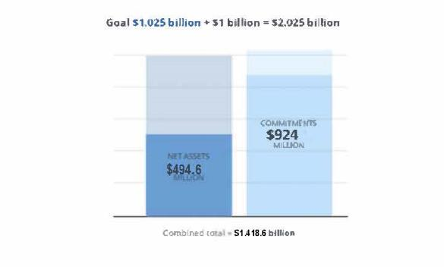
2.025 BY 2025
Notes:
Ted: The Rotary Foundation Endowment ensures that future Rotary members will have the resources they need to design and implement sustainable projects year after year. The principal of gifts to the Endowment is never spent. Spendable earnings generated on the principal are directed annually to Foundation grants and programs. Gifts to the Endowment support the same programs that the Annual Fund supports, but in perpetuity. Contributions can be made to the Endowment in the form of Outright gifts of cash, investments, or other property, such as Life income gifts; Testamentary gifts through wills or estate plans; or by making The Rotary Foundation a beneficiary of life insurance, retirement plan accounts, or other financial accounts. Our goal is to build our Endowment to $2.025 Billion by 2025.

Slide 19
The Rotary Foundation Goals 2023-24
Annual Fund
  Beat Your Best (per capita)
  Increase total number of members and clubs contributing to the Annual Fund (10%)
  Encourage each new member to donate $25 to the Annual Fund
  Increase total number of Paul Harris Society members
PolioPlus Fund
  $30 per capita (minimum of $1,500 per club)
  Increase total number of members and clubs contributing to the PolioPlus Fund (5%)
  Establish PolioPlus Society or increase total number of PPS members
  Increase gifts of District Designated Funds (DDF) to PolioPlus by at least 10% (minimum 20%)
Endowment Fund
  Identify at least two individuals per district for potential major gift
  Add 5 new members to the Bequest Society or to a new level of the Bequest Society
  Help build the Endowment to $2.025 billion by 2025
Notes:
PAS: Setting and sharing goals and achievements are extremely important to Increase our Impact and Engage our Participants. These are our goals for this year.

Slide 20
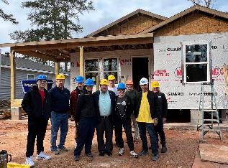
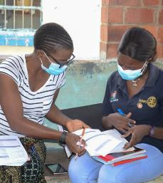

4 GRANT TYPES
District Grants
Short-term
Smaller scale
Global Grants
Long-term
sustainable
area of focus
$30,000 minimum
Programs of Scale Grants
3-5 years
Partnerships
Area of focus
$2 million
Disaster Response
Grants
Funded by Disaster Response Fund
Notes:
PAS: We are helping to expand our reach through more grant options, now 4 instead of 2.

Slide 21
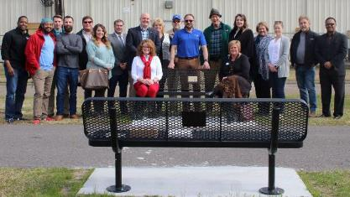
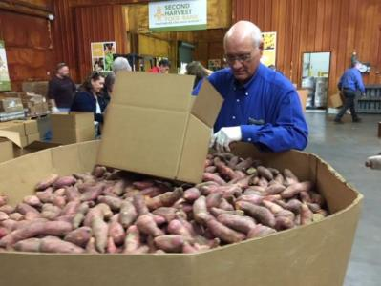
District Grants
Smaller activities and projects
Funds both local & international activities
Activities must be consistent with the mission of Rotary
Notes:
Jane -As Lance explained, our Annual Fund-SHARE gifts come back to our districts in the form of the District Designated Fund. One use of these funds is for district grants which are smaller, short-term projects usually in our local communities, but some districts even use these funds to do smaller, shorter term international projects.

Slide 22
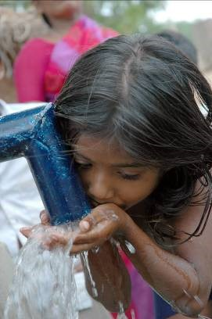
Global Grants
Longer-term projects
Sustainable impact
Support One of Rotary’s 7 Areas of Focus
Larger amount ($30,000-$400,000)
Address an important need identified in the community
Strengthen the community’s capacity to address its own needs
Notes:
Debbie: As [Jane] explained, our Annual Fund-SHARE gifts come back to our districts in the form of the District Designated Fund. In addition to district grants, these funds are available for global grants. Global grants are by nature longer-term, larger grants and as such have additional requirements set by The Rotary Foundation to ensure that the projects are sustainable with measurable and lasting outcomes and that the grant funds are managed responsibly. A global grant must also meet an important need of the community within one of Rotary’s 7 areas of focus and help improve the community’s capacity to address its own needs.

Slide 23

Seven Areas of Focus
Notes:
Mike: Remember we now have 7 areas of focus, as we added the Environment.

Slide 24
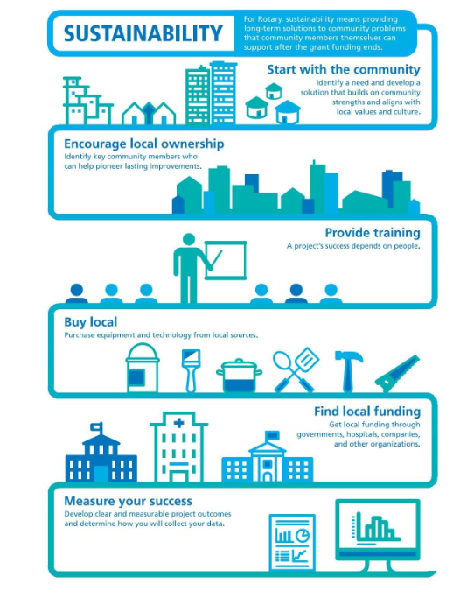

Notes:
Lance: Global grants must have sustainable impact. Here we have 6 steps to sustainability. Start with the community to identify a need and develop a solution that builds on community strengths and aligns with local values and culture. This means we need to start with a community assessment – ask the community what they need rather than deciding what you think you would like to do. You may want to provide school uniforms, but the community may have a greater need for clean water or for trained teachers and books. Identify key community members to assess their needs and become partners committed to the project and maybe even create new jobs or sell goods and services. Provide training and education so that the community knows how to take over the project when the grant funding is gone. Buy local, getting at least 3 bids, and make sure spare parts will be available locally. Get local funding through governments, hospitals, companies or other organizations. Develop clear, measurable project outcomes and engage the community in collecting data and evaluating the outcomes.

Slide 25
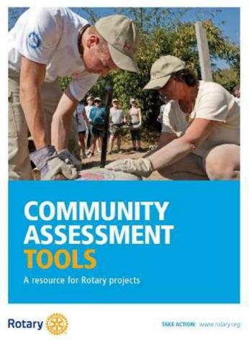

Community Needs Assessment
Remain open minded
Choose participants carefully
Include overlooked or marginalized groups
Consider yourself an outsider
Avoid promising a project before your club makes a formal decision
Empower stakeholders
Notes:
M.J. - Don’t presume you know what the community needs, choose a group of diverse participants (gender, age, ethnicity, religion, income levels, and vocations), include women, young, elderly, religious and ethnic minorities, speak with your participants not at them, AND don’t overpromise – your club may not vote for the project you think they will. While community needs assessments are required for global grants, it is wise to use them for district grants and club projects to make sure you are having the greatest impact for good.

Slide 26
The Rotary Foundation – District Qualification Memorandum of Understanding
District Qualification
District Officer Responsibilities
Club Qualification
Financial Management Plan
Annual Financial Assessment
Bank Account Requirements
Report on Use of Grant Funds
Document Retention
Method for Reporting and Resolving Misuse of Grant Funds
Notes:
Sam: For those of you who have worked on grants or are considering requesting grant funding, you will need to make certain that your club and district meet qualifications for grant funding annually and provide proper documentation and oversight to ensure funds are safe-guarded.

Slide 27

Programs of Scale
Supports long-term activities that benefit more people
Aligns with the areas of focus
Includes $2 million from the World Fund
Is implemented with partners
Uses a competitive process
Notes:
PAS: Rotary’s Programs of Scale builds on the scope, impact, and sustainability of successful Rotary service projects in our areas of focus by supporting larger and longer-term undertakings. Programs of Scale empowers Rotary members to work with experienced partners to implement large-scale, high-impact programs that benefit many people. The Rotary Foundation awards one $2 million Programs of Scale grant each year to a program sponsored by a qualified club or district that is working in strong collaboration with partner organizations. Each grant helps a program scale up, or expand, over three to five years to create lasting change.

Slide 28

2022-23 GRANT STATISTICS
District grants
473 grants
$26 million
Global grants
1,098 grants
$55 million
Disaster response grants
321 grants
$15 million
Notes:
PAS- In addition to the $2M Program of Scale grant, in 2022-23 our donations funded 473 district grants, 1,098 global grants, and 321 disaster response grants, plus addition specialized grants.

Slide 29
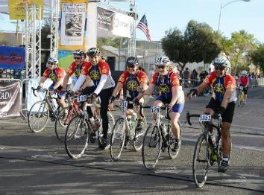
Ways to Give and How to Support Fundraising
Educate members
Thank donors in innovative ways
Get donors and potential donors involved in projects
Rotary.org/donate
Rotary Direct
Memorial/tribute gifts
Employee matching
Raise for Rotary
Facebook
Encourage members and donors to support the Foundation in different ways
Notes:
Bill - Bill: Contributions to The Rotary Foundation may be made by credit card at rotary.org/donate. You can also give by check or wire transfer, or through your club, using The Rotary Foundation Contribution Form available at My Rotary. Club officers who sign into My Rotary can make online gifts for their club or its members. With all gifts, be sure to include your member ID to ensure that you get proper credit and recognition.
Support Rotary’s Foundation year-round by making a recurring gift with Rotary Direct. You choose how much and how often to give. It is a simple and secure way to make a big impact.
If you wish to honor or memorialize someone with a contribution to The Rotary Foundation, please go to rotary.org/donate. Select Donate, choose what you would like to support, and then select “I would like to make this donation in honor or in memory of someone.” Donors will receive gift credit and a tax receipt (where applicable). The person they honor, or the family in the case of a memorial, will be notified of the gift by email.
Double the impact of your gift by asking your employer to match your contribution to The Rotary Foundation. More than 15,000 companies match gifts to the Foundation, including many international corporations. Find out if your employer does at rotary.org/matching gifts.

Slide 30
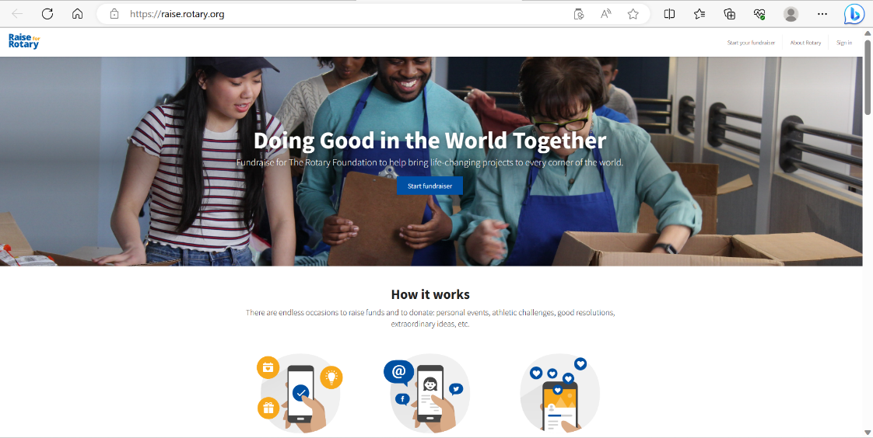
Notes:
Jane: Raise for Rotary is a platform that allows individuals and teams to create online fundraisers that benefit The Rotary Foundation. They are a great way to celebrate personal events and special occasions. Organizers can share their fundraisers through social media, email, and text, so family, friends, colleagues, and supporters can donate online.

Slide 31
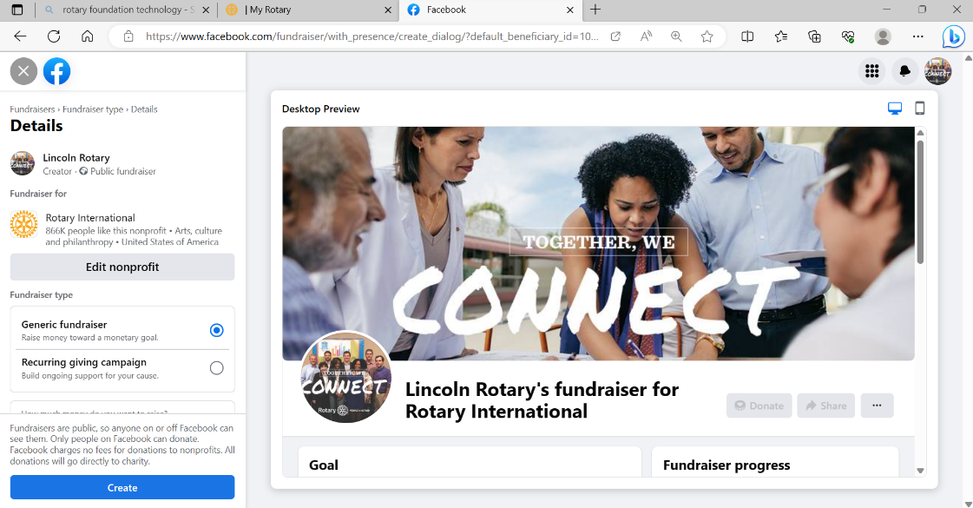
Notes:
Jane: You can raise funds for The Rotary Foundation using Facebook. Simply select either Rotary International

Slide 32
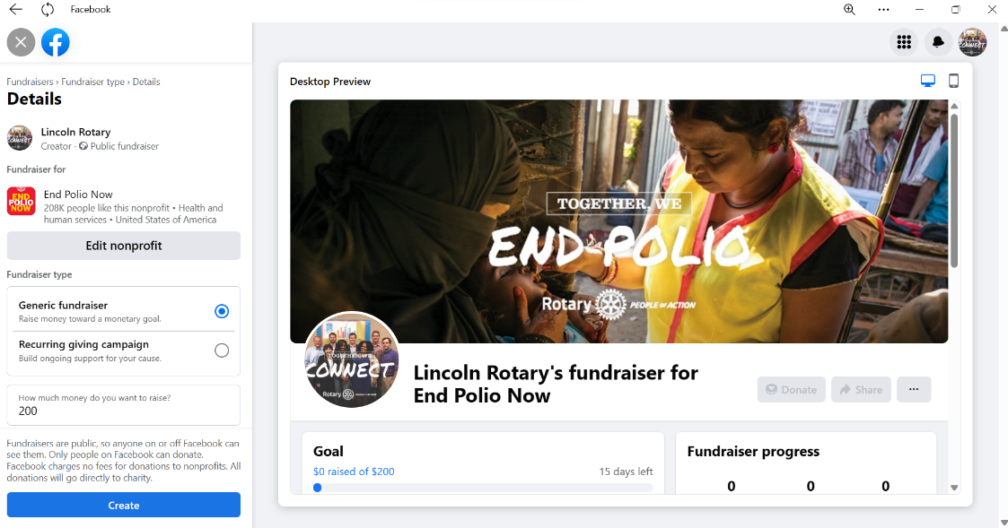
Notes:
Jane: or End Polio Now as your nonprofit and share it with your friends.

Slide 33
Follow-up on The Rotary Foundation
Poll 2
As a result of this webinar, I would like to see a more advanced follow up
Yes
No
Notes:
Sam: We would love to know if you would be interested in more opportunities to explore The Rotary Foundation. We have a couple of very quick polls we would appreciate your answering and would like to know what questions you might like to have answers for. You will see a poll pop-up and let’s take a couple minutes to see our results.
[Poll 2]
As a result of this webinar, I would like to see a more advanced follow up
Yes
No
[Poll 3]
As a result of this webinar, I would like to know more about:
Fundraising ideas for the Annual Fund and Polio
How the funds are spent [and invested]
Endowment Fund
The ABCs of doing a Global Grant
Let’s see our results. [comment…]
Tonight’s session has been recorded, but we would like to also provide you answers to other questions you may have. If you have any questions you would like addressed, please enter them in the chat box. We will prepare responses and share those answers, along with the video link for tonight.

Slide 34
Follow-up on The Rotary Foundation
Poll 3
As a result of this webinar, I would like to know more about:
Fundraising ideas for the Annual Fund and Polio
How the funds are spent and invested
Endowment Fund
The ABCs of doing a Global Grant
Other
Notes:
PAS: We would like to know what you want to learn more about
[Poll 3]
As a result of this webinar, I would like to know more about:
Fundraising ideas for the Annual Fund and Polio
How the funds are spent [and invested]
Endowment Fund
The ABCs of doing a Global Grant
Other
Let’s see our results. [comment…]
Tonight’s session has been recorded, but we would like to also provide you answers to other questions you may have. If you have any questions you would like addressed, please enter them in the chat box. We will prepare responses and share those answers, along with the video link for tonight.

Slide 35
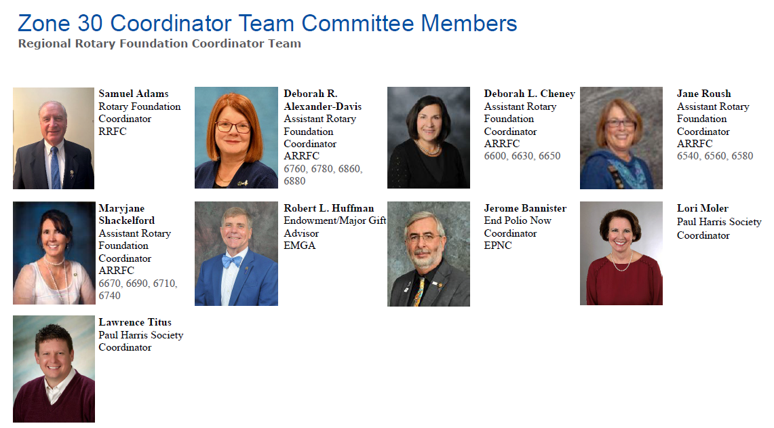
Notes:
Sam: Thank you for joining us tonight. We would love to hear from you, to respond to questions, and to provide support to help you to be successful in your support of The Rotary Foundation. Zone 30 [name each].

Slide 36
Notes:
PAS – Zone 31’s team includes…., and we stand with Zone 30’s team to help support our Zones 30 & 31 Rotarians and Rotoractors and The Rotary Foundation.
Thanks again for joining us.

