Slide 1
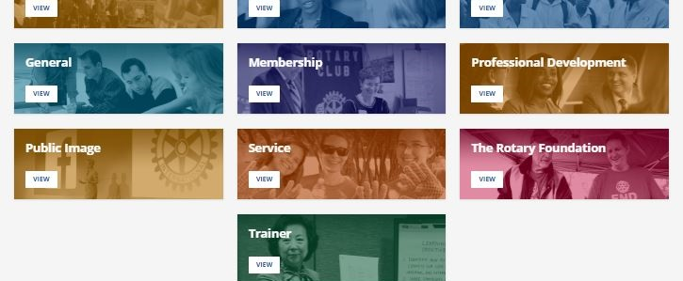
Rotary’s Learning Center
Kimberly Kouame, Learning Resource Manager at World Headquarters
Notes:
Thank you for joining me tonight. I’m excited to share with you Rotary’s online Learning Center. We’ll look at content that’s available.
Links for chat:
Course Catalog: https://my-cmsuat.rotary.org/en/document/learning-center-course-catalog
Facebook Page: https://www.facebook.com/RotaryLearn
Access to Learning Center Report course: https://my.rotary.org/learn?deep-link=https%3A//learn.rotary.org/members/learn/course/internal/view/elearning/504/access-to-learning-center-reports
Learning Plan links: https://my.rotary.org/learn?deep-link=https%3A//learn.rotary.org/members/share/asset/view/3701

Slide 2
Agenda
Overview of the Learning Center
Learning Resources
Leveraging the Learning Center
Stay Connected
Notes:
Today I’ll be sharing an overview of the Learning Center and some of the resources you have access to on the Learning Center as a Rotary member.
We’ll also look at how you can leverage the Learning Center and stay connected with the staff team for support.
There will be time for questions at the end.

Slide 3
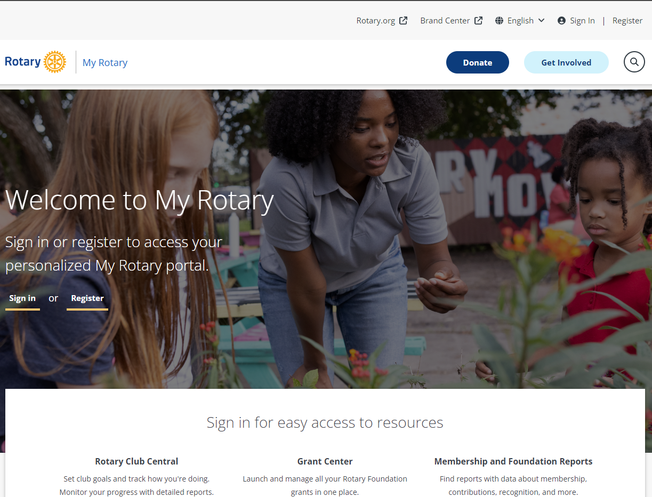
Notes:
To start, to access the Learning Center, we recommend that you keep your system updated. That means regularly completing updates when prompted for you computer system and browser, shutting down and re-starting your computer regularly, and clearing cookies and cache so your browser is refreshed.
The Learning Centers platform is compatible with Google Chrome, Microsoft Edge, Safari, and Firefox for web browsers. To ensure the best experience, we recommend that you have one of the two latest versions of your preferred browser.
Note: You can only access the Learning Center if you have created a My Rotary account and logged in.

Slide 4
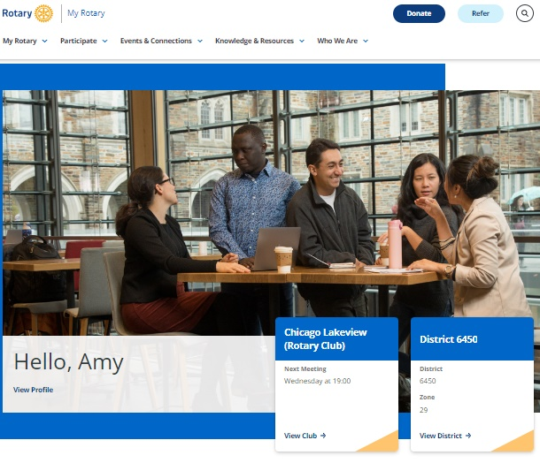
Notes:
There are three easy ways to enter the Learning Center.
After you sign into My Rotary, you can hover over Knowledge & Resources.

Slide 5
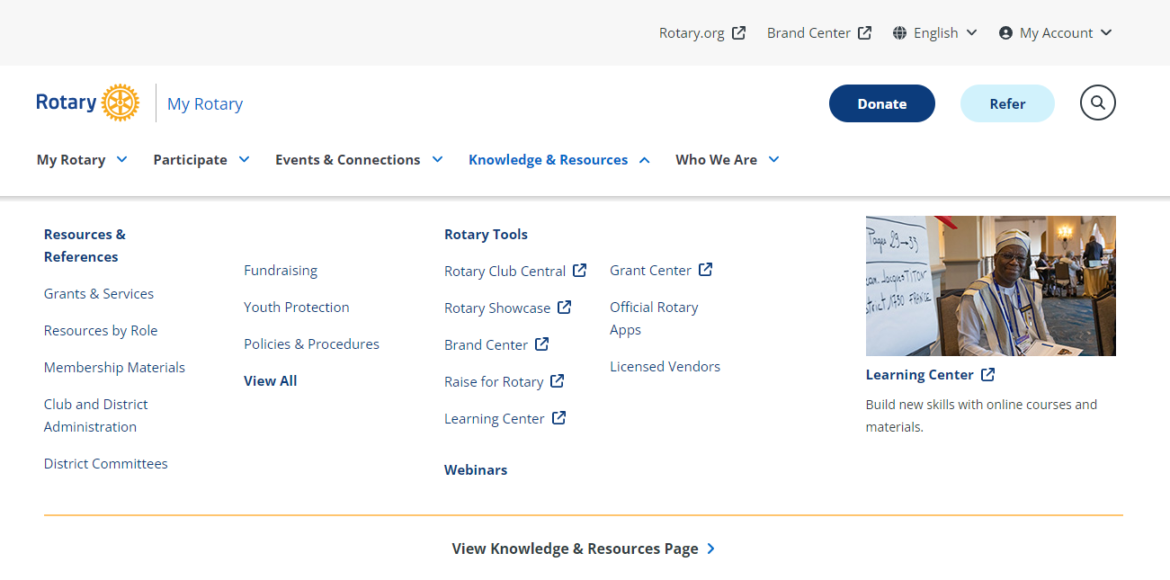
Notes:
You will see a drop-down menu that allows you to access the learning center.

Slide 6
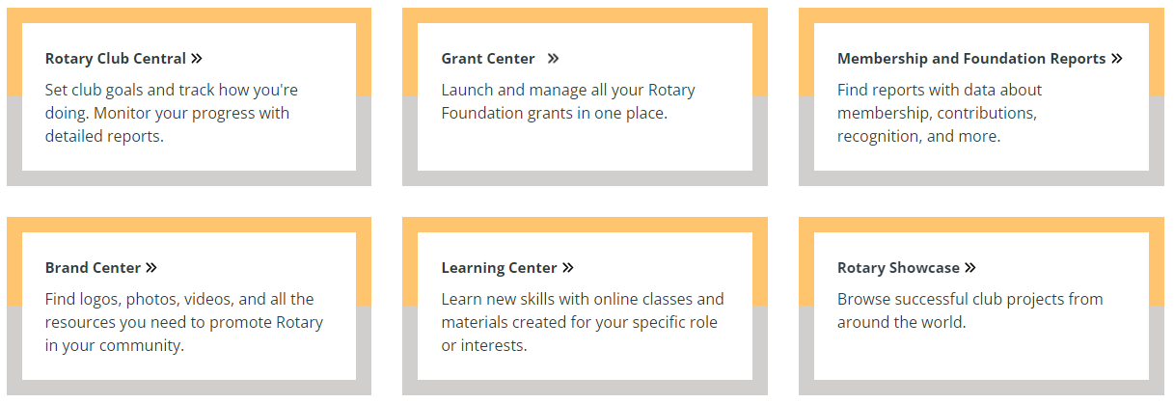
Rotary.org/learn
Notes:
The learning center can also be accessed directly on the My Rotary Homepage. After you sign in, you can also scroll to the bottom of the page and click on Learning Center button.
Lastly, you can type rotary.org/learn in your URL and sign into My Rotary.
Note: When encouraging your members to create a My Rotary account to access the Learning Center, remind them to use the email associated with their Rotary membership. If they use a different email, it will create a second account in our database that isn't attached to their club, so in the Learning Center they will view the courses for non-members. If this happens, email learn@rotary.org and we'll investigate further.
https://www.rotary.org/myrotary/en/document/how-create-my-rotary-account (for reference if anyone asks for the link)

Slide 7
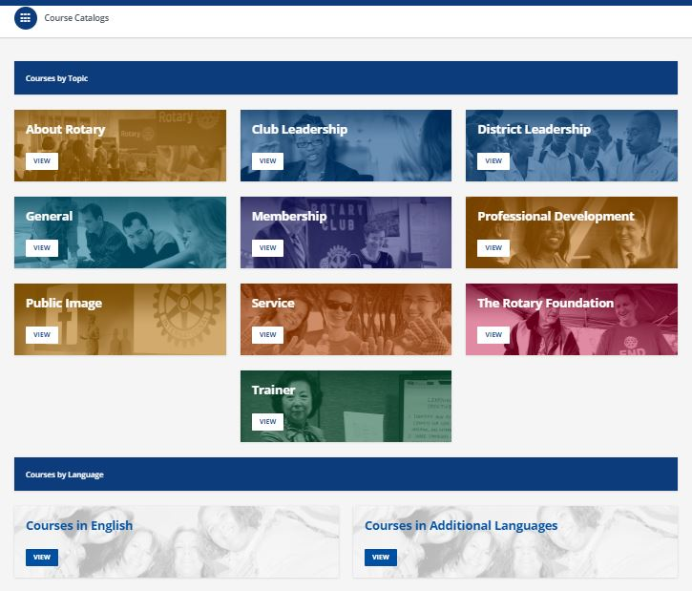
subhead
Accept Privacy Policy
Then procede to the course catalog page.
Notes:
If you haven’t been before, you will be asked to accept the privacy policy before being taken to the course catalog page, or the home page. Each box on this page is a catalog of courses.
Course catalogs include courses you can choose to enroll in. Learners can browse courses by topic or by language. Click view on the button of the course catalog you want to look through. As incoming governors, you’ll want to go to district leadership.

Slide 8
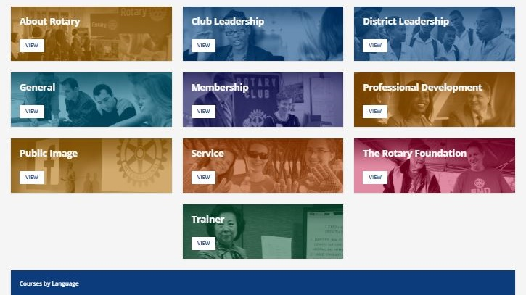
Leadership Courses
Notes:
PAUSE: QUESTIONS?
Now that you know what resources are available to you, let’s talk about some best practices as a committee chair.

Slide 9
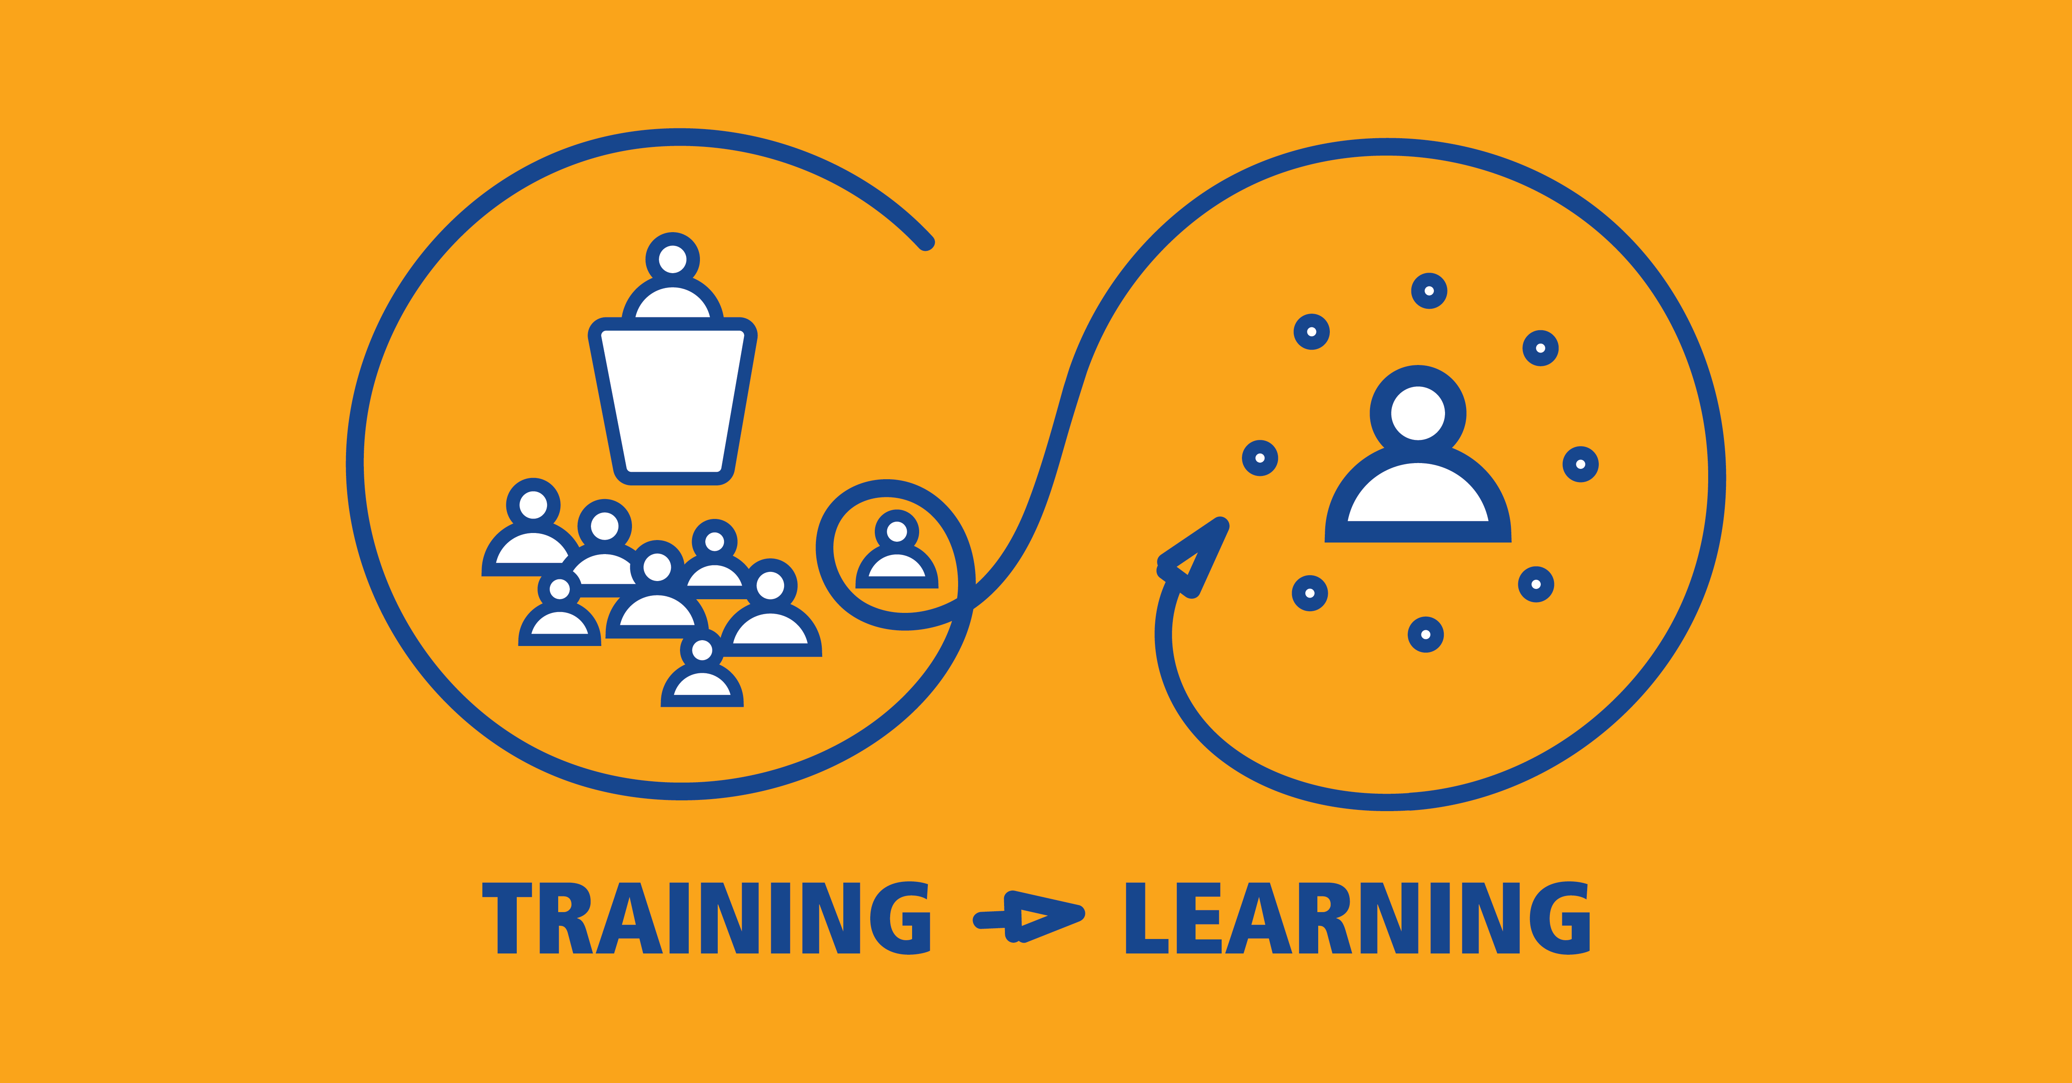
Notes:
Before I get into your courses I’d like to talk about our philosophy.

Slide 10
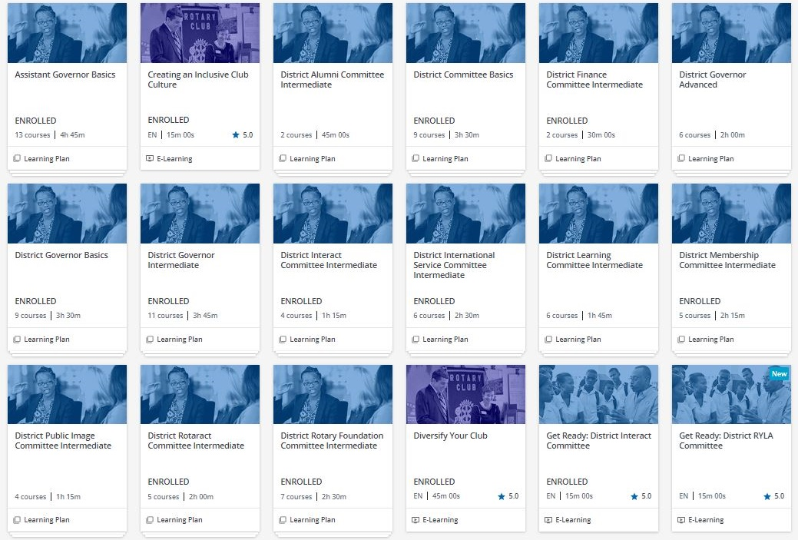
District leadership catalog
Notes:
You can see that this is mostly learning plans. We have the three learning plans for governors,

Slide 11
District Governor Basics
2024-25 Courses
Get Ready: District Governor-nominee
Working With Your District Team
Your District Events
Rotary’s Action Plan and You
Rotary Foundation Basics
The Rotary Brand
Committing to Diversity, Equity, and Inclusion
Preventing and Addressing Harassment
Protecting Personal Data
Notes:
These slides show the current learning plans and proposed changes for July 2023.
Text that is crossed out and in blue means it is staying in the series but moving to a different learning plan.
Red text means a new course is being added.

Slide 12
District Governor Intermediate
2023-24 Courses
Get Ready: District Governor-elect
Maximizing Governor Visits
Managing District Finances
Managing Grants and Foundation Funding
Minimizing Risk
District Elections and Council Representatives
Online Membership Leads
Starting a Club
Our Logo: Representing Rotary
Protecting Youth Program Participants for DGs 2024-25
Leading Change
Notes:
Propose moving Leading Change to Intermediate, as DGEs are most likely already planning the changes they want to implement for their year when completing this learning plan
These slides show the current learning plans and proposed changes for July 2023.
Text that is crossed out and in blue means it is staying in the series but moving to a different learning plan.
Red text means a new course is being added.
Let’s watch if 11 courses are too much.

Slide 13
District Governor Advanced
2023-24 Courses
Uncovering Unconscious Bias
Microaggressions
Essentials of Understanding Conflict
Fundraising Basics
The Power of Giving
Building Rotary’s Public Image
Notes:
Leading Change moved to Intermediate
Removed Conducting Training Online as this is covered by District Learning Committee, DG should work with that team
Removed Deliver a Speech and Building Consensus, reducing courses required during the same timeframe as GETS and IA, courses are better served as personal/professional development courses rather than basics needed to understand the Rotary role
These slides show the current learning plans and proposed changes for July 2023.
Text that is crossed out and in blue means it is staying in the series but moving to a different learning plan.
Red text means a new course is being added.

Slide 14
Notes:
DGNs should be working on their basic learning plans. A number of DGNs need to get to the LC to enroll. I will be enrolling DGNs as well.

Slide 15
Notes:
DGEs should be done with the basics and working on their intermediate learning plan. We have a few that have already finished their advanced courses. Some of you already completed your intermediate plans, you will need to go back and complete this year’s Protecting Youth Program Participants if you want your district to be eligible to participate in youth programs. This is new this year.

Slide 16
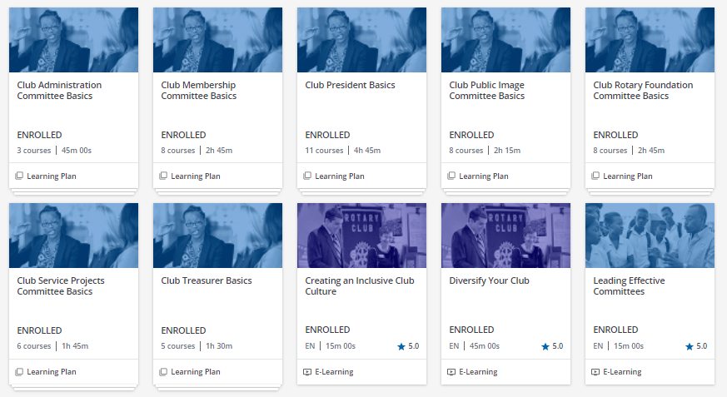
Club officer materials
Courses required for incoming club presidents, secretaries, and treasurers.
Notes:
Club officers each have a learning plan (or series of courses) that is required before taking office.
We encourage you to ask your club officers to take these courses. Once their names are entered into My Rotary and our database, the following Monday we send a message telling them about the courses they are required or recommended to take based on their role. One of our challenges is that we don’t get club president names into our system in a timely manner, so we’ll need your help getting club officers entered into My Rotary by February 2025.
You can go back any time to review content or save it in your favorites to find it more easily.

Slide 17
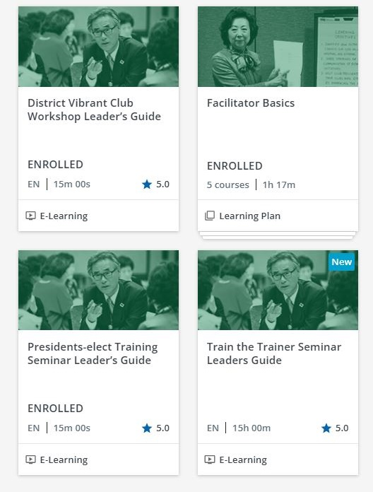
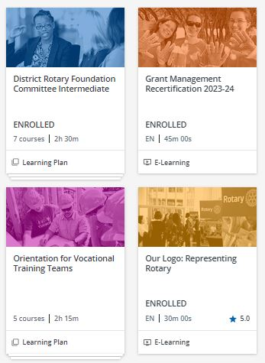
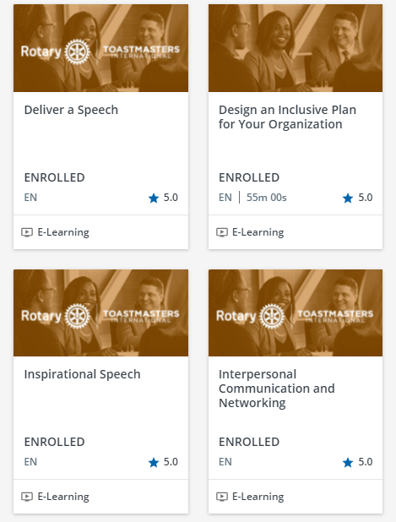
Other courses
Notes:
We will have four total leadership course that could help you work on specific skills as Rotary leaders.
Leadership Basics
Leading a Team
Building Consensus
Collaboration
For Communication we have
Develop a Speech
Deliver a Speech
Inspirational Speech
Interpersonal Communication and Networking
If you are interested in building you leadership or communication skills, I highly recommend taking these courses before the start of your year and using your role to complete the projects and seek feedback from other members.
If you are more interested in improving your speaking skills, we also have four Toastmaster courses focused on communication.

Slide 18
Features
Notes:
PAUSE: QUESTIONS
Now that you know what resources are available to you, let’s talk about features you can benefit from.

Slide 19

Customize Content
Create customized learning plans
Request a learning topics for your district or zone by topic or language
Notes:
You can email our team with a list of individual courses you would like to see in a learning plan. The benefit of this is if you are asking members to take a group of individual courses, we could give you one deep link and you can track progress of the learning plan on your reports.
You can also request us to set up a learning topic for your zone or district by topic or language. For example, we have a topic called District 5890 Expanding Our Reach only visible to members in D5890. We also have several catalogs for other languages. For example, we enrolled Chinese-speaking districts in a learning topic for Rotary Resources in Chinese. This reminds me if you speak a language not represented here, but members in your district translate Rotary materials into your local language, and you would like to post materials in a central location, you can use the Learning Center.

Slide 20
Report access
Governor-nominee
Governor-elect
Governor
Current and Incoming
  District learning facilitator
  District membership chair
  District Rotary Foundation chair
  District public image chair
  District youth protection officer
Notes:
The following positions have the ability to receive reports of the members in their district.

Slide 21
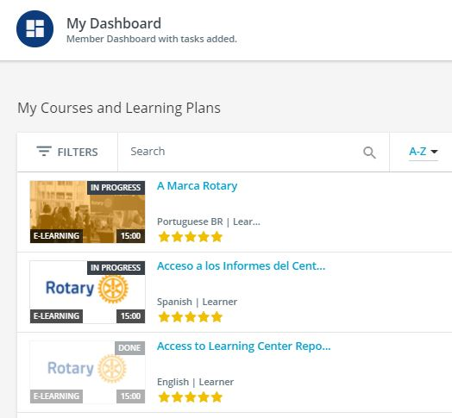
How to get Report access
Complete the Access to Learning Center Reports course
Staff will schedule two automatic emails delivered Mondays
Notes:
The following positions have the ability to receive reports of the members in their district.

Slide 22
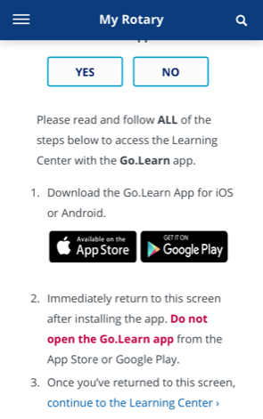
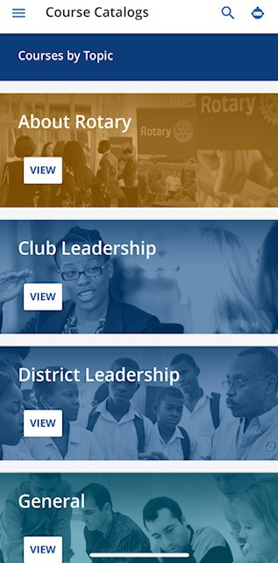
Mobile
Access the Learning Center by going to My Rotary on your mobile phone.
Sign in to My Rotary
Tap Learning and Reference
Tap Learning Center
Follow Instructions
Notes:
Instructions on the mobile app can be found in the Getting Started with the Learning Center course in the additional resources.
Our goal is to have a new mobile app by December where you click on the app, log into My Rotary, and get directed to the Learning Center.

Slide 23
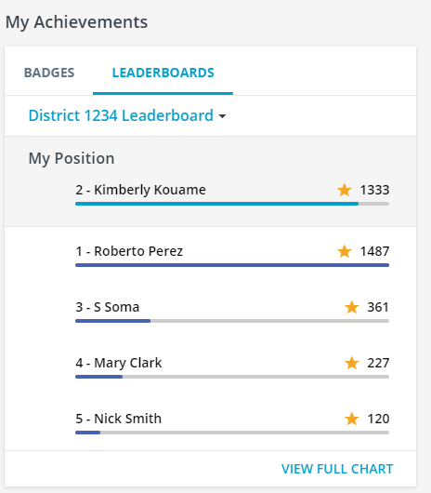
Additional Features
Virtual badges and leaderboards
Deep link directly to courses, learning plans, learning topics, or catalogs
Resource sharing and discussions
Notes:
Note districts can create learning plans or learning topics visible only to the members in the district. Learning plans use courses that are already available and put them into a group that is easily accessible. While learning topics allow district leaders to post materials about a specific topic for discussion or easy download.
Add a poll or have participants type in chat: What Features are you most interested in using?

Slide 24
Learning Center Data
Notes:
PAUSE QUESTIONS:
Now that you know what resources are available to you, let’s talk about some best practices as a committee chair.

Slide 25
Course Completions by Zone
Notes:
As of 30 June 2024

Slide 26
Members With an account in the LC by Zone
Notes:
Zones 30 and 31 have the lowest LC usage in the US. Why do you think that is?
As DGEs you can be asking your incoming officers to complete courses. Most members learn about online courses from their district leaders.
Area all your district committee chairs going to the LC?

Slide 27
Top 10 Districts with Most Completions in Zones 30/31
Notes:
Here are the top 5 districts with completed course in each zone. District 6760 has moved from third to first place from last year with the highest number of completed courses. 6780 remains in second place and 6110 moves to third place.
D6760 has the highest completions in zone 30 and D6110 has the highest completions in zone 31.

Slide 28
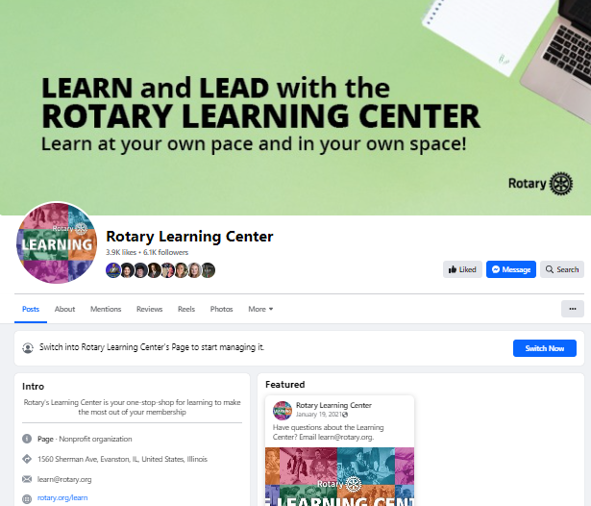
Notes:
Like us on Facebook. I post updates on new courses, revised courses, data, and tips here. You can share these posts on your district and club pages to encourage others to take courses.

Slide 29
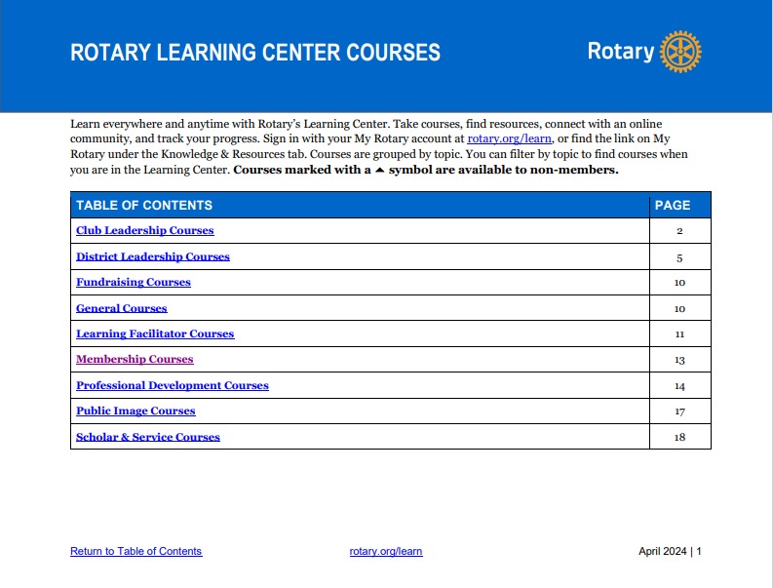
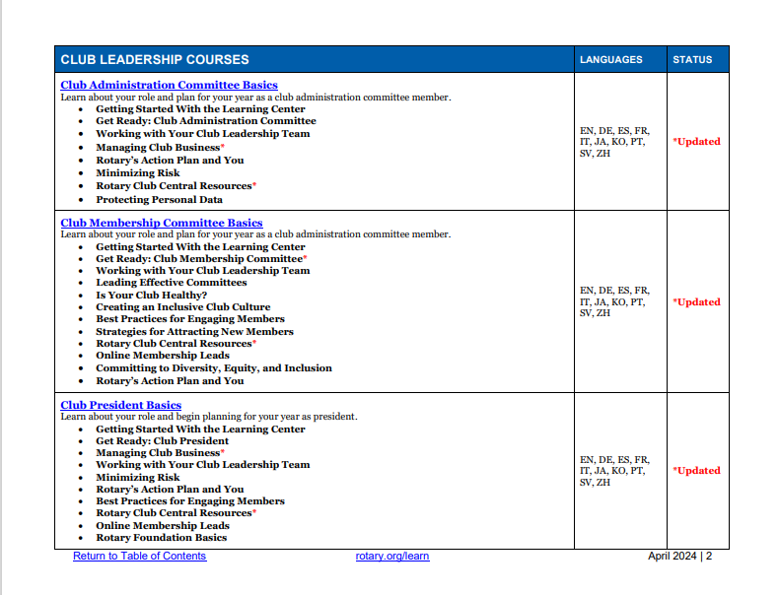
Notes:
Find a list of all our courses with links on My Rotary. I’ll add the link to chat. These links can be used to promote courses and to link to courses on your web sites.
https://my-cmsuat.rotary.org/en/document/learning-center-course-catalog

Slide 30
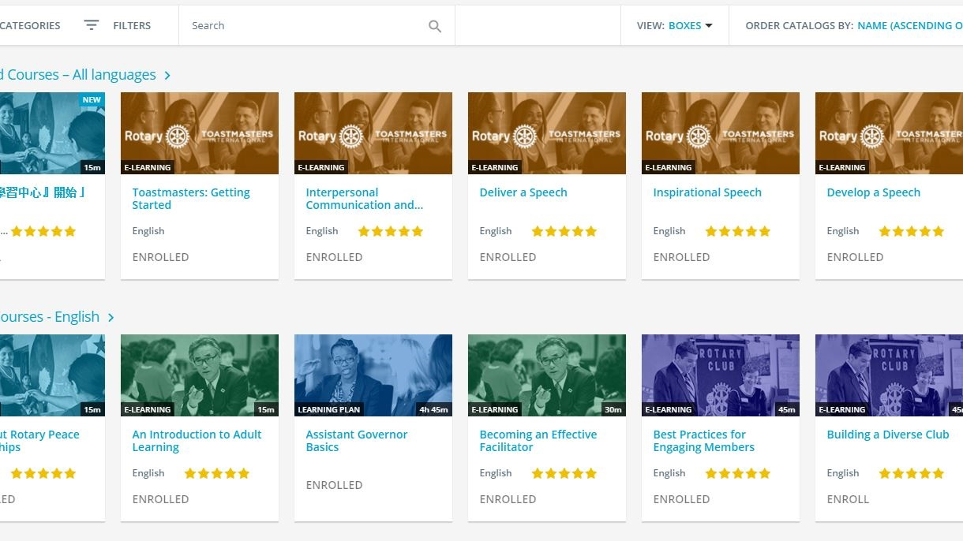
Email learn@rotary.org

Slide 31
QUESTIONS & DISCUSSION

Slide 32
Using chat, what is one action you plan to take as a result of this presentation?
Notes:
Type in the chat window. And we’ll take questions as well.

