Slide 1
Brand Center Resources to Strengthen Rotary’s Public Image
July 30, 2024

Slide 2
subhead
Our Action Plan asks us to increase awareness of our impact and brand – by strengthening our public image.
What is public image?
What is Rotary’s public image?

Slide 3
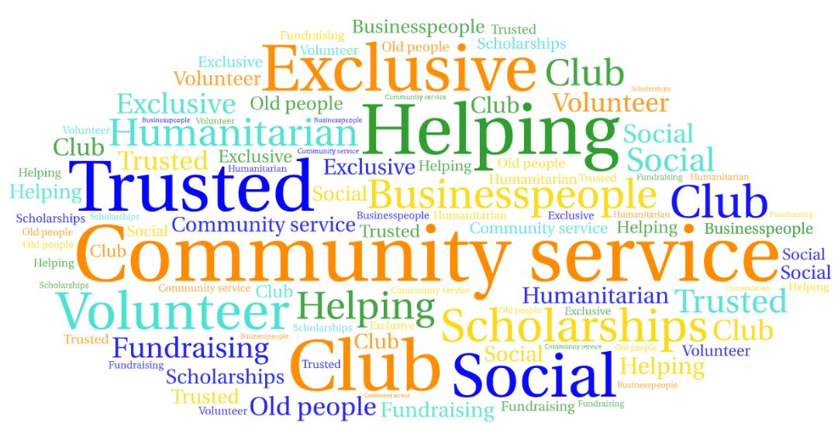
What is Rotary’s Public Image?
While many people have heard of Rotary, the public does not have a consistent understanding of who we are or what we do
Source: Rotary Global Public Image Research December 2022
Notes:
And how do others see us?
We learn this by conducting research with the general public. These results are from our most recent study. Rotary International and research partner Leger conducted research among the general public in 15 countries around the world to assess awareness and understanding of Rotary and identify opportunities to expand our reach and increase participant engagement.
Here’s what we learned from the US respondents when it comes to our public image (their perception or understanding) of Rotary – Community service, Trusted are prominent as are Exclusive and Social.
And while the responses vary from market to market, on thing remains the same – whiles some of the descriptions are accurate, there are a lot of misperceptions about our brand. In fact, many people respond “don’t know” when asked What comes to mind when you hear the name Rotary or Rotary Club?

Slide 5
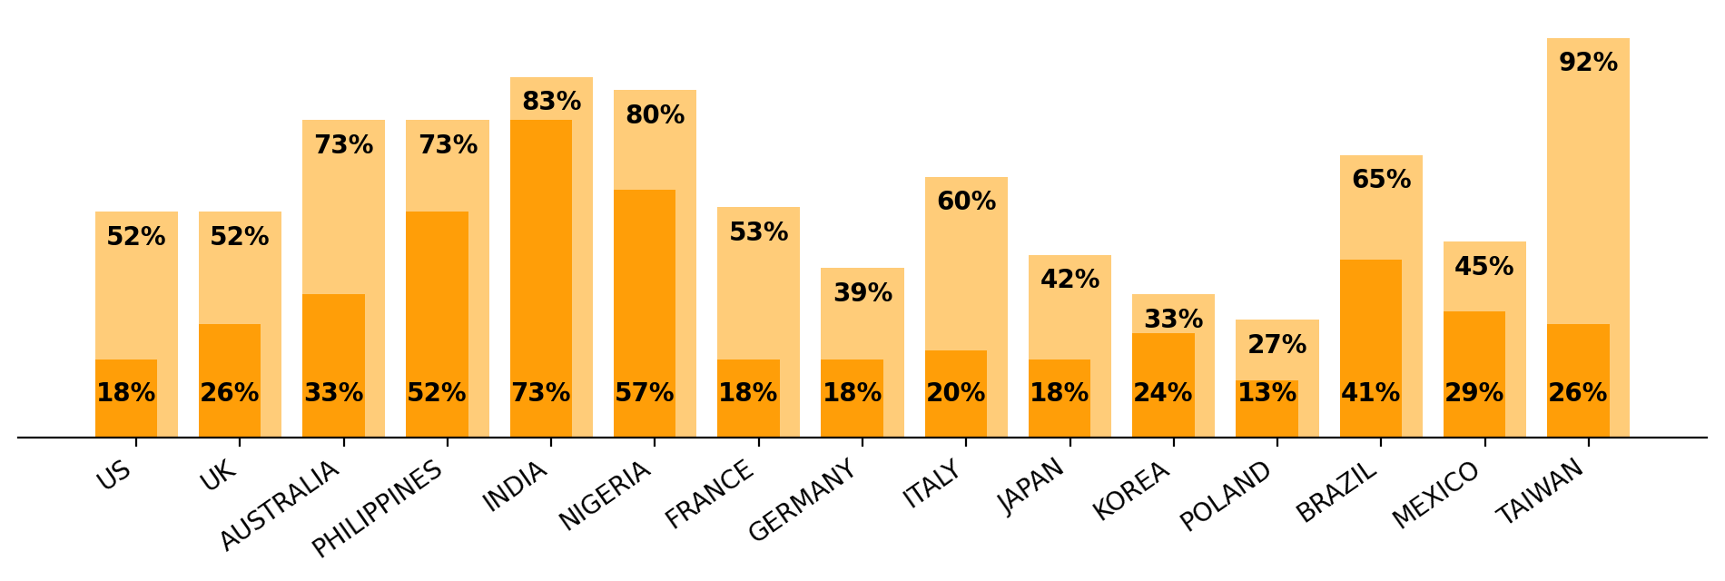
Global Awareness and Understanding of Rotary
There are distinct regional variations in both recognition and familiarity
High brand awareness does not always correspond to high understanding
Notes:
This chart shows awareness and understanding of Rotary in the 15 countries we included in the survey – 500 in each country.
A high level of brand awareness doesn’t always correspond to understanding. While markets such as Philippines, India and Nigeria benefit from high levels of both, others such as US, Australia, European countries and Taiwan can benefit from increased information about Rotary so that the public understands who we are, what we do, and how we are relevant.
The findings will inform strategies and allow regions to tailor their messages, offerings and outreach to meet the needs of new audiences.

Slide 6
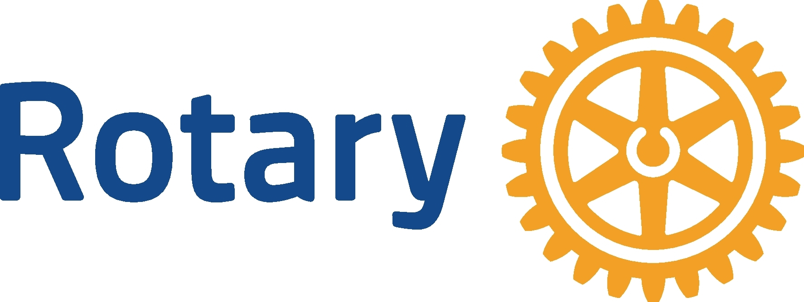
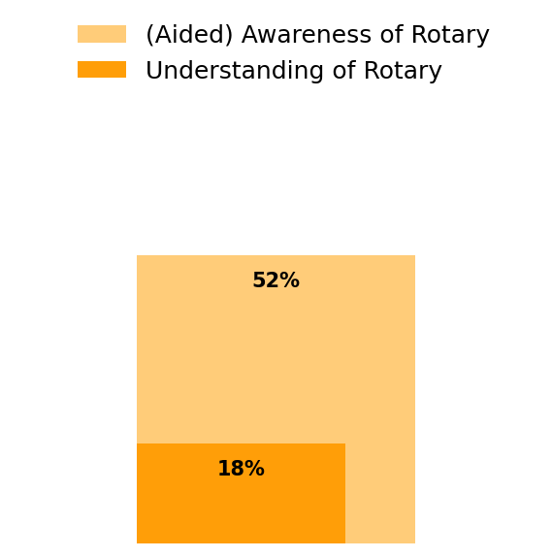
United States: Awareness and Understanding
When asked to name service-oriented community organizations in United States, the top answers were Red Cross, Salvation Army, and food banks.
When the Rotary name was mentioned, over half of the public say they have heard of Rotary, but a less than twenty percent say they are familiar with what we do.
UNITED STATES
Red Cross
Salvation Army (Salvos)
Food banks
2%
(Unaided) Awareness of Rotary
#1
#2
#3
% said Rotary
Q: When you think of local organizations/community groups that provide opportunities for working with others to address social issues and unmet needs in your community, which come to mind?
Q: Have you heard of an organization called Rotary?
Q: How familiar are you with the work that Rotary does?

Slide 7
Global Awareness of Local Clubs
Awareness of local Rotary clubs has increased by 26% since 2015
67%
66%
41%
Global: 2022
US: 2023
Global: 2015
Q10: Are you familiar with local Rotary Clubs?
Source: Rotary Global Public Image Research, January 2023
Notes:
Good news, global awareness of Rotary clubs has increased significantly – across the globe and here in the US.
On average 60% of the respondents were unfamiliar with a local Rotary club or project, and we call this out because our clubs are where people experience Rotary first hand and they provide the greatest opportunity for public engagement. While this measure is disappointing, it provides valuable insight into where RI can focus support in helping clubs promote themselves and their good work.

Slide 8
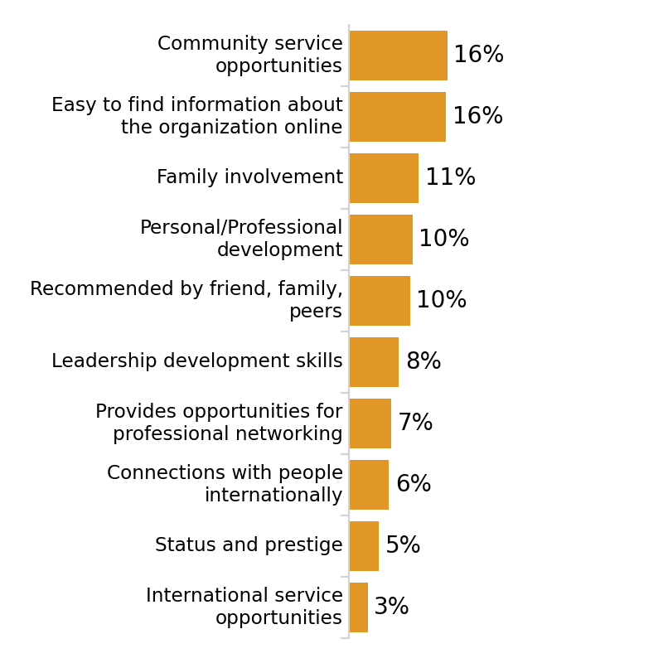
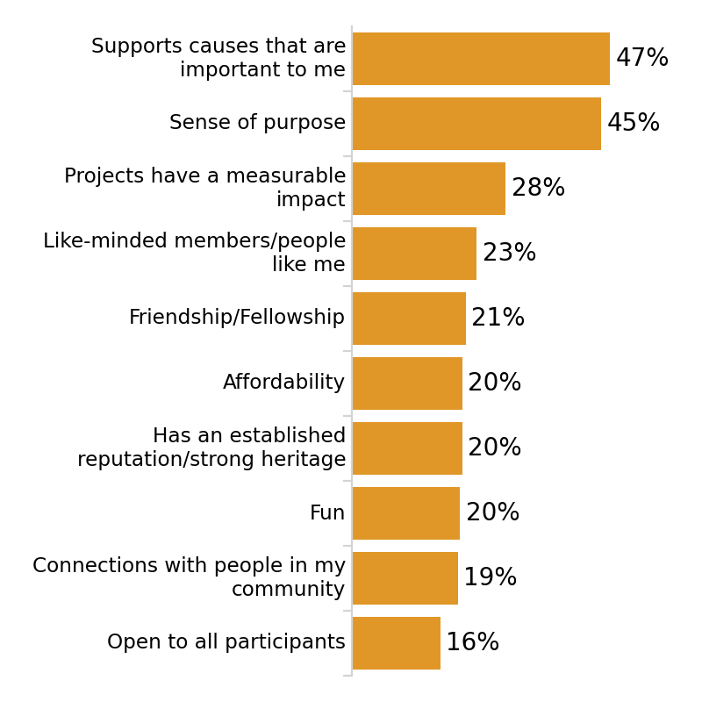
Most important features (non-branded)
The top reasons people join nonprofit service-oriented organizations are to support causes that are important to them and that provide a sense of purpose.
To make Rotary relevant and appealing, focusing on these attributes will generate more interest from the public.
Q: When you consider joining a non-profit service organization, what attributes are most important to you?
Notes:
Before introducing the Rotary brand, we took the opportunity to understand the key factors that the public considers when choosing to join a nonprofit service-oriented association which can allow us to tailor how we present Rotary and its benefits to potential participants. In all markets “a sense of purpose” and “supports causes important to me” rise to the top. However, while status and prestige are important to joining organizations in some countries and cultures, this is not the case in the United States.

Slide 9
Building Public Image Helps Expand our Reach
And supports Rotary’s Action Plan
Eradicate polio and leverage the legacy
Focus our programs and offerings
Improve our ability to achieve and measure impact
Eradicate polio and leverage the legacy
Focus our programs and offerings
Improve our ability to achieve and measure impact
Grow and diversify our membership and participation
Create new channels into Rotary
Increase Rotary’s openness and appeal
Build awareness of our impact and brand
Build awareness of our impact and brand
Grow and diversify membership and participation
Create new channels into Rotary
Increase our openness and appeal
Increase Impact
Expand Reach
Increase Impact
Expand Reach
A Stronger Brand
Build a culture of research, innovation and willingness to take risks
Streamline governance, structure and processes
Foster more diverse perspectives in decision-making
Support clubs to better engage their members
Develop a participant-centered approach to deliver value
Offer new opportunities for personal and professional connection
Provide leadership development and skills training
Support clubs to better engage members
Deliver value through participant-centered approach
Offer new opportunities for personal and professional connection
Provide leadership development and skills training
Increase Our Ability to Adapt
Increase Our Ability to Adapt
Enhance Participant Engagement
Enhance Participant Engagement
Notes:
Expanding our Reach is one of the key pillars or our Action Plan which aims to strengthen and grow Rotary. To that end
we need to continue to narrow that gap between awareness and understanding among the general public and those who we want to engage with us AND
drive internal awareness and understanding of the priorities, because they all work together to make us a stronger and more attractive organization for current and future members and participants

Slide 10
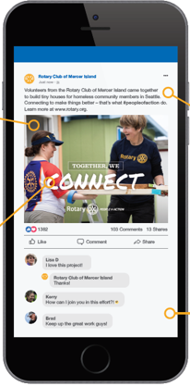
Strategy
Objective
Leverage our 1.4M members to raise Rotary’s public image connecting with the community, increasing club visibility and sharing stories of impact
Increase public awareness of Rotary – our impact and brand
Notes:
So, of course one of our main objectives at RI is to increase awareness and understanding of Rotary around the world. But how do we do that?
How do we help the public see Rotary as we do?
By highlighting the impact clubs and members are making in their local communities and presenting Rotary in a consistent and compelling way to those who don’t know us. And while we have a small but mighty marketing team at RI, the real power is in our membership. Who understands the benefits of Rotary better than our members – who can speak from experience? That is why our strategy relies on leveraging our >40,000 clubs and 1.4 million members to share their stories with the public.

Slide 11
subhead
We’re all Rotary brand ambassadors.
What does it mean to be a brand ambassador?
How can Governors inspire members to tell stories of the impact they’re making?

Slide 12
subhead
Where can I find…
Guidance to promote Rotary
Images and videos
Tip for taking photos
Templates for creating materials
Templates to create logos
Branding do’s and don’ts
Help and guidance

Slide 13
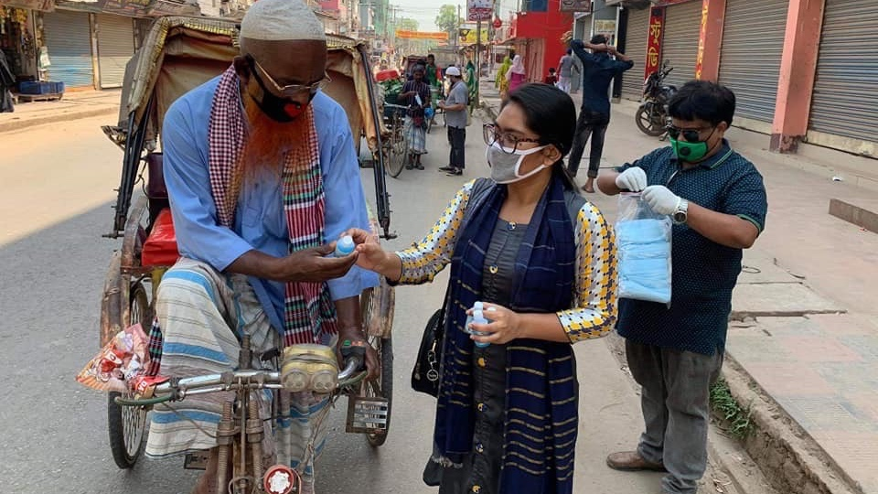
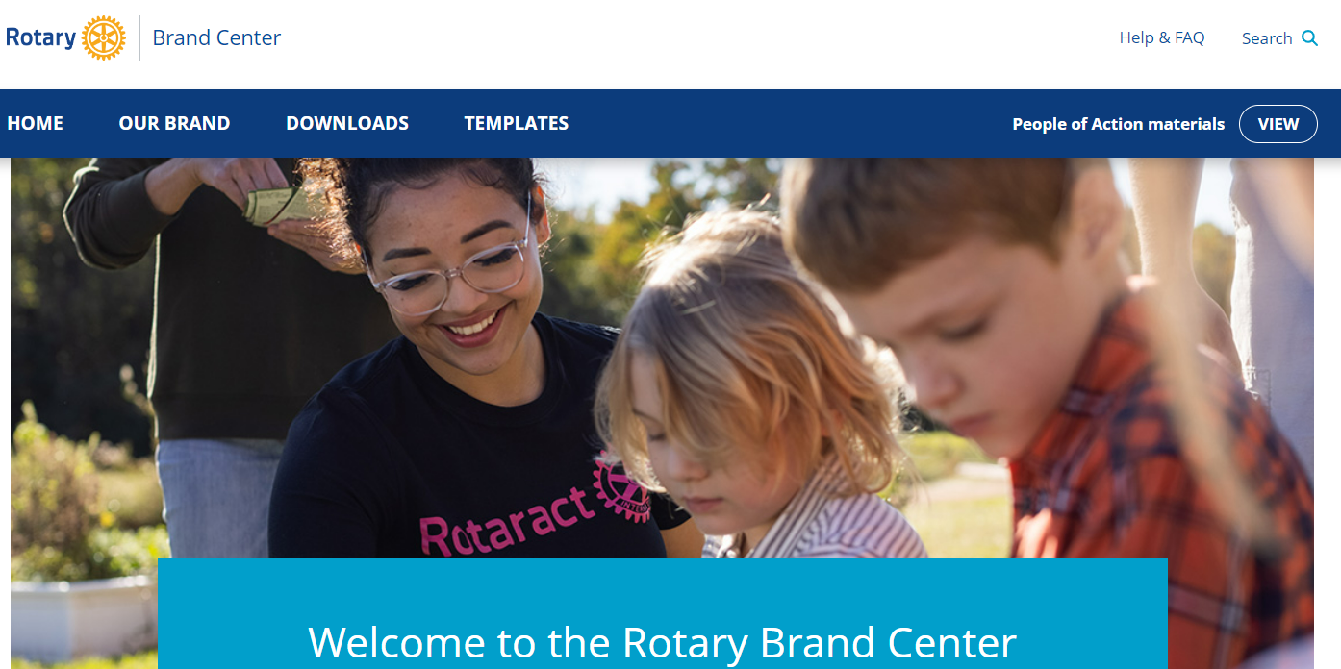
Brand Center: #1
resource for public image materials

Slide 14
Public Image Resources
Brand Center
Learning Center
Research Reports
rotary.org/brandcenter
learn.rotary.org
My Rotary
search: Rotary Research
brand guidance
videos/images >1000
public image presentations - 11
public image courses - 6
public image learning plans
awareness & understanding - US
member survey

Slide 15
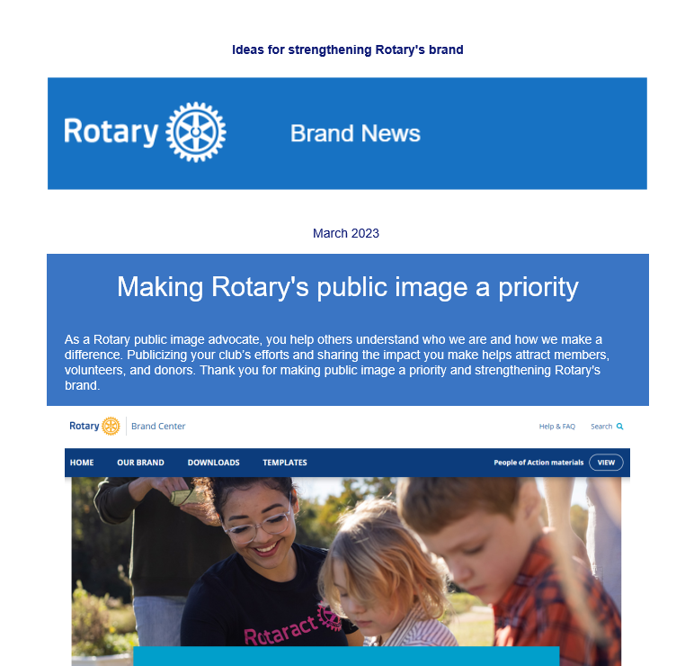
E-Newsletter
Brand News, sent quarterly to Rotary leaders highlighting new assets, information, resources and ideas for strengthening Rotary’s brand
If you’d like to be added to the distribution list, please email
PR@Rotary.org
Notes:
Sign up for Brand News so that you are able to keep abreast of the latest resources!

Slide 16
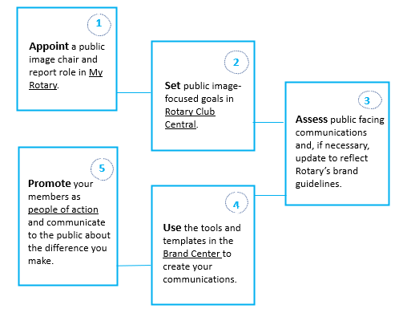
Taking Action to Expand our Reach
Five Steps to Strengthen Your Public Image
Notes:
Steps clubs can take:
Please work with clubs to ensure that strengthening Rotary’s brand and enhancing Rotary’s public image a priority. RI’s board of directors recognizes that the strength of our brand is only as strong as our club’s branding. They’ve asked all clubs to ensure they’re using correct branding by 30 June 2022. We will follow up with you in the coming months with more information about this goal, but guiding your club with these key messages is an essential foundation.
1. Appoint a public image chair and set aside a budget for them to be effective
2. Assess club’s brand & brand fidelity to see where your club is at.
3. Use the tools in the Brand Center
4. Promote your club as People of Action and communicate the difference you’re making to external audiences.
CLICK

Slide 17
What’s your story?
Notes:
contact us at pr@rotary.org

