Slide 1
How to prevent conflicts through “Active Listening”
Darwin Sampedro, CDS Rep.

Slide 2
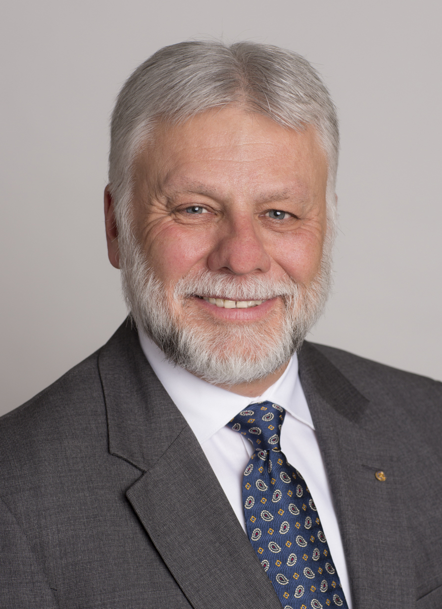
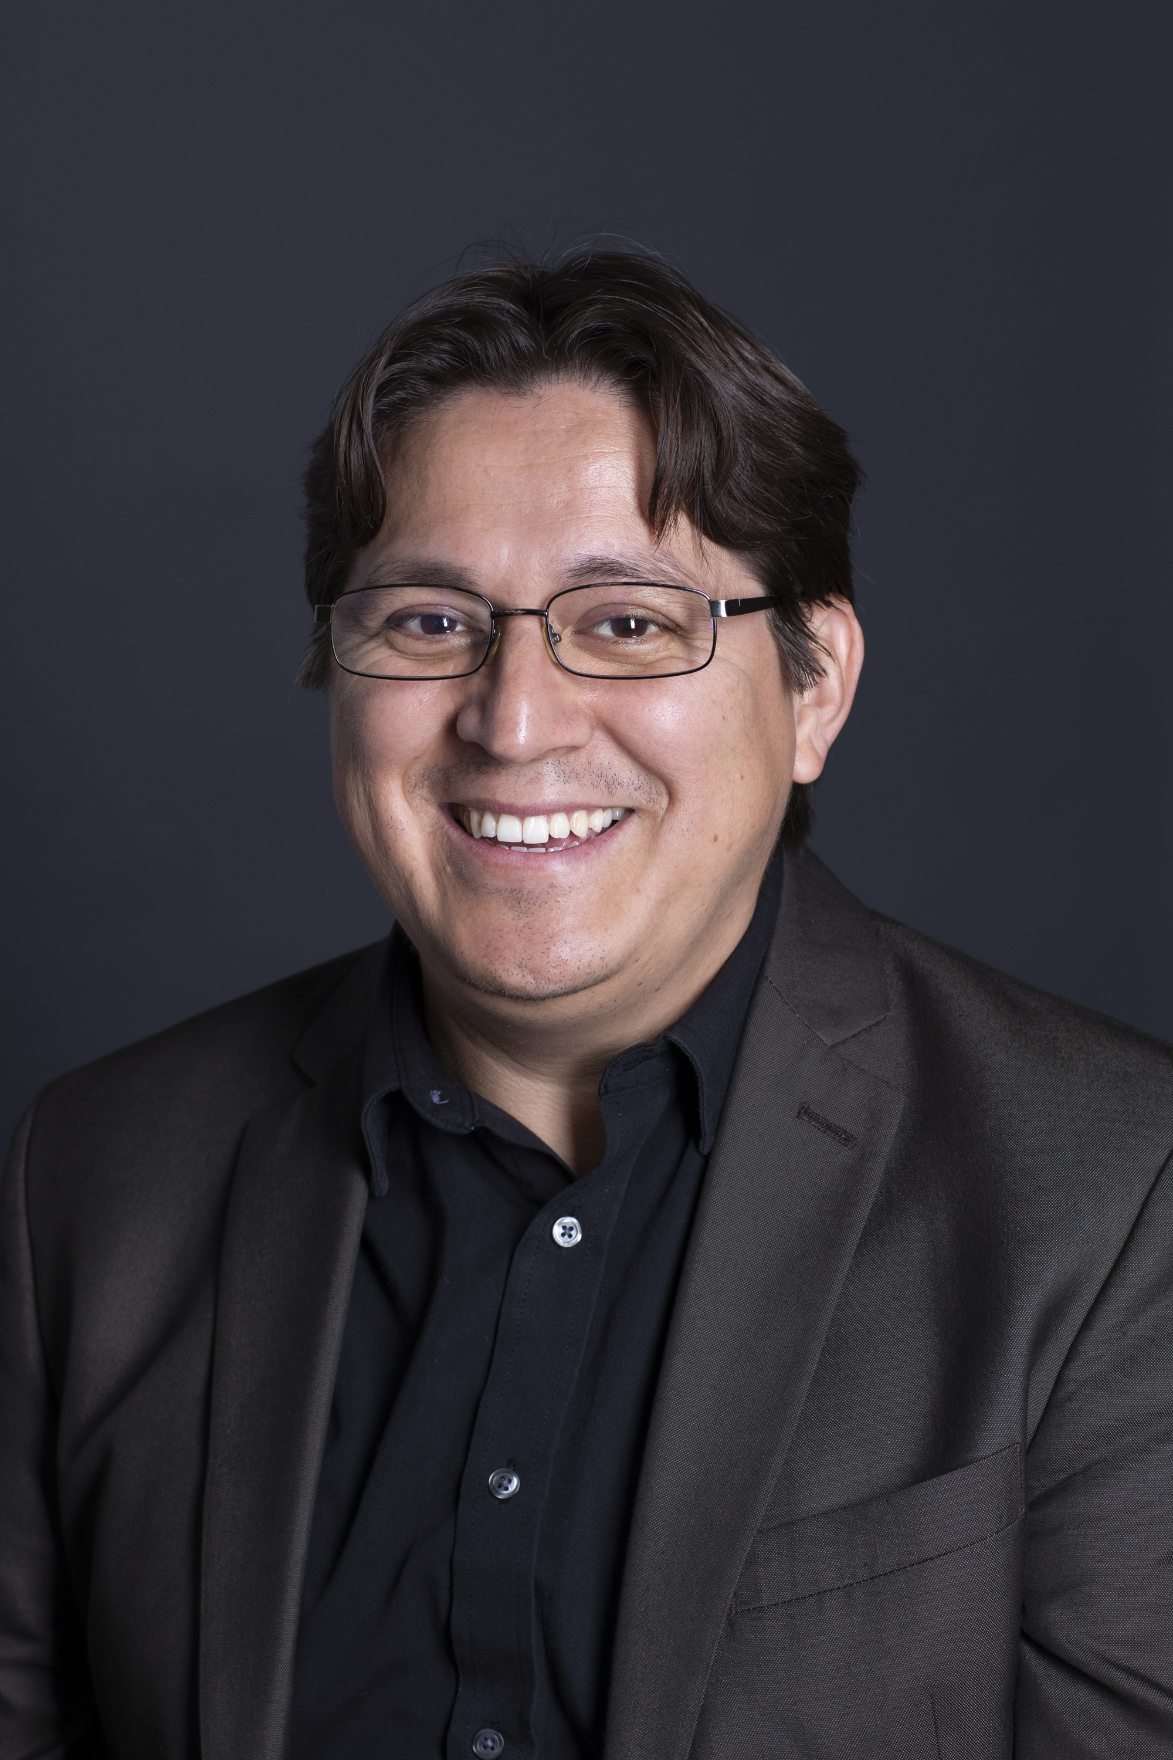
YOUR CLUB & DISTRICT SUPPORT (CDS) TEAM
Gregory Franks,
Senior Supervisor Gregory.Franks@Rotary.org
1-847-866-3272
Darwin Sampedro,
Senior Officer
Darwin.Sampedro@Rotary.org
1-847-866-3259
Districts: 6040-6200, 6510, 6710-6880
Notes:
Although we’re a large organization, we serve Rotarians through an office with specialists familiar with your region.
Your Club and District Support Team, also known as CDS, will serve as your primary contact at Rotary over the next two years.
We provide direct support and assistance to Rotarians and work closely with club and district leaders.
Your team, pictured here, includes [add names]
We are your regional experts and just one email or phone call away.
[click]

Slide 3
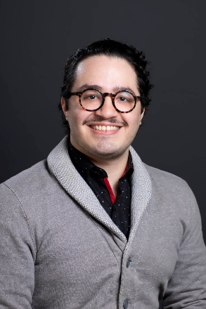
YOUR CLUB & DISTRICT SUPPORT (CDS) TEAM
Cassandra DellaCorte,
Associate Officer
Cassandra.DellaCorte@rotary.org
1-847-424-5212
Andrez Perez,
Associate Officer
Andrez.Perez@Rotary.org
1-847-424-5368
Districts: 5750, 5770, 5830, 6460, 6490,
6540- 6690

Slide 4
YOUR CLUB & DISTRICT SUPPORT (CDS) TEAM
We are your first contact with Rotary.
We collaborate closely with club and district leaders.
In addition, we…

Slide 5
YOUR CLUB & DISTRICT SUPPORT (CDS) TEAM
TRAINERS: Provide training during GELS, GNLS, PELS, IA and more.
ADMINISTRATIVE PROCEDURES PROCESSING: New Rotary, Rotaract, Satellite club admissions and more.
ROTARY POLICY GUIDANCE: MOP and COP.
ONLINE RESOURCES: My Rotary

Slide 6
Conflict
Notes:
What comes to your mind when you hear the word conflict? War, Fights, Rivalry, Competition, Struggle

Slide 7
Conflicts happen and are part of life, how we handle them, makes a difference.

Slide 8
FOR MORE THAN 30 YEARS, OUR MEMBERSHIP HAS NOT INCREASE FROM:
1,200,000 Rotarians
What is happening?

Slide 10
Participation
72% of current rotary club members
20% of proposed rotary club members
8% of former rotary club members
65% Male
34% Female

Slide 11
52% of current members
WOULD RECOMMEND their family members, friends and relatives join their Rotary club.

Slide 12
46% of former members
WOULD NOT RECOMMEND anyone join Rotary

Slide 13
Of all the reasons why, a member ended their membership with Rotary, the main one was:
52% of former members
Personality conflicts

Slide 14
4 Steps to solve conflicts in clubs
Club and District Support, Americas

Slide 15
OBJECTIVES
The impact of conflict
Sources of conflict
Emotions Test
4 Steps to handle club conflicts
Benefits of good conflict management

Slide 16
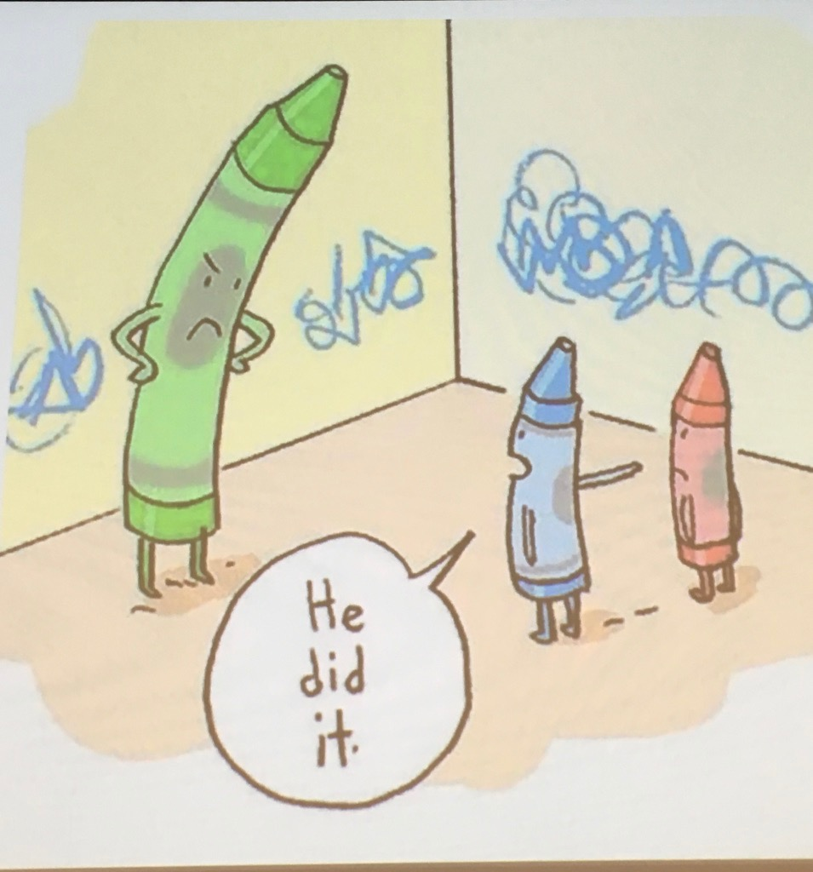
Sources of a conflict
Communication
Emotions (Test)
Values

Slide 17
Crucial Conversations
How to Handle Difficult Conversations
Club and District Support, The Americas
Notes:
1. Every day we engage in conversations, some are with our mother, spouse, children, while others are with co-workers, and/or people in general , the conversations can be formal or informal. But whatever the dialogue may be things can get heated,
Or
2. We all have experienced discussions where they have quickly taken a turn for the worse and both you and the other person you were talking end up hurt or frustrated
QUESTION FOR THE PUBLIC:
HOW MANY OF YOU WOULD LIKE TO GET BETTER AT DIFFICULT CONVERSATIONS AND RESOLVING CONFLICTS?
We all have experienced discussions where they have quickly taken a turn for the worse and both you and the other person you were talking end up hurt or frustrated
Text taken from the Four Minute YouTube video: https://www.youtube.com/watch?v=Aqrlb8WvSGs&t=63s

Slide 18
Objectives
What are Crucial Conversations?
How We Usually Handle Crucial Conversations
Crucial Conversation - Exercise
Three main principles in Crucial Conversations
The Power of Dialogue

Slide 19
How We Usually Handle Crucial Conversations
Notes:
1. Every day we engage in conversations, some are with our mother, spouse, children, while others are with co-workers, and/or people in general , the conversations can be formal or informal. But whatever the dialogue may be things can get heated,
Or
2. We all have experienced discussions where they have quickly taken a turn for the worse and both you and the other person you were talking end up hurt or frustrated
QUESTION FOR THE PUBLIC:
HOW MANY OF YOU WOULD LIKE TO GET BETTER AT DIFFICULT CONVERSATIONS AND RESOLVING CONFLICTS?
We all have experienced discussions where they have quickly taken a turn for the worse and both you and the other person you were talking end up hurt or frustrated
Text taken from the Four Minute YouTube video: https://www.youtube.com/watch?v=Aqrlb8WvSGs&t=63s

Slide 20
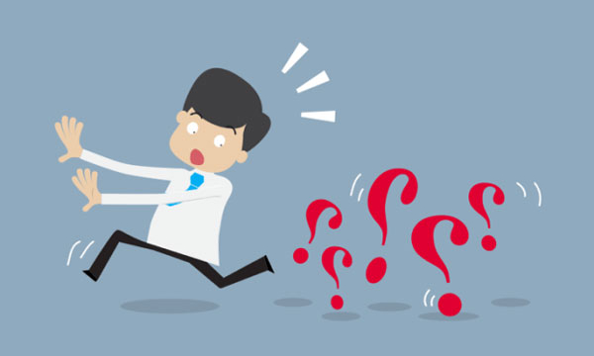
Avoid them
Notes:
We try to avoid them at all costs, in any way, without realizing that avoiding them makes the problem bigger. Example of the Titanic, if a crucial conversation would have taken place between the captain and crew, maybe more people could have been saved. does this sound like the situations our clubs are experiencing
Delay or Avoid CC and face the consequences.
Photo link: https://apartirdeunafrase.wordpress.com/2015/02/19/usted-no-puede-evitar-que-los-problemas-golpeen-a-su-puerta-pero-no-hay-necesidad-de-ofrecerles-una-silla-joseph-joubert-moralista-y-ensayista-frances-recordado-sobre-todo-por-sus-pensamiento/

Slide 21
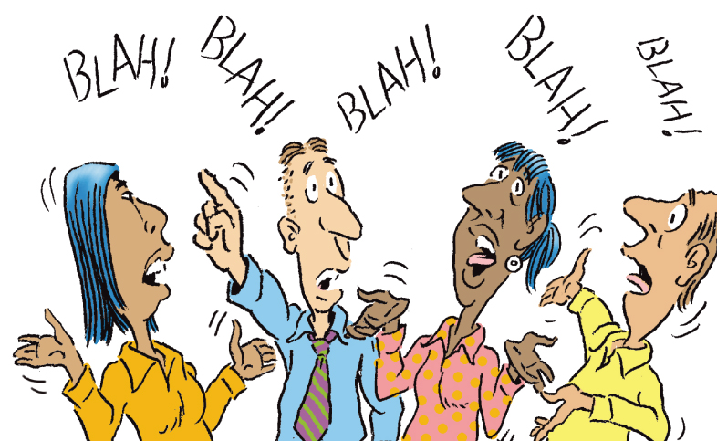
Wrong
Think too much, talk too much, solved little
Notes:
We usually handle crucial conversations the wrong way,
2. We think that we are the only who is right, and we speak in a thousand ways and give a thousand reasons why the other people are wrong, and there is no other truth than mine.
3. At the end you, you thought a lot, talked a lot and solved so little or nothing. Maybe you even made an enemy of someone because of a misunderstanding, just by looking at your point of view.
4. Apart from that if you got carried away by your emotions and said things that you may later regret, it is too late. Remember that you are the owner of what you think and a slave to what you say.
UNFORTUNATELY, When it matters most, we do the worst
Foto tomada de: http://blog.readytomanage.com/communication-cartoon/
Frase: Ricardo Arjona

Slide 22
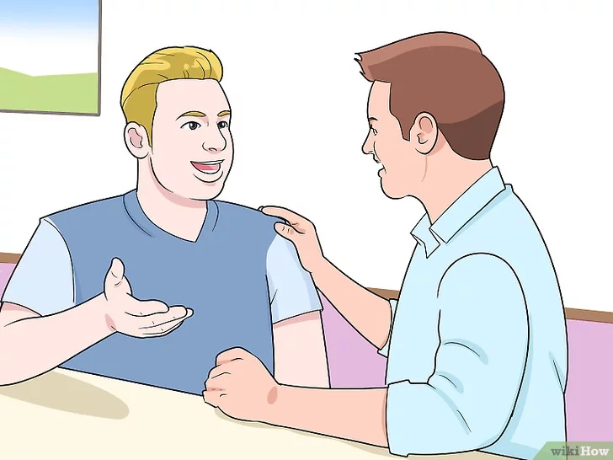
Well
Dialogue
Notes:
Talking and Listening Actively – Takes practice
This seems simple but there are many barriers to honest dialogue.
Photo taken from: https://es.wikihow.com/iniciar-una-buena-conversaci%C3%B3n

Slide 23
How to Prevent Club Conflicts through “Active Listening”
Club and District Support, The Americas

Slide 24
Poor Listening vs. Active Listening

Slide 25
Active Listening Exercise
Notes:
https://www.youtube.com/watch?v=KNYBTZjE2Yk
Exercises taken from The Benchmark Portal video: Active Listening Exercises: https://www.youtube.com/watch?v=KNYBTZjE2Yk

Slide 26
Active Listening
Rules:
Listen and take notes
Answer questions

Slide 27
Active Listening Exercise
Notes:
You are driving a bus that leaves Springfield at 8:30am with 23 passengers onboard. Stops in Wellington dropping 10 people and picking up four passengers. It travels south to Monroe dropping another 5 passengers and picking up 6. It arrives at Cincinnati 2 hours later. WHAT IS THE BUS DRIVER’S NAME

Slide 28
Active Listening Exercise
Notes:
If some months has 31 days, and other months has 30 days how many months has 28 days.

Slide 29
Active Listening Exercise
Answers
YOUR NAME
ALL 12 MONTHS
Notes:
YOUR NAME. Because you were driving the bus
9 Because all 9 because all butt nine sheep died
12 TWO CENTS STAMPS Because there is always 12 stamps in a dozen regardless of the denomination
ALL 12 MONTHS Because all 12 months contains 28 days
NOWHERE Because you did not buried survivors
Now, I am going to ask you to write down in a paper a conflict that your club has experienced, is experiencing or might experience in the future. You do not have to write down your club’s name. At the end of the presentation, we will pick one scenario and work on it together.

Slide 30
Active Listening
What can we learn from this exercise?
Focus on details
Listening vs. problem-solving
Avoid distractions
Notes:
If you missed the question about the airplane, it was only one word, SURVIVORS, which change the meaning and outcome of their entire situation. Your focus on one detail change everything, so stay focus in detail. Because DETAILS DO MATTER.
In some cases, you might have switch from listening to problem-solving. In the bus example you might have focused on the number of passengers. Trying to solve a math problem that you though was going to be the issue. Stay in listening mode without jumping ahead to problem solving.
Bias Listening. Is Jumping to conclusions because the listener believes they already know the answer that could have happened in one question where you mind jump ahead assuming we meant months with only 28 days.
Keep in mind that good listening means having an open mind and without holding judgment until the speaker has finished. It is easy to be distracted by surroundings and emotions or even details. In the airplane or the bus example the addition of irrelevant details could cause you to become distracted and miss the point. Don’t allow outside circumstances or irrelevant details to distract you.
The most important thing is asking relevant questions. When mistakes are made is due to not taking the time to ask questions. That clarify your understanding and avoid mistakes.
https://www.youtube.com/watch?v=KNYBTZjE2Yk

Slide 31
“Our worst enemy in communication is that we do not listen to understand, we listen to respond. ” -Pilar Morey Bulbena
Notes:
It takes us one year to learn to speak… and an entire life to learn to listen.

Slide 32
Poor Listening vs. Active Listening
The Price of Poor Listening
Notes:
Poor listening leads to assumptions and misunderstandings. These lead to errors, ineffective decisions, and/or costly mistakes. On a personal level, poor listening leads to hurt feelings and a loss of team cohesion. This deteriorates trust and weakens communication even further.

Slide 33
Poor Listening vs. Active Listening
In the business industry:
Assumptions
Misunderstandings
Errors
Ineffective decisions and/or costly mistakes

Slide 34
Poor Listening vs. Active Listening
On a personal level:
Hurt feelings
Deteriorates trust
Weakens communication even further

Slide 35
Poor Listening vs. Active Listening
Aggrieved member:
Becomes disinterested
Becomes negative
Takes a leave of absence
Joins another Rotary Club
Resigns from Rotary
Notes:
agrif

Slide 36
Poor Listening vs. Active Listening
The price for Active Listening
Notes:
This is where you make a conscious effort to hear not only the words that another person is saying but, more importantly, the complete message being communicated.

Slide 37
What is Active Listening?
It improves mutual understanding.
Notes:
https://blink.ucsd.edu/HR/supervising/conflict/handle.html
The University CA San Diego did a research about conflicts in workplace and provide practical strategies you can use to handle conflicts

Slide 38
What is Active Listening?
2. It’s an important first step in defusing situations or finding solutions to problems.

Slide 39
5 Key Active Listening Skills

Slide 40
5 Key Active Listening Skills
Pay Attention
Notes:
1. Pay attention.
Give the speaker your undivided attention, and acknowledge the message. Recognize that non-verbal communication also "speaks" loudly.
Look at the speaker directly.
Put aside distracting thoughts. Don't mentally prepare a rebuttal!
Avoid being distracted by environmental factors.
"Listen" to the speaker's body language.
Refrain from side conversations when listening in a group setting.
Taken from Mindtools.com

Slide 41
5 Key Active Listening Skills
2. Show that you are listening
Notes:
2. Show that you are listening.
Use your own body language and gestures to convey your attention.
Nod occasionally.
Smile and use other facial expressions.
Note your posture and make sure it is open and inviting.
Encourage the speaker to continue with small verbal comments like “Yes” and “Aha”

Slide 42
5 Key Active Listening Skills
3. Provide Feedback
Notes:
3. Provide feedback.
Our personal filters, assumptions, judgments, and beliefs can distort what we hear. As a listener,
your role is to understand what is being said. This may require you to reflect what is being said and
ask questions.
Reflect what has been said by paraphrasing. "What I'm hearing is" and "Sounds like you are saying"
are great ways to reflect back.
Ask questions to clarify certain points. "What do you mean when you say", "Is this what you mean?"
Summarize the speaker's comments periodically.

Slide 43
5 Key Active Listening Skills
4. Defer Judgement
Notes:
4. Defer judgment.
Interrupting is a waste of time. It frustrates the speaker and limits full understanding of the message.
Allow the speaker to finish.
Don't interrupt with counter arguments

Slide 44
5 Key Active Listening Skills
5. Respond Appropriately
Notes:
5. Respond Appropriately.
Active listening is a model for respect and understanding. You are gaining information and
perspective. You add nothing by attacking the speaker or otherwise putting him or her down.
Be candid, open, and honest in your response.
Assert your opinions respectfully.
Treat the other person as s/he would want to be treated.

Slide 45
Benefits of Handling Club Conflicts Effectively
Retention of members
Better club atmosphere
Mutual respect between members
Increase focus on club projects, membership and goals!

Slide 46
Conclusion

Slide 47
Conclusion
Use “Active Listening Skills”
to effectively prevent any club or district conflict.
Notes:
Rotary for 119 years, through active listening:
Has changed people’s lives
Has responded to world challenges
Has created HOPE in the world

Slide 48
cds@rotary.org

